Slide 1

New Rules!
Morphing with
The New ADA Standards
An Overview
Don Brandon
Director
Northwest ADA Center

Slide 2



Northwest ADA Center – Region X
Located in Mountlake Terrace with CCER (Center for Continuing Education in Rehabilitation)
Program in Rehabilitation Medicine at the University of Washington
Funded by NIDRR (National Institute on Disability and Rehabilitation Research)

Slide 3
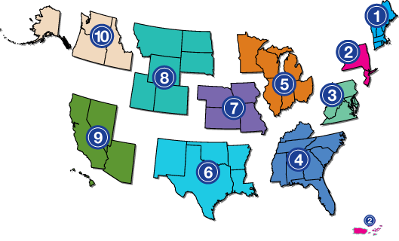
The National Network of ADA Centers
Funded By NIDRR
Common Research
National Programs
Mandated By TITLE V of The ADA
Same 800-949-4232
National Web Site www.adata.org

Slide 4
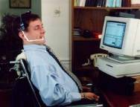
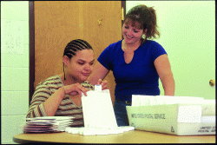
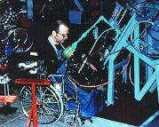
What Do We Do?
We Provide Comprehensive And Accurate Information On ADA Compliance, Including:
  Employment Of Persons With Disabilities (E.G., Reasonable Accommodation)
  Accessibility In Facilities, Programs And Information (Public And Private)
  Assistive Technology, Universal Design

Slide 5

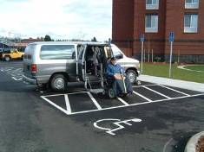
Why We Can Be Valuable To You!
We Are Knowledgeable Professionals Providing Information About The ADA
We Are Not An Enforcement Authority
We Are Not Lawyers Or Advocates
Note: All Contacts Are Confidential

Slide 6

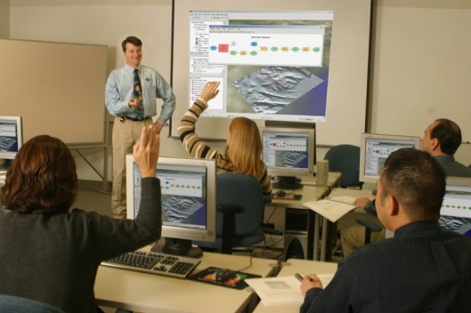



Ways We Can Help
Technical Assistance
Training
Information Dissemination
Research
Public Awareness

Slide 7
New Rules !
Employment
  New Interpretation of Definition of Disability
  Mitigating Measures No Longer Applicable
  Clarity on Types of Conditions Covered
Programs & Services
  Web Sites
  Ticketing
  Service Animals
Facilities
  Signs, Parking,
  Two Standards (1991 2010) & Safe Harbors

Slide 8
Agenda
How The 2010 ADA Standards Developed
The Regulations That Are a Part AS 2010
The Basics Are the Same (CAT)
The Technical Stuff!
Scoping More Prescriptive More Areas Are Defined
Chapter Variables

Slide 9
Civil Rights Standards & Facilities
1991 Standard
UFAS or ADAAG
Safe Harbor 3/15/2012
ADAAG
Revised 1994
2010 Standard
Added 1998,2002 & 2004 Chap 11-14
Notes:
Civil Rights standards effect facilities creating minimum requirements. The ADAAG has had 3 significant enfroceble Standards, m41991, 1994, & 2010

Slide 10
The Basics: DOJ Adopts 2004 ADAAG
& Adds Provisions
Access Board’s Guidelines Become Standards For New Construction And Alterations
DOJ Adds
  Triggers And Applicability
    Compliance Date
  Scope
    Fixed Or Built-in Elements On A Site
    Figures, Notes Do Not Establish Enforceable Requirements
  Structural Impracticability
  Path Of Travel Details
  Noncomplying New Construction And Alterations

Slide 11
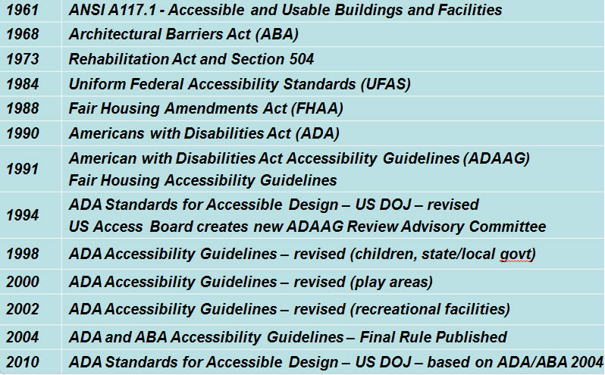
ANSI A117 Is 50 Years Old This Month

Slide 12
Revisions to ADA regulations published
September 15, 2010
President Announced, And DOJ Posted, Final ADA Regulations On July 26, 2010
Published In Federal Register September 15, 2010
First Major Updates/Revisions In 19 Years
Two Regulations
  Title II: State And Local Governments (Title II), 28 CFR Part 35
  Title III: Public Accommodations And Commercial Facilities, 28 CFR Part 36
Regulations, Appendices, Standards Are At DOJ’s ADA Web Site (Www.Ada.Gov).

Slide 13
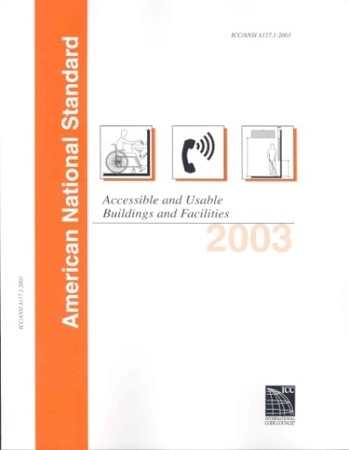

Harmonization
ICC/ANSI A117.1-2003 IBC 2003

Slide 14
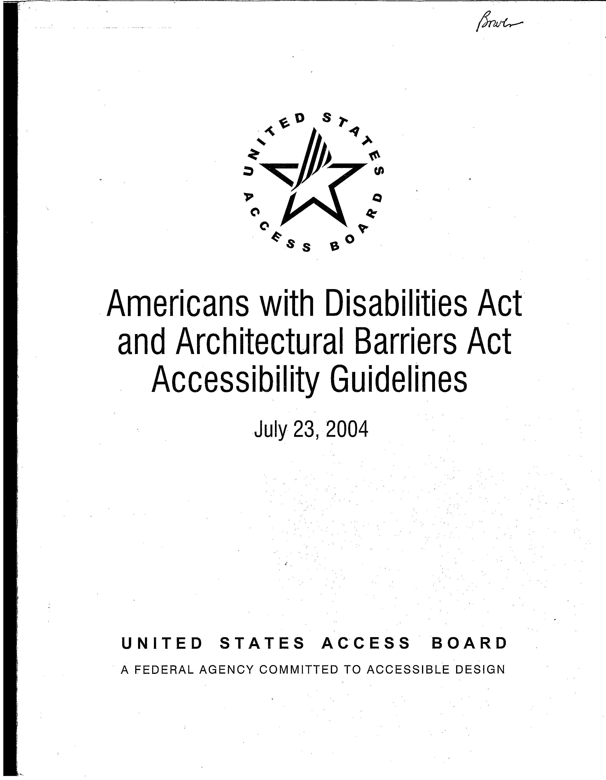
ADA/ABA Accessibility Guidelines - 2004

Slide 15
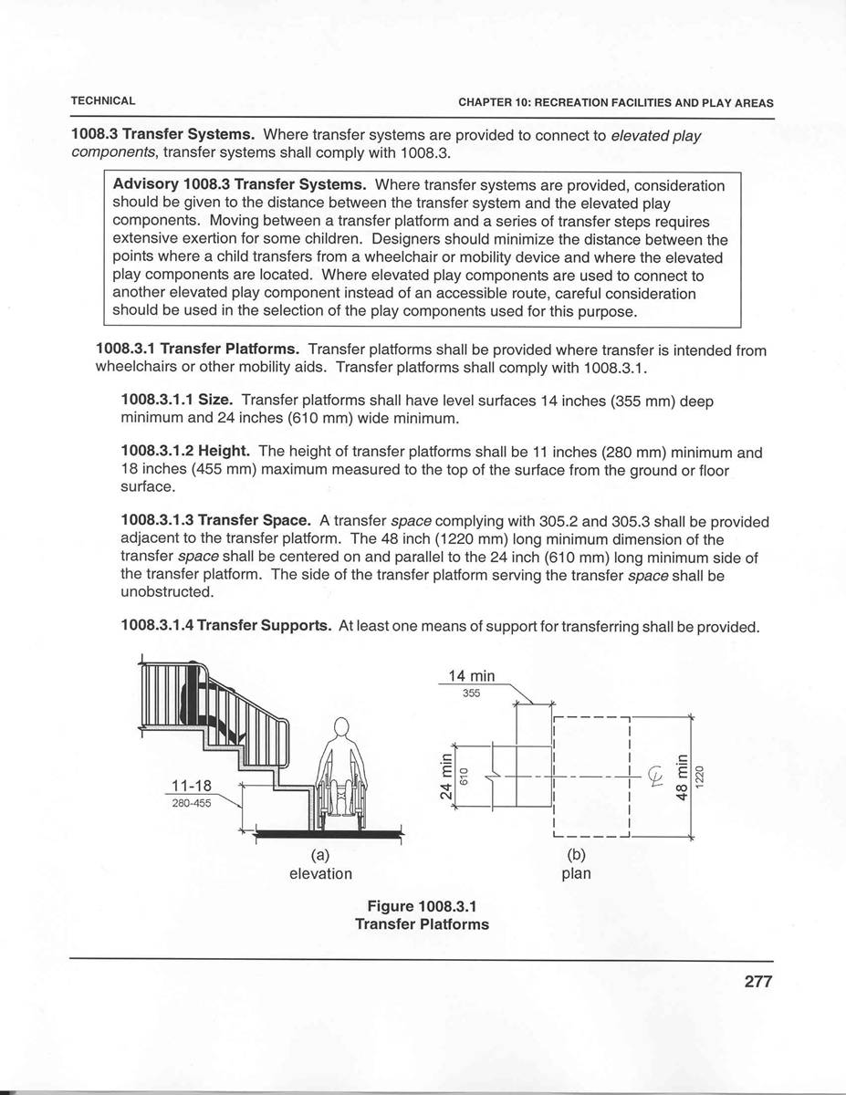
New Format
Numbering System
New Figures (Informational Only)
All Dimensions In Text
(Not Just Figures)
New Advisory Notes Follow Provision

Slide 16
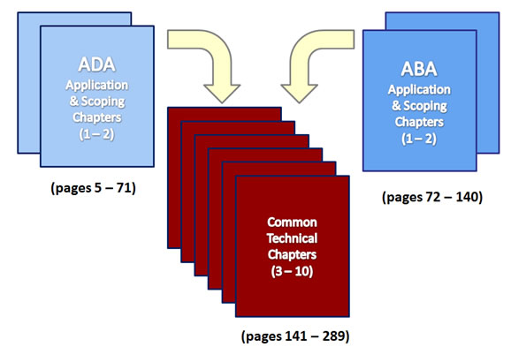
ADA-ABA Guidelines,

Slide 17
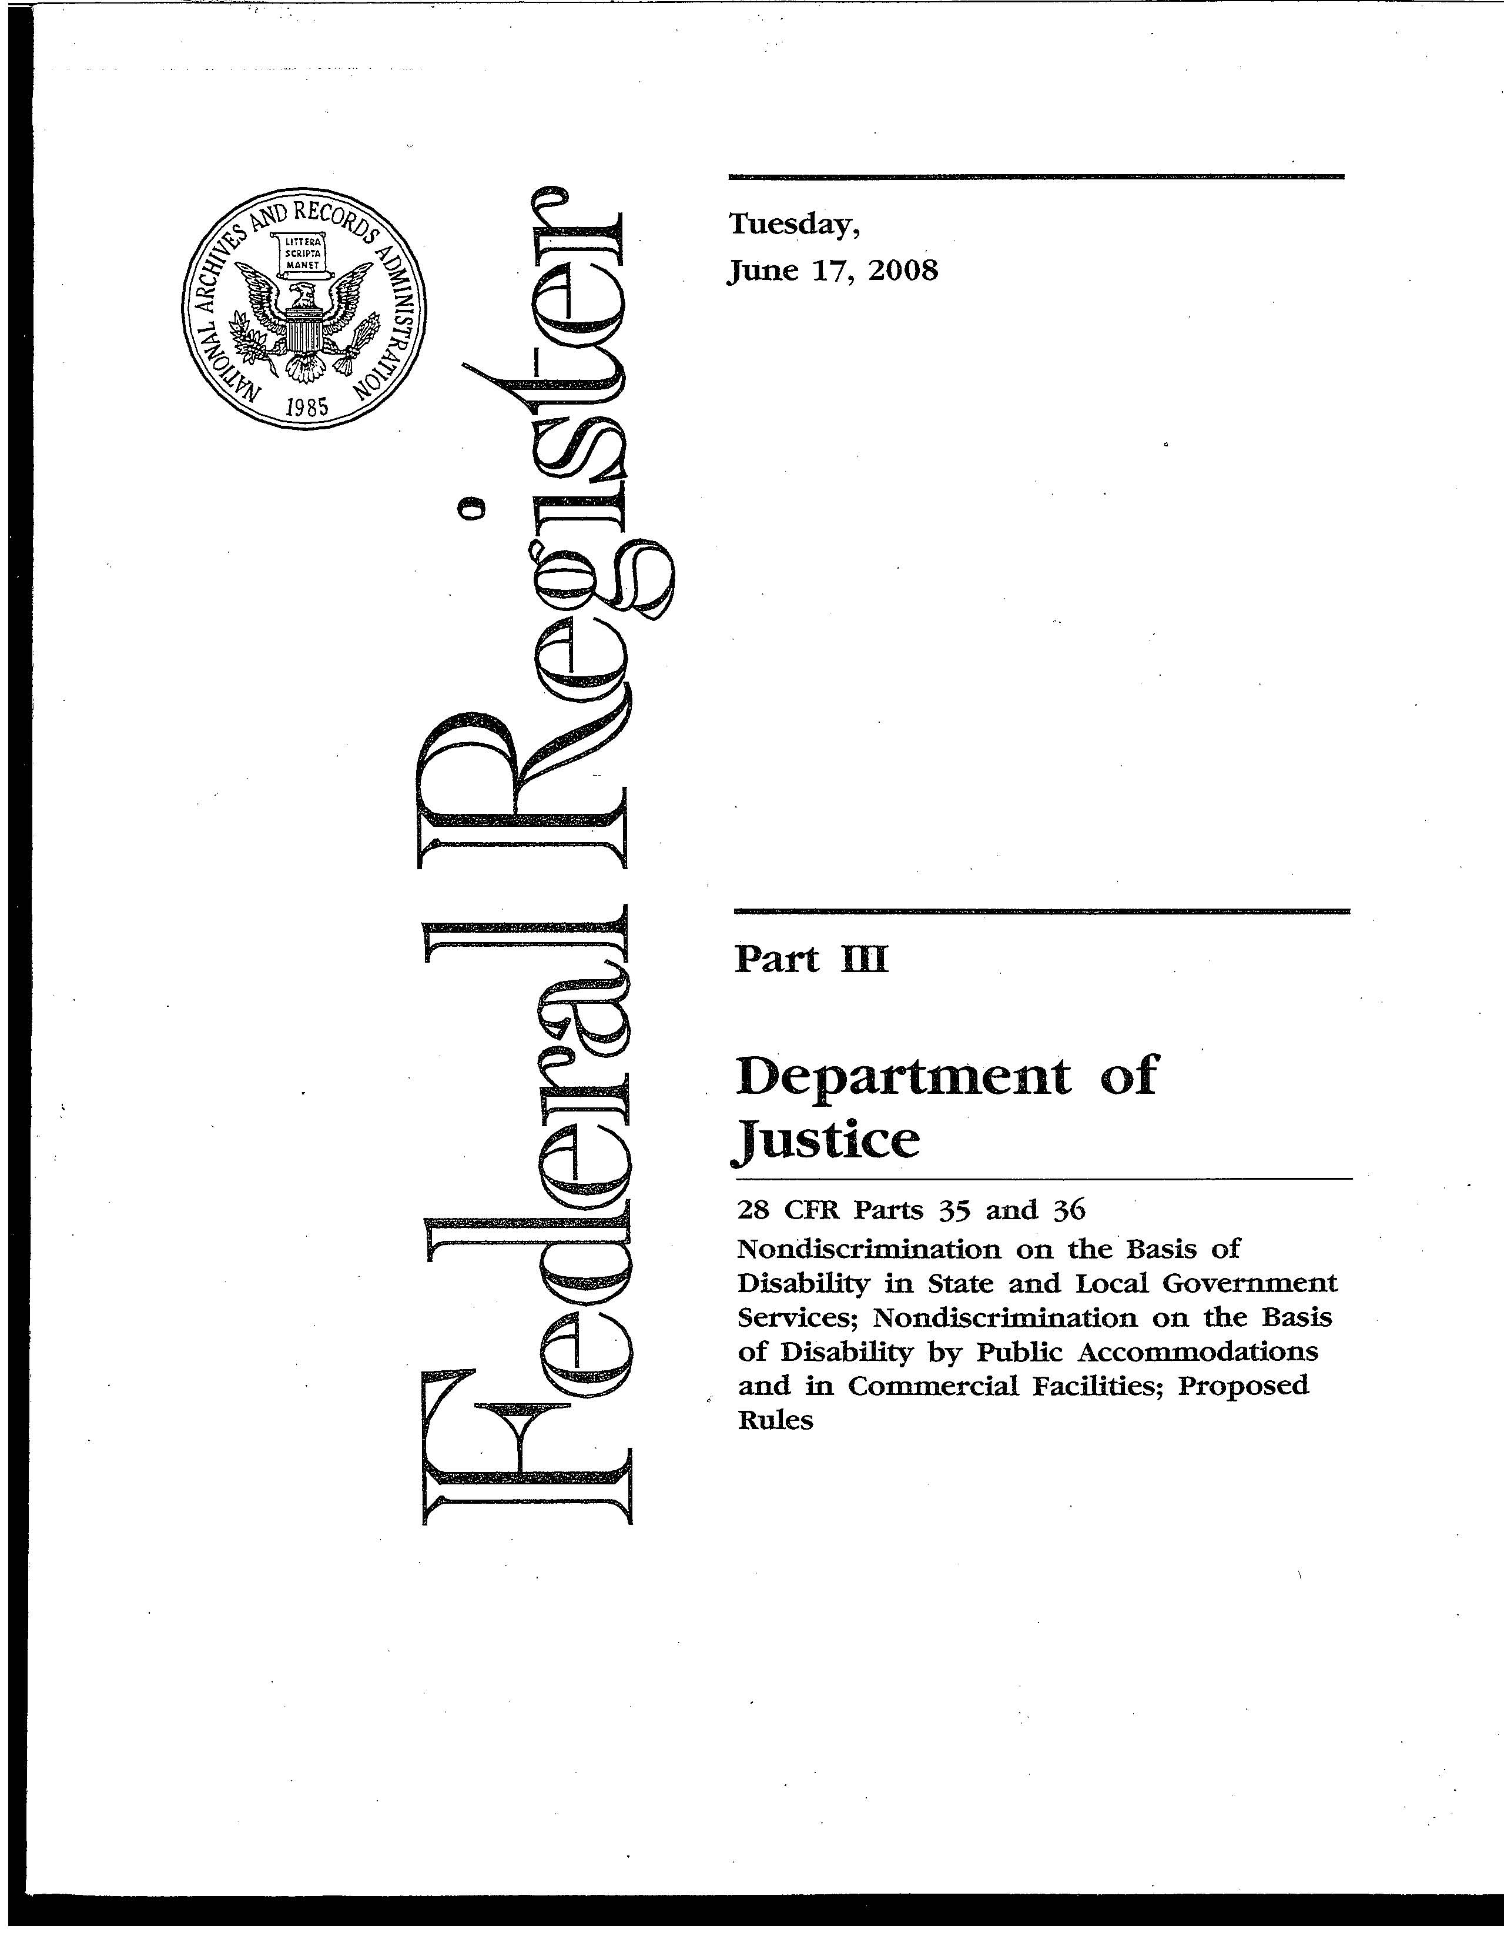
At Last!
New ADA Standards

Slide 18
ADA 2010 Standards Has 3 Parts Applicable to Title II & III
Technical
Chapters
(Part III)
ADA Scoping
(Part II)
28 CFR Part 36 Subpart D

Slide 19
Additional Requirements Applicable to Specific Types of Facilities
Applies To New Construction And Alterations, Program Access, And Barrier Removal.
Final Rules Describe Additional Requirements Beyond Those Originally Contained In The ADA/ABA Accessibility Guidelines.

Slide 20
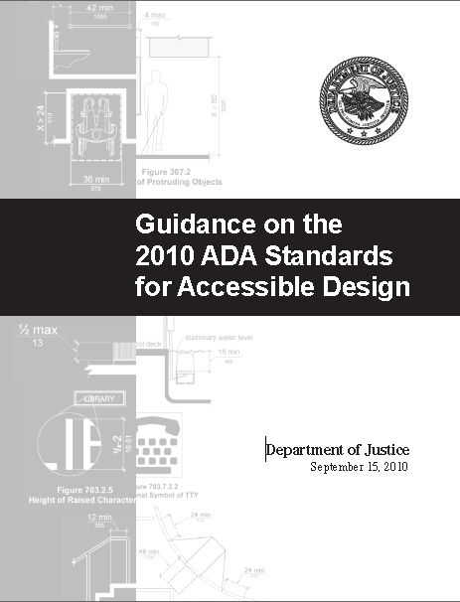
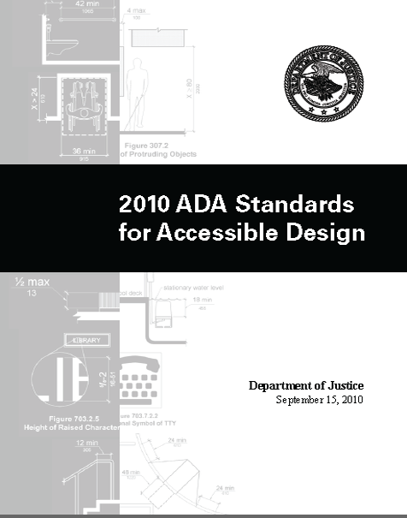


http://www.ada.gov/regs2010/2010ADAStandards/2010ADAstandards.htm

Slide 21
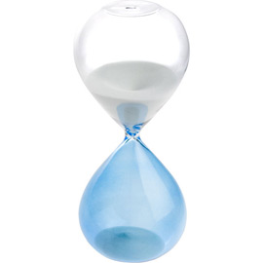
Challenges
Learning The New Standards
Figuring Out What To Do In The Next Six Months
Understanding The “Safe Harbors”
(New Concept)
Modifying Certain Types Of Policies
Keeping Up With Other Regulatory Developments
Notes:
An hour glass with some of the sand in the bottom, most in the top.

Slide 22
Triggering Events
Title II
  Start Of Physical Construction Or Alterations, 35.151(c)
Title III Tied To Permits, If Granted, 46.406(a)
  If State/Local/County Government Requires Permits, Date That Last Application For Building Permit Or Permit Extension Certified Complete
  If Government Doesn’t Certify Completion Of Applications, Then Date Of Last Application For Permit Or Extension
  If Government Doesn’t Require Permits, Start Of Physical Construction Or Alterations

Slide 23
Definition of “Existing Facility”
Rules Add A Definition Of “Existing Facility”
An “Existing Facility” Is “A Facility In Existence On Any Given Date, Without Regard To Whether The Facility May Also Be Considered Newly Constructed Or Altered Under This Part.”
Notes:
Give examples

Slide 24
Title II – Compliance
For Program Access, Until Compliance Date, Covered Entities May Choose To Use Either The UFAS, The 1991 Standards, Or The 2010 Standards

Slide 25
Title III Compliance – Existing
Facilities Before Compliance Date
Requirement: Elements That Do Not Comply With The Corresponding Requirements For Those Elements In The 1991 Standards, Must Be Modified To The Extent Readily Achievable.
(Barrier Removal) (Section 36.304)
Applicable Standard Before Compliance Date (18 Months After Publication In The Federal Register):
  1991 Standards; Or
  2010 Standards (Section 36.304(d)(2)(ii)(a)

Slide 26

Title II Can Choose Any of the Standards Till 3-15-12
UFAS
1991
2010
Title III Can Only
Choose Two Till 3-15-11 (Safe Harbor Option)
Notes:
26

Slide 27
Maintenance of Accessible Features (New Provision)
If The 2010 Standards Reduce The Technical Requirements Or The Number Of Required Accessible Elements Below The Number Required By The 1991 Standards, The Covered Entity May Reduce The Level Of Accessibility In Accordance With The 2010 Standards.
Stadium Seating
Notes:
Give examples.

Slide 28

Maintenance
Maintenance Of Accessible Features:
Not In “Standards” Sections
Sections 35.133(c) And 36.211 (C) Of General Requirements:
If The Standards Reduce The Technical Or Scoping Requirements For An Element Below What The 1991 Standards Required, The Technical Or Scoping Standards May Be Reduced Per 2010 Standards.
Example: 1991 Standards Require 4% Of Seats To Have Ald’s In Auditorium. 2010 Require Only 2%. You Can Reduce Existing Number To 2%.
Notes:
Red flag icon in heading

Slide 29

Additional DOJ Requirements
Social Service Center Establishments
Housing At Places Of Education
Assembly Areas
Medical Care Facilities
Residential Dwelling Units
Detention And Correctional Facilities
Places Of Lodging

Slide 30
Social Service Center Establishments
Facilities With More Than 50 Beds With Common‐use Bathing Facilities Must Provide At Least One Roll‐in Shower With A Seat.
If Common‐use Shower Facilities For Both Genders Are Provided, Roll‐in Showers Required For Each Group.

Slide 31
Social Service Center Establishments
Section 35.151(e) and Section 36.406(d)
Social Service Establishments Are Required To Comply With The Requirements For Residential Facilities, Including, But Not Limited To The Provisions In Sections 233 And 809.
In Sleeping Rooms With More Than 25 Beds, A Minimum Of 5 Percent Of The Beds Must Have Clear Floor Space.

Slide 32
Housing at a Place of Education
“Housing Operated By Or On Behalf Of An Elementary, Secondary, Undergraduate, Or Postgraduate School, Or Other Place Of Education, Including Dormitories, Suites, Apartments, Or Other Places Of Residence.”
Defined At Section 35.104 And Section 36.104

Slide 33
Housing at a Place of Education
Section 35.151(f) and Section 36. 406(e)
Kitchens Within Housing Units Containing
Accessible Sleeping Rooms With Mobility
Features Or On Floors Containing Accessible
Sleeping Rooms With Mobility Features Must
Provide Turning Spaces & Accessible Route That Comply With The Requirements Of A.S. 2010

Slide 34
Housing at a Place of Education
Multi‐bedroom Housing Units That Contain
Accessible Sleeping Rooms With Mobility
Features Must Have An Accessible Route
Throughout The Unit In Accordance With The
Requirements Of The Residential Dwelling
Units Standards.

Slide 35
Housing at a Place of Education
Apartments Or Townhome Facilities Which Are
Leased On A Year‐round Basis Exclusively To
Graduate Students Or Faculty, And That Do Not
Contain Any Public Or Common Areas Available
For Educational Programming, Are Required To
Comply With The Requirements For Residential
Facilities.

Slide 36
Assembly Areas
Section 36.151(g) And Section 36.406(f)
The 2010 Standards Require:
Dispersion Of Wheelchair Spaces
And Companion Seats To All Levels That Include Seating Served By An Accessible Route In
Stadiums, Arenas, And Grandstands.

Slide 37
Assembly Areas
Wheelchair Spaces And Companion Seats Are Required To Be Horizontally Dispersed Have Seating Encircling, In Whole Or In Part, A Field Of Play Or Performance Area.
Wheelchair Spaces And Companion Seats May Not Be Located On Temporary Platforms Or Other Moveable Structures Except In Certain Specified Circumstances.
Wheelchair Spaces And Companion Seats Shall Be Placed To Assure Line‐of Sight

Slide 38
Assembly Areas
Wheelchair Spaces And Companion Seats Are Required In Each Specialty Area That Provides Spectators With Distinct Services Or Amenities That Are Generally Not Available To Other Spectators. (Section 36.308)
This Requirement Is Included In, Rather Than In Addition To, Wheelchair Space Requirements Set Forth In Table 221.2.1.1 In The 2010 Standards.

Slide 39
Medical Care Facilities
Section 35.151(h) And Section 36.406(g)
The AS 2010 Require: Dispersion Of
Accessible Patient
Bedrooms In A Manner
That Is Proportionate By
Type Of Medical
Specialty.

Slide 40
Title II—Residential Dwelling Units
Standards Require At Least 5 Percent To Be Accessible To Persons With Mobility Disabilities And At Least 2 Percent To Be Accessible To Persons With Communication Disabilities.
Section 35.151(j) Applies These Requirements To Those Housing Programs Operated By Public Entities That Provide Units For Sale To Individuals.

Slide 41
Title II—Residential Dwelling Units
Residential Units Subject To The Section
504 Regulations Of The Department Of Housing And Urban Development (HUD) Defer To The HUD Regulations For The Scoping Requirements.

Slide 42
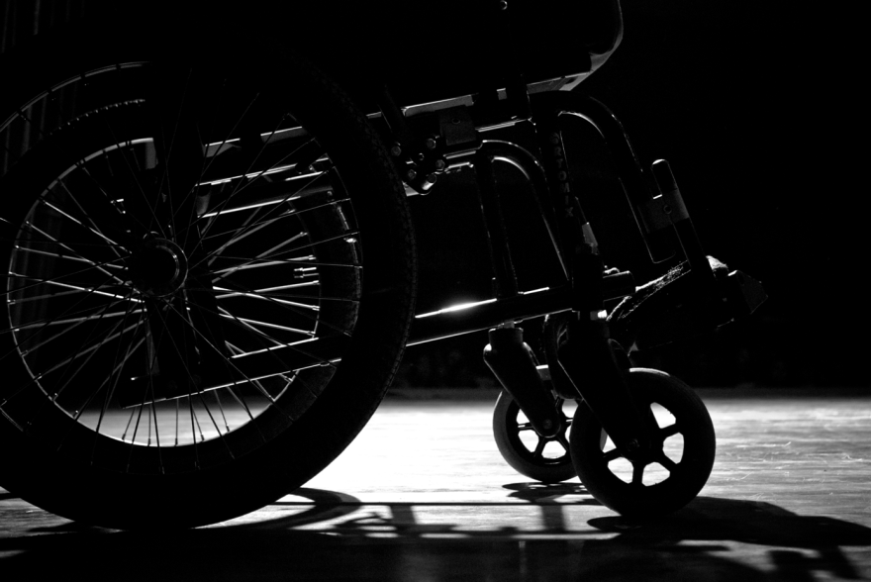
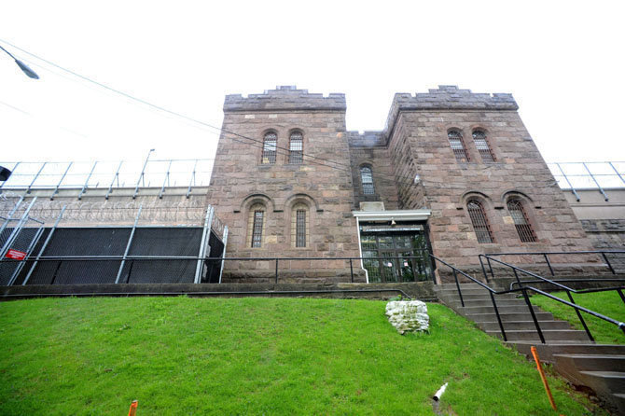
Title II ‐ Detention and Correctional
Facilities ‐ Section 35.151(k))
Increases Required Scoping For New Construction And Alterations Of Accessible Cells To 3 Percent, But No Fewer Than One.
Cells With Mobility Features Shall Be Provided In Each Classification Level.

Slide 43
Places of Lodging (Section 36.406(c))
Places Of Lodging Include Other Facilities Such As Timeshare And Condominium Properties That Operate Similarly To Hotels. (Defined At Section 36.104)
These Facilities Must Comply With Transient Lodging Requirements.

Slide 44
Places of Lodging
May Combine Multiple Facilities On A Single Site That Have 50 Or Fewer Guest Rooms And Are Constructed Or Altered Subject To The Same Permit Application.
More Than 50 Guest Rooms Treated Separately

Slide 45
Places of Lodging
Rule Exempts From The Alterations Requirements, Guest Rooms That Are:
1) Not Owned Or Substantially Controlled By The Entity That Owns, Leases, Or Operates The Overall Facility; And
2) Where The Physical Features Of Guest Room Interiors Are Controlled By The Individual Owners.

Slide 46
Places of Lodging That Are Part of
Mixed Use Facilities
Mixed‐use Facilities ‐ Where A Facility Contains
Both Residential Dwelling Units And Other
Units Designed As Transient Lodging Facilities,
The Residential Dwelling Units Are Not Covered
By The Transient Lodging Standards.
Section 36.406 (C)(3)

Slide 47
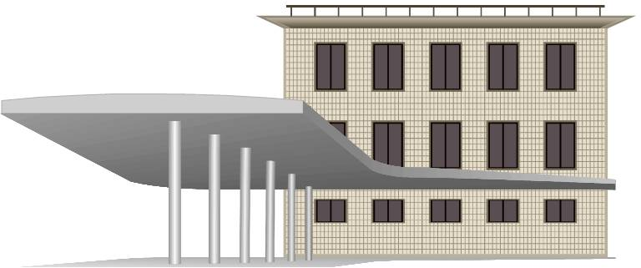
Current ADA Standards
Transit Facilities
(e.g., bus stops/stations, rail stations):
DOT’s ADA standards (2006)

Slide 48
Element-by-Element Safe Harbor:
Existing Facilities
Elements That Comply With The Corresponding Requirements For Those Elements In The 1991 Standards Do Not Need To Be Modified To Meet The 2010 Standards Unless Those Elements Are Altered On Or After March 15, 2012.
Safe Harbor Does Not Apply To Those Elements In Existing Facilities That Are Not Subject To Specific Requirements In The 1991 Standards.

Slide 49
Safe Harbor
Exist & Complies with 1991 Standard, No Change Ever Required; Except for Alteration after 3-15-2012
ADAAG 2010 Standard
Only Applicable Element By Element
Can Use Either Standard Till 3-15-2012
After 3-15-2012; 2010 Standard Only
Can Use Lower Applicable Standard
Title II Entities Can Use 1991 or 2010 or UFAS

Slide 50
Elements in 2010 Standards Not Subject to Safe Harbor
Residential Facilities And Dwelling Units
Amusement Rides
Recreational Boating Facilities
Exercise Machines And Equipment
Fishing Piers And Platforms
Golf Facilities
Miniature Golf Facilities

Slide 51
Elements in 2010 Standards
Not Subject to Safe Harbor
Play Areas
Saunas And Steam Rooms
Swimming Pools, Wading Pools, Spas
Shooting Facilities With Firing Positions,
Miscellaneous
  Team Or Player Seating
  Accessible Route To Bowling Lanes
  Accessible Route In Court Sports Facilities

Slide 52
Path of Travel - Safe Harbor
Both Title II And Title III Specify That If A Covered Entity Has Constructed Or Altered Required Elements Of A Path Of Travel In Compliance With The Applicable Standards (1991 Or UFAS), Before March 15, 2012, They Are Not Required To Retrofit Such Elements To Reflect Incremental Changes In The 2010 Standards, Just Because They Alter A Primary Function Area Served By The Path Of Travel.

Slide 53

…Title II and III alterations:
Safe Harbor
Alterations Don’t Trigger Requirement To Alter Elements Of Path Of Travel That Already Comply With The 1991 Standards.
Title II: 35.151(b)(4)(ii)(c)
Title III: 36.403(a)(1)
Notes:
Graphic of safe harbor: lighthouse by shore

Slide 54
Existing facilities: safe harbor
Program Accessibility (Title II)
Basic Requirement Stays:
  Every Program Must Be Accessible When Viewed In Its Entirety
  Whether Something Is “Accessible” Is Measured By Reference To Standards
The “Measure”/Reference Point Changes (1991, 2010)

Slide 55
…Existing facilities: safe harbor
New “Safe Harbor”: Elements Complying With UFAS Or 1991 Standards Don’t Have To Be Altered Just For Sake Of Program Access Even After March 2012
  Areas Not Addressed In 1991 But Addressed In 2010 Are Not Subject To Safe Harbor: Recreation, Play Areas, Etc.
Barrier Removal (Title III): Similar Safe Harbor

Slide 56
Using The Safe Harbor Before 3-25-12
Document Existing Elements Complying With 1991 Standards (Or UFAS If Title II)
If Changes Are Required, Remove Barriers To Program Access (Or Title III Barriers) Under 1991 Or 2010 Standard Considering Safe Harbor

Slide 57
Resources
Regulations, Appendices, Standards Are Available At Doj’s ADA Web Site At www.AdA.Gov
For Answers To Specific Questions, DOJ Toll-free Ada Information Line:
800-514-0301 (Voice)
800-514-0383 (TTY)
Network Of Ada Centers (Formerly Known As DBTAC”S)
800-949-4232 (Voice/Tty)
U.S. Access Board Web Site At Www.Access-board.Gov.

Slide 58
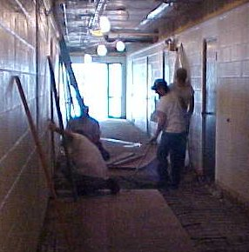
Alterations: title II
“Path Of Travel” Requirement Now Applies Under Title II Too. 35.151(b)(2) And (4).
  Aka 20% Rule: If You Alter A “Primary Function Area,” You Have To Comply With Alterations Standards For That Space, Plus Spend Up To 20%
  On Path Of Travel Accessibility
  (Route To Space, Restrooms,
  Drinking Fountains, Phones)
Structural Impracticability

Slide 59

ABA Standards
(Federal facilities)
Similar Standards In Effect For All Federally Funded Facilities (Except Housing)
Housing – UFAA Still Applies (HUD To Update Standards)

Slide 60
AS 2010 The Technical Stuff!

Slide 61
CHAPTER 1
Dimensions – Range Instead Of Absolute Dimension Where Possible
Construction And Manufacturing Tolerances
Scoping Percentages/Ratios (Round Up)
Referenced Standards

Slide 62
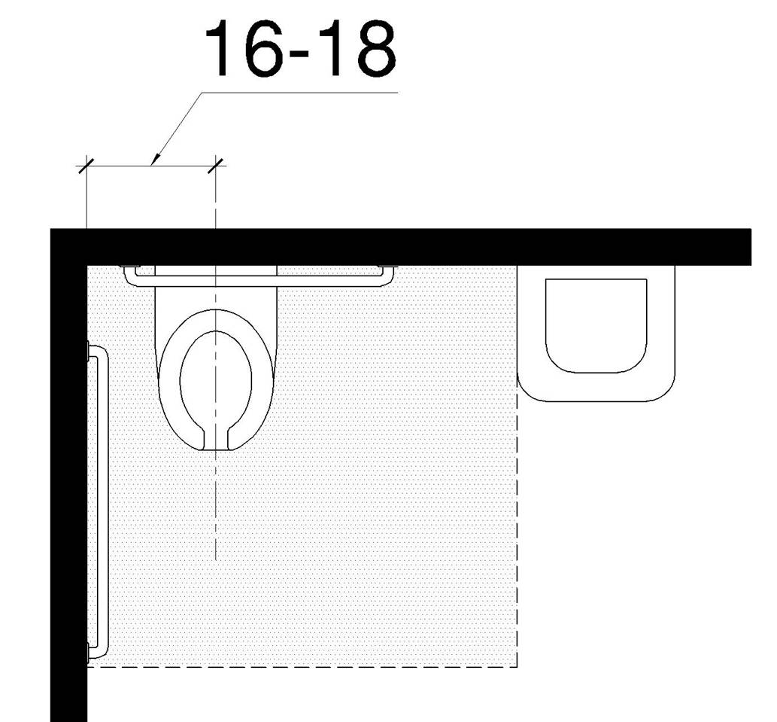
2010 ADA Standards
104 Conventions
104.1 Dimensions
Dimensions That Are Not Stated As A
Maximum Or Minimum Are Absolute.
104.1.1 Construction And Manufacturing Tolerances
All Dimensions Are Subject To Conventional Industry Tolerances Except Where The Requirement Is Stated As A Range With Specific Minimum And Maximum End Points.

Slide 63
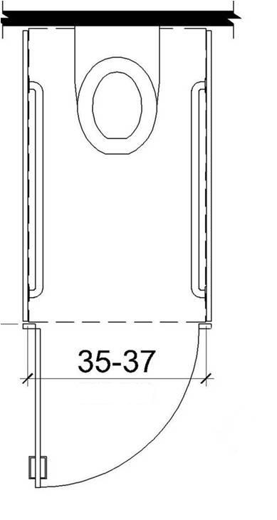
Ranges instead of absolute dimensions
Water Closet Centerline (16-18”)
Width Of Ambulatory Accessible Stall (35”- 37”)

Slide 64
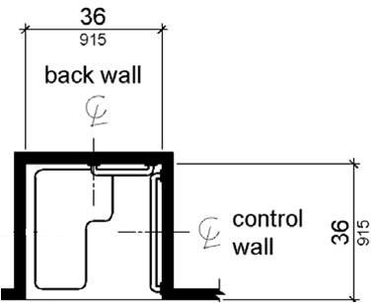
Some Absolute Dimensions Remain
E.G. Transfer Shower Stall (36” X 36”)
(Measured To Center Points; Manufacturing Tolerances Recognized)

Slide 65
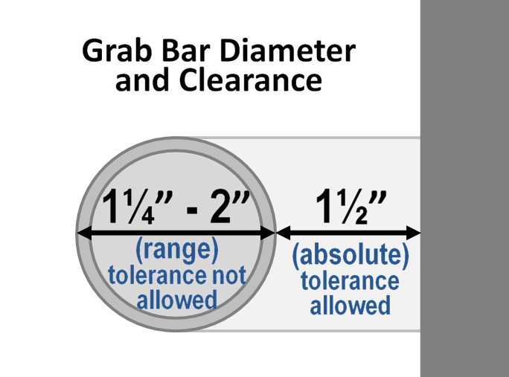
Tolerances do not apply to ranges

Slide 66

CHAPTER 2
General Scoping
New Construction
Exceptions
Additions and Alterations

Slide 67
New Construction
All areas must comply except:
  Exempted structures/ spaces
  Work areas (ADA facilities)
  Partially scoped spaces

Slide 68
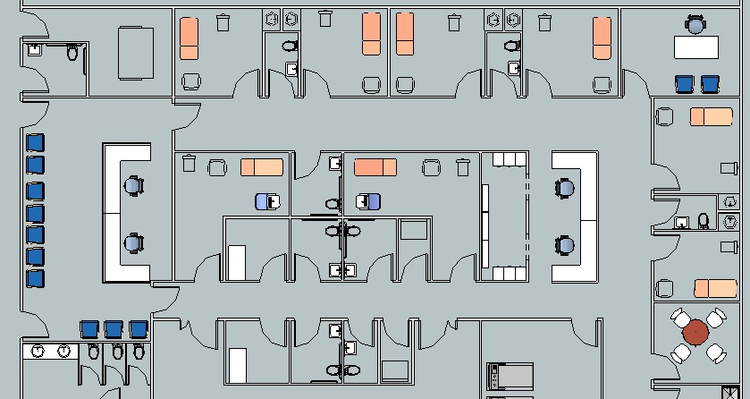
New Construction
Example: Medical Care Suite
Mechanical (exempt)
Clustered toilet rooms (partial scoping – 50%)
Work areas (partial access) – e.g, reception area, nurses station

Slide 69
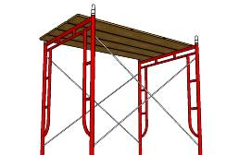
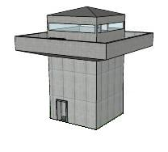
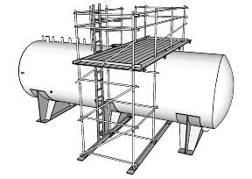
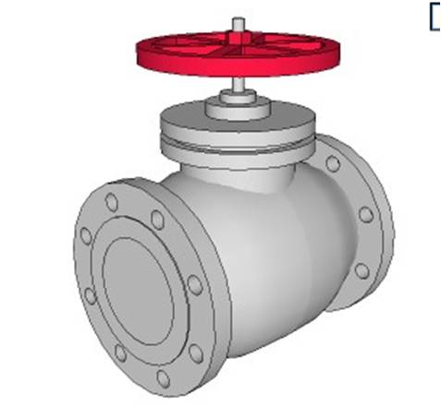
General Exceptions
Construction Sites
Raised Areas (Security, Life/Fire Safety)
Spaces Accessed By Ladders, Catwalks, Crawl Spaces, Narrow Passageways
Machinery Spaces

Slide 70
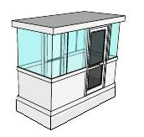
General Exceptions
Single Occupant Structures (E.G., Toll Booths)
Accessed Only By Below-grade Passageways Or Elevated Above Standard Curb Height

Slide 71
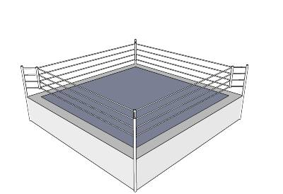
General Exceptions
Recreation Facilities
Raised Structures Used Solely For Refereeing, Judging, Or Scoring A Sport
Raised Boxing/ Wrestling Rings
Water Slides And Raised Diving Boards/ Platforms
Animal Containment Areas Not Open To The Public

Slide 72
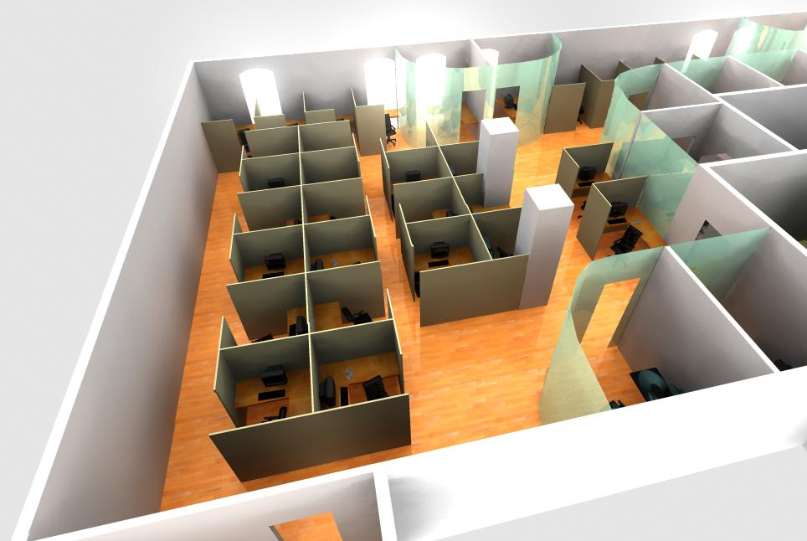
Work Areas
Accessible Circulation Paths
Exceptions:
Areas < 1000 Sq. Ft.
Paths = Integral Part Of Equipment
Exterior Areas Fully Exposed To Weather

Slide 73
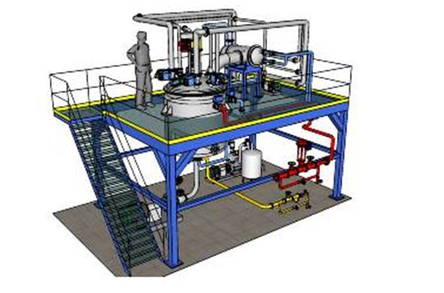
Work Areas
Exempt:
Areas Under 300 S.F. That Are Elevated At Least 7” As An Essential Functional Condition Of The Space (Excluding Raised Courtroom Stations)

Slide 74
Alterations
Standards Apply Based On:
Planned Scope Of Work
Technical Feasibility
Primary Function Areas/ Path Of Travel

Slide 75
CHAPTER 3
Building Blocks:
Floor/ Ground Surfaces
Changes in Level
Turning Space
Clear Floor Space
Knee & Toe Clearance
Protruding Objects
Reach Ranges and Operable Parts

Slide 76
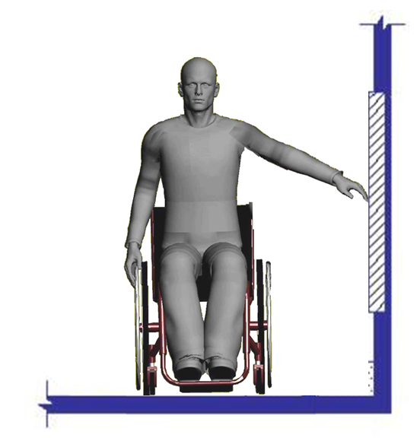
Reach Ranges
Side reach range reduced:
48” – 15”
(same as forward reach)

Slide 77
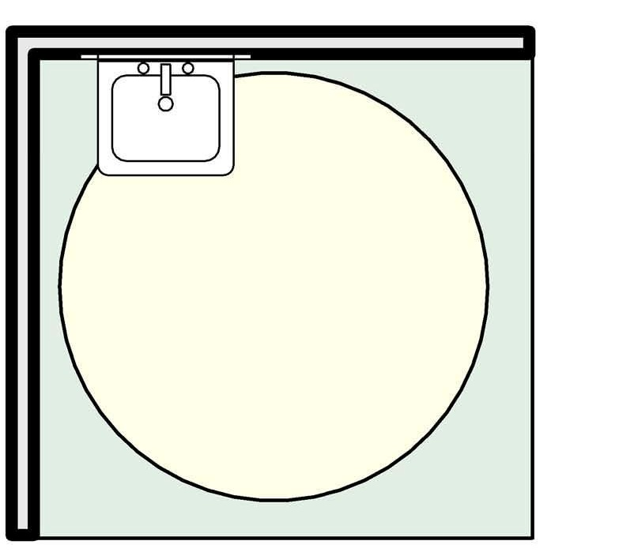
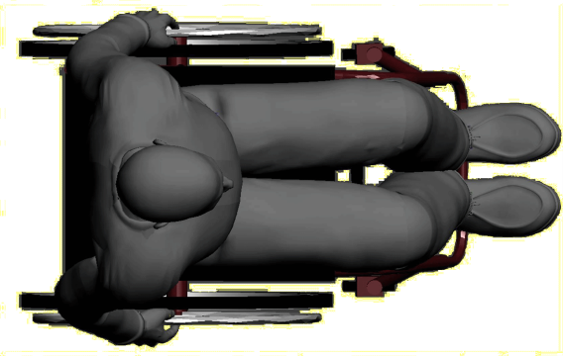
Turning Space
Permitted overlap clarified (objects with required knee/ toe clearance)

Slide 78
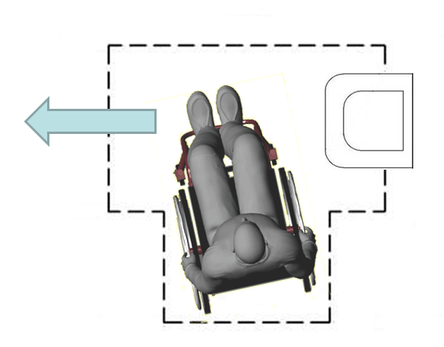
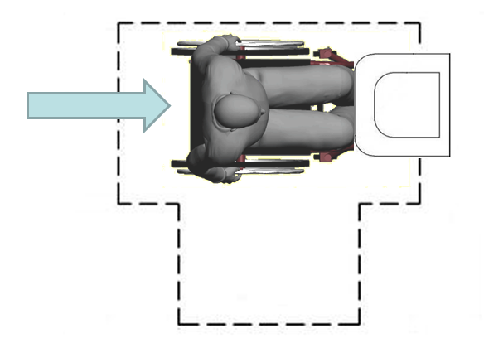
Turning Space
Overlap limited to 1 arm of T-shaped space
(2 arms unobstructed for approach, backing up)

Slide 79
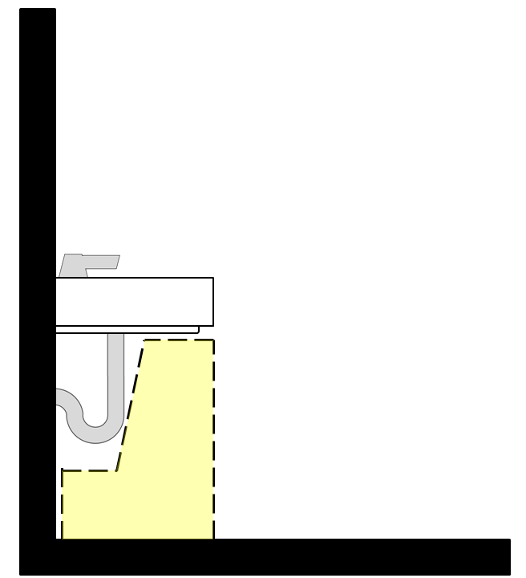
Knee/Toe Clearances
Specified in Chapter 3 for all elements (e.g., lavs, sinks, counters, tables, etc.)
Depth: 17” – 25”

Slide 80
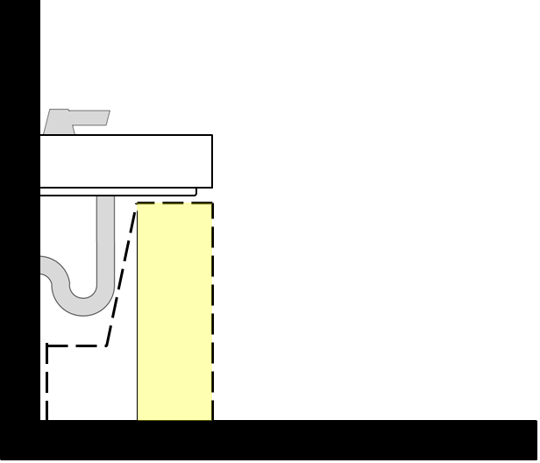
Knee/Toe Clearances
Knee Clearance:
Height: 27”min.
Depth: 8” min.

Slide 81
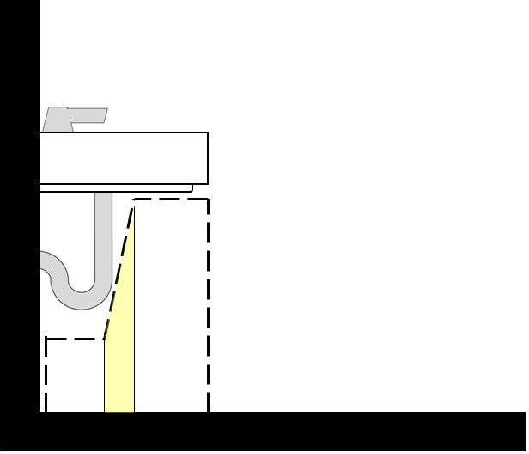
Knee/Toe Clearances
Beyond 8” depth: clearance can reduce to 9” min. at 11” depth
(6:1 slope)

Slide 82
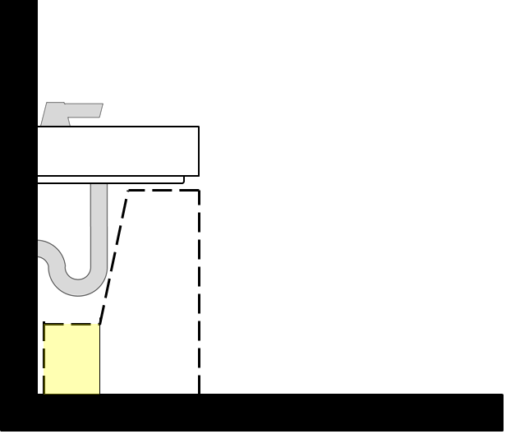
Knee/Toe Clearances
Toe Clearance:
Height: 9” min.
Depth: 6” max. (of usable CFS)

Slide 83


Slide 84
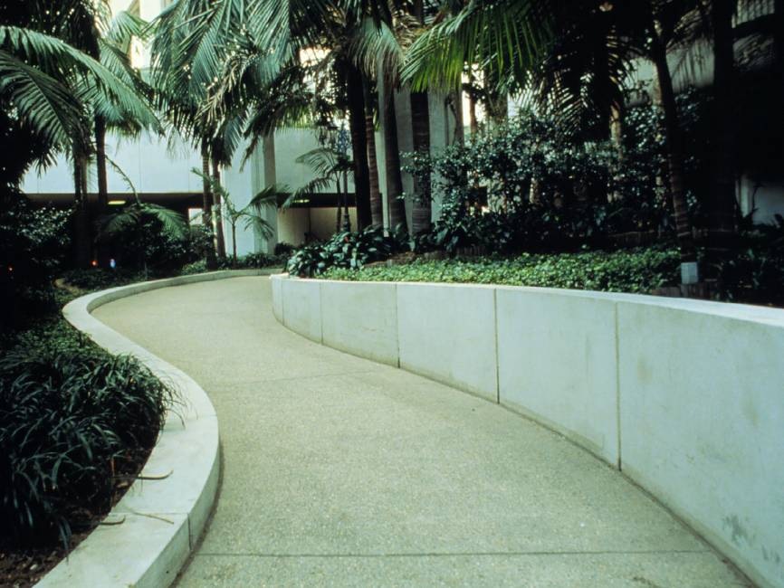
CHAPTER 4
Accessible Routes:
Walking Surfaces
Doors And Gates
Ramps And Curb Ramps
Elevators
Platform Lifts

Slide 85
Accessible Routes
At Least One Accessible Route To Building Entrances From:
Streets And Sidewalks
Transportation Stops
Parking
Passenger Loading Zones
(Where Provided)

Slide 86
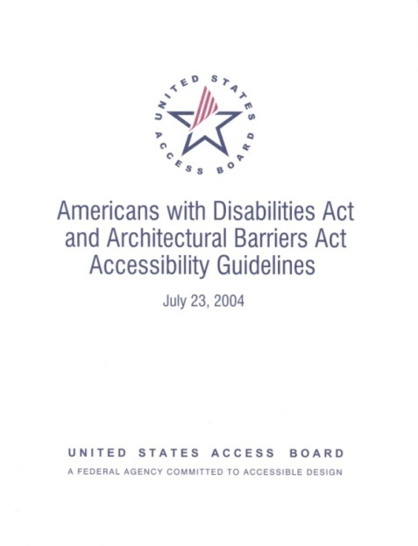
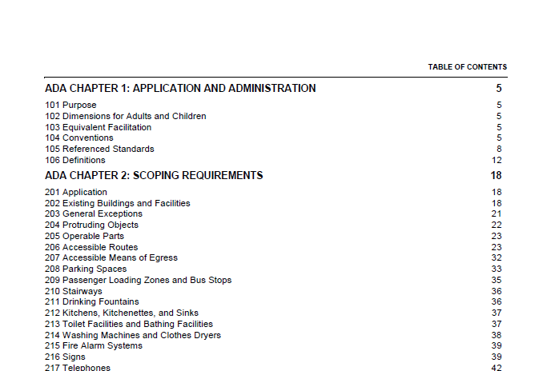

Accessible Route Scoping
Section 206

Slide 87
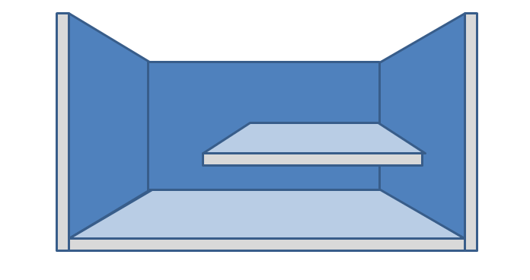
Accessible Routes
Clarifications:
if circulation path interior, AR must be interior
AR not req’d if no pedestrian route provided
AR not req’d to mezzanines in buildings without elevators

Slide 88
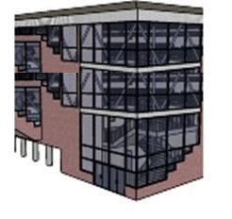
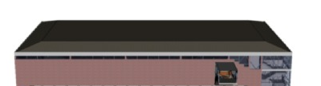
Exceptions (206.2.3)
AR between floors (“elevator exception”)
Private sector facilities only:
less than 3 stories OR less than 3,000 sf/ flr)

Slide 89
Exceptions (206.2.3)
Exception not allowed for:
Shopping centers/ malls
Professional offices of health care providers
Terminal, depots, or stations used for public transportation

Slide 90
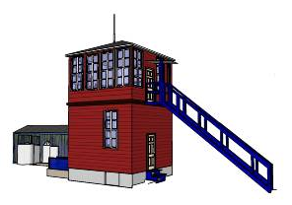
Exceptions (206.2.3)
New Exception For Public (Gov’t) Buildings:
2 Story Only And
1 Floor Has: No Public Space AND Max.
Occupancy Of 5
E.G. Train Dispatch
Or Boat Traffic Towers

Slide 91

Exceptions (206.2.3)
Additional exceptions:
detention and correctional facilities
residential facilities
transient lodging (certain
(multi-story units)
air traffic control tower cab
qualified historic facilities

Slide 92
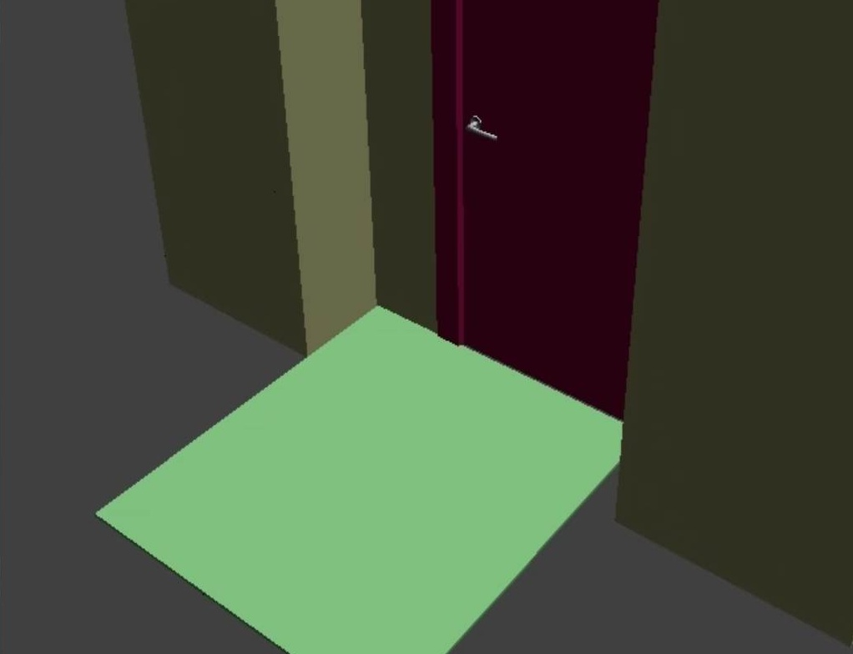
Doors and Gates
Recess: greater than 8”
(forward approach clearance flush with plane of door)

Slide 93
Doors and Gates
Other changes:
hardware height (34” – 48”)
limited projections into clear width
closing speed
smooth surface (push side)
vision lights

Slide 94
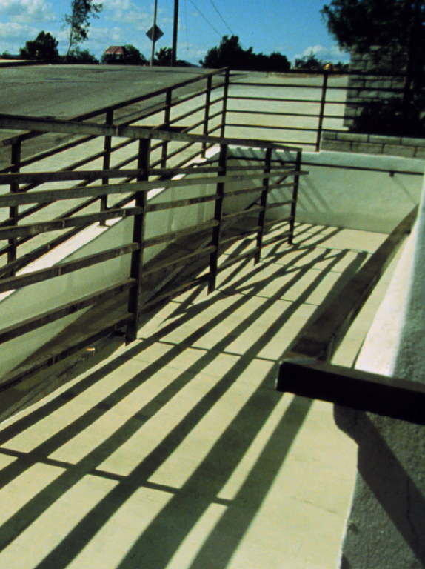
Ramps
Slope: 1:12 Max.
Cross Slope: 1:48 Max.
Clear Width: 36” Min.
Rise: 30” Max.
Level Landings
Handrails (Both Sides)
Edge Protection

Slide 95


Ramps
Edge Protection
◄Barrier (rail or curb)
Extended Platform►

Slide 96

Handrails
Ramps, Stairs, And Walkways
Knuckle Clearance: 1 ½” Min. (Not Absolute)
Diameter: 1 ¼” – 2” (Instead Of 1 ½” Max.)
Applies To Outer Diameter (Clarification)
Circular & Noncircular Cross Sections

Slide 97

Handrails
Handrails must comply where provided along walkways

Slide 98

Curb Ramps
Landing 36” min. required at the top

Slide 99

Curb Ramps
Lack of space at top makes curb ramps difficult to use

Slide 100


Curb Ramps
Detectable Warnings – required at:
Transit facilities (DOT standards)
FHWY funded projects
Other public sidewalks (strongly recommended)
- Board to address in new ROW guidelines

Slide 101

Curb Ramps
DWs – revised specifications available where provided (draft ROW guidelines)

Slide 102

Detectable Warnings
www.access-board.gov/adaag/dws/update.htm

Slide 103
Elevators
Standard Elevators
Destination-Oriented Elevators
Existing Elevators (alterations)
Limited Use/ Limited Application Elevators (LULAs)
Private Residence Elevators

Slide 104

Standard Elevators
Car sizes – more alternatives
designs providing turning space within car recognized

Slide 105
CHAPTER 5
General Site & Building Elements
Parking
Passenger Loading Zones
Stairways
Handrails

Slide 106

Parking
Clarifications:
Scoping Calculated Lot-by-lot
Exempt: Parking For Buses, Trucks, Delivery And Law Enforcement Vehicles, Impound
Marking Of Access Aisles
Sign Height (60” Min.)
Angled Vans Spaces (Aisle On Passenger Side)

Slide 107

Parking
Van Spaces: 1 of 6 accessible spaces
(instead of 1:8)

Slide 108

Parking (208)

Slide 109

Passenger Loading Zones
At least 1 for every 100 linear ft. of loading zone space provided

Slide 110

Passenger Loading Zones
Aisles - Same Level As Pull-up Space
Aisles To Be Marked
No Level Changes In Space Or Aisle

Slide 111


Stairways
Covered: all stairs that are part of means of egress
(exceptions for altered and assembly stairs)
• Removed: level 12” h-rail
extension at bottom
• Riser height (4”-7”)

Slide 112
CHAPTER 6
Plumbing Elements & Facilities:
Drinking Fountains
Toilet & Bathing Rooms
Water Closets, Toilet Compartments, Urinals
Lavatories & Sinks
Bathtubs & Shower Compartments
Washing Machines & Clothes Dryers
Saunas & Steam Rooms

Slide 113

Drinking Fountains
Where Provided At Exterior Site Or Floor, 2 Units Required (Wheelchair & Standing Access)
  Alternative: Single “Hi-lo” Unit Multiple Installations: 50% Of Each Type (Can Round Up Or Down)

Slide 114

Clustered Toilet Rooms
50% Scoping For Single User Toilet Rooms Clustered At One Location That Serve Same Users

Slide 115

Private Toilet Rooms
“Adaptability” Permitted:
Private Use
Single Occupant
Accessed Only Through Private Office

Slide 116
Private Toilet Rooms
Clarified That Adaptability Allows:
Later Provision Of Grab Bars (Reinforcement/ Blocking)
Alternative Toilet Seat & Lavatory Heights
Removable Base Cabinetry At Lavs
Door Swing Into Fixture Clearances (Where Swing Can Be Reversed)

Slide 117

Water Closet Clearance
Lavatory overlap no longer permitted

Slide 118

Water Closets
Original ADAAG (fig. 28) permitted overlap

Slide 119

Toilet Rooms
Range for toilet centerline
lavatory cannot overlap toilet clearance (except in dwelling units)

Slide 120


Toilet Rooms
Allows space for side transfers

Slide 121

Toilet Rooms
fixtures can be recessed
shorter (24” min.) rear grab bar allowed in this case

Slide 122

Toilet Rooms
Door man. clearance; swing outside fixture clearances

Slide 123

Toilet Rooms
Doors Can Swing Into Fixture Clearances If Clear Floor Space (30” X 48” Min.) Provided Outside Swing

Slide 124

Turning Space
60” Diameter Circle Or “T” Turn (Elements With Knee/Toe Clearance Can Overlap)
T-turn: Overlap Limited To One Segment

Slide 125

Toilet Rooms
Turning Space Can Overlap Fixture & Door Clearances; Door Can Swing Into Turning Space

Slide 126

Toilet Rooms
Same Requirements Apply For Any Design/ Configuration
(Turning Space Not Shown)

Slide 127

Toilet Rooms
… Including Less Common Designs
(Turning Space Not Shown)

Slide 128

Grab Bars
Clearances:
1 ½” Behind (Abolute)
1 ½” Min. Below
12” Min. Above (New)
Other Changes:
2” Max. Diameter (Instead Of 1 ½”)
Circular And Non-circular Cross Sections

Slide 129

Grab Bars
Clearances At Grab Bars Help Ensure Usability

Slide 130


Grab Bars
ANSI A117.1 requires 18” min. vertical grab bar (ADA and ABA guidelines do not)

Slide 131

TP Dispenser
Dispenser location

Slide 132

TP Dispenser
grab bar height (33”-36”) and clearances further limit location of non-recessed dispensers

Slide 133

Children’s Toilets
Alternate Specifications Permitted For Toilets Designed For Children 12 & Younger

Slide 134
Children’s Toilets
Advisory information provides guidance according to age group
 | Ages 3 & 4 | Ages 5 - 8 | Ages 9 - 12
WC Centerline | 12” | 12” – 15” | 15” – 18”
Seat Height | 11” – 12” | 12” – 15” | 15” – 17”
Grab Bar Height | 18” – 20” | 20” – 25” | 25” – 27”
Dispenser Height | 14” | 14” – 17” | 17” – 19”

Slide 135

Lavatories and Sinks
Apron Clearance (29” Min.) Removed
Parallel Approach - Kitchen Sinks In Spaces Without Cook Tops/ Ranges
Removable Cabinetry:
Allowed In Dwelling Units
(If Certain Conditions Met)

Slide 136

Lavatories
Locate controls & dispensers above, not beyond, usable CFS to be within reach

Slide 137

Lavatories
Tip: Avoid Hospital Style Lavs With Deep Projections
They Take Up More Space And Require A Greater Reach To Faucet Controls And Dispensers

Slide 138
Sinks
Public/ Common Use: Full Access To 5%
  Classrooms
  Research Laboratory (If Used For Instruction)
  Break Room*
  Preschool Classroom*
  * Side Approach Access Allowed
Work Areas: Access Not Required (Recommended)
  Commercial Laboratory
  Research Laboratory (Employee Use Only)
  Restaurant Kitchen
  Janitor’s Sink (Exempt)
Dwelling Units: Adaptability Allowed
  Kitchens

Slide 139

Toilet Stalls
Standard Stall

Slide 140

Toilet Stalls
Stalls With More Than 1 Plumbing Fixture Treated As Toilet Room
Second Accessible Lav Required Outside Stall

Slide 141

Ambulatory Stall
Where 6 Or More Stalls Provided
Parallel Grab Bars
Width: 35” – 37”
Depth: 60” Min.
Doors: Out-swinging, Self-closing

Slide 142
Bathing Facilities
At Least One Shower Or Tub Required
Options:
Transfer Shower Stall
Roll-in Shower
Combination Transfer/Roll-in Shower (Required In Some Transient Lodging Rooms)
Tubs

Slide 143


Transfer Stall
Clear Floor Space Positioned For Alignment With Seat

Slide 144

Roll-in Shower (no seat)
Shower Head And Controls Permitted On Any Wall If No Seat Provided

Slide 145

Roll-in Shower (with seat)
Shower Head/Controls Required On Back Wall Within Reach From Seat

Slide 146

Roll-in Shower (with seat)
Improper Location Makes Controls And Shower Spray Unit Unusable From Seat

Slide 147


Alternate Roll-in/Transfer
Location Of Controls And Shower Head On Side Or Back Wall

Slide 148


Roll-in Showers
½” Max. Beveled Curb Allowed (New)
Other Ways To Control Water:
2% Max. Slope Allowed
Consider Trench Drain
Resource From The
Center For Universal Design
Www.Design.Ncsu.Edu

Slide 149

Shower Spray Unit
Hand-held Shower Spray Unit Required (Exception For “Unmonitored” Facilities)
On/Off Control
Water Temperature
(120 Degrees Max.)

Slide 150


Bath Tubs
Permanent Seat
Removable Seat

Slide 151

Washing Machines & Dryers
1 Accessible Where 3 Or Fewer Provided
2 Accessible Where More Than 3 Provided

Slide 152
CHAPTER 7
Communication Elements & Features:
Fire Alarm Systems
Signs
Telephones
Detectable Warnings
Assistive Listening Systems
ATMs & Fare Machines
Two-Way Communication Systems

Slide 153

Fire Alarms
NFPA 72
(1999 or 2002)
guidelines require
110 dB max.

Slide 154

Fire Alarms
NFPA 72 covers:
flash rate & pulse duration
location - wall & ceiling
minimum intensity
larger coverage thru fewer appliances
many spaces (other than corridors) can be covered by 1 appliance
synchronization of multiple appliances

Slide 155

Signs
Tactile/ visual – labels for permanent rooms & spaces, exit doors
Visual only – directional or informational signs
Exempt: temporary signs, building menus, directories, addresses, company names and logos

Slide 156
Tactile Signs
Scoping (interior & exterior):
Restroom labels (at entry)
Room numbers/ names (not likely to change)
Floor levels
Exit access/discharge
Areas of Rescue Assistance

Slide 157

Tactile Signs
Cane detection of doorways

Slide 158
Signs
Tactile & Visual Visual Only
“Room 123” “Exit →”
“Restroom” “Accounting Department”
“Mechanical Room” “Visitors must sign in”
“Exit”
“Floor B” Exempt
“Ballroom A” building directory
“C. Smith Room” “Mr. C. Smith, Accountant”

Slide 159

Signs
Exempt
(temporary)
Visual
(Informational)
Tactile (Room number)

Slide 160

Tactile Signs
Raised characters
Grade 2 Braille
Visual access (finish and contrast)
Pictograms (designating room/space)

Slide 161

Signs
Raised Characters
sans serif
character proportion, height, spacing
line spacing
height (48” – 60”)
placement at doors

Slide 162

Pictograms

Slide 163
Visual Signs
“conventional form”
character proportion & spacing
character height based on viewing distance
location (40” min. height)
stroke thickness
line spacing
finish & contrast

Slide 164
Character Style
New standards specify “conventional form”
Prohibited:
Italic Oblique script
highly decorative
or other unusual forms

Slide 165
CHAPTER 8
Special Rooms, Spaces & Elements:
Assembly areas
Dressing, fitting, and locker rooms
Kitchens and kitchenettes
Medical care and long-term care
Transient lodging
Prison cells
Courtrooms
Dwelling units
Transportation facilities
Storage

Slide 166

Dwelling Units
New section:
5% wheelchair accessible
2% communication access features
Recognize coverage by HUD 504 regulations

Slide 167
Transient Lodging
Bed scoping (5%)
Communication features no longer required in all mobility access rooms (at least 1, no more than 10%)
All rooms: 32” min. clear width for doors
Housing at Places of Education (DOJ Regs)

Slide 168
Transient vs. Residential
Transient Lodging: primarily short-term in nature/ not used as a residence
Residential: Intended to be used as a residence, primarily long-term in nature.

Slide 169

Detention/ Correction Facilities
Accessible cells: 3% (DOJ regs)
Dispersion (DOJ regs)
Special holding cells: 1 of each type)

Slide 170

Courtrooms
jury boxes
witness stands
judges’ benches
clerk stations
spectator areas
assistive listening systems

Slide 171

CHAPTER 9
Built-In Elements:
Dining & Work Surfaces
Benches
Check-Out Aisles
Service Counters

Slide 172
Sales and Service Counters
36” max. height (accessible portion)
Applies to full depth of counter
36” min. length (30” min. forward approach)
security glazing – method to facilitate voice communication

Slide 173

Benches
Back support - new specifications

Slide 174
CHAPTER 10
Recreation Facilities:
Amusement Rides
Recreational Boating Facilities
Exercise Machines
Fishing Piers And Platforms
Golf Facilities
Miniature Golf Facilities
Play Areas
Swimming Pools, Wading Pools, And Spas

Slide 175

Swimming pools
Means of access:
Small (< 300 linear ft)
lift or sloped entry
Large (300 or more linear ft)
lift or sloped entry AND
transfer wall/system, stairs, lift, or sloped entry (must be different)

Slide 176

Swimming pools
Sloped Entry
Extend to 24” – 30” below water level
1:12 maximum slope
Handrails – 33” – 38” max clear width

Slide 177

Swimming pools
Lifts
Unassisted operation
Location (48” max water level)
Submerged depth: 18” min.
Footrests

Slide 178



Swimming pools
Transfer Wall
Transfer System
Pool Stairs

