Slide 1
Independent Living Services To Alaska Natives with Disabilities (IL-STAND) Program
Needs Assessment Launch identifying IL barriers for Alaska Natives supported by federal grant 90IL0356-01-00. Research partnership with the Alaska Native Elders Care (ANEC)
Presented at the APRIL Conference 10/06/18

Slide 2
Your Presenters:
Gail Dabaluz, IL-STAND Program Coordinator
Joan O’Keefe, SAIL Executive Director

Slide 3
Presentation Overview
Context: Where and Why
ACL NAILD Project Proposal
Challenges
Lessons Learned
Other Possible Take-Aways
Q & A

Slide 4
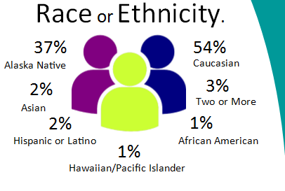
SAIL in a Nutshell…
CIL, incorporated 1992
Aging and Disability Resource Center, 2007
Serving 1200+ Elders and PWD
Consumers in 18 communities

Slide 5
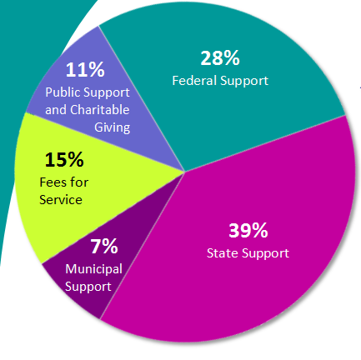
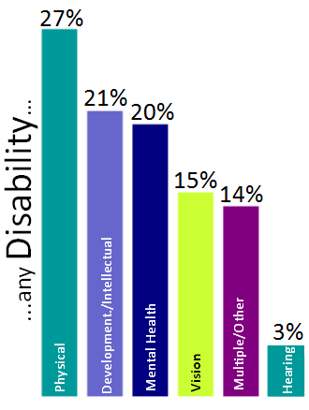
More About SAIL

Slide 6
Alaska Is BIG!

Slide 7
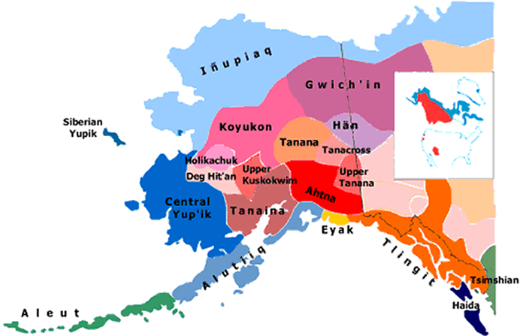
Tribal regions of ALaSKA

Slide 8
Native Am. IL Demonstration project (NAILD): IL-STAND
The SAIL Board of Directors, Executive Director, and staff identified a need to work with rural Alaska to better provide Independent Living (IL) services for Alaska Natives.
This long-held goal resulted in a grant proposal submitted to the Administration on Community Living. Three projects chosen in round one. SAIL received a 3-year award, to work with 6 communities: Angoon, Hoonah, Hydaburg, Kake, Klawock, and Yakutat. Two more recent round.

Slide 10
IL-STAND Program goals
Develop and implement culturally appropriate strategies;
Increasing capacity to deliver Independent Living services to Alaska Natives residing in southeast Alaska with disabilities; and
Disseminate lessons learned and best practices for replication.

Slide 11
Project Goals and Objectives
Increase understanding of service needs of Alaska Natives with disabilities. This can improve cultural competencies of SAIL staff and build capacity to deliver all 5 core services;
Advocacy.
Independent Living (IL) Skills,
Information/Referral.
Peer Support.
Transition.
In each target community and disseminate lessons learned and best practices.

Slide 12
Anticipated Outcomes
SAIL staff will demonstrate an increase in cultural competencies;
Alaska Natives with disabilities residing in six (6) target communities will self-identify an increase in:
Awareness of IL services;
Personal independence as a result of IL service delivery; and
Satisfaction with CIL services.

Slide 13
Products to be Developed
A sustainability plan to support the project in the future. Through dissemination of best practices and lessons learned, CILs outside of our service area will learn to better serve people with disabilities in Tribal villages and Reservations.
A formal paper capturing lessons learned and best practices will be developed. We plan to work w/ IRLU on dissemination.
Presentations at The National Council on Independent Living (NCIL); and Associated Programs for Rural Independent Living (APRIL) conferences.

Slide 14
Partnerships and Relationships!

Slide 15
Local Input
The project will require:
Local input and participation to examine barriers to Independent Living (IL) for Alaska Natives.
Review of partner organizations who provide services to them.
The development of a Comprehensive Needs Survey completed by community members, identifying IL barriers.
The creation of a Regional Advisory Committee to provide guidance on cultural protocols when working in rural communities.

Slide 16
Research Component
SAIL is working with the Alaska Native Elders Care (ANEC) for project research.
The questionnaire will identify awareness and gaps affecting IL .
The Research Advisory Council, and the 6 federally recognized Tribes will influence research questions, emphasizing IL conditions in each community.

Slide 17
Alaska Native Tribal Health Consortium (ANTHC) Role
For health related research projects, ANTHC is the organization who reviews/approves/disapproves proposals.
Their purpose and role for the IL-STAND project is:
Assist health researchers to obtain approval for research in Alaska Native communities.
Through our working partnership between SAIL and ANEC, we will submit our proposal via the Institutional Review Board (IRB).

Slide 18
Alaska Native Tribal Health Consortium (ANTHC) Role
This includes presenting the conceptual framework for Tribal review and approval of health research in Alaska tribal communities.
It is important to demonstrate the research review and approval process of health research in Alaska Native communities.
In the past, Native Americans and Alaska Natives were mistrustful of research protocols, based upon misinformation about project results given to participants and communities.

Slide 19
Partner Agency Collaboration
Through this project:
Increased IL services in rural SE Alaska.
Hired one Village IL Advocate per community.
37% of our consumers are Alaska Native.
Continual dialogue with our partners to increase IL services for Alaska Natives, including:
Supporting use of telemedicine in communities, via SEARHC.
Use of facilities with CCS/SESS and SEARHC.
Increasing work opportunities, through IL Advocates in six (6) target communities.

Slide 20
Local Partner Agencies
Catholic Community Services - Southeast Senior Services (CCS-SSS).
Central Council Tlingit and Haida Indian Tribes of Alaska (CCTHITA).
Tlingit and Haida Regional Housing Authority (THRHA).
Southeast Alaska Regional Health Consortium (SEARHC).

Slide 21
Challenges
Staff changes were a soft challenge; it was just a matter of adjusting to each program director’s way of doing business.
Program funding carry-over budget uncertainty. Submitting our requests took a long time to officially know if the budget modifications was approved.
Hiring very part-time staff in each community was tricky.

Slide 22
Challenges
Providing training via distance delivery.
Everyone has their own level of IT capabilities;
What is the best method to offer training from a distance?
What training tools are available?
What training tools need to be developed?
Trouble-shooting staff logistics from a distance.
Securing office space;
How to transport office furniture, supplies to remote villages;
Setting up the tools staff need on a daily basis (phone, internet);
Cost of travel in SE Alaska.

Slide 23
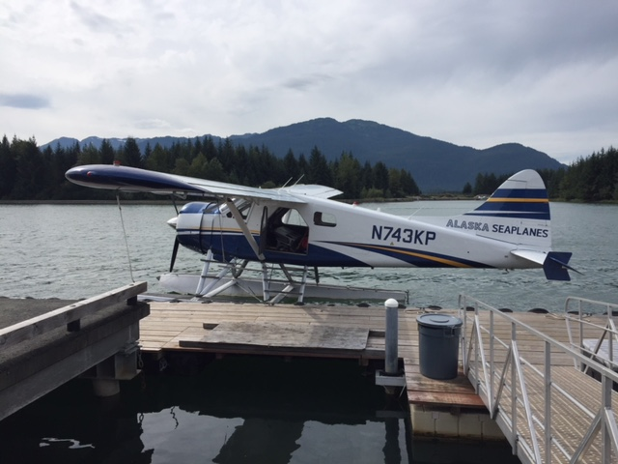

Slide 24
Lessons Learned
Through meaningful partnerships with Tribes, we’ve learned:
Hiring models can use multiple approaches.
Identifying community tribal needs is unique, in each village.
Launching community surveys can provide great opportunities to listen to consumer feedback.
Mandatory employee training on Native history, values, and culture is critical for all CIL staff.

Slide 25
Other Take aways Questions and Answers

Slide 26
GunalchÉesh (Thank you!)
Joan O’Keefe, Executive Director
jokeefe@sailinc.org
800-478-7245
907-523-4430
www.sailinc.org
Gail Dabaluz, Project Coordinator
gdabaluz@sailinc.org
800-478-7245
907-523-4432
www.sailinc.org

