Slide 1
Washington State Independent Living Council (WASILC) Coalition on Inclusive Emergency Planning (CIEP)
Notes:
The Coalition on Inclusive Emergency Planning (CIEP) and my position was created with in the Washington State Independent Living Council.
The Washington State Independent Living Council WASILC consists of a Fifteen person governor-appointed board, an Executive Director and an Executive Assistant.
WASILC’s Mission: “To serve and ensure People with disabilities in Washington State live independently and participate fully in their community.
The purpose of the WASILC is to promote Independent Living Philosophy. “IL” for people with disabilities in Washington State, and to collaborate with the Centers for Independent Living (CIL) to develop capacity and expand their services.

Slide 2
Efforts Toward Full Inclusion of People with Disabilities and Access and Functional Needs
Coalition on Inclusive Emergency Planning
CIEP
Notes:
Back in January of 2015 the Washington SILC and the Washington Centers for independent living received one time funding from the DOH to hold three emergency planning workshops for people with disabilities and others with access and functional needs.
Disability organizations ,Emergency Managers, Tribal VR and Human services Gathered for 3 Inclusive Emergency Planning Workshops. The workshops were held in different geographic areas in the state so that the whole state could participate.
The project concluded with a Ground Breaking State Wide Conference in Yakima. At the end of June 2015.
Which was the first of its kind.
It takes leadership, thought, time and community partnerships for emergency plans to encompass the whole community. When people with disabilities are included in all phases of the disaster cycle and advise to emergency management, they can provide a wealth of information, knowledge and resources. Across the nation more states are developing Disability Advisory Groups which can be utilized to provide cross disability perspectives to offer a holistic approach for local/state emergency management to reach successful disability integration and whole community planning.
We had three national experts presenting.
Marci Roth from FEMA Office of Disability Integration, Susan Dooha from The center for independence of the disabled in NEW York ,JUNE Kales , who is a National Disability Policy Consultant.
We gathered to discuss , educate and learn from each other on how to integrate Inclusive Emergency Planning in Emergency Management.
At the end of the Conference we discussed our next steps, the next steps were to create the Coalition on Inclusive Emergency Planning.
.

Slide 3
Disability Advisory Groups
State Disability Advisory Group
Capacity Building
Local Disability Advisory Group
Notes:
It takes leadership, thought, time and community partnerships for emergency plans to encompass the whole community. When people with disabilities are included in all phases of the disaster cycle and are able to advise emergency management, they can provide a wealth of information, knowledge and resources. Across the nation more states are developing Disability Advisory Groups which can be utilized to provide cross disability perspectives to offer a holistic approach for local/state emergency management to reach successful disability integration and whole community planning
Disability Advisory Groups : A model practice for state and local emergency management stakeholders for building disability accessibility and inclusion into all aspects of emergency management. This model fosters communication and working relationships among emergency managers and state and local disability service, support and advocacy staff who are disability subject matter experts and are local people who can advise emergency managers during steady state and disaster response and in recovery, to include people with disabilities and others with access and functional needs in: planning (emergency operations plans, exercises) processes; response (accessible emergency evacuation, sheltering and emergency messaging/communication); recovery (long-term recovery group leadership, membership and local citizen involvement; mitigation (infrastructure requirements for providing equal access to people with disabilities); and protection. Most Disability Advisory group members come with expert advice for inclusive practices and technical training in all aspects of the Americans with Disabilities Act for physical access, programmatic access and effective communication access. The concept is ICS (Incident Command Structure) compliant (it simply adds the inclusion of people with disabilities).

Slide 4
Washington Disability Partners
Washington Centers for Independent Living
Washington State Assistive Tech – Reuse programs
Washington State Services for the Blind
Washington Office of the Deaf and Hard of Hearing
Disability Rights Washington
Washington Vocational Rehabilitation
Northwest ADA Center
NAMI Washington ( National Alliance for Mental Illness)
Area Agencies on Aging
Community Transportation Association of the Northwest

Slide 5
Local Disability Advisory Group
Adjunct disabilities advisors to local Emergency Management officials
Comprised of disabilities entities
Consumers
Local Protection and Advocacy
Local Independent Living Center
Local Vocational Rehabilitation
Local Disability Service Providers

Slide 6
Steady State
Ongoing training and technical assistance to emergency response agencies through Disability Advisory Groups presence
Ongoing disaster planning for notification, transportation and sheltering
Promotes partnerships

Slide 7
Disabilities Core Advisory Groups in Disaster
Stand up the CIEP
Two-way communication flow
CIEP - Subject Matter experts

Slide 8
Disability Access

Slide 9
When Speaking to Emergency Managers
THREE PILLARS OF ACCESSABILITY
PHYSICAL
PROGRAMATIC
EFFECTIVE COMMUNICATION

Slide 10
Physical Accessibility Shelters, Temporary Housing , Distribution Locations, Transportation, Community Meetings, Resource Centers
Notes:
Access to the buildings and areas where services are provided
Parking
Entry and egress
Path of travel to and through the building
Access to facilities and areas where services are provided

Slide 11
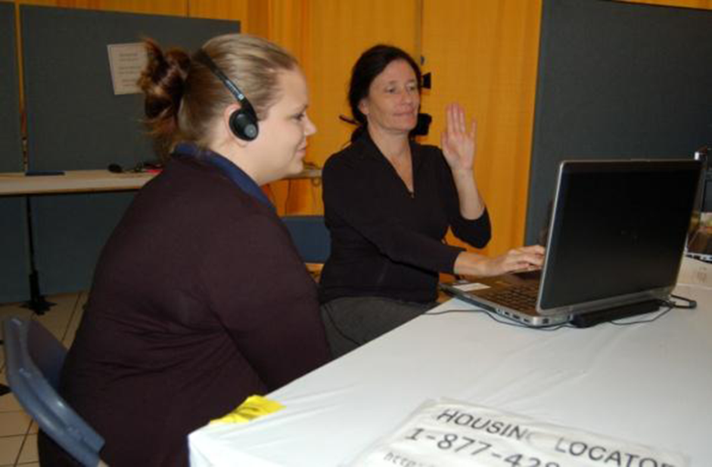
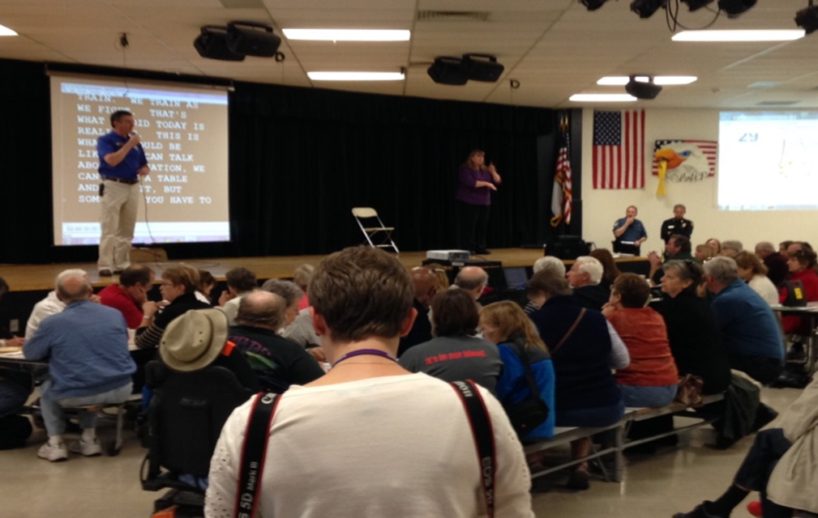
Effective Communication
Computer Aided Real
Time Transcription (CART)
Video Remote Interpreting
Closed/Opened Captioning
Sign Language Interpreters
Notes:
Access to Effective Communication – People with disabilities must be given the same information provided to the general population using methods that are understandable and timely.
Providing access to the same information others are receiving, at the same time.

Slide 12
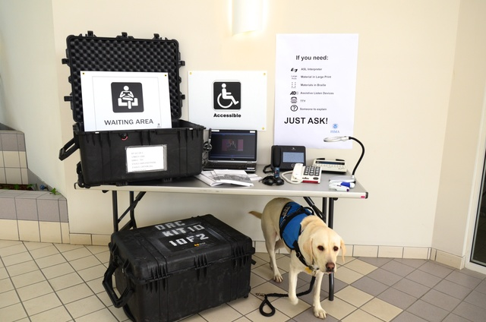
Notes:
Access to Effective Communication – People with disabilities must be given the same information provided to the general population using methods that are understandable and timely.
Providing access to the same information others are receiving, at the same time.

Slide 14
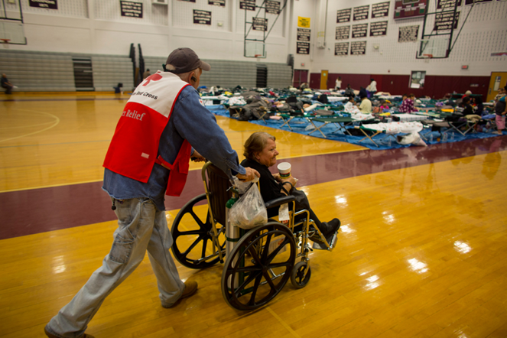
Programmatic Access Reasonable modifications to policies and practices
Awareness of and methods for selecting and purchasing accessible equipment
Staff training and knowledge
System-wide coordination and flexibility to enable access; disability cultural competence
Notes:
A public entity's services, programs, or activities, when viewed in their entirety, must be readily accessible to and usable by individuals with disabilities.
Reasonable Accommodations
Providing assistance to an applicant in filling out required paperwork
Providing materials in alternate formats
Providing sign language interpreters and assistive listening devices
Reasonable Modifications to Programs, Policies and Procedures
Allowing service animals in a “no pets” facility
Providing snacks for people with diabetes or other dietary needs
What is your service animal policy
What if someone needs assistance with completing/understanding eligibility forms
How shelters operate
How programs ae delivered
What is your service animal policy
What if someone needs assistance with completing/understanding eligibility forms
How shelters operate
How programs ae delivered
The Red Cross has conducted trainings for its employees and volunteers on helping people with disabilities maintain their independence while in a shelter. “We have health services personnel who have RN licenses and can assist individuals with their care,” she says.
What is your service animal policy
What if someone needs assistance with completing/understanding eligibility forms
How shelters operate
How programs ae delivered
What is your service animal policy
What if someone needs assistance with completing/understanding eligibility forms
How shelters operate
How programs ae delivered
The Red Cross has conducted trainings for its employees and volunteers on helping people with disabilities maintain their independence while in a shelter. “We have health services personnel who have RN licenses and can assist individuals with their care,” she says.

Slide 15
Planning with Disability Partners
(Inclusion)
Conversations with Emergency Management

Slide 16
Planning for and not with people with disabilities reflects an old paradigm “a lot about us without us.”

Slide 17
Why Inclusion of People with Disabilities
Knowledge of services, resources and supports (difference between service and advocacy)
Can provide disability, access, functional needs and universal design perspectives.
Qualified advisors who understand and can think through issues from disability, access, functional needs and universal design perspectives.
Notes:
When we are starting our conversations with EM- Its important to talk about how we can assist. Often times EM have limited capacity and they see a disability advisory group as more on their plate, but if we start our communications with we want to assist you and not make your job harder it can be a helpful way to start that conversation.
It is important to include people with disabilities as contributors and collaborators
Understanding the difference between service and advocacy disability agencies
It is important to include people with disabilities as contributors and collaborators, not just as people viewed as patients or victims to be rescued.
Qualified advisors who understand and can think through issues from disability, access, functional needs and universal design perspectives.
Are connected to and actively involved with segments of national, state or local constituencies of disability communities
Able to facilitate two-way communication with the segments of the disability communities they represent.
Identify as a person with a disability & experience with disability advocacy
Are knowledgeable about a variety of physical, communication and program access issues

Slide 18
Identify community-wide approaches that involve local and state disability agencies/organization.
Build relationships with disability community members to identify accessibility concerns, gain community perspective and improve outcomes and challenges within communities
Inclusive plans that address accessibility
Involve disability partners in exercise

Slide 19
The Message…
Focus on what we know about accessibility, what resources we can bring to the table and what resources we can identify for community planning, response and recovery

Slide 20
Kim Conner
Executive Director
Washington State Independent Living Council (WASILC)
360.725.3695 office
360.819.0672 cell
connekb@dshs.wa.gov
www.WASILC.org
Alex Hatcher
Disability Integration Manager- CIEP
Washington State Independent Living Council (WASILC)
(360)725-3692- Office
(360)810-1087- Cell
hatcham@dshs.wa.gov

