Slide 1
Why do Systems Advocacy
Ian Engle
Joan LaBelle

Slide 2
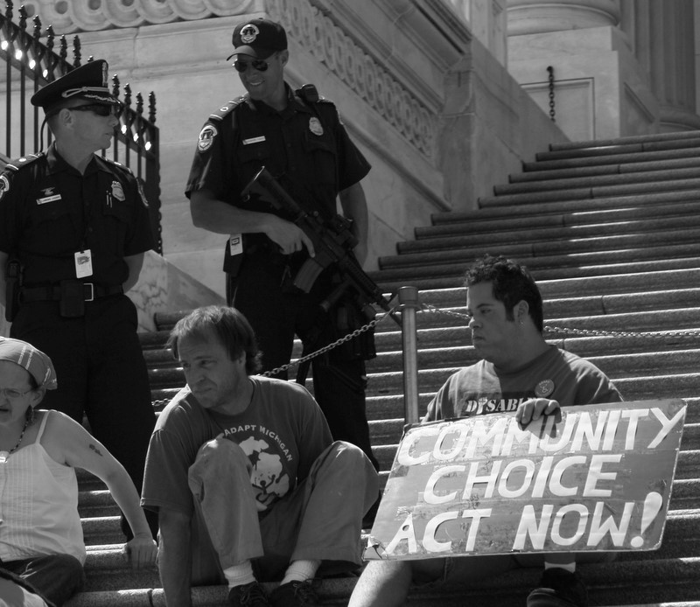
Community Choice Act Action
A black and white photo on stairs of the U.S. Capitol. Two police officers are on the steps up from the protesters, laughing at them. Ian is in the center of three people with disabilities. One to the left of him is holding a handwritten sign that says “Community Choice Act Now”. Ian is out of his wheelchair, halfway up the stairs. He is looking to his right.

Slide 3
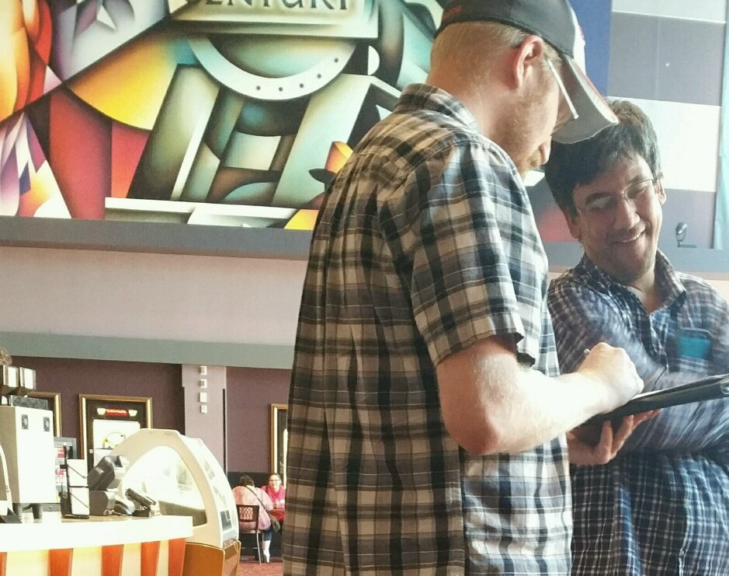
CHEC Assessment
At the Century movie theatre Mike is hold a checklist writing on the form while Aaron smiles watching Mike write.

Slide 4
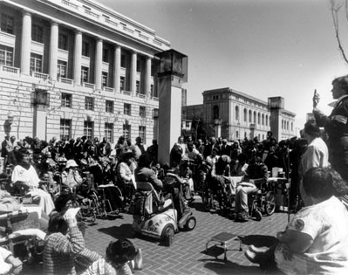
504 Sit-In
Another shot of the 504 sit in outside the building. Too many people with disabilities to count. It is in black and white.

Slide 5
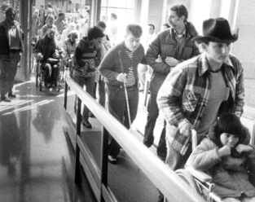
504 Sit-in
A group of people with disabilities are entering the building to Califano’s office. It is a black and white photo

Slide 6
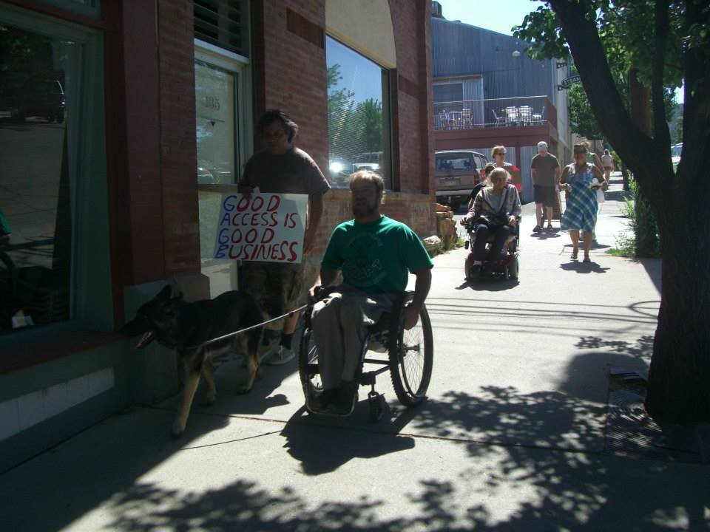
Creating Community Access
Ian and Zuma on a sidewalk in a downtown rural city. Beside Ian someone is walking holding a handwritten sign that says “GOOD ACCESS IS GOOD BUSINESS”

Slide 7
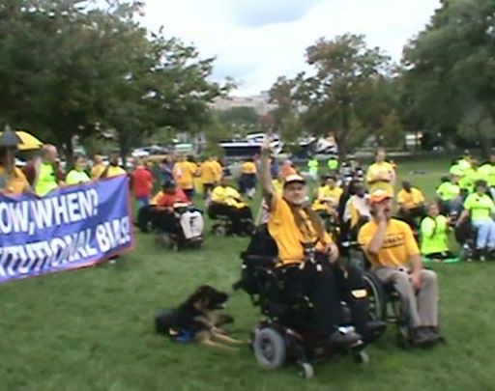
My Medicaid Matters
On a green grassy lawn in a park with trees are a crowd of individuals with disabilities. Ian (who has a hand cupped to his mouth and appears to be shouting, imagine that) and a person using a power chair (whose arm in raised in protest) are in front and Aslan is laying on the grass behind them. People are in various shades of yellow t-shirts. Several have a blue banner with white words on it that they are holding waist high.

Slide 8
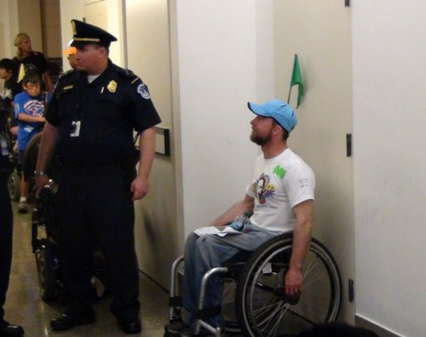
Negotiations
Ian is sitting looking up at a police officer who is looking in the other direction. This is at a rally at Paul Ryans’ office during the Medicaid Block Grant negotiations.

