Slide 1
Examples of Systems Advocacy

Slide 2
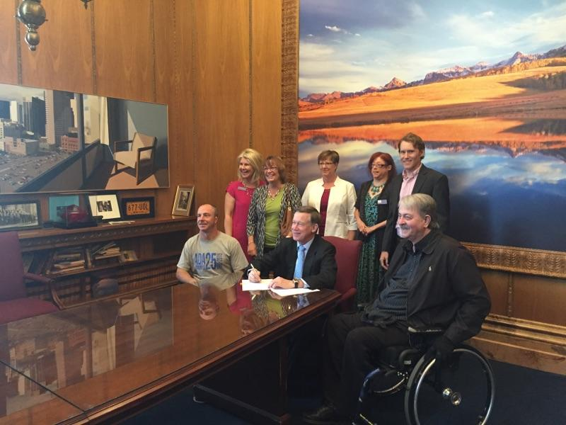
Bill signing
Ian and Larry, another wheelchair user, flank the Governor of Colorado as he is about to sign a bill that moved our Designated State Entity. Behind are five of us. The governor is sitting at the head of a long, shiny wood table.

Slide 3
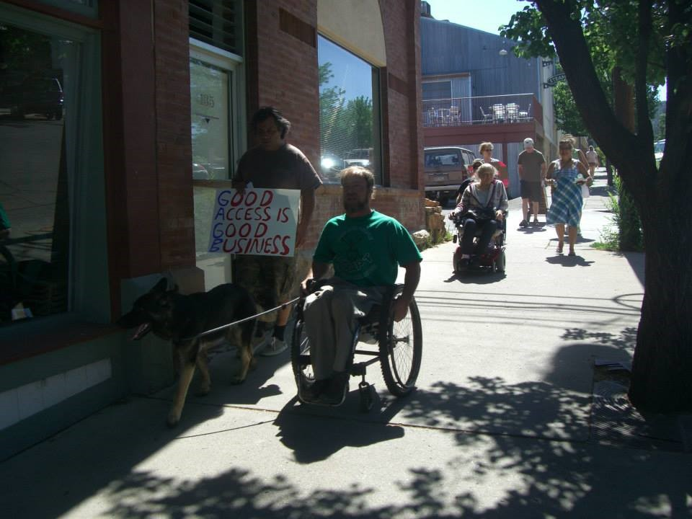
Creating Community Access
Ian and Zuma on a sidewalk in a downtown rural city. Beside Ian someone is walking holding a handwritten sign that says “GOOD ACCESS IS GOOD BUSINESS”

Slide 4
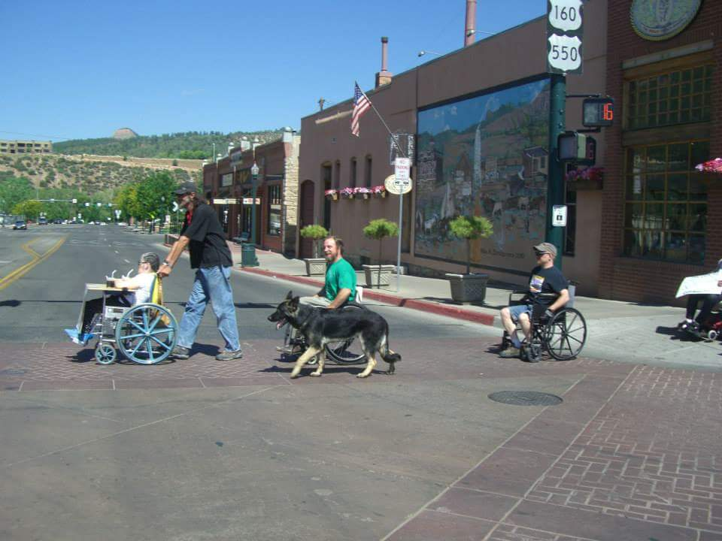
Creating Community Access
Three individuals in wheelchairs in a row crossing a rural downtown street. Ian is in the center with Zuma. In front of him someone is pushing someone in a wheelchair

Slide 5
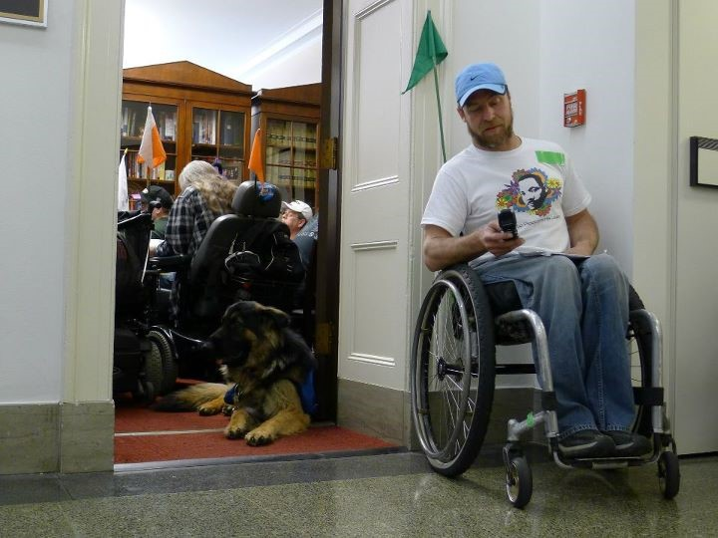
Sit-Ins
Ian is using a flip phone (dating Ian) outside in a hall on the other side of Paul Ryan’s office. In the open doorway laying down is Aslan. Several people with disabilities are in the office blocking the way.

Slide 6
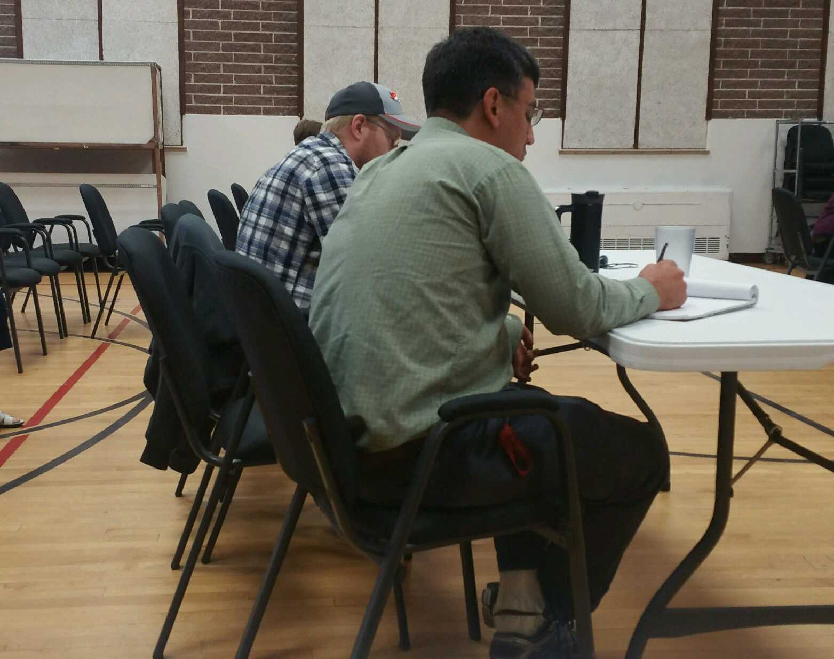
Fun at SILC
Ian and Mike are at a table while the SILC meets out of sight in front of them. Aaron has a tablet of paper, but he is probably doodling…

Slide 7
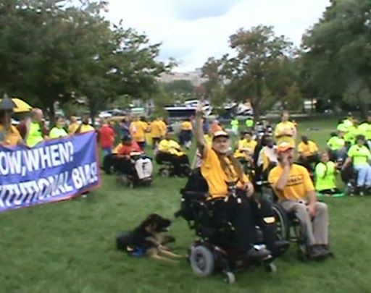
Rallies
On a green grassy lawn in a park with trees are a crowd of individuals with disabilities. Ian (who has a hand cupped to his mouth and appears to be shouting, imagine that) and a person using a power chair (whose arm in raised in protest) are in front and Aslan is laying on the grass behind them. People are in various shades of yellow t-shirts. Several have a blue banner with white words on it that they are holding waist high.

Slide 8
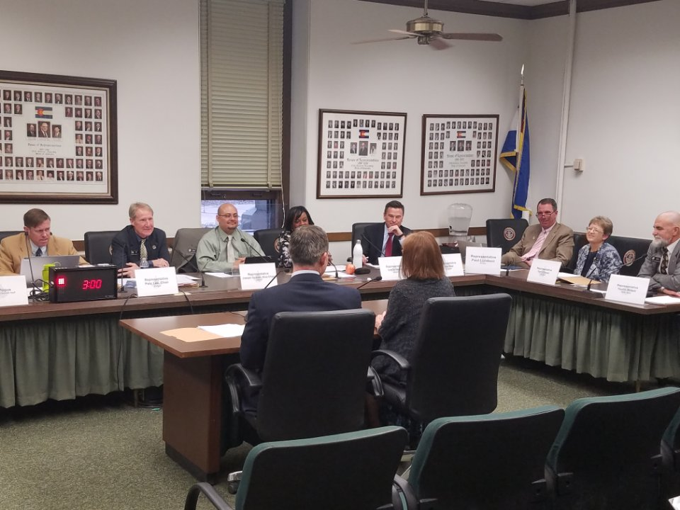
Testifying on bill
A desk with myself and a senator facing the “L” portion of the committee hearing the testimony. There are five people in front of me and three to the side.

Slide 9
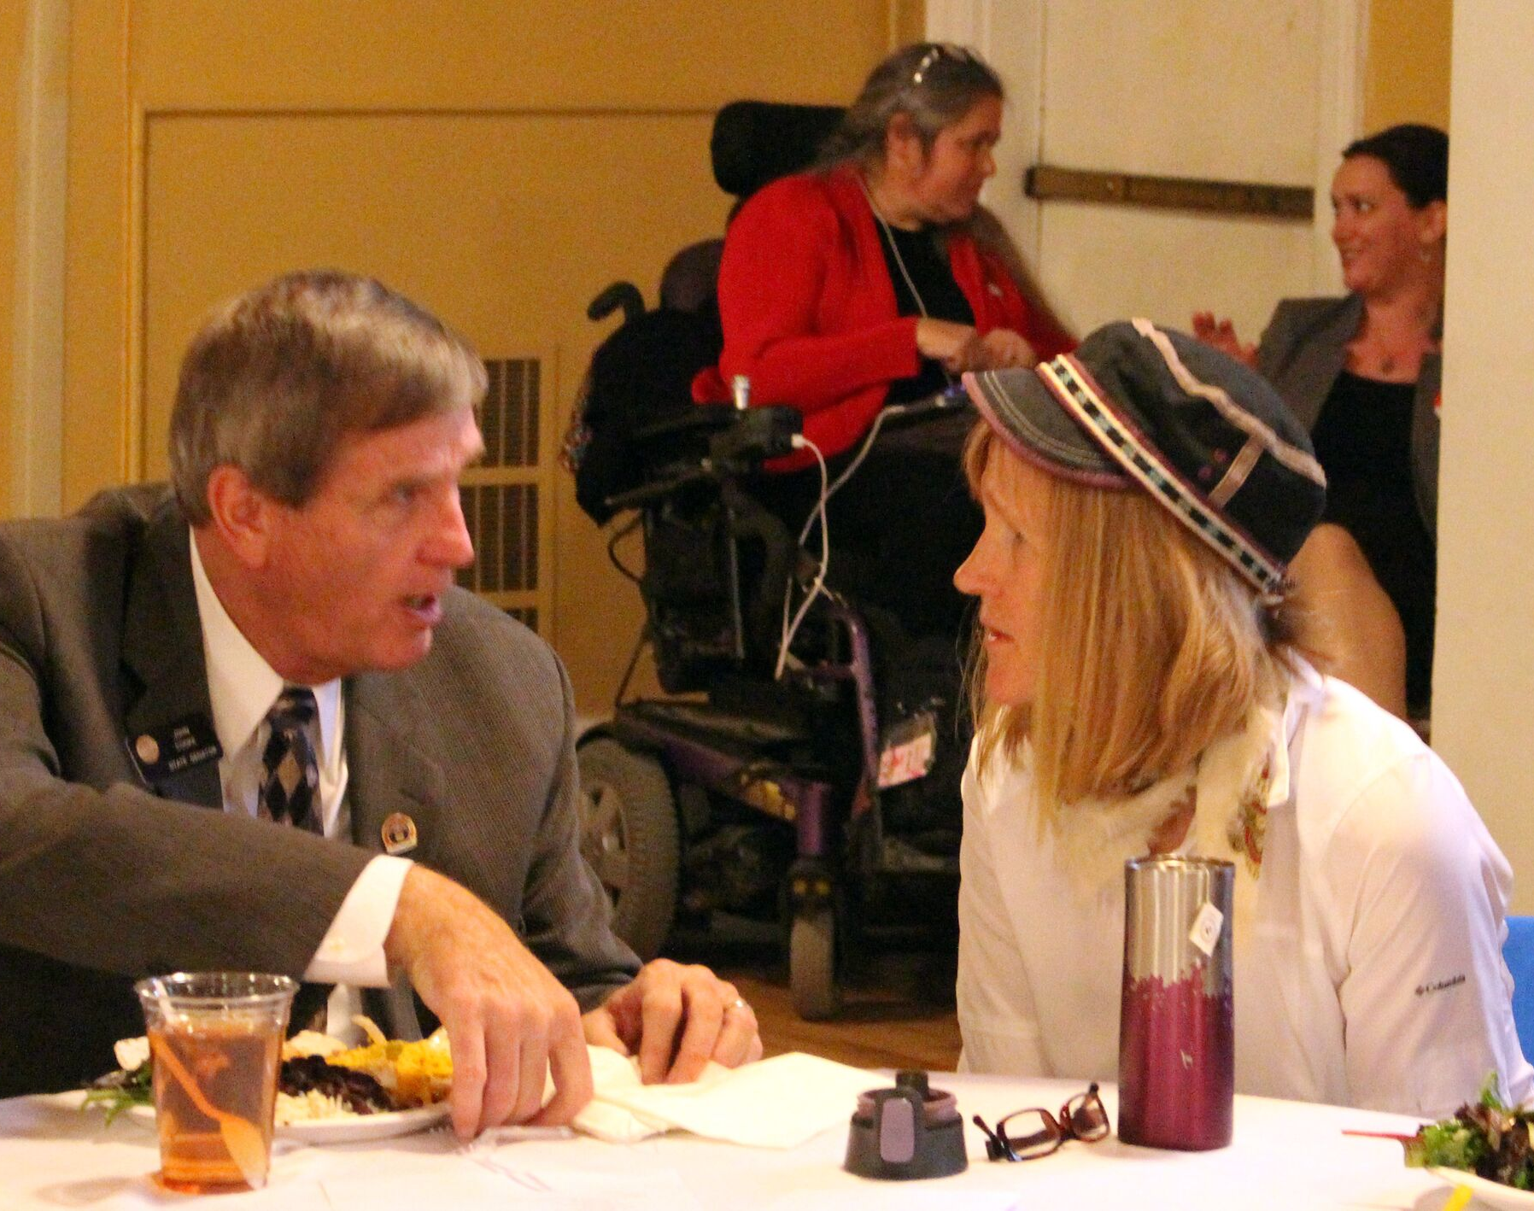
Legislative Receptions
A senator and a CIL staff person talking at a table. In background is a person in a wheelchair and a colleague talking.

Slide 10
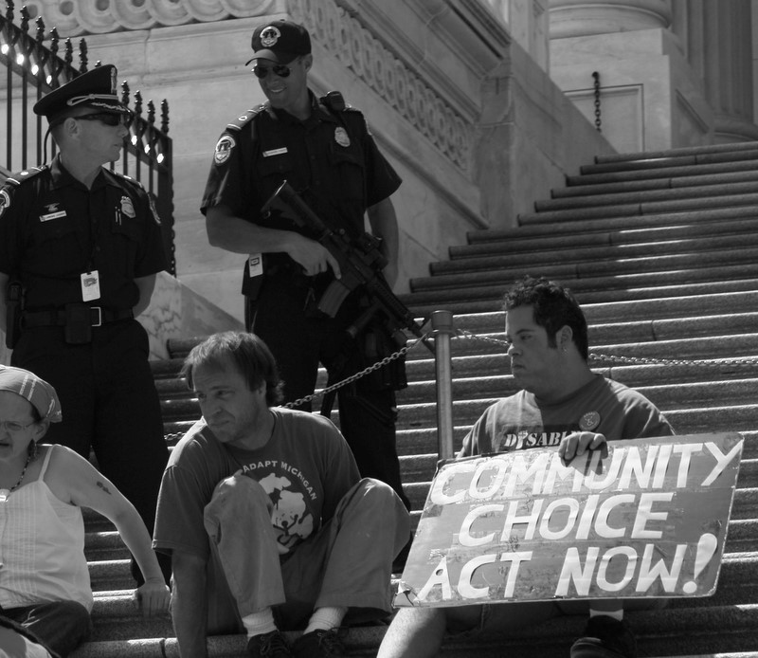
Civil Disobedience
A black and white photo on stairs of the capitol. Two police officers are a few steps up from the protesters, laughing at them. Ian is in the center of three people with disabilities. One to the left of him is holding a handwritten sign that says “Community Choice Act Now”. Ian is out of his wheelchair, arms on the stairs about to crawl up the stairs. He is looking to his right.

