Slide 1

Department of Commerce
Disability Workgroup
Peter Tassoni, Workgroup Manager
Chris Gagnon, Program Manager
Michelle Bradley, Administrative Assistant
Notes:
Small workgroup
Almost a year old
ABLE, DDETF, DD Ombuds

Slide 2

WA Disability Statistics
  Disability in WA (2015)
  Individuals with a Disability
  908,818
  All Individuals
  7,066,812
  Percent with a Disability
  12.9%
Notes:
Let us set the context for Washington State’s disability rates – an eighth of the population and nearing a million folks
Not all these individuals are eligible for ABLE
Individuals with disabilities are growing faster proportionally to the overall population of Washingtonians
Cognitive, Hearing and Vision disabilities before age 26 are most likely eligible; probably most of Ambulatory; however SSA defines disability as permanent condition and unable to work

Slide 3
WA Disability Statistics
Clients of the DDA by Age Groups, Gender and Caseload Types
Prepared by: Developmental Disabilities Administration, Data Source: CARE System on 7/1/2017
Notes:
Most of these folks will qualify for ABLE – half have not entered their working years (21-61)

Slide 4
The ABLE Act is Law
ABLE = Achieving a Better Life Experience
Federal Law:
The Stephen Beck, Jr. Achieving a Better Life Experience (ABLE) Act - December 19, 2014
Washington State Law:
ESHB 2323: Representative Christine Kilduff -
June 9, 2016
Notes:
Trend #1: Folks with disabilities are twice as likely to live in poverty
Trend #2: More folks are going to be classified as disabled throughout their lives
Trend #3: Folks with disabilities like the general population are living longer lives
Therefore, ABLE can help provide for a better quality of life by allowing individuals to save money / resources beyond the $2000 SSI limit

Slide 5
Washington State’s ABLE
Partnership:
Oregon ABLE + BNY Mellon
Governing Board:
Amy Patterson
Carole McRae
Jeffrey Manson, Chair
Nathan Loose
Betty Lochner, WA Student Achievement Council, GET Program
Brad Hendrickson, Office of the State Treasurer
Gwen Stamey, Office of Financial Management
Notes:
Oregon offered their services
Really good staff
Good fees
Easy to work with, logistics, etc.
-Maryland
-New Mexico

Slide 6
Why ABLE?
Currently there is a $2,000 limit to the amount an individual with a disability can save before losing vital benefits such as Medicaid and Social Security benefits
ABLE funds are meant to supplement, not supplant, benefits
Enable Saving Without Losing Benefits
Notes:
People very excited about the program

Slide 7
What is ABLE?
Savings Accounts
Preferred federal and state tax treatment
Contributions to the account will be made using post-taxed dollars and will not be tax deductible
Enable Saving Without Losing Benefits
Eligible individuals & families can save for disability related expenses
Over 27 states have launched ABLE programs - ABLE National Resource Center - www.ablenrc.org

Slide 8
Who is Eligible?
Requirement 1: Age of Onset
Those with an onset of disability before age 26
and
Requirement 2: Severity of Disability
2a. Meet disability requirements for SSI or SSDI
  or
2b. Have a “disability certification” signed by a physician
      Keep on file (does not need to be submitted)
Notes:
Onset prior to age 26
Receive SSI and/or SSDI –or-
Doctor note states you qualify
Military – TBI – PTSD – Physical – Mental – Developmental
Note: Moratorium for loss of eligibility for ABLE:
ABLE account continues, individual continues as designated beneficiary
No contributions allowed that next taxable year.
Distributions not considered qualified disability expenses.
If regain eligibility, moratorium lifted.

Slide 9
ABLE Account Owner
Individual with disability is the account owner
    Authorized Legal Representatives
      Parent
      Legal Guardian/Conservator
      Power of Attorney
          Sibling
          Spouse
          Representative Payee
Notes:
Eligible individual / designated beneficiary / account owner:
One account
Another person may be allowed signature authority over the account
Anyone can contribute to an ABLE account
Soon there will be gifting program

Slide 10
Account Limitations
One account per individual with disability
$14,000 limit on annual contributions
$86,000 limit over time (will increase in 2018)
$100,000 limit before SSI cash benefits are suspended
Notes:
ABLE is federal tax code 529A
College savings plans are federal tax code 529
ABLE ceiling in each state mirrors College savings plan in that state
WA currently ceiling $86K
Checking into whether $86K includes investment earnings
However WA State working on the Traditional College Savings Plan
New ceiling in $400K range
IRS Proposed ABLE Rules 2015 – page 17 Finally, a qualified ABLE program must provide adequate safeguards to ensure that total contributions to an ABLE account (including the proceeds from a preexisting ABLE account) do not exceed that State’s limit for aggregate contributions under its qualified tuition program. Assumed Aggregate means contributions and earnings.
IRS Proposed ABLE Rules 2015 – page 28 the program prohibits any additional contributions to an account as soon as the account balance reaches the specified contribution limit under such State’s program established under section 529. Once the account balance falls below the prescribed limit, contributions may resume, subject to the same limitation. Assumed via withdrawals or market losses.

Slide 11
Qualified Expenses
Expenses which help improve health, independence, and/or quality of life:
    Education
    Housing ***
    Basic Living Expenses
    Transportation
    Employment Training & Support
    Assistive Technology
    Personal Support Services
    Health, Prevention & Wellness
    Financial Management
    Legal Fees
    Funeral & Burial
Make it Explainable & Defendable
Keep Receipts & Good Records
Notes:
If ABLE $ is held aside for a future order, must be able to document that
If ABLE $ is set aside to pay rent, use it that same month
Buying a car or home may be reasonable, need to explain quality life
Don’t buy a car for your neighbor
IRS Proposed ABLE Rules 2015 – page 24 conclude that the term “qualified disability expenses” should be broadly construed to permit the inclusion of basic living expenses and should not be limited to expenses for items for which there is a medical necessity or which provide no benefits to others in addition to the benefit to the eligible individual. For example, expenses for common items such as smart phones could be considered qualified disability expenses if they are an effective and safe communication or navigation aid for a child with autism.
Therefore, buying friends coffee at Starbucks could be okay. Certainly buying their own is okay if its justified as a quality of life expense.

Slide 12
***Housing Expenses
Should be spent within the same month as withdrawn from ABLE account (otherwise those funds could affect your SSI benefits for next month)
Mortgage (including property insurance required by mortgage holder)
Real property taxes
Rent
Heating fuel
Gas
Electricity
Water
Sewer
Garbage removal

Slide 13
Tax Advantages
Federal
Growth is tax free as long as it is used for a qualified expense
State
No state income tax
Income earned / assets (principal) in ABLE account are not taxed
Notes:
Investment earnings grow tax-deferred
Qualified disability expense distributions come out federally tax-free

Slide 14
Medicaid Implications
Benefits
Medicaid (Apple Health) benefits are NOT suspended if an ABLE account balance exceeds $100,000*
Payback
Funds remaining in the ABLE account when a beneficiary passes may be subject to Medicaid Recovery.
Medicaid Recovery may recoup Medicaid-related expenses from the time the account was open.
*Washington has several waivers to standard Medicaid plan that funds additional services. Should be addressed in HCA or DDA future rule making.
Notes:
WA starting process to waive Medicaid recovery (OFR would do)
In the event of the death of a beneficiary, the funds from their ABLE account can be used by his or her estate to repay any outstanding eligible expenses or funeral and burial costs. Remaining funds will be transferred to the estate of the beneficiary.
Due to the passage of Senate Bill 1027 during the 2017 legislative session, Medicaid in Oregon cannot file a claim for a payback on funds that were previously in an ABLE account of a deceased beneficiary.
IRS Proposed ABLE Rules 2015 – page 29 any State may file a claim for the amount of the total medical assistance paid for the designated beneficiary under the State’s Medicaid plan after the establishment of the ABLE account.

Slide 15
Death of an Account Owner
Family provides death certificate
Qualified withdrawals can be used to pay:
    Outstanding Qualified Disability Expenses
    Cover funeral and burial expenses
Remaining funds are transferred to individual’s estate
Medicaid may try to reclaim some of the funds
Notes:
IRS Proposed ABLE Rules 2015 – page 28 Neither gift nor GST taxes apply to the change of designated beneficiary of an ABLE account, as long as the new designated beneficiary is an eligible individual who is a sibling of the former designated beneficiary. Change must be executed before the death of the former designated beneficiary. Includes step and half siblings by blood or adoption.

Slide 16

Online portal
launches in 2017!

Slide 17
Online Portal
Open an account - $25 minimum deposit
Save money in cash option and/or investment option
Choose an investment option
    Put minimum of 10% into investment option
Cash option
For “savers” rather than “investors”
Savings accounts are FDIC-insured

Slide 18
Online Portal
    Contributions
    Anybody may contribute to an ABLE account
    Online (or paper) – bank account to ABLE
    Gifting platform for contributions
    Withdrawals
    Online (or paper) –ABLE account pulls from bank
    Prepaid card ($15,000 load limit)
    $10 minimum for each transaction
    Purchase / withdrawal / contribution
    Prepaid card purchases are automatically tracked
Notes:
Minimum of $10 for each contribution or withdrawal
Contributions and withdrawals are proportionally added or taken per the savings / investment ratio you determined

Slide 19

ABLE Investment Options
Conservative | Moderate | Aggressive
ABLE Conservative seeks to provide current income and some growth by investing in a ABLE Conservative seeks to provide current income and some growth by investing in a portfolio of mutual funds that consists of 20% global public stocks and 80% bonds. Overall, there’s a small amount of risk and limited appreciation potential, designed for a shorter investment period. | ABLE Moderate seeks to provide a combination of growth and current income by investing in a portfolio of mutual funds that consists of 50% global public stocks and 50% bonds. Overall, there’s a medium level of risk for a pursuit of investment return, designed for a medium or uncertain time horizon. | ABLE Aggressive provides the potential to grow by investing in a portfolio of mutual funds that consists of 84% global public stocks and 16% bonds. Overall, there’s a higher level or risk and potential for return (or loss), designed for a longer investment period (10 years or more).
Stocks Bonds
Stocks Bonds
Stocks Bonds
Notes:
3 Investment Options – Conservative, Moderate and Aggressive
Or can use savings program only

Slide 20
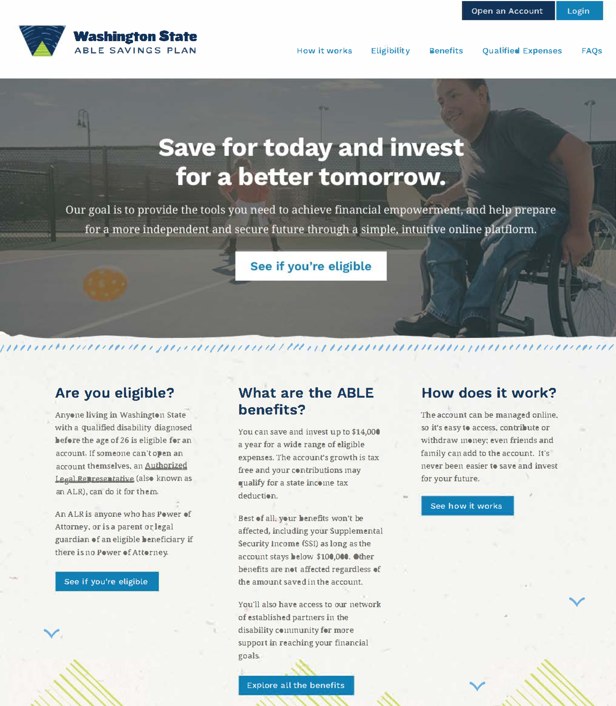
www.washingtonstateable.com
Notes:
Screen shot of what WA ABLE will look like

Slide 21
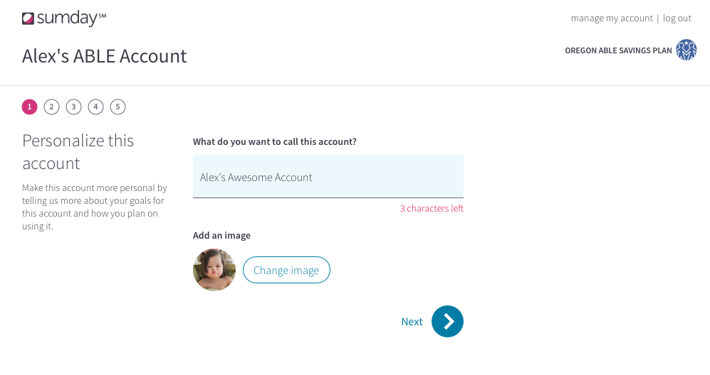
Notes:
People can personalize their ABLE account page

Slide 22
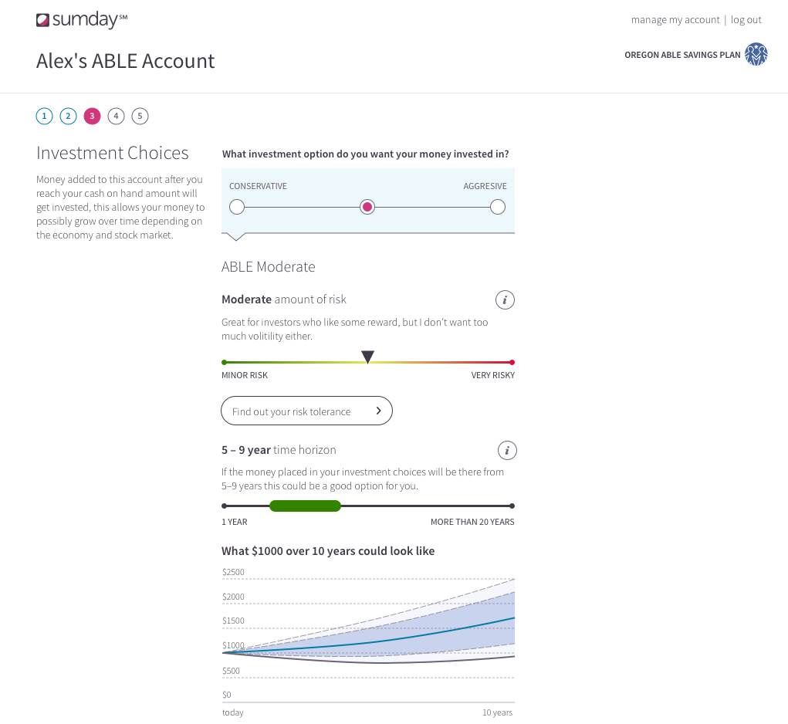
Notes:
Page shows how you can estimate investment earnings based on the options you choose

Slide 23
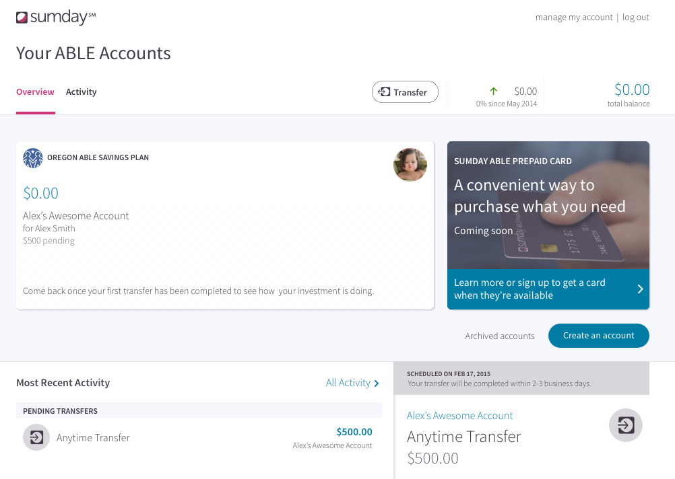
Notes:
Online reports you can download

Slide 24
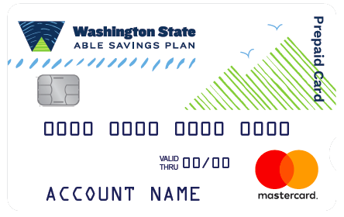
Prepaid Card
Activate online
    Sumday.com/Washington-able/activate
Set your card PIN
    Set a 4 digit PIN to help protect your card
    Transfer money to card
    Enjoy your prepaid card
Notes:
Monthly fee $1.25; maximum $15K on card; cannot use for cash
Acts like a debit card to pay for goods and services in US
No transaction fees
Records of purchases on Sumday site to help with record-keeping
Should save receipts for purchases
Cannot use card for:
Security brokers/dealers
Dating/escort services
Massage parlors
Betting/casino gambling
Non-FI, money orders
Wires, money orders
Government owned lotteries
Government licensed online casinos (online gambling)
Government licensed horse/dog racing

Slide 25

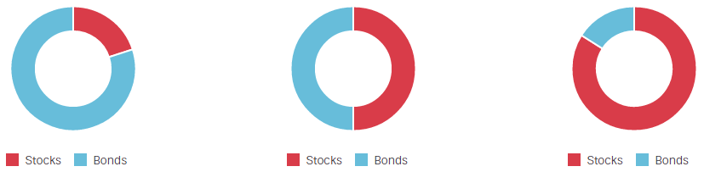
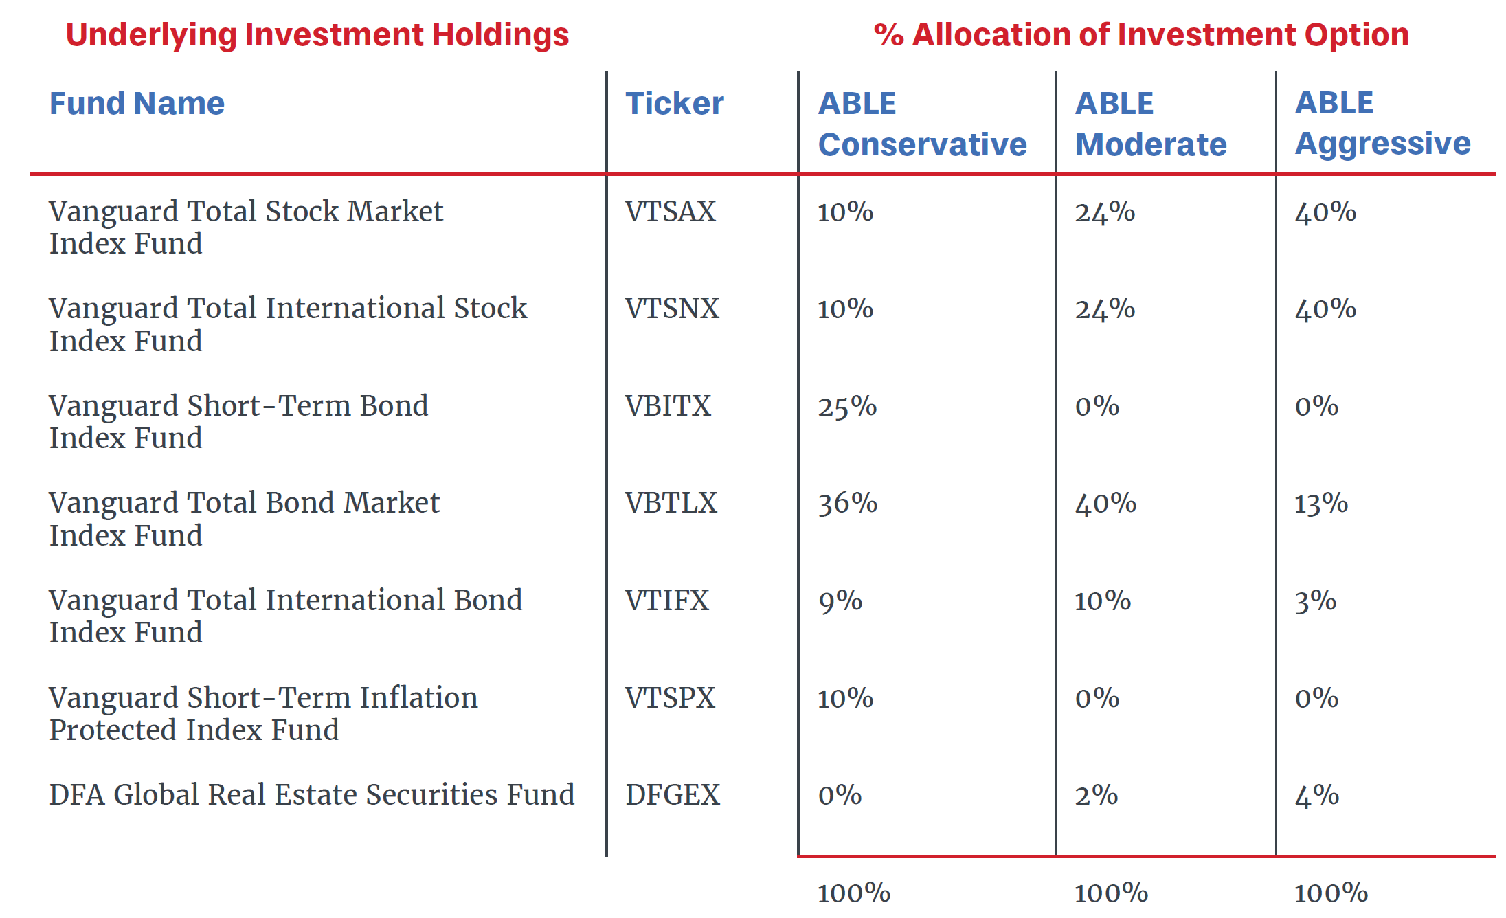
Cash Option
Conservative
Moderate
Aggressive
Notes:
FDIC insured up to $250K; if bank goes bankrupt, federal government steps in
Similar Funds but in Different Ratios between Conservative, Moderate, and Aggressive

Slide 26
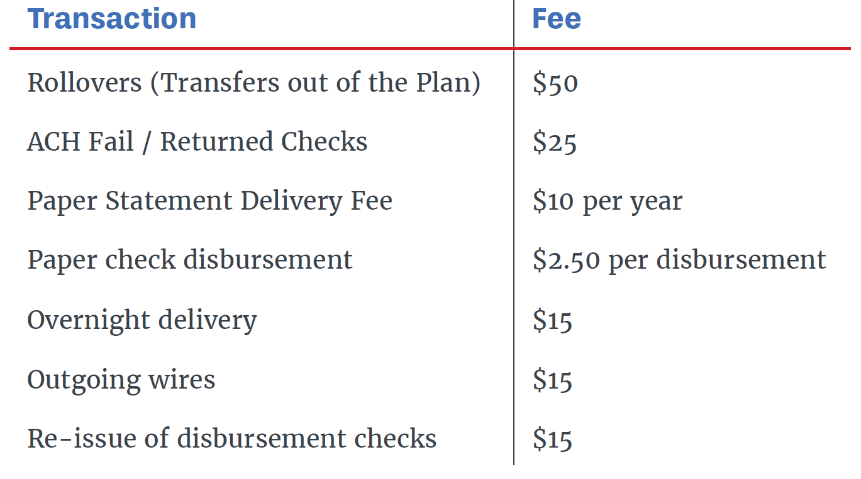
Fees
$35 Annual mgmt fee – Waived for 1st year!
0.30 – 0.38% fee based on investments
Notes:
No rollover fee if transferring from ABLEforAll.com to WA ABLE

Slide 27
Medicaid Payback Limits
States cannot collect Medicaid costs incurred before the date the ABLE account opened from the ABLE account
WA DSHS Office of Financial Recovery must file a claim against the estate
Other states can recover from WA ABLE account for Medicaid expenditures in that other state for the beneficiaries if they file a claim
Notes:
https://www.hca.wa.gov/free-or-low-cost-health-care/program-administration/estate-recovery
WAC 182-527-2740 Estate recovery - Age-related limitations
Liability for Medicaid services.
Beginning July 1, 1994, a client's estate is liable for Medicaid services subject to recovery that were provided on or after the client's fifty-fifth birthday.
Liability for state-only-funded long-term care services.
A client's estate is liable for all state-only-funded long-term care services provided by the home and community services division of the department of social and health services (DSHS) on or after July 1, 1995.
A client's estate is liable for all state-only-funded long-term care services provided by the developmental disabilities administration of DSHS on or after June 1, 2004.
WAC 182-527-2742 Estate recovery-Service-related limitations
The State of Washington's Estate Recovery Program was enacted July 26, 1987. In 1993, federal law mandated that all states enact Estate Recovery programs. State and federal law mandate the State of Washington's estate recovery program. Recovery of the cost of services and the age when recovery applies has changed several times since the program was enacted. The department recovers from estates according to the estate recovery law in effect at the time the services were received.
DSHS will file a lien or make a claim against property that is included in the deceased individual's estate. Prior to filing a lien against real or titled property, the department gives notice and an opportunity for a hearing to the probate estate's personal representative, if any, or any other person known to have title to the affected property. Liens placed through the Estate Recovery process are valid for 20 years.
The Office of Financial Recovery (OFR) administers Estate Recovery collections for the Department of Social and Health Services (DSHS). OFR collects approximately $17 million per year to offset payments made by the State for medical services.

Slide 28
Apple Health
Health Care Authority - Eligibility WAC
Rulemaking is complete. ABLE exempt.
NEW SECTION
WAC 182-560-100 Achieving a Better Life Experience (ABLE) Act.
This rule describes a qualified achieving a better life experience (ABLE) account and its effect on the determination of eligibility for Washington Apple Health coverage.

Slide 29
SNAP, TANF, etc.
DSHS - Revisions WAC
Proposed rule filed. ABLE exempt.
AMENDMENTS
WAC 388-450-0015
What types of income are not used by the department to figure out my benefits?
WAC 388-470-0055
How do my resources count toward the resource limit for basic food?

Slide 30
Child Care
Department of Early Learning
Working Connections Child Care subsidy
No related rulemaking activity at this time
WAC 170-290
Child care facilities have a sliding scale
Need to exempt ABLE as a resource from $1M household/family resources limit
Notes:
For facilities that have a sliding scale, need to exempt ABLE as a resource
In midst of merging agencies
New Dept. of Children, Youth and Families
Merge parts of DSHS, some juvenile justice functions into DEL
Legislature is creating a mechanism in the department of children, youth, and families to align, integrate, and ensure accountability of state services for children, youth, and their families across state agencies so that there is a seamless, effective, prevention and early intervention-based service system regardless of which state agency is responsible for particular services.

Slide 31
Housing
HUD – Section 8
Should not be impacted
Conflicting information
-Variations of interpretation
-Regulations/handbooks may not be current
Notes:
Need handbook updated

Slide 32
SSA Reporting
States Report Monthly to SSA
Individuals with account balances reported
SSA reconciles against current SSI clientele
If over $100,000 = monthly cash benefits recalculated / reduced / suspended until balance is under $100,000
Unclear if ABLE funds will impact waiver services
Notes:
BNYM will do this reporting to SSA
SSA wants to know its there, but will ignore ABLE funds

Slide 33
IRS Reporting
States Report Annually to IRS
Establishment of each ABLE account via new form 5498-QA, “ABLE Account Contribution Information.”
Information regarding distributions via new Form 1099-QA, “Distributions from ABLE Accounts.”
Notes:
A qualified ABLE program must maintain records that enable the program to account to the Secretary with respect to all contributions, distributions, returns of excess contributions or additional accounts, income earned, and account balances for any designated beneficiary’s ABLE account.

Slide 34
Comparison of ABLE and Special Needs Trust
UPDATE: May 25, 2017
FROM: Barbara Isenhour and Sean Bleck
SENIOR BULLETIN: MEDICAID & SSI
Protecting Resources for Medicaid & SSI Beneficiaries with Special Needs Trusts and ABLE Accounts
http://www.washingtonlawhelp.org/files/C9D2EA3F-0350-D9AF-ACAE-BF37E9BC9FFA/attachments/D6057FC6-083D-4360-8DBA-4B805FC6385D/senior-bulletin-on-special-needs-trusts-and-able.pdf

Slide 35
Comparison of ABLE and DDETF Special Needs Trust
See Arc one page flyer

Slide 36
Resources
Washington State ABLE Savings Plan
www.Washingtonstateable.com (not yet active)
ABLE National Resource Center
http://www.ablenrc.org/
ABLE for ALL Savings Plan
http://ABLEforALL.com/
Social Security SI 01130.740 Achieving a Better Life Experience (ABLE) Accounts
https://secure.ssa.gov/poms.nsf/lnx/0501130740
IRS Notice of Proposed Rulemaking Guidance – Section 529A
https://www.irs.gov/irb/2015-27_IRB/ar09.html
SENIOR BULLETIN: MEDICAID & SSI
http://www.washingtonlawhelp.org/files/C9D2EA3F-0350-D9AF-ACAE-BF37E9BC9FFA/attachments/D6057FC6-083D-4360-8DBA-4B805FC6385D/senior-bulletin-on-special-needs-trusts-and-able.pdf

Slide 37
Questions?

Slide 38

Thank You!
Peter Tassoni
360-725-3125
Peter.Tassoni@commerce.wa.gov
Chris Gagnon
360-725-3131
Christina.Gagnon@commerce.wa.gov
Michelle Bradley
360-725-3133
Michelle.Bradley@commerce.wa.gov

