Slide 1
The Laws of Inclusive Neighborhoods:
Protections for People with Disabilities Under the Fair Housing Act and Americans with Disabilities Act in Local Building and Zoning Laws

Slide 2
The Ability Center of Greater Toledo
5605 Monroe Street
Sylvania, Ohio 43560
866-885-5733 (Toll Free)
www.abilitycenter.org

Slide 3
Ability Center Ramp Build

Slide 4
Commercial Vehicle in a Residential Neighborhood

Slide 5
Zoning Laws
Standard State Zoning Enabling Act and Standard City Planning Enabling Act (1926, 1928)
Gave zoning and planning power to local jurisdictions
Create rules for those districts
Established local and regional plan commission

Slide 6
What about Civil Rights?

Slide 7
Fair Housing Amendments Act
“to end the unnecessary exclusion of persons with handicaps from the American mainstream.”
“right to choose to live in single-family neighborhoods,” and “prohibits local governments from applying land use regulations in a manner that will exclude people with disabilities entirely from zoning neighborhoods, particularly residential neighborhoods.”

Slide 8
Fair Housing Amendments Act
Prohibits discrimination on the basis of disability in the rental or sale of a dwelling;
Includes a refusal to make reasonable accommodations in rules, policies, practices, or services when they are necessary to use and enjoy a dwelling;
a refusal to permit reasonable modifications of the premises if they are necessary to afford a person full enjoyment of the premises. 42 U.S.C. 3604(f).

Slide 9
Americans with Disabilities Act
“architecture, transportation, and communication barriers, overprotective rules and policies, failure to make modifications to existing facilities and practices, exclusionary qualification standards and criteria, segregation, and relegation to lesser services, programs, activities, benefits, jobs, or other activities.” 42 U.S.C. § 12131.
prohibits public entities, including local and state governments, from discriminating against people with disabilities on the basis of their disability. 42 U.S.C. § 12132.

Slide 10
Americans with Disabilities Act
Prohibits public entities from excluding qualified people with disabilities from participation in or denying them the benefits of their services, programs, and activities or subjecting them to discrimination. 41 U.S.C. 12132.
Discrimination includes refusing to make reasonable modifications in policies, practices, or procedures when necessary to avoid discrimination on the basis of disability. 28 C.F.R. 35.130.

Slide 11
Discriminatory Ordinances
Where an ordinance is passed for the purpose of discriminating against people with disabilities, it is unlawful under the FHAA and ADAA. Smith & Lee Associates v. City of Taylor, 102 F.3d 781, 791(6th Cir.1996).
Where the enforcement of an ordinance has the effect of denying housing or making housing unavailable to people with disabilities, it is unlawful under the FHAA and ADAA. Smith & Lee Associates v. City of Taylor, 102 F.3d 781, 791(6th Cir.1996).

Slide 12
Reasonable Accommodations
Non-discriminatory ordinance;
Enforcement of the ordinance prevents a person with a disability from having access to housing;
Must grant a reasonable accommodation.

Slide 13
Ordinance enacted or enforced without discriminatory malice
It may be lawful for local governments to have an ordinance with a disparate effect on people with disabilities or to deny reasonable accommodations if there is a legitimate, non-discriminatory reason for the ordinance or enforcement decision;
One court found that a 500 ft. spacing requirement between group homes was lawful;
To the extent that a local ordinance would violate federal law, it is unenforceable.

Slide 14
Neighborhood Opposition
What happens when neighbors object to placing housing for people with disabilities in their neighborhood or to the aesthetics of housing modifications?

Slide 15
Occupancy requirements: Smith & Lee Associates v. City of Taylor (6th Cir. 1997)
Spacing Requirements: Pacific Shores Properties LLC v. City of Newport Beach (Ninth Circuit)
Larkin v. Michigan Department of social services (Sixth Circuit)
Courts found were not violations:
Spacing Requirements: Oxford House v. City of Raleigh
Fence: Howard v. City of Beavercreek (S.D. Ohio)
Carport: Woodward v. City of Paris (W.D. TN)

Slide 16
Reasonable Accommodation Examples:
A person with a physical disability sought access to the alley behind her house as a reasonable accommodation because the back door was the only accessible entrance. The Northern District of Ohio found that the city was required to provide access. (2013)
A homeowner’s association was required by an Arizona Court of Appeals to reasonably accommodate a person with a disability by modifying the community’s age restrictions to allow him to live with his parents. (2002)
Developer of a group home requested a reasonable accommodation to a rear yard requirement. Despite local opposition, the E.D. Penn found they were entitled to a reasonable accommodation. (1993)
Mother with a child who had a service miniature horse requested an accommodation of a city ordinance banning farm animals from the city. The Sixth Circuit found that the miniature horse could constitute a reasonable accommodation. (2015)

Slide 17
What can we do without an attorney?
Exception = Variance in the Zoning Code
Without a variance, something in violation of the zoning code is a nuisance.

Slide 18
Variance at a local level:
Application for Building Permit
Denial by Building Inspector
Appeal to Board of Zoning Appeals

Slide 19
Nuisance at a local level:
Violation of Zoning Code
Ticked for Nuisance by a Code Inspector
Appeal to Board of Housing Appeals

Slide 20
Developing Local Procedures for Reasonable Accommodations in Zoning
Local governments can create their own procedures for processing reasonable accommodations in zoning
Cannot act as a barrier to reasonable accommodations because of cost or difficulty
Sample local ordinance developed by Mental Health Advocacy Services, Inc. here:
http://www.hcd.ca.gov/housing-policy-development/housing-element/documents/model_reasonable_accomodation_ordinance.pdf

Slide 21
File a Complaint
Department of Housing and Urban Development (HUD): http://portal.hud.gov/hudportal/HUD?src=/topics/housing_discrimination
Department of Justice Disability Rights Section: https://www.ada.gov/complaint/

Slide 22
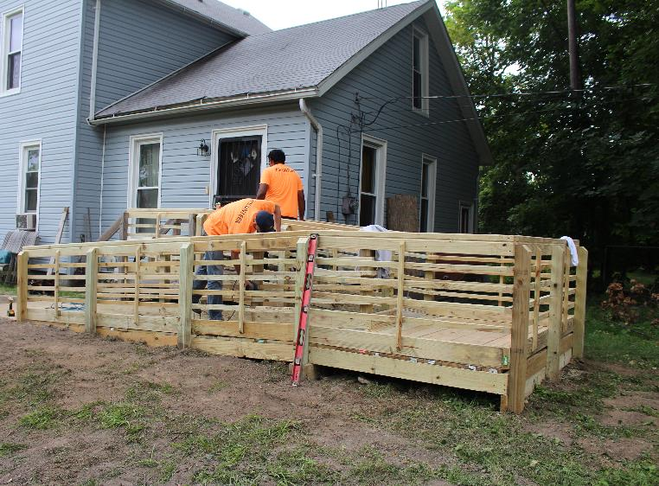
What happened?
Commercial Vehicle in a Residential Zone
Ramp that Didn’t Fit Within Zoning Guidelines

Slide 23
Resources
ADA National Network
Local Fair Housing Center
Department of Justice
Department of Housing and Urban Development

Slide 24
Want a copy of our booklet (they’re free!)?
Contact us:
Lisa Justice
ljustice@abilitycenter.org

