Slide 1
IL Movement and African Americans Yesterday, Today, Tomorrow
The 22nd Annual National Conference on Rural Independent Living
“Betting on the Youth….VOTE for the Future”
Sunday, October 23, 2016 – 1:30 pm – 3:00 pm
PRESENTER: Liz Sherwin, Executive Director – Illinois/Iowa CIL (IICIL)

Slide 2
IL Movement and African Americans Yesterday, Today, Tomorrow
A look at the history of how people with disabilities have been treated by various Western cultures can help us see how the movement for independent living began in this country. From nomad tribes to social change in the 1960s, people with disabilities have played various roles in their societies. What is occurring now is the horizon of a new age for people with disabilities of all types and ethnicities
IL Movement dominated by Caucasian males with physical disabilities
Cultural considerations specific to African Americans who also experience disability and how that has impacted representation within the IL movement
Notable African Americans in IL from 1960s-1990’s
Notable current CIL/SILC leaders who are African American
Presenters’ personal experiences with leading CILs as African American females

Slide 3
Historical Perspective: Cultural considerations specific to African Americans who also experience disability and how that has impacted representation within the IL movement
1619 - The first 20 enslaved Africans are brought to the American colonies. The slaves land at Jamestown, Virginia, and are subsequently sold to colonists
1738 - The Charleston, South Carolina Workhouse opens and starts receiving: “all rogues, vagabonds, lewd and idle persons and beggars, stubborn and obstinate apprentices and servants, and children, common drunkards, common night walkers, pilferers, wanton, and lascivious persons, common scolds, and brawlers, tradesmen, and laborers neglecting their callings, and leading idle and dissolute lives and who do not provide for the support of their families, …..stubborn, obstinate or incorrigible negroes or slaves.”
1745 - The South Carolina colonial assembly legislates that colonial parishes are responsible for the public maintenance of “lunatic” slaves if that maintenance can not be provided by the owner.
1752 - The colonies of Maryland and Avalon (present day Newfoundland and Labrador) enact laws that protect slaves with disabilities and the elderly.

Slide 4
Historical Perspective Cont..
Slaves could not be emancipated based on age or disability in these provinces.
1755 - The city of Charleston recognizes the need to construct a separate facility for “persons disordered in their senses, fugitive slaves, and others.”
*By 1768 the old workhouse became a correctional facility and was used primarily to discipline slaves
1773 - Eastern State Hospital, the first public facility in the United States constructed solely for the care and treatment of the mentally ill, opens in Williamsburg, Virginia.
*Free blacks were admitted to the hospital and were not fully segregated from the white population
1792 - American physician Benjamin Rush explains that the skin color of Africans was due to an affliction known as congenital leprosy or “Negritude.”
*He theorized that the color of the skin could be changed through an aggressive rubbing treatment

Slide 5
Historical Perspective Cont..
1808 - The New York African Society for Mutual Relief is established, operating out of a building in southern Manhattan.
*Primary functions of this benevolent society were education, care for the sick, infirm and disabled, burying the dead, and protecting families of deceased members.
1811 - The almshouse in Charleston, South Carolina starts to admit insane free blacks.
*Free blacks who did not have a mental disability were excluded from this public service.
1820 - Taking Care of Our Own Kind - The city of Charleston begins to hire black nurses to care for the insane free blacks in the almshouse
1824 - Early Efforts - A lunatic asylum opens in Lexington, Kentucky. This was the fifth institution in the United States that provided care for people with mental disabilities.
*The first patient admitted to the asylum was a black woman.

Slide 6
Historical Perspective Cont..
1825 - An Elite, White Institution - Western Lunatic Asylum opens in Staunton, Virginia.
*Free blacks were denied admission to preserve the impression that the asylum was an elite, white institution
1828 - South Carolina Lunatic Asylum opens in Columbia, South Carolina in 1829, a fourteen year-old slave named Jefferson was admitted, but was expected to live outside in the yard. Blacks were not legally admitted until 1848
Horace Mann -1833 - Trustee of the hospital and famous education reformer Horace Mann stated: “Africans… ought not to mingle with the other female patients.”
1835 - Phineas Taylor Barnum - P. T. Barnum starts exhibiting Joice Heth as George Washington’s 161 year old African American nurse. Heth, who was blind and partially paralyzed, was the first “human oddity” exhibited by Barnum. Barnum’s claims about Heth were later determined to be a hoax when Heth’s body underwent an autopsy

Slide 7
Historical Perspective Cont..
1837 - James McCune Smith graduates with a medical degree from the University of Glasgow, Scotland.
*After Dr. Smith returned to the United States, he became the first African American in the nation to practice medicine. He worked at the Free Negro Orphan Asylum for 25 years
1839 - The American Anti-Slavery Society American Slavery As It Is: Testimony of a Thousand Witnesses, co-authored by Theodore D. Weld, is published by the American Anti-Slavery Society.
*The document offered insight into the views that masters held in regards to slaves with disabilities: “The blind, lunatics, and idiots. As all such would be a tax on him, it would be for his interest to shorten their days.” Other descriptions of disabilities also appeared in the testimony

Slide 8
The United States Census as Propaganda (Part 1)1840
The United States conducts the sixth census of the nation’s population.
2. This census attempted to enumerate people with various types of disabilities.
3. Pro-slavery advocates used the data to further their argument that slavery was necessary, because the census seemed to indicate that the percentage of “insane negroes” increased the further north one resided in the country.

Slide 9
Historical Perspective Cont..
1840 - Care for Free Black Females - Eastern State Lunatic Asylum admits its first free black females. These women are housed in an out-building segregated from the white patients
1842 - Poor Relief - Commissioners of the Poor in Charleston, South Carolina argue that “insane free blacks” have the right to poor relief if family members are unable to provide care for that person. Thus, “insane free blacks” were sent to the city workhouse and eventually to the poorhouse
1844 - Committee on Asylums for Colored Persons - The committee’s official stance, written by Dr. John M. Galt in 1853, stated: “The prominent disadvantage in the admission of lunatics of the two races into one asylum, is thought to be the prejudice existing in the United States as respects color.”

Slide 10
Historical Perspective Cont..
1851 - Rascality in Slaves - Pro-slavery advocate and Louisiana physician Samuel Cartwright identifies two mental syndromes distinctive to slaves.
*The first was known as Drapetomania, a disease that caused slaves to run away.
*Dysaethesia Aethiopica, known as “rascality” by slave overseers, caused “hebetude of the mind and obtuse sensibility of the body.” Symptoms included disobedience, insolence, and a refusal to work.
*Both “diseases” were remedied through punishments such as whipping and hard labor
1833 - Liberator of Slaves - An adolescent Harriet Tubman witnesses an overseer preparing to punish a slave from another family and intervenes.
*In the process, Harriet is struck in the head with a two pound weight—resulting in a skull fracture. She recovered slowly from the injury and, for the rest of her life, experienced seizures, narcolepsy, and headaches

Slide 11
Historical Perspective Cont..
1855 - Dr. Thomas Story Kirkbride, architect of insane asylums, states: “The idea of mixing up all colors and classes, as seen in one or two institutions in the United States, is not what is wanted in our hospitals for the insane.”
1857 - Thomas Wiggins, also known as “Blind Tom,” gives his first concert in Georgia.
*He was an autistic savant who was able to play music on the piano after listening to a song only once.
*He could sing and recite poetry and prose in several languages, phonetically duplicate long speeches, and reproduce the sounds of nature, machines, and musical instruments on the piano
1857 - The Kentucky Institute for the Feeble-Minded opens in Frankfort.
*This facility was one of two institutions of its kind in the south that provided care and education to both races.

Slide 12
Historical Perspective Cont..
1862 - Freedmen’s Hospital - Camp Barker was established to provide shelter, medical care, food, and possible employment to escaped slaves.
*Eventually the camp and others combined to create Freedman’s Village on the estate of Robert E. Lee in Arlington, Virginia.
*Freedmen’s Hospital was built on the grounds in 1862 to care for freed African Americans with disabilities and other medical issues
1866 – Black Codes – Implemented. These codes, passed at both the local and state level, were used to restrict the rights of former slaves

Slide 13
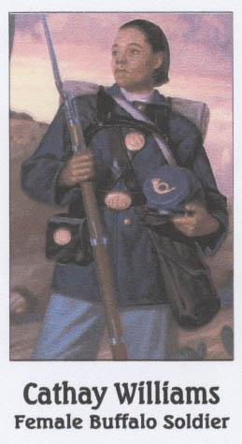
Historical Perspective Cont..
1866 - A Female Buffalo Soldier - Cathay Williams poses as man in order to enroll in the United States Army.
*She served from 1866 – 1868 and was eventually discharged with a disability.
*The army surgeon claimed that she was of “a feeble habit.”
*She was the first African American woman to enlist and be documented as a soldier in the United States Army
1868 - Federal Disability Pensions - Black Civil War veterans become eligible for federal disability pensions.

Slide 14
Historical Perspective Cont..
1869 - First of Their Kind - The North Carolina School for Colored Blind and Deaf is established in Raleigh. This was the first separate school for African American children who were deaf in the United States
1869 - The Central Lunatic Asylum for the Colored Insane is built near Petersburg, Virginia. This was the first institution established specifically for the care of African Americans with various mental disabilities.
*By 1938, the asylum became the largest institution for African Americans who were labeled as mentally ill—housing over 3,500 patients.

Slide 15
Historical Perspective Cont..
1876 - Jim Crow Laws - Between 1876 and 1965, every southern state implemented Jim Crow Laws to force the segregation of blacks and whites. The laws mandated “separate but equal” accommodations for African Americans.
*These laws extended to institutions for people with disabilities and even to hospitals.
1890 - Gallaudet College - Ennals Adams Jr. becomes the first African American student to be enrolled at Gallaudet College in Washington, D.C
1895 - Increasing Insanity in the African American Population - Dr. T. O. Powell, superintendent of the Georgia Lunatic Asylum, reports on the increase of insanity among blacks between 1860 and 1890. He believed that this increase was due to their freedom from bondage

Slide 16
Historical Perspective Cont.
1904 - Tuberculosis: A Black Disease? - The National Association for the Study and Prevention of Tuberculosis is established to treat and prevent the deadly disease from spreading.
*At the time, medical theory believed that tuberculosis occurred more in African Americans than it did in whites.
*Much of this was do to the scant knowledge of microbiology and the poor conditions in which many southern blacks lived.
*When it was realized germs knew no color line, the Association cared for both blacks and whites

Slide 17
Historical Perspective Cont.
1906 – Overcrowding - Due to overcrowding at the Louisiana Insane Asylum in Jackson, a new institution—built exclusively for “Negro patients”—opens in Alexandria.
*However, increasing numbers of both white and black patients soon forced the new facility to admit both races.
1909 - Taft, Oklahoma - The Industrial Institute for Colored Deaf, Blind and Orphans opens in Taft, Oklahoma.
*The “exclusive purpose” of the institute was: “to care for, teach and train the unfortunate of the said colored race in the rudiments of English, as in graded schools, and the practical and primary industries, such as may fit such unfortunates for useful citizenship and make them self-helpful and self- reliant.”

Slide 18
Historical Perspective Cont..
1912 - For Blacks Only - Governor Frederick Plaisted evicts 45 families from Malaga Island, located one hundred yards off the coast of Maine.
*A racially mixed community, founded in 1794, the residents were said to be feeble-minded and many were sent to the Maine School for Feeble-Minded in Pownal, Maine
1916 - The Black Stork - The silent film “The Black Stork” is released. Using eugenics as its central theme, the movie discusses the consequences of breeding with the unhealthy—including a black slave that causes a “genetic contamination” in an otherwise well-to-do family.
*It was claimed that the result is the birth of defective children, making members of such families unfit for marriage

Slide 19
Historical Perspective Cont..
1932 - The Tuskegee Experiment - The “Tuskegee Study of Untreated Syphilis in the Negro Male” is initiated by the United States Public Health Service in conjunction with the Tuskegee Institute and the John A. Andrew Memorial Hospital.
*Conducted without the consent of the initial 600 black men, the study continued until 1972. Long term effects of untreated syphilis include issues with mental functions, memory loss, loss of vision, balance, and other symptoms
1939 - The “Negro Project” The American Birth Control Federation begins planning a “Negro Project” with the aid of activist Margaret Sanger.
*Elements of the project included sterilization and birth control of impoverished African Americans.
A “White” Disease - As polio epidemics spread during the early 20th century, it was thought to be only a “white” disease.
*This thinking in medical circles changed by the end of the 1920’s when it was realized that any race could contract the disease.
*Because of this conceptual change, African American children were included in the first vaccination field trials

Slide 20
Historical Perspective Cont..
1954 - Desegregation Begins - Brown v. Board of Education of Topeka: The United States Supreme Court declares “separate but equal” schools unconstitutional.
*This ruling led to national desegregation of the nation’s schools— including educational and medical institutions for people with disabilities.
1955-56 - Avoiding a Supreme Court Ruling - During these two years, enrollment in Washington, D.C. special education classes doubled—with close to 77% of the students being African Americans.
*This was one of many attempts to circumvent the Court’s Brown v. Board of Education decision.

Slide 21
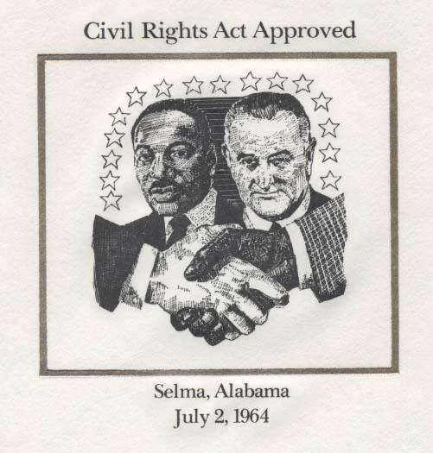
Historical Perspective Cont..
1961 - Wrongfully Admitted - Civil rights activists Juanita Nelson, Wallace Nelson, and Rose Robinson are arrested for trying to eat at a restaurant in Elkton, Maryland.
*They were arrested for trespassing and eventually sent to Crownsville State Hospital for a mental evaluation.
*The Maryland State Attorney believed the 3 trespassers showed signs of mental illness. Dr. Charles Ward, the hospital’s superintendent, disagreed and they were later just charged for trespassing.
1964 - Civil Rights Act - Discrimination based on race, color, national origin, religion, or sex is outlawed with the passage of the Civil Rights Act.

Slide 22
Historical Perspective Cont..
1967 – Movement - Hobson v. Hansen is ruled on by United States Court of Appeals for the District of Columbia Judge J. Skelly Wright.
*Wright’s ruling declared that ability-grouping based on race, or the “track system,” was unconstitutional.
*Ability-grouping was found to place more African American students in special education classrooms than white students. The suit was led by civil rights leader Julius Wilson Hobson
1972 – Inclusivity - Mills v. Board of Education of the District of Columbia forces the District of Columbia’s public schools to be inclusive of children with disabilities.
*The seven plaintiffs in the case were African American children with disabilities, but the case was fought on behalf of 18,000 children with disabilities being excluded from public education

Slide 23
Historical Perspective Cont..
1973 - A Racial Distinction - Several studies conducted in 1973 in the Archives of General Psychiatry, showed that African American patients were more likely to be diagnosed as schizophrenic than white patients.
*The previous decade suggested a movement of “racializing” schizophrenia as a black condition.
1974 - An End to Eugenic Sterilization - The federal lawsuit Relf v. Weinberger comes to trial in Alabama.
*The lawsuit was brought to court by the Southern Poverty Law Center after two African American girls with “mental disabilities,” ages 12 and 14, were sterilized without consent.
*Mike Easley, the governor of North Carolina, signs legislation ending the state’s use of forced sterilization on people with disabilities - 2003
*Over 7,600 people—many with developmental disabilities—were sterilized during the state’s eugenic program from 1929 until 1974.
*Sterilizations were performed on young black women in the state through the 1960s

Slide 24
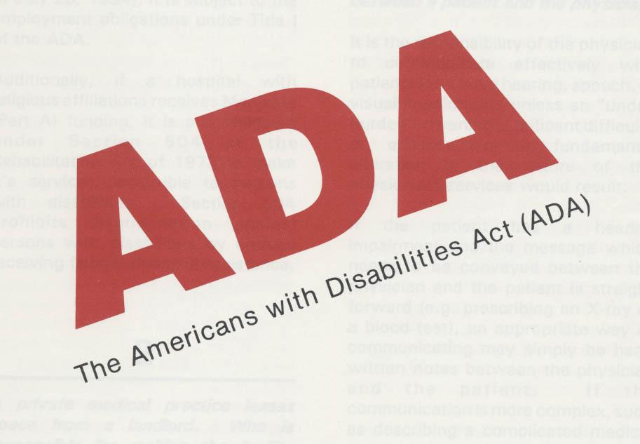
Historical Perspective Cont..
1990 - The Americans with Disabilities Act - The Americans with Disabilities Act is signed into law by President George H. W. Bush.
*This breakthrough civil rights legislation forbids discrimination based on a wide range of disabilities.
*A foundation for the law was the 1964 Civil Rights Act.

Slide 25
Independent Living and the Black Community Yesterday- Don Galloway and Ed Roberts
Mr. Galloway’s introduction to the independent living movement came in 1974. Ed Roberts invited him to work with the Center for Independent Living as its director of services for blind people and soon began pressing the almost entirely white independent living movement to become more inclusive of people of color.
Don Galloway, Manager of Blind Services, and Ed Roberts, Executive Director of the fledgling Center for Independent Living, in 1974 on the Berkeley campus.

Slide 26
Independent Living and the Black Community – Yesterday Brad Lomax, Black Panther – Revolutionary Black Nationalism and Disability Power
In 1974, Lomax was working at the Panthers’ George Jackson Clinic, which provided free community medical care as part of the BPP “serve the people” programs.
Recognizing the need for more disability services and supports in his own community, in 1975, Lomax approached Ed Roberts (who had helped found the Center for Independent Living in Berkeley in 1972), with a proposal to open a Center for Independent Living (CIL) in East Oakland under Black Panther sponsorship.
Less than a year later, with Lomax as one of a two-person staff, the East Oakland CIL opened in a storefront, offering basic peer counseling and attendant referral.
Brad Lomax and his brother Glenn

Slide 27
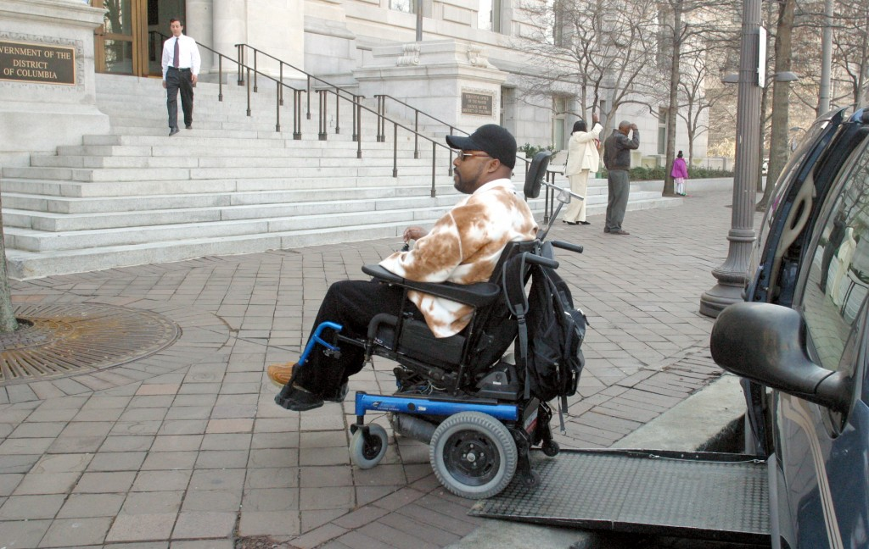
Independent Living and the Black Community – Yesterday and Today Bobby Coward, D.C.- Advocate
“It is still hard to believe that it has been more than a year since the passing of Bobby Coward. A mainstay in the DC. Disability advocacy scene, Bobby Coward was a tireless advocate for wheelchair-equipped taxicabs, wheelchair lifts on public buses and wheelchair access to public housing and especially increasing the quality of life for all individuals with disabilities.
He served as the Executive Director of Direct Action but was probably best known (and feared) as the head of Capitol Area ADAPT. With a significant focus on transit policy, Bobby was a key voice in the
discussion of accessible transportation, and in a major city like DC, he was a force that did not allow individuals with disabilities to be
ignored in the conversation.
Bobby epitomized constant vigilance, and for a
significant time was the name when considering disability advocates that were also members of the Black Community. Though serious
about our work and engagement, Bobby still always had time for the growing parade of young people seeking to learn more about their place in the disability movement.”
Posted on February 28, 2016 by Lead On Update Admin

Slide 28
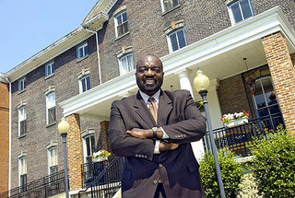
Independent Living and the Black Community – The Present Stanley A. Holbrook, (NCIL)- Board Member V-C of the (PCIL)
Stan Holbrook has over 25 years of non-profit administration experience that covers program development, organizational administration, planning, training and development, and grant writing. Mr. Holbrook serves as a grant reviewer for Administration on Aging. He previously served as President and CEO of Three Rivers Center for Independent Living in Pittsurgh, PA.
He is currently an active board member of the National Council for Independent Living (NCIL), chair of the NCIL diversity subcommittee, President of the Pennsylvania Council for Independent Living (PCIL), and Vice Chair of the Pennsylvania Statewide Independent Living Council. He is also the representative for the Network of Multicultural Agencies (NOMA), member of the membership committee which is a part of the American Society on Aging (ASA). He has also served as a delegate on the White House Conference on Aging.
Mr. Holbrook has successfully completed Leadership Pittsburgh and the New Ventures in Leadership program (sponsored by ASA). His vision for his life is to have a positive impact on as many people as he can in this lifetime.

Slide 29
Independent Living and the Black Community –Yesterday William E. Fielding - Illinois Advocate
William E. Fielding, 52, of Peoria passed Wednesday, March 21, 2007. William was born Sept. 6, 1954, in East St. Louis, IL. A 1978 graduate of Southern Illinois University, Edwardsville, he was a very strong advocate for people with disabilities.
He worked tirelessly with the Coalition of Citizens with Disabilities of Illinois and the Statewide Independent Living Council while working full time for the state of Illinois as an independent living specialist, client assistance program manager and, later, as an EEOC Officer in Springfield.
He moved to Peoria and worked as the Executive Director for the Central Illinois Center for Independent Living. In his spare time he was past chairman of the Greater Peoria Mass Transit District Board, a member of the Easter Seals Board and the Senior Citizen Commission, all the while maintaining his relationship with Independent Living. William will be remembered as a loving and giving person to anyone who happened to have crossed his path in life. There was never a stranger to William.

Slide 30
Independent Living and the Black Community – The Present and Future - Anita Cameron, Social Justice and Social Change Activist
Anita Cameron describes herself this way: “I’m a disability rights activist, CERT instructor/Program Manager, writer and cat lover who has been fighting the good fight for almost 30 years.”
From LinkedIn: She is a disability rights activist and advocate with an extensive background in community organizing and systems change. Her passion has long been working to ensure that people with disabilities are equal participants in all aspects of society, not only as recipients of services, but as valued members of, and contributors to the well-being of their communities.
Her Community Emergency Response Team (CERT) instructor and Program Manager has allowed her to work working with teams of first responders, planners and governmental agencies to develop and implement emergency management plans, particularly for people with disabilities. Cameron has participated in several CERT exercises, including 2 National Disaster Medical Services (NDMS) exercises serving as a Site Manager at two local Denver hospitals. She also served as a communications operator during the Colorado flood of 2013.

Slide 31
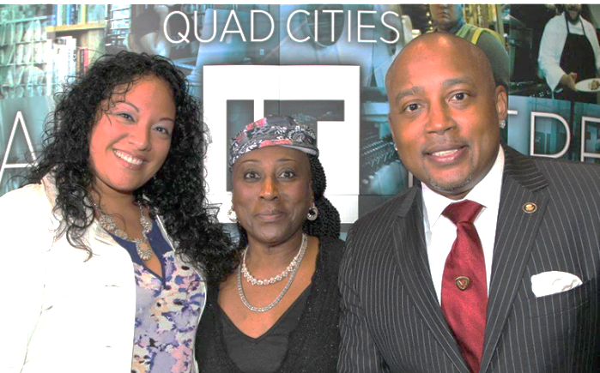
Independent Living and the Black Community – The Present and Future DAYMOND JOHN, ENTREPRENEUR - FUBU FOUNDER
Daymond Garfield John is an American entrepreneur, investor, television personality, author and motivational speaker was born February 23, 1969 Brooklyn, New York City, NY. John grew up in the Queens neighborhood of Hollis. An only child, John was raised by his mother and grandfather. As a kid in elementary school in Queens, New York. John excelled in math and science but did poorly with anything requiring extensive reading and writing. His father would often angrily yell at him to stop slacking.
His school eventually diagnosed him with a general "learning disability," but due to a lack of information on dyslexia, his parents still believed that his bad language arts grades had something to do with his attitude.
In high school, he participated in a program that allowed him to work a full-time job and attend school on an alternating weekly basis, which he credits with instilling an entrepreneurial spirit. He founded FUBU in 1992. Today, John likes to say he's "blessed with dyslexia," and he encourages others not to conceal it as he once did.

Slide 32
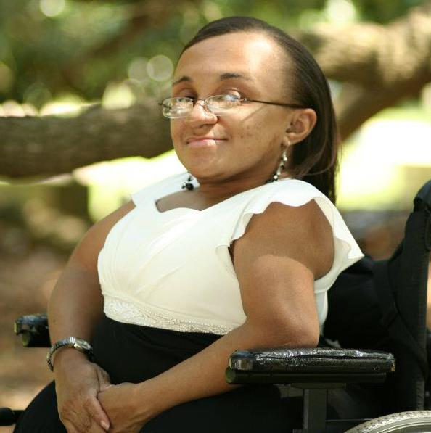
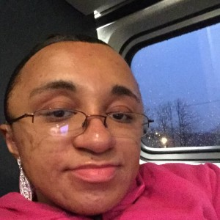
Independent Living and the Black Community – Today and Tomorrow VILISSA THOMPSON, LMSW FOUNDER “RAMP YOUR VOICE” Winnsboro, South Carolina
Welcome to Ramp Your Voice!
Ramp Your Voice! is the brainchild movement of Vilissa Thompson, LMSW, a macro-minded social worker who is on a mission to educate and inform the public & political figures about the plight of people with disabilities, especially women of color with disabilities, in America. I also strive to promote the importance of self-advocacy & strengthen empowerment efforts among people with disabilities.
I am a woman of color with a rare condition called Osteogenesis Imperfecta (OI), better known as brittle bone disease. Though my bones may be fragile, my spirit and determination to share my story and improve the status of those like myself are unbreakable. I will use Ramp Your Voice! (RYV for short) as a way to spotlight the issues and barriers of people with disabilities, as well as create effective social and political changes to ensure that all people have the ability to succeed and prosper, regardless of their ability, ethnicity, religion, socioeconomic status, educational level, or place of origin

Slide 33
Picture Tomorrow
“Picture if you can, a town where every curb has a curb cut and ramp - - where children with disabilities are fully integrated into all schools and all grades with non-disabled children -- where there are no institutions or "state schools" but many scattered small group homes for those with disabilities so severe that they are not capable of controlling their every day lives -- where buses are equipped to pick up any type of passenger, including those who use wheelchairs or have other mobility impairments -- where closed or open captioning is available on every TV station and for every program -- where in-home services are available at any time and for any person, regardless of type of disability or level of income. A picture of equal opportunity and access for all. A picture shared by people involved in both the traditional rehabilitation system and the newer, younger disability rights and independent living movement.”
Maggie Shreve, 1982

