Slide 2
Step One of Leading Online
(Getting Online…)

Slide 4
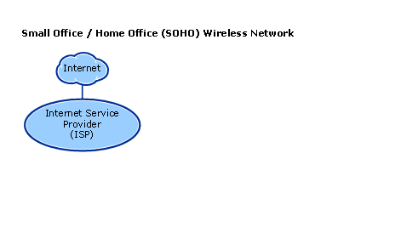

Slide 5
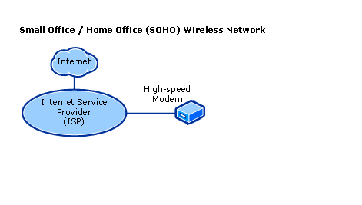

Slide 6
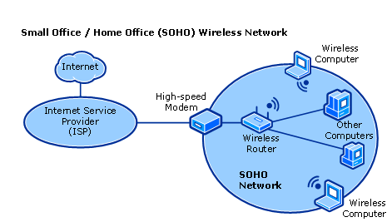

Slide 8
BBQ

Slide 9
BBQ
Barbecue!
(Note: No ‘q’ in Barbecue)

Slide 10
LOL

Slide 11
LOL
Laughing Out Loud

Slide 12
LMAO

Slide 13
LMAO
Laughin’ My A’ Off

Slide 14
LAN

Slide 15
LAN
Local Area Network

Slide 16
ISP

Slide 17
ISP
Internet Service Provider

Slide 18
WAN

Slide 19
WAN
Wide Area Network

Slide 20
NCIL

Slide 21
NCIL
National Council on Independent Living

Slide 22
NCIS

Slide 23
NCIS
Naval Criminal Investigative Service
(Note: We would have also taken: ‘That show on CBS’)

Slide 24
APRIL

Slide 25
APRIL
Association of Programs for
Rural Independent Living

Slide 26
ADA

Slide 27
ADA
Americans with Disabilities Act OR
American Dental Association

Slide 28
L8R

Slide 29
L8R
Later
(Note: La – Eight – Er)

Slide 30
TTYL

Slide 31
TTYL
Talk To Ya’ Later

Slide 32
TLDR;

Slide 33
TLDR;
Too Long; Didn’t Read (Note: Also, TL;DR – semi-colon placement is magic!)

Slide 34
ROFL

Slide 35
ROFL
Rolling On Floor Laughing

Slide 36
YOLO

Slide 37
YOLO
You Only Live Once

Slide 38
CIL

Slide 39
CIL
Center for Independent Living OR
Cash-in-lieu (Note: Cash in lieu of what? Not paying them at all?)

Slide 40
AFK

Slide 41
AFK
Away from Keyboard

Slide 42
BRB

Slide 43
BRB
Be Right Back

Slide 44
BYOB

Slide 45
BYOB
Bring Your Own “Beverage”

Slide 46
FAQ

Slide 47
FAQ
Frequently Asked Questions (Note: Like, “What does FAQ mean?”)

Slide 48
BTW

Slide 49
BTW
By The Way AND
Bring The Wheelchair

Slide 50
GR8

Slide 51
GR8
Great
(Note: Frosted Flakes are GR8)

Slide 52
IMHO

Slide 53
IMHO
In My Humble Opinion

Slide 54
JK or J/K

Slide 55
JK or J/K
Just Kidding (Note: But not really…)

Slide 56
SSI

Slide 57
SSI
Supplemental Security Income

Slide 58
SSDI

Slide 59
SSDI
Social Security Disability Insurance

Slide 60
MDCR

Slide 61
MDCR
Medicare
(Note: Oh, we can just pick random letters to be abbreviations now?! ARNM = Acronym -_-)

Slide 62
CAP

Slide 63
CAP
Client Assistance Program OR
Cost Allocation Plan OR
Corrective Action Plan

Slide 64
ADL

Slide 65
ADL
Activities of Daily Living

Slide 66
I&R

Slide 67
I&R
Information and Referral

Slide 68
IEP

Slide 69
IEP
Individualized Education Program OR Individual Employment Plan

Slide 70
OCR

Slide 71
OCR
Office of Civil Rights

Slide 72
Social Media Terms

Slide 73
Social Networking
The use of dedicated websites and applications to interact with other users, or to find people with similar interests to oneself.

Slide 74
Social Media
Websites and applications that allow users to create and share content or participate in social networking.

Slide 75
Chat
Chat can refer to any kind of communication over the internet but traditionally refers to one-to-one communication through a text-based chat application, commonly referred to as instant messaging (IM) applications.

Slide 76
Engagement
Social media engagement refers to the acts of talking to, messaging or otherwise interacting with other people on social networks.
This broad term encompasses a several different types of actions on social media, from commenting on Facebook posts to participating in Twitter chats.
At its simplest, social media engagement is any interaction you have with other users. For that reason, it’s a core part of every social media strategy. Your followers expect you to interact with them. Being social is core to social media, after all.

Slide 77
Facebook
Facebook is a social media platform founded by Mark Zuckerberg in 2004.
The site connects people with friends, family, acquaintances, and businesses from all over the world and enables them to post, share, and engage with a variety of content such as photos and status updates.
The platform currently boasts around 1.7 billion active users.

Slide 78
Flickr
Flickr is a social network for online picture sharing.
The service allows users to store photos online and then share them with others through profiles, groups, sets, and other methods.

Slide 79
Instagram
Instagram is a photo sharing application that lets users take photos, apply filters to their images, and share the photos instantly on the Instagram network and other social networks like Facebook, Flickr, Twitter, and Foursquare.
The app is targeted toward mobile social sharing, and has gained more than 300 million users.

Slide 80
Snapchat
Photo and video messaging app created in September 2011 that allows users to take photos and videos and add text, drawings, or emojis before sending to recipients. One of the distinguishing features is that the individual messages only last up to 10 seconds before they disappear forever and are erased from the company’s servers.
In 2013, the Story feature was added, which allows users to post a replayable Snap for up to 24 hours in the “Our Story” section.

Slide 81
Pinterest
Pinterest is a visual organizer for saving and sharing links to webpages and other media that you like—otherwise known as Pins. Pins are represented by a picture and a description of your choosing. They can be organized into collections called Pinboards. Pinterest users can share their Pins with others, or Repin pictures they liked from other users.
Think of Pinterest as a virtual scrapbook, or a bookmarks page with pictures. Common uses include event planning, food blogging, and fashion blogging.

Slide 82
Twitter
A social network and media platform that enables users to publish 140-character messages along with photos, videos, and other content.
Twitter is famous for its real-time and emergent discussions on breaking news stories and trends. Example: Reporters in closed courtrooms will use Twitter to share the results of a trial live.

Slide 83
YouTube
A video-sharing website. The site allows users to upload, view, rate, share, and comment on videos.
More than a billion people use YouTube.
Just YouTube’s mobile application has more 18-49 year old viewers than any cable TV station.

Slide 84
Coupla’ Examples
(Companies Trying to Do Online Engagement)

Slide 85
Amtrak
A woman named Amanda Carpenter got stuck in an Amtrak elevator, and, unable to call out, managed to send a tweet asking for Amtrak for help.

Slide 86
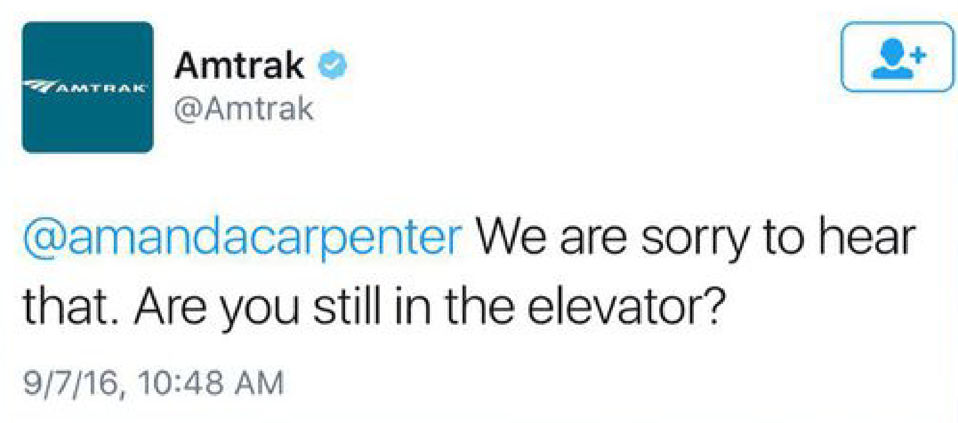
Amtrak
And Amtrak responded.

Slide 87
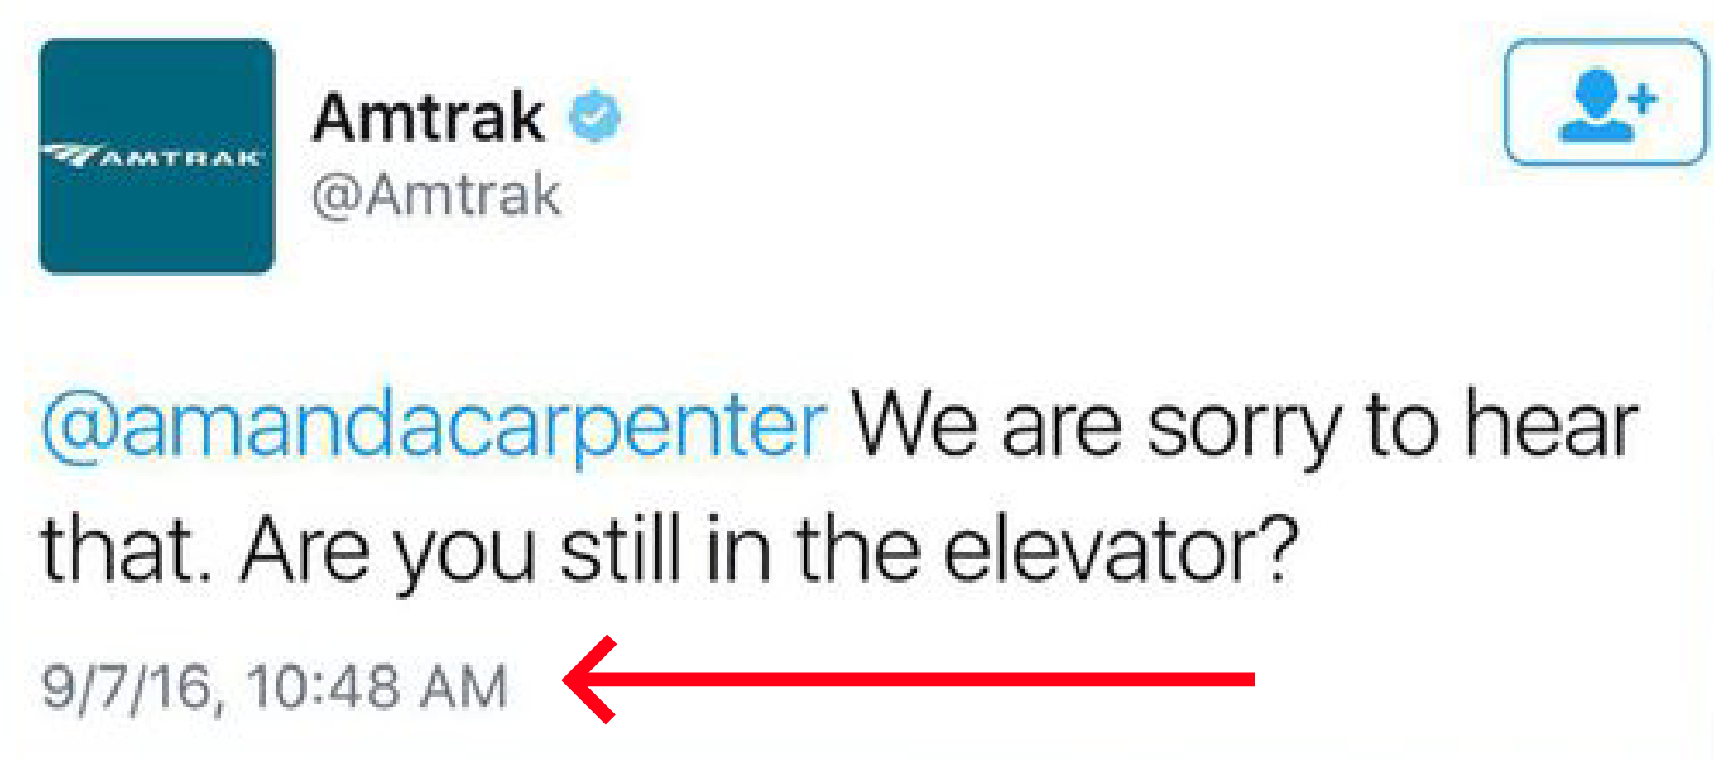
Amtrak
7 months later.

Slide 88
Amtrak
Amtrak half-apologized, and had actually originally responded on time (only 16 minutes after she was stuck, and Amanda had gotten out safely).
It’s just Amtrak’s social media operator had seen a re-tweet about Amanda’s situation and responded to Amanda--again.
The apology and explanation was too late though. The internet is a harsh sea, and its sirens had already sung before the confusion had been sorted.

Slide 89
Amtrak

Slide 90
Amtrak

Slide 91
Amtrak

Slide 92
Skyscanner
A man named James was planning a trip using an online airline search engine, Skyscanner, to go from New Zealand to London.
It was going OK, except for one small hiccup.

Slide 93
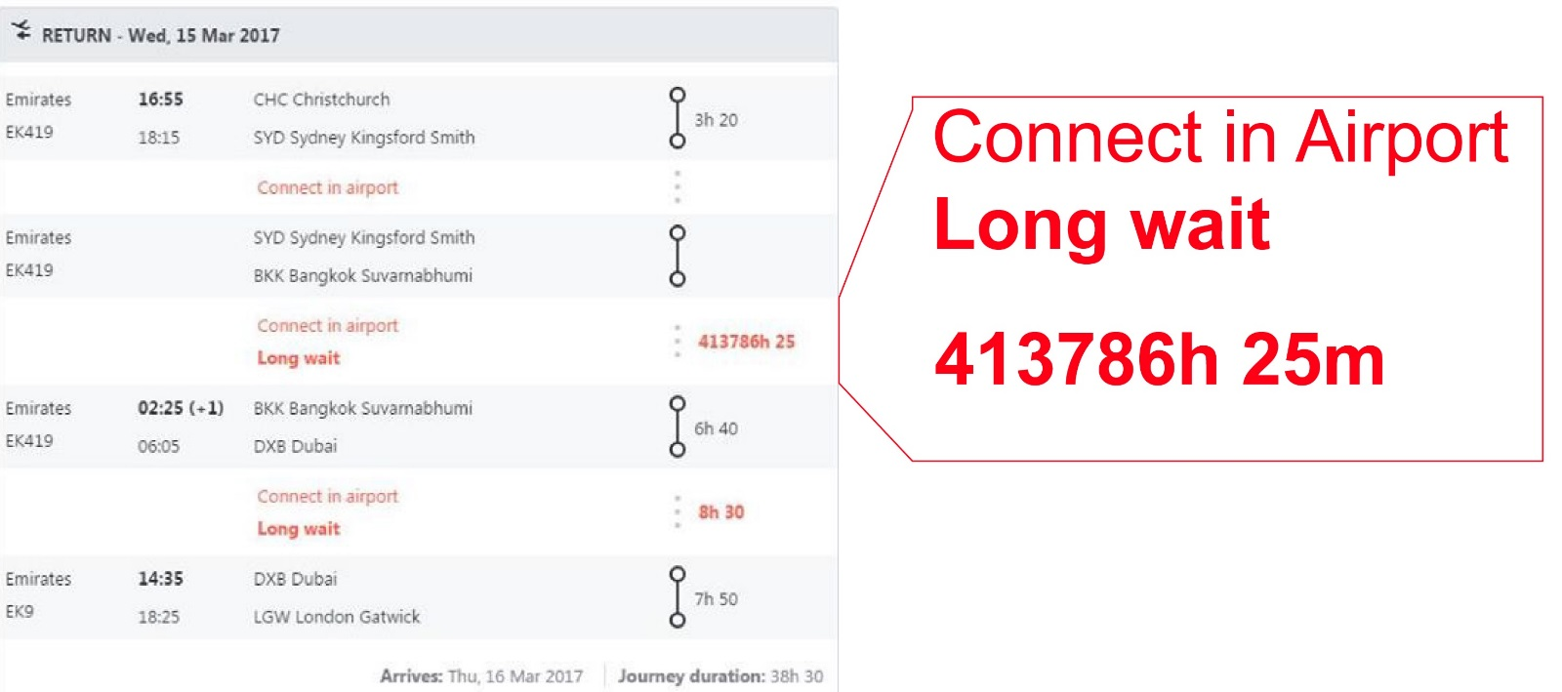
Skyscanner
The site’s plan for James included a 47-year layover in Bangkok.

Slide 94
Skyscanner
It’s OK, though. Skyscanner’s social media person, Jen, was all over it.
While the tech folks worked on sorting out the glitch, she chatted with James.

Slide 95
Skyscanner

Slide 96
Skyscanner
Jen got people’s attention.

Slide 97
Skyscanner
She won a few new customers.

Slide 98
Skyscanner
She even deflected a few haters.

Slide 99
Skyscanner
Unlike Amtrak, Skyscanner’s Social Media response turned a negative situation into a positive, and even her employers declared themselves to be…
#TeamJen

Slide 101
Social Media sites, including Boing and Reddit, mobilized users into hijacking a Green Peace poll to name a humpback whale the group was tracking in 2007. This ended up being fairly controversial, but ultimately garnered media attention and helped the group convince the Japanese government to cancel a planned whale hunt.
This whale’s name became:
The Whale
Libertad
Mr. Splashy Pants

Slide 102
Mr. Splashy Pants

Slide 103
A similar poll, to name a British Polar Research ship, also gained massive attention.
The Brits overruled the most voted name after deeming it inappropriate, especially if the ship were to wreck and become part of history, and ultimately named the ship the RRS Sir David Attenborough. The poll-winner name lives on, though, as the title of one of the ship’s tiny robot submarines. That submarine’s name is:
The Yellow Submarine
Boaty McBoatface
Irish Wake

Slide 104
Boaty McBoatface

Slide 105
Customer reviews are slowly become fairly standard for businesses, whether through websites like Yelp!, product-reviews like those on Amazon.com, or even on Google business pages.
Many people are much more likely to leave negative reviews than positive ones, which can especially have a detrimental impact on word-of-mouth-based businesses such as restaurants. However, several restaurants have handled such negative reviews brilliantly, posting signs outside that say things like this:
One-star rating? Five-star coffee!
#Yelp?Nope!
Come on in and try the worst blank that person on Yelp! ever had in their life!

Slide 106
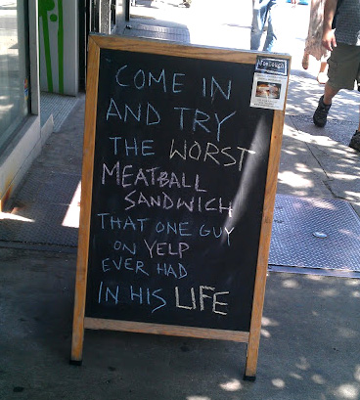
Come on in…

Slide 107
After a social media blitz asked people to sign a petition on the website Change.org, which gained over 250,000 signatures, this bill was passed to allow some people with disabilities to save thousands of dollars without endangering Medicaid or SSI benefits:
ABLE Act
Disability Integration Act
Eleanor Smith Act

Slide 108
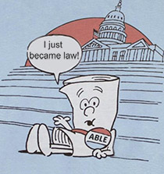
ABLE Act

Slide 109
In what was probably a poor choice, the New York City police department encouraged people to send messages on Twitter with a specific hashtag, documenting their interactions with police officers. The hashtag for these interactions was:
#GoCops
#myNYPD
#BlueAndYou

Slide 110
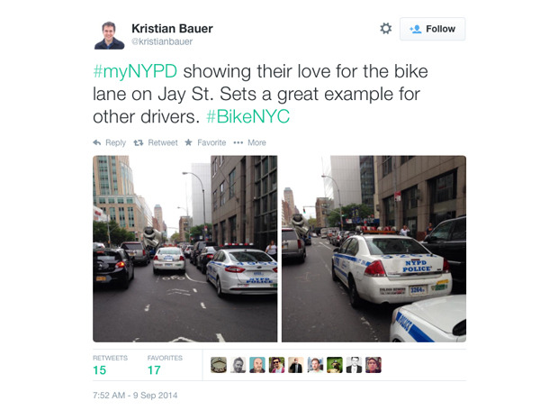
#myNYPD

Slide 111
Online stores, which allow almost anyone to sell things globally, also are changing how we expect services to be delivered – at the push of a button, and with maximum convenience to the consumer.
This company, surprisingly, became the first to deliver products via automated drone in the US after dropping off a chicken sandwich, hot coffee and donuts to a hungry customer:
Amazon
Craigslist
Flirtey

Slide 112
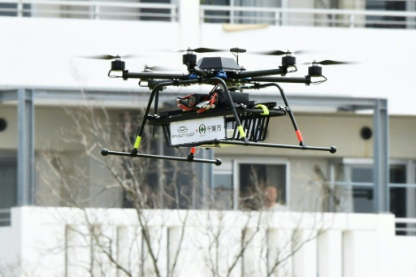
Flirtey

Slide 113
Social media is impacting traditional media as well. On top of news and other stories going viral, some shows have changed their format to allow for more user-participation.
One late-night comedy show features celebrities reading mean tweets about themselves, like, ‘Is there a Kickstarter campaign for Kevin James to never make another movie?’ What show does this?
Jimmy Kimmel Live!
The Late Show with Stephen Colbert
@midnight

Slide 114
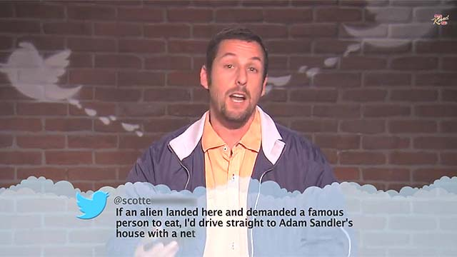
Jimmy Kimmel Live!

Slide 115
One disability-cure group started a viral ask that requested followers to challenge their friends to do a task or donate $100 to their cause.
While not everyone who participated donated money, and many likely only cared about the silliness of the challenge, it still led to more than $115 million going to research for Amyotrophic lateral sclerosis (ALS).
What was this event called?
Cinnamon Challenge
Pushup Challenge
Ice Bucket Challenge

Slide 116
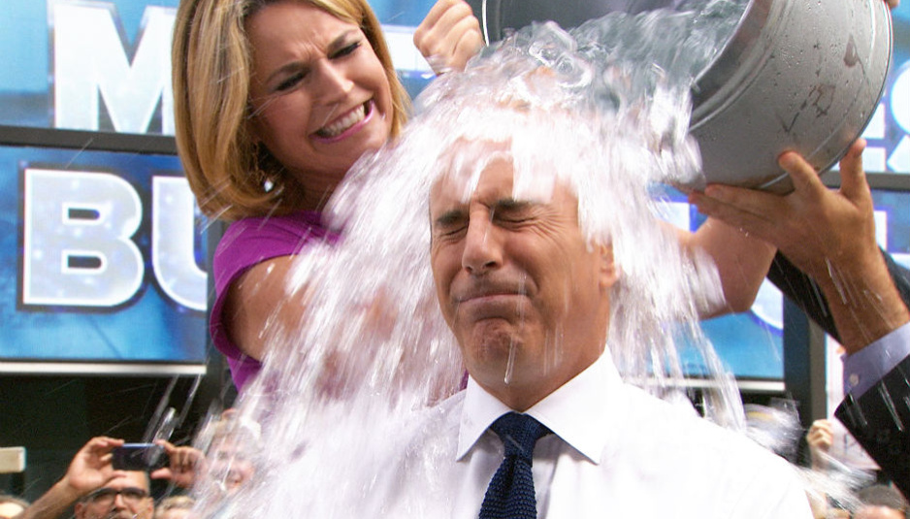
Ice Bucket Challenge

Slide 117
Examples of Social Media in Use

Slide 118
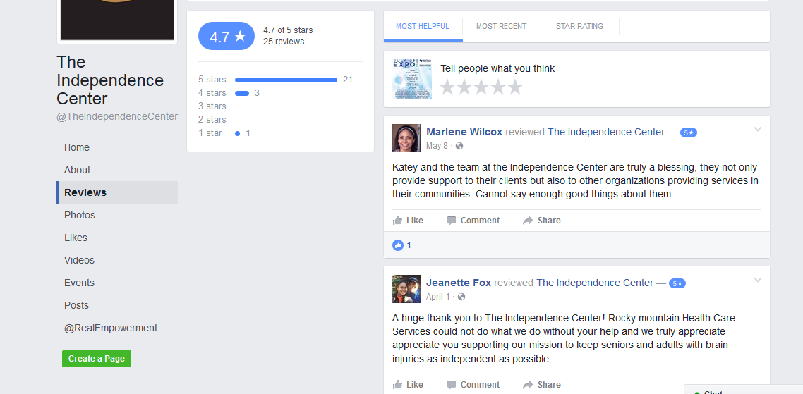

Slide 119
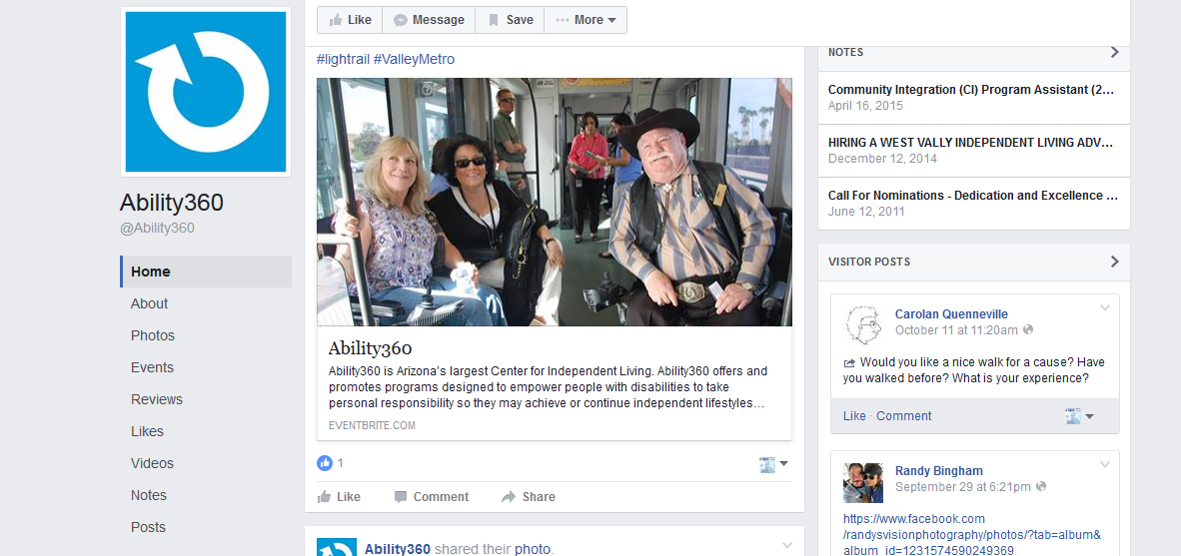

Slide 120
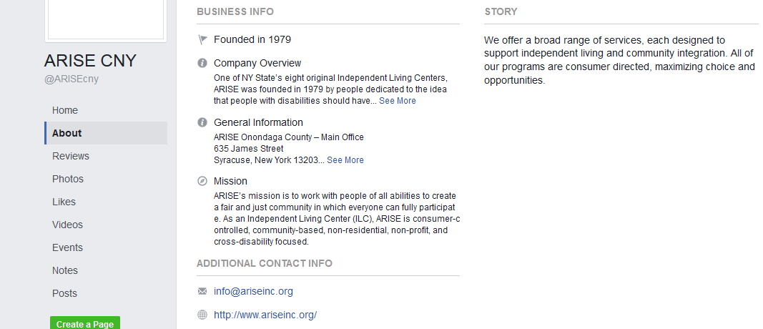
https://www.facebook.com/ARISEcny/

Slide 121
This presentation brought to you by:
This presentation was funded by a grant from the National Institute on Disability, Independent Living and Rehabilitation Research (90RT50250100).

