Slide 1
BE LOUD, BE PROUD, BE A SELF-ADVOCATE!
APRIL Conference: Saturday, October 22, 2016 from 3:30 – 5 pm

Slide 2
Learning More about YOU!
Icebreaker Activity

Slide 3
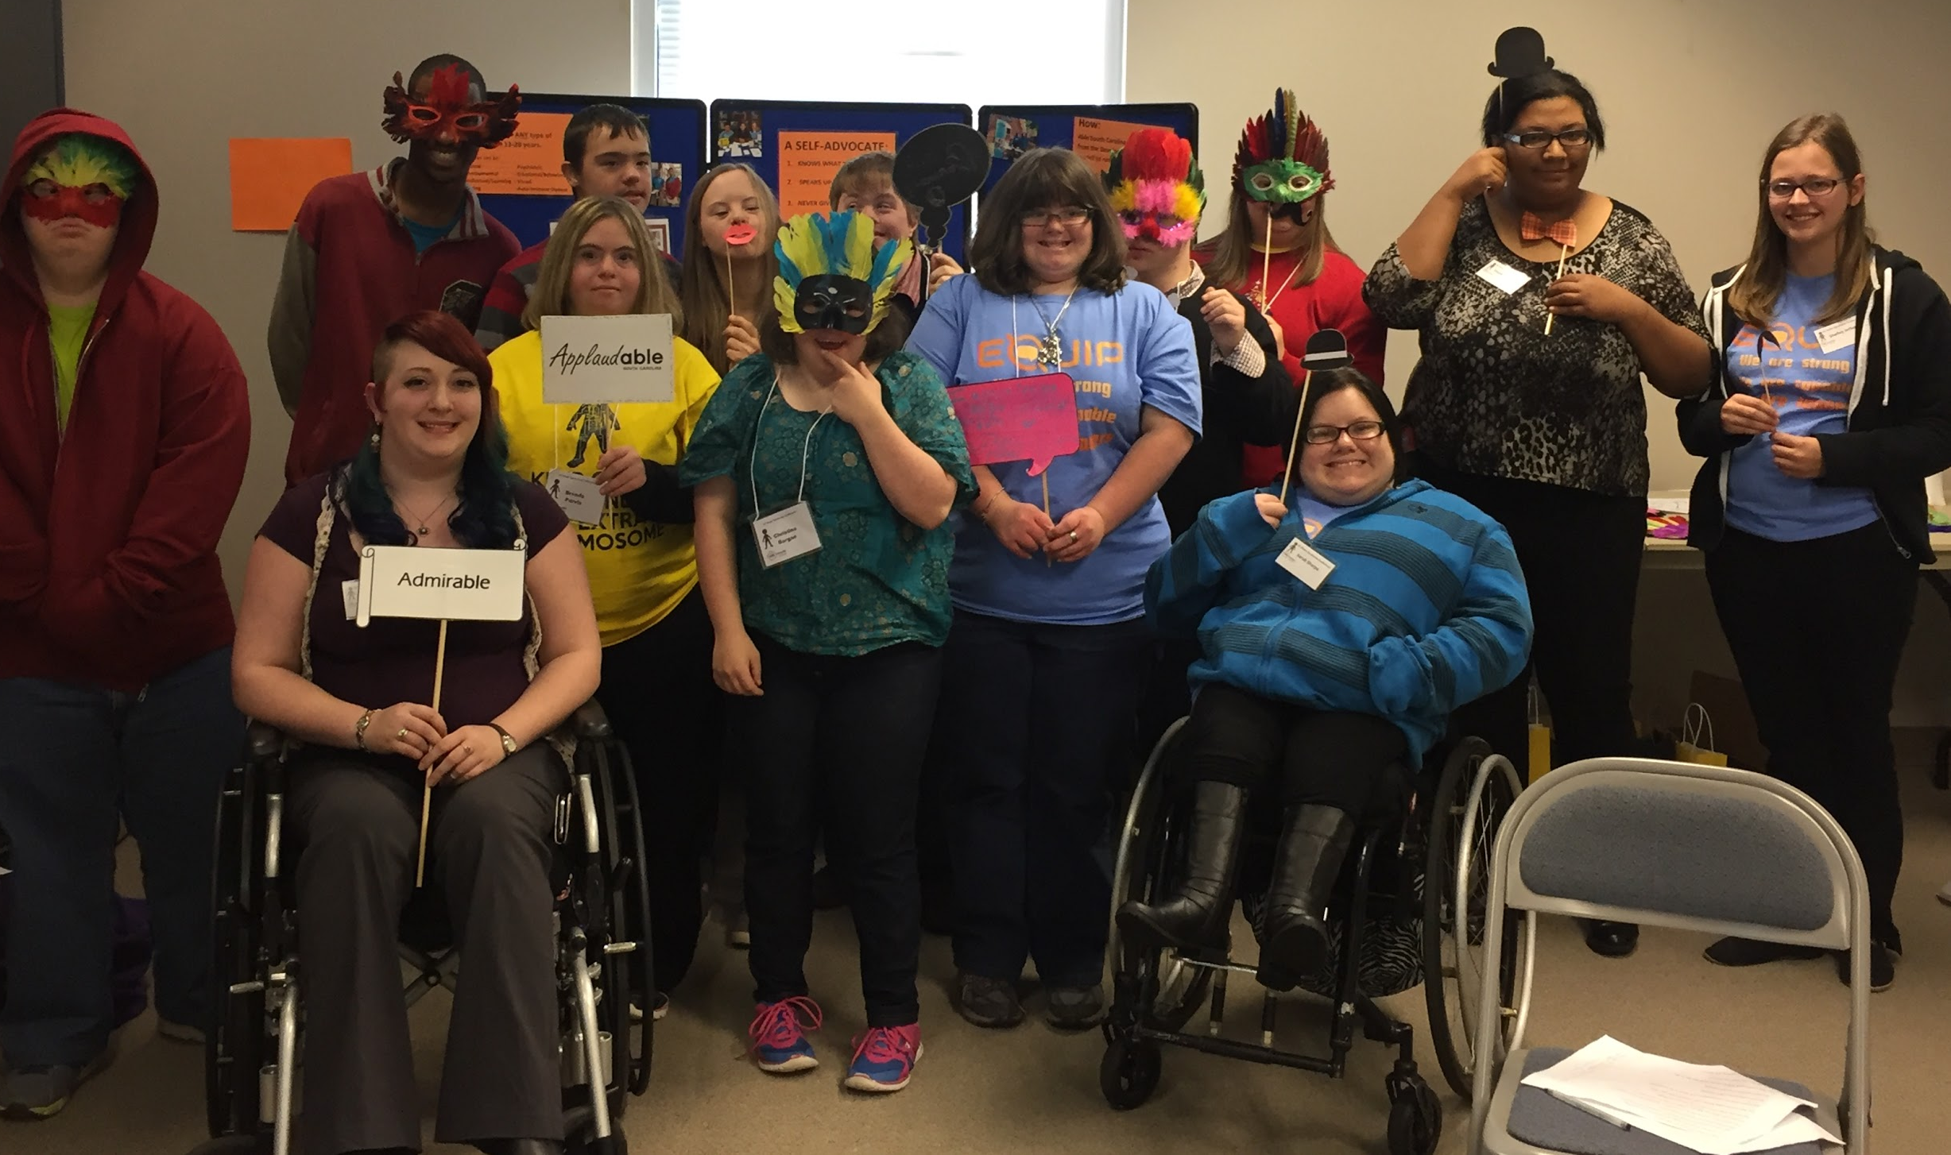
Share it With the Group

Slide 4
“DISABILITY” IS NOT A BAD WORD
Notes:
Disability does not have to be a negative word. Disability doesn’t mean there is something wrong with you or that you are less than. Disability is simply another word that helps to describe some things you may need to do differently in order to still be successful and reach all your goals.

Slide 5
DISABILITY PRIDE
Being a self-advocate means knowing what you want, can do on your own, need help with, how you want to receive help, and who you want to help you
In order to really know the answers to those questions, every single one of you needs to KNOW you have a disability ,and know what that disability is.
Notes:
10 minutes
Supplies: None
Room Set-up: Nothing Specific in Layout
Activity Description: I want everyone to take a moment to think….do you know you have a disability? Do you know what your disability is?
Everyone close their eyes. Do not open them until I tell you to. With your eyes closed, raise your hand if you know you have a disability.
Put your hands down and still keep your eyes closed.
With your eyes closed, raise your hand if you know what your disability is.
Put your hands down and keep your eyes closed.
Wait 3 seconds….you may now open your eyes.
Based on this brief question that I asked, you all were able to answer and determine if you know you have a disability and what kind. This is the first step of being a self-advocate and practicing disability pride.
De-Brief and Take Home Message: Having a personal check-in to determine and establish if each young adult knows they have a disability and knows what it is. Everyone will be in a different stage of disability awareness and pride, and this is a good way to get each participant to assess where they are in this process without having to acknowledge this publicly and feel embarrassed about either not knowing their disability, not knowing they have one, or their specific disability diagnosis.

Slide 6
DISABILITY PRIDE…WE ARE ALL A PIZZA
Notes:
10-15 minutes
Supplies: None
Room Layout: No Specific Layout
Activity Description: Imagine that you are ALL a large pizza. Whatever kind of pizza you want to be = veggie lovers, Hawaiian, cheese, mushroom and black olive, pepperoni, sausage, etc.
What kind of pizza would you be? Let’s go around the room and share with the group
There are 8 slices in a large pizza. Imagine that your disability is ONE slice of this pizza. If we only focus on that one slice of pizza, we are ignoring and wasting the other slices. We don’t have a full pizza. If we try to focus on everything BUT that one slice that represents our disability…then we still don’t have a whole pizza. In order to be a whole and complete pizza, we have to acknowledge and love different aspects of who we are. We are MORE than just disability. We are the people we spend time with, hobbies we enjoy, activities we engage in, things we are good at, things we like to do, sports teams we watch, books we like to read, places we like to travel to, etc.
Deb-Brief and Follow-up Message: Disability pride is JUST like this large pizza. Disability pride means knowing what your disability is, what things you might need to do differently and any accommodations you need to reach goals, and embracing that about you. To pretend you don’t have a disability isn’t going to be very helpful. If I decide that I just don’t want to have my disability, and I’m not going to take insulin, the medicine I need, do you think that is going to end up working out for me? No. I’m going to get sick and not be able to do all the things I want to do. However, if I take my insulin when I am supposed to, then I can do any and everything that my peers and friends are doing. This is the same for other disabilities. Someone with a learning disability, who needs extra time on tests, if they rush through the test so they don’t have to ask for extra time or admit they may need that accommodation, do you think they are going to get a good grade on that test? Probably not. If they use their accommodation, admit they have a disability, and use that information to get the things they need to be successful and ask for that extra time on a test…the grade is going to be a lot better.

Slide 7
WHAT IS A SELF-ADVOCATE?
A Self-Advocate
Knows what they want
Speaks up for themselves
Never gives up!
Notes:
10 minutes
Self-Advocacy is a HUGE part of what we are here to talk to you about today. We aren’t just going to TALK about how to be a self-advocate, but actually practice the different steps to feel comfortable and confident in becoming the strongest self-advocate we can be. In order to even start becoming a self-advocate, we need to know what that word means!
*** Someone read the three steps of a self-advocate out loud ***
*** Have the group repeat back Neato-Repeato style afterwards line-by-line *** → If they aren’t very loud we can make them do it again, or even encourage a competition and split the group into two smaller groups to see who is louder - really depends on how many young adults are attending.
The first part of being a self-advocate is knowing what you want. This means setting goals that YOU want to set and working on things YOU find important and interesting. Something very important that we want you to know is that this has to be something YOU want to work on, a goal YOU decide on. This isn’t about what your parent wants, or what teachers want you to do or think you should focus on; it’s not even about what your friends think you should learn or do. Having the support of people around you that can encourage you is important, but you need to be able to make choices based on your own needs as well.
This means setting goals and talking about the difference between short-term goals and long-term goals.
The first part of being a self-advocate isn’t just about knowing what you want, but knowing what you need in order to be successful and reach goals. We are not here to label you and tell you that you have a disability so that you feel different or singled out. We want you to know that you have a disability so you know WHAT your disability is and what that MEANS in terms of accommodations.
Do you all know what an accommodation is? *** Wait for some responses ***
Accommodations are the things you get in school in order to be successful and do well in your classes
It is great to know what you want, but the second part of being a self-advocate is speaking up for yourself. Nobody knows what is going on in your head and what you are thinking unless you TELL them. This is where practicing good communication is essential.
Speaking up doesn’t only mean using your words, it can be writing down your thoughts or feelings and providing that information to a teacher or parent, or using other preferred communication methods to get points across and desires, wants, needs across to someone else.
The third part of being a self-advocate is never giving up. Sometimes things are going to be difficult, but that doesn’t mean that a goal can’t be achieved or reached. Everyone does things differently in a way that works best for them, whether they have a disability or not. You aren’t going to do things exactly the same as anyone else.
For example, think about how we all got here today…
We didn’t all get here the same way with the same roads or people assisting us, but all reached that goal of getting to this room to be here right now learning about self-advocacy. So we all accomplished our goal...just in different ways. And that is NORMAL.

Slide 8
Short-Term Goals
S = specific M = measurable (how will you know goal has been reached?) A = attainable (reachable in the time period stated) R = realistic (can actually happen) T = time-oriented (when will goal be complete?)
Short-Term Goals Can Take:
Minutes
Hours
Days
1-2 Weeks
Notes:
Keep this slide up as a reference during short-term goal writing time.
10-15 minutes
Allow participants to create their own short-term goals
Have everyone go around the room and share the short-term goals. If they are NOT SMART goals ask questions to turn them into smart goals so participants can see the difference and learn how to set these specific, measurable, attainable, realistic, and time-oriented goals.
Ensure that participants are creating short-term goals based on the definition of something that can take minutes, hours, days, or a couple of weeks.

Slide 9
Long-Term Goals
YOU IN THE FUTURE!
Long-Term Goals:
3-4 weeks
months
years
Require us to split our long-term goal into smaller, more manageable pieces.
YOU NOW
Notes:
5-10 minutes
Long-Term Goals can take much longer than short-term goals to reach and achieve. They can take anywhere from 3-4 weeks to months to YEARS before we reach that long-term goal we have set for ourselves.
Reaching long-term goals involves splitting that long-term goal up into small short-term goals to make progress, and requires knowing some Independent Living skills to be successful. This is why there is an image of a stone pathway on this slide. In order to get from one side of the path to the other, you have to start going from stone to stone. You don’t magically get from the first stone to the last stone, do you? *** wait for responses ***
You get there by walking each stone down the path until you are at your destination. That is how long-term goals are; you have to be able to reach those small victories and goals in order to keep moving forward towards reaching your big long-term goal.

Slide 10
Identifying Long-Term Goals WE Want to Reach
I’m NOT SURE what I want!
NO WAY - not for me!
I WANT to do this!
Notes:
20 minutes
Supplies: Three Signs to place along one wall of the room: “I WANT to do this!”, “I’m NOT SURE what I want!”, “NO WAY - not for me!” and tape
Room Set-up: Room will be split into three sections based on signs posted on the wall. Participants will start in the middle and move from side to side throughout the duration.
Activity Description: Have everyone start in the middle of the room where the “Not Sure” section is going to be. Facilitator of this activity will read out some long term goals one at a time. After each one is read, participants will get to choose if that is a goal they would like to reach. If they do, they will go to the “want” side of the room. If they don’t, they will go to the “no way” side of the room. If they are not sure, they can stay in the “not sure” center of the room where they started. For people who stated they WANT to reach that goal, start asking them some questions such as “how long do you think this will take you to reach?” or “what skills are you going to need to know how to do to reach this goal?” or “how can you start working towards this goal right now?”
Long-Term Goal Questions to Ask:
1. I want to learn to drive a car
2. I want to go to college
3. I want to be able to live by myself someday
4. I want to get a job
5. I want to get married
6. I want to own a pet
7. I want to have kids and a family
8. I want to travel to a place I have never been to
9. I want to know how to cook meals for myself
10. I want to be able to do my own laundry
De-Brief and Purpose of Activity: To get young adults to think about long-term goals that may take 3-4 weeks, months, or even years to reach and HOW they are going to begin working towards achieving those goals. Reaching long-term goals involves splitting that long-term goal up into small short-term goals to make progress, and requires knowing some Independent Living skills to be successful.

Slide 11
Self-Advocacy Skills: Communication
Verbal Communication:
Non-Verbal Communication:
Noises that show you are listening and engaged in a conversation
Paraphrasing
Reflecting
Using “I” Statements
Tone of voice
How loud you speak
Head Nodding
Hand Gestures
Body Posture
Eye Contact
Facial Expressions
Notes:
*** Skip Communication Scenarios if not enough time - teach main concepts of verbal vs. non-verbal communication examples ***
20 - 25 minutes
Supplies: Printed scenarios to provide to small groups to act out. If there are not many participants, we will do one large group and have different participants volunteer to act out the scenarios.
Room Set-Up: Split into small groups of 3-4 in different sections of the room to practice communication scenarios.
Activity Description: Split participants into small groups of 3-4 people if there are enough participants total. Each group will get 1-2 scenarios that they are going to act out. Each scenario will feature a different communication situation and a different dynamic of characters. Groups will get 10 minutes to practice their scenario and then we will all get back together as a large group to act out for everyone. This will showcase examples of how to communicate about different situations and learn to self-advocate.
Scenario #1: Will works in a large dental office and winds up rushing to get to work every day after school. He ends up showing up late to work every day. His job tasks include filing, making photocopies, stuffing envelopes, and answering the telephone. Ms. T, the office manager, has asked to speak with Will about his time sheet.
Scenario #2: Jade has her first job mowing lawns. She works for her best friend’s brother who owns a landscaping company. She’s had the job for about three weeks and really feels like she’s getting into the groove. In fact, it’s the perfect job for her: she loves being outside and appreciates the fact that she can work on her own and even listen to her MP3 player! Jade arrives early at Mr. Z.’s house (her first customer of the day) and gets ready to begin mowing.
Scenario #3: College interview (the student has poor communication skills) - wears inappropriate clothing, chews gum and talks about how popular he/she was in high school
Scenario #4: Group presentation (at least one student in group of presenters demonstrates communication faux pas) - poor posture, fidgets with pen, hair or necklace, uses vague sentences, looks at feet and turns back on audience when writing on board
Scenario #5: Conversation between best friends (best friend is talking about his/her recent breakup and listener is not very sympathetic) - listener acts distracted, changes subject, pulls out cell phone and begins texting, rolls eyes when friend isn’t looking and answers, “Uh-huh”
Scenario #6: Conversation with teacher (student is shy and unable to have a meaningful dialogue concerning science project) - student fails to make good eye contact, student’s voice is low and barely audible, student taps foot on floor and has body partially turned away from teacher, student’s shoulders are slumped and student uses vague, indecisive language
Scenario #7: Conversation between mother and teenage daughter - daughter wants to stay out one hour longer than her curfew, but mother is refusing to listen to the daughter’s reasons because the daughter has proven to be irresponsible in the past
Scenario #8: Conversation between members of opposite sex who are attracted to each other – both parties are nervous, somewhat tongue-tied, being silly, fidgeting with hair, using their cell phones and stuttering
De-Brief or Take Home Message: Communication is very essential in explaining what we want and what we need. The way we communicate can change the outcome and goal of what we are trying to accomplish. Not only does communication CHANGE the way we reach goals and IF we reach them, but how we communicate with different people is going to change depending on who the yare. The way you would talk to a friend is different than how you would talk to a teacher, right?

Slide 12
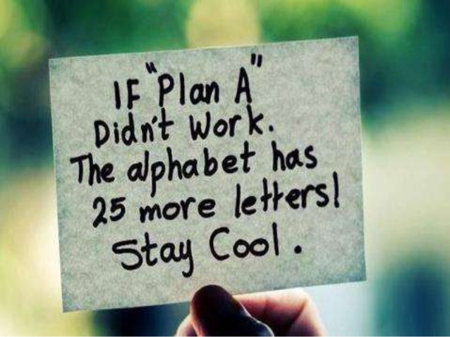
Self-Advocacy Skills: Never Giving Up!
Notes:
5-10 minutes
The last part of being a self-advocate is never giving up. This means that even when things get really hard, or someone tells you “no” when you express something you want or need….you don’t just stop trying. You keep going and keep trying; even if it means talking to more than one person about what you want or need and finding the support system member that can really assist you. For example, if you go to the doctor, and they give you some pretty serious news and say you’ll need to get surgery, would you take them on their word? Probably not. You will probably go get a second or third opinion to make sure it’s the right choice for you. Just because a doctor tells you something doesn’t mean it is the only answer; and that is what we want you all to learn today. You are allowed to keep advocating for yourself and finding the person that will help you in the way you want.

Slide 13
I’M TYLER…DON’T BE SURPRISED
Click Here! To watch "I'm Tyler...Don't Be Surprised" Video
Notes:
*** Skip if not enough time ***
10 minutes
We are going to watch a video about Tyler, a young man with a disability who has a lot of self-advocacy skills. After we watch this video we are going to talk about WHY and HOW Tyler is such a strong self-advocate

Slide 14
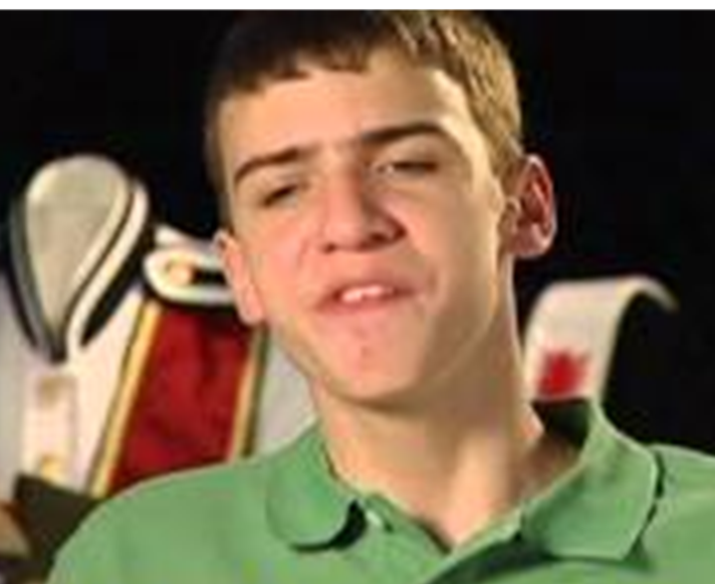
HOW IS TYLER A SELF-ADVOCATE?
Does Tyler know what he wants? What are some examples you heard?
How does Tyler speak up for himself and communicate?
Thinking about this video, what is an activity Tyler talked about where he had to practice never giving up?
Notes:
*** Skip if not enough time ***
10 minutes
Q: Does Tyler Know what He Wants?
Follow-up Explanation: Knowing what you want can include knowing what you are good at, what you like, what you don’t like, things you need help with, things you can do on your own, who you want to help you, how you want to receive help, etc.
Q: How does Tyler speak up and communicate for himself?
Tyler is able to state what activities he likes and participates in them. If he hadn’t told his teachers, parents, friends, etc. what he likes to do and that he wants to do it, do you think he would have ever been in plays and acting in the community playhouse? Part of his high school acting group? Keeps a 3.5 GPA? Been an eagle scout? Is a member of the band?
Q: When did Tyler have to practice not giving up?
In any of his activities
Keeping a 3.5 GPA takes work, Tyler probably failed a test or two and had to learn different ways to study
Learning all the songs for band takes practice, and Tyler didn’t magically learn those songs, he had to work at learning them and practicing them, as well as going to practice with his band team – even on days he didn’t feel like going, or during times when he messed up on the song. He didn’t stop going to band or stop playing just because of one mix up, mistake, or setback.

Slide 15
HOW ARE YOU A SELF-ADVOCATE?
Notes:
10 minutes
Supplies: None
Room Set-Up: Not Anything Specific
Activity Description: We are now going to do a quick activity to show that you are on your way to becoming strong self-advocates too. You may not feel as confident as Tyler, speak up like Tyler does, or have a long list of activities you are involved in and goals you have…but in many different ways, both big and small, you are practicing self-advocacy. If you practice your self-advocacy skills in a lot of different ways every day, before you know it you will BE a stong self-advocate who can know what you want, speak up for yourself, and never give up!
We are now going to play a game called Self-Advocacy Popcorn. When I say a sentence, if it is something you do or have done, I want you to hit your hands against the table, like making the sound of popcorn in the microwave. The more confident you feel in doing the activity in the sentence, the faster you can hit your hands on the table.
Pop Self-Advocacy Popcorn if…
You choose what clothes you want to wear to school – stop popping popcorn
You decide what you want to eat for breakfast in the morning – stop popping popcorn
You raise your hand if you don’t understand what is going on in class – stop popping popcorn
You talk to your teacher privately after class if you are confused about an assignment or something you learned – stop popping popcorn
You order for yourself when you go out to eat at restaurants – stop popping popcorn
You tell your friends something you want to do together – stop popping popcorn
You get to decide what you want to do for your birthday – stop popping popcorn
You can talk to your parents if you are having a bad day and need advice – stop popping popcorn
Your brother or sister is bothering you, you know how to ask them to stop doing what they are doing – stop popping popcorn
You have popped popcorn at ANY point during this game – stop popping popcorn
De-Brief and Follow-up Message: Did you hear how much popcorn was being popped during this activity? This means that all of you are showing GREAT qualities of a self-advocates and have a lot of examples of how you are self-advocates in many different situations throughout your day and life. You don’t have to be a Tyler’s level of self-advocacy to be a self-advocate. All you have to do is know what you want and be able to express that and communicate that to other people….even on the smallest possible level of deciding what to wear to school that day. Do that enough and before you know it you will not just be engaging in activities of self-advocacy, but will BE a self-advocate.

Slide 16
WHAT IS A SELF-ADVOCATE? RE-CAP
A Self-Advocate
Knows what they want
Speaks up for themselves
Never gives up!
Notes:
5 minute closer activity
Go over again just to reiterate. Have them guess the answers before they appear.

Slide 17
Review!
What is disability pride and why is it important?
What does it mean to be a self-advocate?
Why are good communication skills important?
What are short term goals? Long term goals?
Why do we set goals?

Slide 18
Want to Keep Working On These Skills?
Contact Able South Carolina to get involved with:
One-on-One Services
EQUIP Leadership Group
www.able-sc.org
Facebook: EQUIP Leadership Group
Facebook: Able South Carolina
Instagram: EQUIPinSC
Instagram: able_sc
Twitter: EQUIPinSC
Twitter: Able_SC

