Slide 1
What is a SILC and why should I Care?
Dr. FranSha’ Anderson – Arkansas State Independent Living Council
Tyler Wilcox – Independent Living Council of Wisconsin

Slide 2

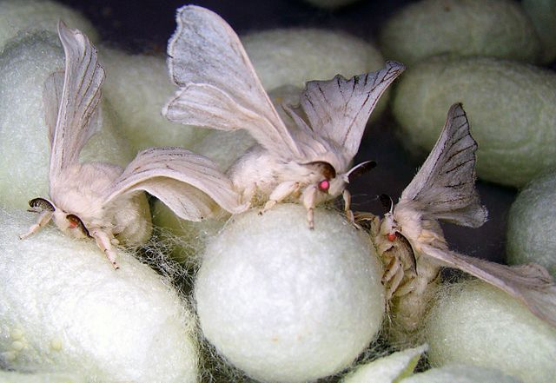
It has nothing to do with this…

Slide 3
SILC stands for
Statewide
Independent
Living
Council

Slide 4
The Council Part is Really Important
Council members are appointed by the Governor
SILCs work, partner, and collaborate with other boards, councils, and commissions
SILCs are frequently in contact with both state and federal government entities

Slide 5
Another thing to remember about SILCs
Even though it isn’t part of the acronym, SILCs are their own thing. Autonomy is really important for a SILC to be effective
  SILCs work with the government but are not part of the government
  SILCs work with CILs but are not an extension of the CILs

Slide 6
There are 56 SILCs
All 50 states, 5 permanently inhabited territories of the United States, and the District of Columbia have a SILC
Each SILC functions a little differently, but they all have the same goal
SILCs are authorized by the 1973 Rehabilitation Act, as Amended in 2015 by Workforce Innovations and Opportunities Act (WIOA, pronounced “we-owe-a”)
Notes:
Territories: Puerto Rico, US Virgin Islands, Guam, the Northern Mariana Islands, and American Samoa

Slide 7
Who would ever want to be on the SILC?

Slide 8
Consumer direction is the most important thing
IL is all about consumer control
  Remember: Nothing about us without us!
A majority (at least 51%) of the SILC members must be persons with disabilities

Slide 9
SILCs don’t want too much interference
A majority (at least 51%) of the council must be persons who do not work for a state agency
A majority (at least 51%) of the council cannot work at a CIL
The Governor appoints new SILC members, but they have to get recommendations from their SILC
  Mileage may vary depending on state

Slide 10
Statewideness is also a thing
Seriously, that is the word we use.
We try to get people from all over the state to join up, including:
  Folks from Tinytown, pop. 1
  Folks from Giantberg, pop. 1,000,000
  Folks from Middleplace, pop. 50,000
  Folks from the middle of nowhere
  Folks from the middle of everything

Slide 11
Equity, Diversity and Inclusion are a big deal, too
We need as many voices to be heard as possible; that means we want to hear from literally everyone…
  This includes different socioeconomic backgrounds, education levels, employment, racial identity, ethnic identity, sexual orientation, gender identity, education level, age…
  We also want as many disabilities represented as possible
…because everyone needs something a little different, and we want to make sure we make our states accessible for as many people as possible.

Slide 12
… and we don’t want things to get stale
SILC members can only serve 2 consecutive 3-year terms, and then they have to take a break from the council

Slide 13
On top of all that, all of this is required by the Rehab act…
…and there might be state laws that we have to think about too

Slide 14
Keeping track of all this is a lot of work
Most SILCs have at least one staff person. Making sure the council has the right people, keeping them well-trained, and active is a big part of what they do

Slide 15
All that being said…
… we love it when CIL leadership, staff, and board members are a part of our team. It makes the SILC stronger and lets us know what’s going on at the centers.

Slide 16
So what does a SILC actually do?

Slide 17
SILCs have two primary responsibilities
Writing the SPIL with the help of the CILs
Making sure that everything in the SPIL gets accomplished, or making changes when they can’t be

Slide 18
They also have to:
Have regular meetings
  Meetings have to be open to the public
  People have to know about meetings before they happen
Submit reports
  and keep records that verify the information in the reports
Work with other groups that provide IL services or similar services

Slide 19
SILCs can choose to do other stuff too
“Work with CILs to coordinate with public and private entities to improve services”
  Read: work with others to make sure persons with disabilities get what they need
“Conduct resource development activities”
  Read: get more money for the SILC
Anything else, as long as it helps improve Independent Living in their state

Slide 20
SILCs are not allowed to do some things
They can’t help consumers directly
They can’t tell persons that work with consumers how to do their job

Slide 21
What is this SPIL thing about anyways?

Slide 22
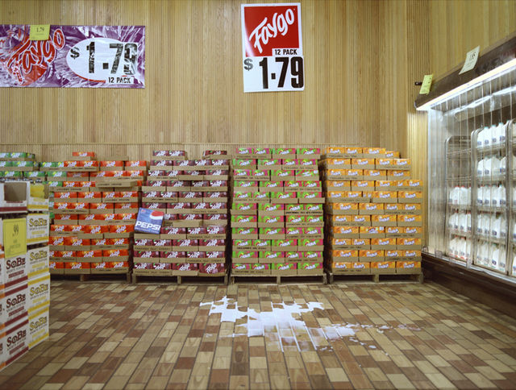
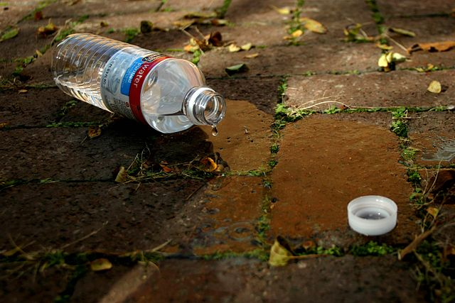
It has nothing to do with this:

Slide 23
The SPIL is kind of like a road map…

Slide 24
The SPIL helps guide IL in your state by:
Figuring out CIL service areas
Making sure as many persons as possible have access to a CIL
Deciding how to spend Part B funding
Setting goals to help persons with disabilities be independent as possible

Slide 25
The SPIL is a 3-year Plan
We are currently in the 2020-2023 SPIL Cycle
  There was an extension due to the COVID-19 pandemic
SILCs are busy working on the 2024-2026 SPIL as we speak
  The new SPIL is due to ACL June 30, 2023

Slide 26
There are 9 Major Sections
Section 1: Goals, Objectives, and Activities
Section 2: Scope, Extent, and Arrangement of Services
Section 3: Network of Centers
Section 4: Designated State Entity (DSE) Responsibilities
Section 5: SILC
Section 6: Legal Basis and Certifications
Section 7: DSE Assurances
Section 8: SILC Assurances and Indicators of Minimum Compliance
Section 9: Signatures

Slide 27
Why is there a whole section for signatures?
There are a bunch of people that have to approve the SPIL before ACL will even look at it:
  The SILC Chair, after the council has given them approval to do so
  At least 51% of the state’s CIL directors; depending on the state, this could be a lot of people
  The DSE

Slide 28
Okay, but who is in charge then?
The short answer is: nobody
  IL should work as a network, not a hierarchy
    CILs do the work of making sure people get what they need
    The DSE makes sure the money goes where it needs to go
    The SILC designs the SPIL and makes sure the state meets its goals

Slide 29
Needless to say, it’s a huge task.
Now it’s time for the soap boxy bit…

Slide 30
So… why should I care?
The SPIL guides how we make IL stronger in its state
Without everyone’s perspective, we can never hope to see from everyone’s point of view
Even if you don’t notice it, everything we do is guided by or influences our SPILs and our SILCs

Slide 31
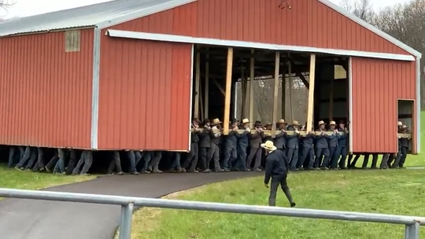
Most importantly, the more people we get involved, the stronger we can be.

Slide 32
Okay, so what can I do?
Read the SPIL
  At the very least, read the goals and objectives
  Ask questions if you don’t understand
Provide public comment and feedback
  The more people we hear from, the more we can make sure we are doing the right things for our state
Get to know your SILC members and staff
  We are nice people; we don’t bite.
Help with SPIL development; see if there is a place for you on the SPIL team
Join your SILC or work with one of the SILC committees

Slide 33
Not tired of us yet? Give us a holler!
Dr. FranSha’ Anderson – arsilcdirector@arsilc.org
Tyler Wilcox – ilcwcoordinator@il-wis.net

