Slide 1
Living in the Long-COVID Era: From Diagnosis to Disability and Everything in Between
Amy Ballinger
Community Engagement Manager;
Social Support and Resource Specialist
Independence, Inc.
Center for Independent Living (CIL), Lawrence, KS
www.independenceinc.org
aballinger@independenceinc.org
The Social Support and Resource Specialist position is a Federal contract position funded through an “Expanding the Public Health Workforce” (PHW) grant offered to centers for independent living to better serve ongoing public health needs of our communities in response to COVID-19

Slide 2
Breaking Down Barriers
The Big Question: Is COVID Still a Threat?
We wrestled with important questions like:
Why now? Does COVID still pose a major public health threat?
We still have CARES Act funding available, how is this different?
Does this mean we have to be trained in clinical knowledge of COVID?
Do we have to hire a medical professional with the funding?
Are additional COVID services needed and relevant in our communities?
Is this another example of government being out of touch with the disability community and what the gaps in services are?
COVID became so political – how do we bridge this gap?

Slide 3
Brookings Institute and CDC Household Pulse Survey
Brookings Institute partnered with The Census Bureau and the CDC’s updated Household Pulse Survey (HPS), to report on the prevalence of Long-COVID and to understand the labor market and economic impact of the condition. The survey found:
At least 23 million Americans currently have Long-COVID, 16 million are working-age (18-65)
Of those 16 million, up to 4 million are out of work due to Long-COVID
The annual cost of those lost wages alone is around $170 billion per year (possibly up to $230 billion)
The speed at which these burdens will grow, depends largely on four factors:
The availability and accessibility of improved treatment options that increase the long Covid recovery rate or move people from “severely ill” to “moderately” or “mildly” ill
Whether vaccines reduce the odds of getting Long-COVID
Whether repeat infections carry additional Long-COVID risk
Whether or not policy interventions are put into place that reduce the workforce impact of Long-COVID
Sources:
https://www.cdc.gov/nchs/covid19/pulse/long-covid.htm
https://www.brookings.edu/research/new-data-shows-long-covid-is-keeping-as-many-as-4-million-people-out-of-work/

Slide 4
Coining the Term “Long-COVID
Source: [Research Article] “How and Why Patients Made Long Covid”, archived, National Library of Medicine
Research prov. By Felicity Callard, Univ. of Glasgow, Elisa Perego, Univ. College London; January, 2021
“How scientists engage with knowledge about new diseases, affects how meaning about a disease accrues, how terminology solidifies, and which evidence is prioritized. In a global health crisis, we need contributions made by those with wide ranges of expertise – including, crucially, patients.”
Excerpt: “Patients collectively made Long-Covid – and cognate term ‘Long-haul Covid’ – in the first months of the pandemic. Patients, many with initially ‘mild’ illness, used various kinds of evidence and advocacy to demonstrate a longer, more complex course of illness than laid out in initial reports from Wuhan. Long Covid has a strong claim to be the first illness created through patients finding one another on Twitter: it moved from patients, through various media, to formal clinical and policy channels in just a few months. This initial mapping of Long Covid – by two patients with this illness – focuses on patients in the UK and USA and demonstrates how they marshalled epistemic authority. Patient knowledge needs to be incorporated into how COVID-19 is conceptualized, researched, and treated.”

Slide 5
What is Long-COVID?
“Long COVID is a complex, chronic illness that requires a robust, personalized approach for symptom management. There is currently no cure. However, based on the scientific literature from previous post-viral conditions, resting and pacing can be the most effective management techniques. Not allowing time for a full recovery from COVID-19 could increase the likelihood of long COVID worsening and turning into a longer-term disability. It’s vital that policymakers learn lessons from COVID long haulers in order to promote wide-ranging social resilience against current and future infections. Long haulers represent the largest influx of new members to the disability community in a generation.” [source: The Century Foundation, Ryan Prior, Contributor, July 07, 2022]
“Long COVID threatens to amass into a new wave of chronic illness with ramifications for health care systems and the economy for years to come.” [source: U.S. News & World Report, Cecelia Smith-Schoenwalder, July 8, 2022]
“Long COVID has been described as our “next national health disaster” and the “pandemic after the pandemic,” but we know little about how many people are actually affected, how long it will last for those affected, and how it could change employment and health coverage landscapes. Long COVID involves a range of potentially disabling symptoms and may affect 10 to 33 million working-age adults in the United States” [source: Kaiser Family Foundation (KFF) Policy Watch, August 1, 2022 https://www.kff.org/policy-watch/what-are-the-implications-of-long-covid-for-employment-and-health-coverage/ ]

Slide 6
Clinically Defined Long-COVID Source: Center for Disease Control (CDC)
Also known as Long-Haul COVID, Post-COVID Conditions (PCC), Post-Acute COVID-19, Chronic COVID, Post-COVID 19 syndrome
Must be at least 4 weeks after COVID diagnosis (symptoms within 4 weeks are not considered Long-COVID) Further broken down into:
Acute COVID-19 often refers to the signs and symptoms from positive test through the first 4 weeks
Ongoing Symptomatic COVID-19 refers to ongoing signs and symptoms from 4-12 weeks not explained by an alternative diagnosis
Long-COVID (or Post-COVID-19 Syndrome) refers to signs and symptoms that develop during or following a COVID-19 infection, continue for more than 12 weeks and cannot be explained by an alternative diagnosis
Signs and Symptoms cannot be explained by an alternate diagnosis
Can affect anyone who has had COVID-19, from mild illness to severe illness
Vaccinated individuals are less likely to develop Long-COVID but may experience breakthrough infections
Lasts weeks, months or even a year or more after the initial 4-week period
Signs and symptoms can be multisystem, overlapping, fluctuating and may follow a relapsing-remitting pattern that changes over time and can affect any bodily system

Slide 7
Clinically Defined Long-COVID Source: The World Health Organization (WHO)
The World Health Organization refers to Long-COVID as Post-COVID Condition and states this official definition:
“Post-COVID condition occurs in individuals with a history of probable or confirmed SARS-CoV-2 infection, usually 3 months from the onset of COVID-19 with symptoms that last for at least 2 months and cannot be explained by an alternative diagnosis. Common symptoms include fatigue, shortness of breath, cognitive dysfunction but also others which generally have an impact on everyday functioning. Symptoms may be new onset, following initial recovery from an acute COVID-19 episode, or persist from the initial illness. Symptoms may also fluctuate or relapse over time.”

Slide 8
Clinical Symptoms of Long-COVID
General:
fatigue, sleepiness, fever, worsening symptoms after physical or mental effort
Respiratory:
Shortness of breath, cough, chest pain, fast-beating or pounding heart
Neurological:
brain fog/difficulty concentrating, headache, sleep disruptions, dizziness when standing, pins-and-needles, loss of smell or taste, depression or anxiety
Digestive:
diarrhea, stomach pain, nausea
Other symptoms:
joint or muscle pain, rash, changes in menstrual cycles

Slide 9
Additional Patient-Reported Symptoms
Patient-Reported Symptoms – Source: Survivor Corp et. al.
Sleep Apnea
Low Blood Pressure
Hair Loss
Beau’s Lines: “horizontal ridges or dents in one or more of your fingernails or toenails. They’re a sign that an illness, injury or skin condition interrupted your nail growth.” – Cleveland Clinic
Severe Vomiting
Rib Pain
Ear Pain, Pressure & Tinnitus
Numbness in Back
“Internal Vibrations” – usually felt in the chest/upper torso area
Uncontrolled shaking – mostly in hands and arms
“Burning, Red” Feet

Slide 10
The Impact of Long-COVID on Mental Health
“COVID “long haulers” face an array of challenges, including an invisible but no less formidable foe: mental health burdens, in the form of anxiety, depression, mood disorders, post-traumatic stress disorder (PTSD) and more. These issues are often entwined with physical issues. Other symptoms may include chronic fatigue; shortness of breath; brain fog; and nerve, joint and muscle pain, just to name a few.”
- UC Health (University of Colorado), Tyler Smith, contributor, April 4, 2022
“The reality is our brains don’t exist in a bubble. So if you have systemic inflammation problems or viral syndromes that are affecting other organs, it makes sense that they would also affect the brain and cause other psychological symptoms. It’s unfortunately something that patients with chronic fatigue syndrome and fibromyalgia, for example, have experienced for years.”
– Dr. Heather Murray, MD, MPH, Sr. Instructor, Psychiatry, University of Colorado School of Medicine
Depression
Anxiety Disorders
Mood Disorders
Thoughts of Suicide
Suicide Attempts and Completions
Loneliness/Isolation
Extreme Stress
Post Traumatic Stress Disorder
Mental and Emotional Effects of Long-COVID:
Source: John Hopkins School of Medicine; Dr. Tae Chung, M.D. and
Dr. Megan Hosey Mastalerz, PhD, et. al., contributors;
published June 14, 2022

Slide 11
Mental Distress: a Factor in Developing Long-COVID
Some studies have shown that pandemic-related psychological stress PRIOR to a COVID infection, was a factor in whether or not a patient developed Long-COVID
Psychological distress, including depression, anxiety, worry, perceived stress, and loneliness, before COVID-19 infection was associated with an increased risk of long COVID, according to researchers at Harvard T.H. Chan School of Public Health. The increased risk was independent of smoking, asthma, and other health behaviors or physical health conditions. [Press Release, Sept. 7, 2022; Harvard T.H. Chan School of Public Health]
“We were surprised by how strongly psychological distress before a COVID-19 infection was associated with an increased risk of long COVID,” said Siwen Wang, a researcher in the Department of Nutrition at Harvard Chan School who led the study. “Distress was more strongly associated with developing long COVID than physical health risk factors such as obesity, asthma, and hypertension.”

Slide 12
Psychological Aspects of Long-COVID
Not all researchers agree to having pinpointed what causes these distressing symptoms, but there are a few possibilities for why they may occur as identified by the University of California, San Francisco, Department of Psychiatry and Behavioral Sciences
They could be the result of the specific effects of COVID-19 on the brain, the immune system, or other organ systems.
They could be the result of traumatic aspects of the experience of having COVID-19. It is well known that long-term hospitalization, particularly in intensive care units, can lead to what is called post-intensive care syndrome, which often includes severe weakness, cognitive problems (including poor concentration), and even post-traumatic stress disorder. This explanation, however, would not explain why severe mental health symptoms occur in people who were not seriously ill at the time of their initial COVID-19 infection.
Ongoing psychological symptoms could be the result of despair patients experience from long-term breathing problems or fatigue with no end in sight.

Slide 13
Video:
Long-COVID: A Parallel Pandemic

Slide 14
A Case Study in Long-COVID:
Image Description: A Middle-aged black woman wearing a gray t-shirt with short black hair and glasses sits on a bed looking out the window.
Caption: “Chantelle James, a Registered Nurse living in Cedar Park, Texas, as seen through the window of her guest bedroom on the first floor of her home. James is unable to walk upstairs due to balance issues from Long-COVID.”
Source: U.S. News & World Report Chelsea Cirruzzo, April 15, 2021

Slide 15
Article: Long-COVID Sufferers are Seeking Disability Benefits. Will they Change the System?
The Power of Peer Support and Self-Advocacy!
“People who are ill and unable to work long after a positive test for COVID-19 could help overhaul the delivery of disability benefits in the U.S.” – Chelsea Cirruzzo, writer, U.S. News & World Report
“It's still unclear precisely how many people have the condition now called long COVID, which is often characterized by persistent symptoms of illness weeks or months after an initial case of COVID-19. Sometimes, symptoms can surface well after infection. Concerns have warranted an initiative by the National Institutes of Health aimed at identifying the condition's underlying causes and treatments, while support groups and clinics have cropped up to help the multitude of people suffering from it.”

Slide 16
Long-COVID as a Disability
As of July 2021, The Office of Civil Rights within the U.S. Department of Health and Human Services determined that Long-COVID can be considered a disability and protected under the Americans with Disabilities Act, Section 504 of the Rehabilitation Act and Section 1557 of the Affordable Care Act, if an individual assessment determines that it “substantially limits one or more major life activities, a record of such an impairment or being regarded as having such an impairment”
Basic definition of “disability” under the ADA applies to Long-COVID
the ADA Amendments Act of 2008 (ADAAA) expanded the definition of “major life activities, redefined who is “regarded as having a disability” and modified the regulatory definition of “substantially limits”
Major life activities include but are not limited to
Caring for oneself
Performing manual tasks
Seeing, hearing
Eating, sleeping
Walking, standing, lifting, bending
Speaking, breathing
Learning, reading, concentrating, thinking
Communicating
Working
Sources: U.S. Department of Labor, Office of Federal Contract Compliance Programs HHS.gov “Guidance on Long-COVID as a Disability Under the ADA, Section 504 and Section 1557”

Slide 17
Will People get the Benefits they Need?
The reality is, getting disability benefits for Long-COVID may be more difficult than it sounds. Consumers need to understand Long-COVID, recognize the symptoms, and advocate for themselves. The clinical world needs to do more research to better understand Long-COVID, doctors need to believe their patients, and support their needs.
Despite the recognition that Long-COVID can be a disability, to qualify for federal programs, Social Security Disability Insurance (SSDI) and Supplemental Security Income (SSI), applicants must be unable to work and have health conditions that last for at least one year or result in death. At this point, it is unclear how many people with long COVID will qualify for disability benefits under this definition.
The hope: If people with Long-COVID do quality for federal disability programs, more people will have publicly funded health insurance through Medicare and Medicaid. People who are eligible for SSDI become eligible for Medicare after a 2-year waiting period and people who are eligible for SSI are generally eligible for Medicaid. If people with Long-COVID are unable to work, these federal disability programs could play a key role helping those patients access the health care they need to recover.

Slide 18
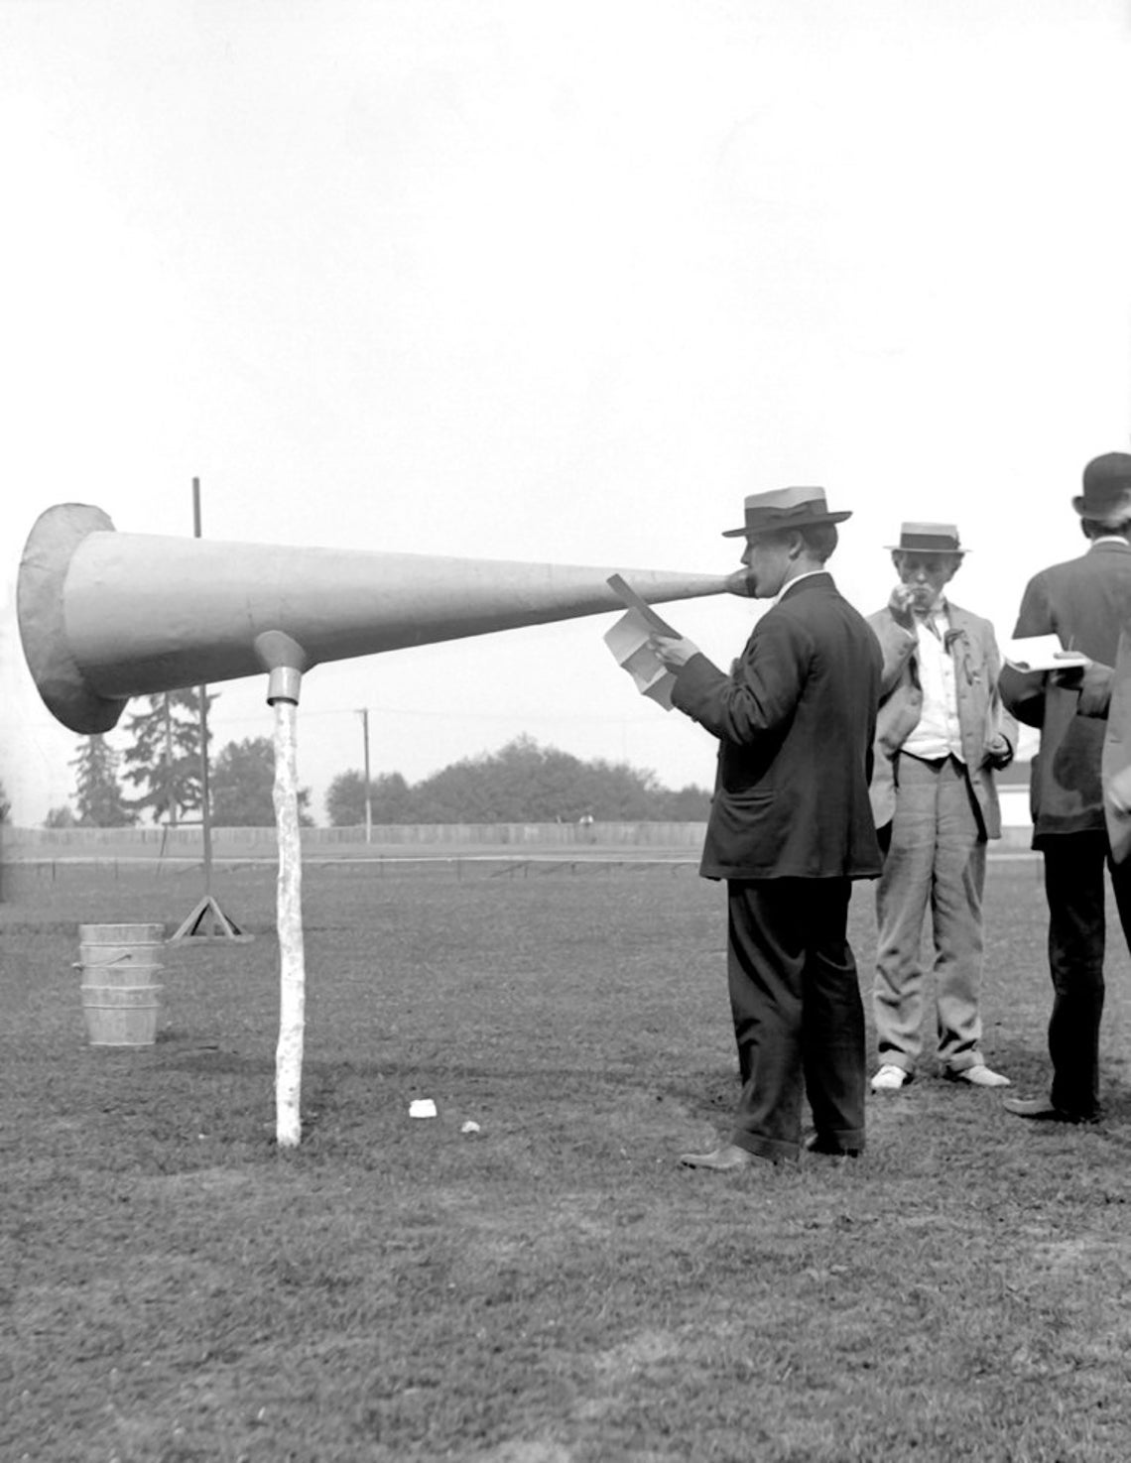
Make Your Voice Heard!
The Challenge:
“People with post-COVID conditions (a.k.a. Long-COVID) may develop or continue to have symptoms that are hard to explain and manage. Clinical evaluations and results of routine blood tests, chest x-rays, and electrocardiograms may be normal even though a patient is presenting with symptoms.
The symptoms may be similar to those reported by people with ME/CFS (myalgic encephalomyelitis/chronic fatigue syndrome) and other poorly understood chronic illnesses that may occur after other infections. People with these unexplained symptoms may be misunderstood by their healthcare providers, which can result in delayed diagnosis and the receiving of appropriate care or treatment.”
The Solution:
Advocy, Advocacy, Advocacy! YOU are your best ally and advocate. You know how you feel and what you’re experiencing. Medical professionals often try to take what you’re describing and tweak it just enough to fit into a better-understood category. This goes right back to the above comment about being misunderstood and delaying diagnosis and possible treatment. The only one that can mitigate this is you. Don’t give up!

Slide 19
Tips for Talking to your Dr. about Long-COVID
Keep explaining and re-explaining your symptoms until they are repeated back to you accurately
Make it clear to your doctor that you need someone who will see you through this complicated process
Bring along an advocate if needed – whether because of a disability, a communication gap or just for additional support and reassurance and to help make sure you are being heard and taken seriously
Request records and visit summaries and check for accuracy - this is your right!
Most medical facilities have online portals where you can
Access medical records
Access test results
Message your doctor or nurse
Set up and cancel appointments
When testing for COVID at a walk-in or emergency clinic:
Always request to have a copy of the visit and results sent to your primary care doctor
When scheduling a Covid test online for walk-in clinics (Walgreen’s, CVS etc.) simply check the box that says “send results to my physician” and fill in the requested information
If you test positive, whether at home or in a clinic, always follow up with a phone call to your primary care doctor making sure they record the results on your medical chart. Documentation is critical!

Slide 20
Resources: Long-COVID as a Disability
Guidance on Long Covid as a Disability Under the ADA, Section 504 and Section 1557 https://www.hhs.gov/civil-rights/for-providers/civil-rights-covid19/guidance-long-covid-disability/index.html
The Office for Civil Rights of the Department of Health and Human Services (HHS) has the following page on civil rights and COVID-19: https://www.hhs.gov/civil-rights/for-providers/civil-rights-covid19/index.html.
Filing a civil rights complaint https://www.hhs.gov/ocr/complaints/index.html

Slide 21
How Will the Workplace Adapt?
Estimates of 16 to 23 million working-age Americans (those aged 18 to 65) currently have Long-Covid
Of those, 2 to 4 million are out of work due to long Covid.
The annual cost of those lost wages alone is around $170 billion a year (possibly as high as $230 billion).
“COVID-19 likely resulted in 1.2 million more disabled people by the end of 2021 alone — workplaces and policy will need to adapt. Workplaces will need to adapt to significant increases to both the disabled population and disabled workforce, and future labor market analysis must center disability.”
“Workplaces must accommodate the needs of disabled workers by decreasing the barriers that make it difficult for them to apply, obtain, and maintain employment. In addition, it will be crucial for labor market analysts and policymakers to understand the economy through the lens of disabled people’s experiences.”
- Center for American Progress, Lily Roberts, contributor, February 9, 2022

Slide 22
Employers are Concerned,
but are They Ready to Adapt?
Survey: Employers concerned about long-term mental health issues post-Covid https://www.fiercehealthcare.com/payers/employers-concerned-about-long-term-mental-health-issues-post-covid-survey - Fierce HealthCare, Paige Minemyer, Aug 24, 2022
Nearly half (44%) of employers surveyed by the Business Group on Health said they have seen this trend in their workforces
another 44% expect to see worsening mental health in the future
Most (85%) said they anticipate enhanced mental health benefits launched under the pandemic to continue
about half of employers said they expect to expand mental health networks for 2023
Employers also expect the lingering effects of COVID to be felt in other ways:
an increase in medical services due to delayed care
Keeping employer pandemic programs in place beyond enhanced mental health and well-being programs.
Ninety-four percent said they will continue to provide expanded virtual care and telehealth offerings
53% said they will offer programs that continue to support workers remotely

Slide 23
Employer Tips
Implementing workplace accommodations can help companies retain employees experiencing long-term effects from COVID-19 and other chronic illnesses.
Educate yourself on long COVID
Create a safe environment for open communication
Offer remote options
Consider job flexibility and be open to change
Reevaluate benefits and paid leave policies
Invest in peer-mentoring programs
Encourage collaborative work systems
source: MIT Sloan Management Review, Fiona Lowenstein, founder of Body Politic, contributor https://sloanreview.mit.edu/article/how-managers-can-support-employees-with-long-covid/
Note: This is what people with disabilities have already been advocating for in the workplace! Should it take a pandemic and a newly identified chronic illness to get the attention of employers?

Slide 24
Additional Resources and Information for Employers
JAN (Job Accommodation Network) & EARN (Employer Assistance and Resource Network on Disability Inclusion Supporting Employers with Long COVID: A Guide for Employers https://askjan.org/publications/upload/Supporting-Employees-with-Long-COVID-A-Guide-for-Employers.pdf
Guidance on Long Covid as a Disability Under the ADA, Section 504 and Section 1557 https://www.hhs.gov/civil-rights/for-providers/civil-rights-covid19/guidance-long-covid-disability/index.html
Questions and Answers on the Final Rule of Implementing the ADA Amendments Act of 2008: https://www.eeoc.gov/laws/guidance/questions-and-answers-final-rule-implementing-ada-amendments-act-2008
What you should know about COVID-19 and the ADA, the Rehabilitation Act, and Other EEO Laws https://www.eeoc.gov/wysk/what-you-should-know-about-covid-19-and-ada-rehabilitation-act-and-other-eeo-laws
Supporting Employers with Long COVID: A Guide for Employers – from the JAN Network https://askjan.org/publications/upload/Supporting-Employees-with-Long-COVID-A-Guide-for-Employers.pdf

Slide 25
Centers for Independent Living
Who and what are we and how can we help?
Independence, Inc. is one of about 400 Centers for Independent Living across the United States and one of 10 in the State of Kansas. CIL’s were born from the Independent Living movement of the 1970’s where disability rights advocates fought for their civil rights live independently in the community, establish expectations that places will be accessible, and that community programs and services will be available to all. CIL’s are staffed by and provide services for people with disabilities through the five required core services of:
Advocacy
Information & Referral
Independent Living Skills Training
Peer Support
Transition services: Transitioning from institution to community-based living and Youth Transition from school to adult life.
CIL’s can also offer an array of additional services like
Transportation
Financial Management Services
Housing assistance and an Accessible Housing Program
Business & Community Services
Independent Living Counseling through the Working Health program
Kansas TAP program
Medical Equipment Loan Bank
Computer Lab

Slide 26
Breaking Down the Barriers:
We haven’t had any calls or inquiries for Covid-related services
The idea of Long-COVID is still quite new and the general public may be experiencing it and not realize it. Doctors often dismiss these claims of ongoing symptoms and say to give it more time without ever seeing the patient in office
We don’t currently offer Covid-related services and aren’t sure there’s really a need
All the research around Long-COVID shows that the need is great and services to assist consumers needs to expand
We didn’t accept the Federal Public Health Work Force grant for Covid-related services
You don’t need to specifically fund a new position to incorporate Covid-related services like I&R, assisting with disability claims, providing community COVID resources etc.
We don’t offer Covid-related peer support and don’t know of any Covid-related support groups in the area
Long-COVID, like any other disability, doesn’t necessarily warrant it’s own specific group of peers. Many chronic health conditions take the same mental and physical toll on people. Already established groups can incorporate people living with Long-COVID
We don’t have any staff trained in Covid-related issues
Staff can intake and assist people with Long-COVID just as any other person with a disability. The key is to educate the public about Long-COVID through established resources
Long-COVID isn’t a big problem in our area
Chances are, it actually is and is either not yet recognized and understood by consumers, or consumers aren’t reaching out for help. Educating the community and participating in outreach is essential
We still have the first round of CARES Act funding to spend and aren’t sure what to do with it
The PHW Grant is completely different and is meant to go towards the salary of a dedicated PHW to serve the community
We don’t feel equipped
You are! You don’t have to fully understand it to be able to assist someone with a COVID-related disability
I don’t know the COVID lingo
That’s ok! The more people you assist, the more you’ll learn alongside them

Slide 27
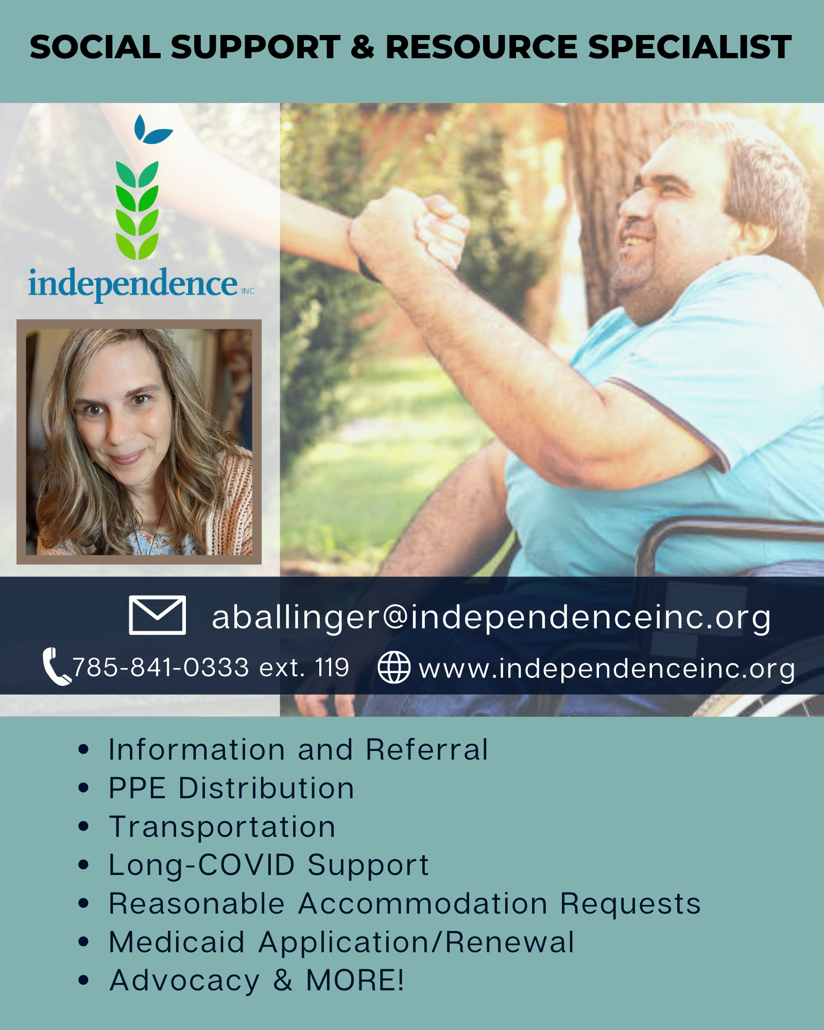
Outreach is Key:
Inform your community!
As with any type of product or service, it takes marketing and outreach to draw in consumers. Most consumers will likely think of Covid in only clinical terms. Once it becomes Long-COVID and may become, or has already become, a disability, this consumer is like any other that we see. Clinical knowledge or specific Covid-related programs are not needed to assist Long-COVID consumers
Create Flyers or Brochures
Utilize Social Media and your website to share info
Send out Newsletters
Contact Consumers Directly
Create Covid-related Community Partnerships
Send Information through your List Servs
Direct Mail or Email to your Donors
Leave info at PT’s, Rehab Facilities, Clinics etc.

Slide 28
Specific ways to Assist Long-Covid Consumers
Apply for SSDI, SSI, Medicare, Medicaid, Unemployment, Housing/mortgage/rent assistance, food stamps etc.
Get vaccinated [Yale Medicine research, Akiko Iwasaki, PhD, Prof. of Immunobiology; April 12, 2021]
Provide or find transportation
Connect them with peer support (newly acquired disability, chronic illness, mental health etc.)
Assist with making sure the consumer has documented illness and symptoms in their medical charts
Utilize DME loan bank or help locate one
Locate funding for home modifications
FMS/PASS assistance if they qualify for a caregiver
Reasonable Accommodation requests
Advocacy with landlords over disputes, ESA or Service animals
Housing services: finding accessible and or affordable housing
Provide PPE to Consumers and Caregivers

Slide 29
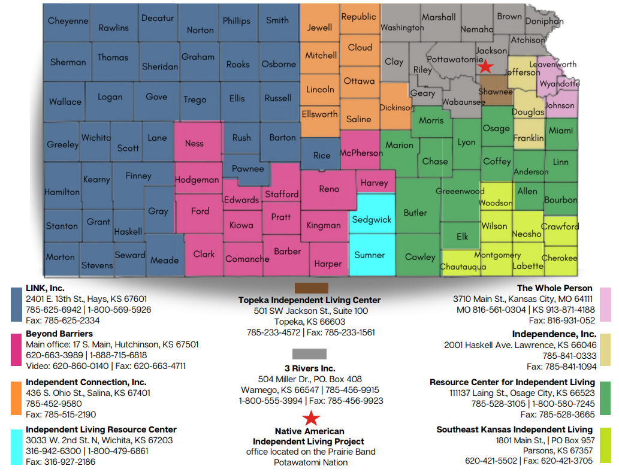
Map of Kansas CIL’s
By County

Slide 30
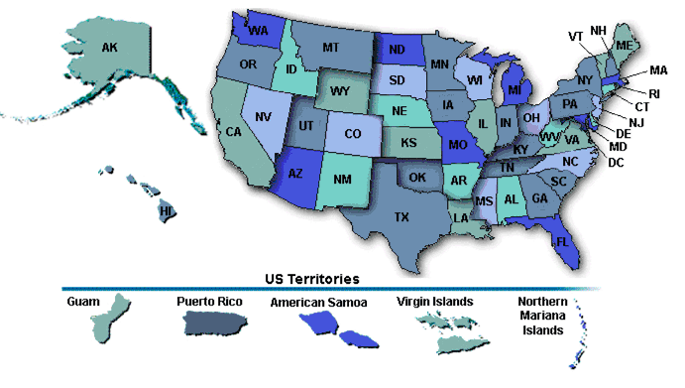
To Locate CIL’s in Your State
To Locate CIL’s in Your State:
Independent Living Research Utilization Program (ILRU)
ILRU is a national center for information, training, research and technical assistance in independent living (IL) aimed at expanding the body of knowledge in IL and improving utilization of research results and demonstration projects in this field.
https://www.ilru.org/projects/cil-net/cil-center-and-association-directory

Slide 31
Survivor Corps
“Survivor Corps is the largest grassroots movement in America dedicated to actively ending the pandemic”
Selected for inclusion in The United States Library of Congress Coronavirus Web Archive: https://www.loc.gov/web-archives/?q=Survivor+corps
Founder Diana Berrent – Her Personal Story: https://www.survivorcorps.com/story
Take Action – Medical, Scientific and Academic research, studies and survey opportunities: https://www.survivorcorps.com/take-action
Long-COVID: Long Hauler Symptom Studies: (Indiana University School of Medicine)
Recovery Corps: To better understand how individuals recover from COVID (Columbia University)
Yale Long COVID Vaccine Study: How vaccines might improve Long Covid symptoms (Yale University)
Join their Facebook group: information, support, community, webinars and news across the nation

Slide 32
Resources and Work Cited (1 of 3)
National Library of Medicine Long Covid-19 Proposed Primary Care Clinical Guidelines for Diagnosis and Disease Management https://www.ncbi.nlm.nih.gov/pmc/articles/PMC8073248/
Center for Disease Control and Prevention: Long COVID or Post-COVID Conditions https://www.cdc.gov/coronavirus/2019-ncov/long-term-effects/index.html
Center for Disease Control and Prevention: National Center for Health Statistics https://www.cdc.gov/nchs/pressroom/nchs_press_releases/2022/20220622.htm
U.S. News & World Report: Long COVID Sufferers Are Seeking Disability Benefits. Will They Change the System? https://www.usnews.com/news/health-news/articles/2021-04-15/covid-long-haulers-could-change-the-disability-system
Employment Guidance: U.S. Equal Employment Opportunity Commission https://www.eeoc.gov/coronavirus and https://www.eeoc.gov/wysk/what-you-should-know-about-covid-19-and-ada-rehabilitation-act-and-other-eeo-laws
Filing a Charge of Discrimination with the EEOC https://www.eeoc.gov/filing-charge-discrimination
University of Colorado Health: Long COVID Mental Health Challenges Require Specialized Treatment https://www.uchealth.org/today/long-covid-mental-health-challenges-require-specialized-treatment/
Center for American Progress https://www.americanprogress.org/article/covid-19-likely-resulted-in-1-2-million-more-disabled-people-by-the-end-of-2021-workplaces-and-policy-will-need-to-adapt/

Slide 33
Resources and Work Cited (2 of 3)
CDC National Center for Health Statistics: https://www.cdc.gov/nchs/pressroom/nchs_press_releases/2022/20220622.htm
A Key to Long-COVID is Virus Lingering in the Body, Scientists Say – Sumathi Reddy, Wall Street Journal, Sept. 8, 2022 https://www.wsj.com/articles/a-key-to-long-covid-is-virus-lingering-in-the-body-scientists-say-11662590900
https://www.survivorcorps.com/
Long Covid as a disability https://www.survivorcorps.com/disability
Federal Resources for Long COVID https://www.survivorcorps.com/resources-federal
Brookings Research and Data: https://www.brookings.edu/research/new-data-shows-long-covid-is-keeping-as-many-as-4-million-people-out-of-work/

Slide 34
Resources and Work Cited (3 of 3)
Research Article: How and Why Patients Made Long Covid – Felicity Callard, Univ. of Glasgow, Geographical and Earth Sciences; Elisa Perego, Univ. College London Jan, 2021 https://www.ncbi.nlm.nih.gov/pmc/articles/PMC7539940/
Living with Long COVID: explaining what’s happening in the body https://www.youtube.com/watch?v=lTIGnHleLNM
Psychological Distress Prior to Long-COVID as Determining Factor? https://www.hsph.harvard.edu/news/press-releases/psychological-distress-before-covid-19-infection-increases-risk-of-long-covid/
Emergency Preparedness and Response Long COVID Guidance: https://www.ada.gov/emerg_prep.html

