Slide 1
Funding to Supplement Core Services
Jerri Davison, Vice President & Chief Program Officer
Kimberly Tissot, President & CEO

Slide 2
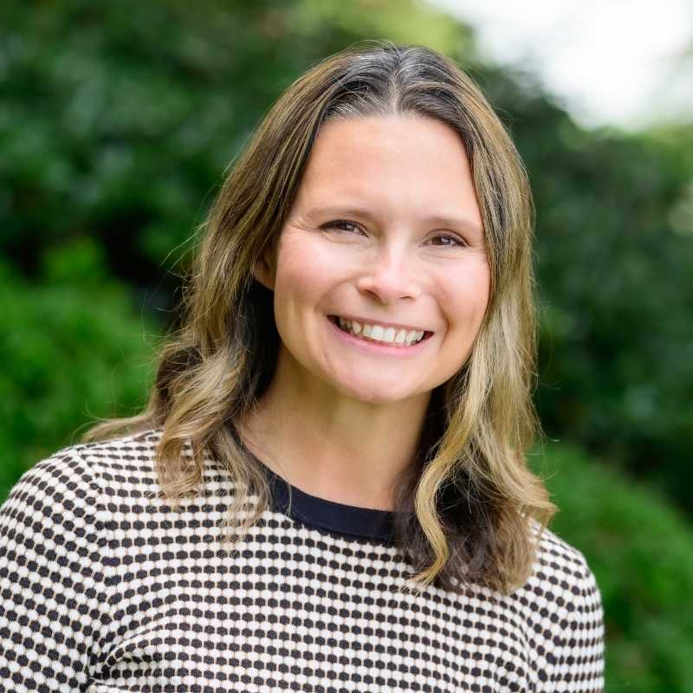
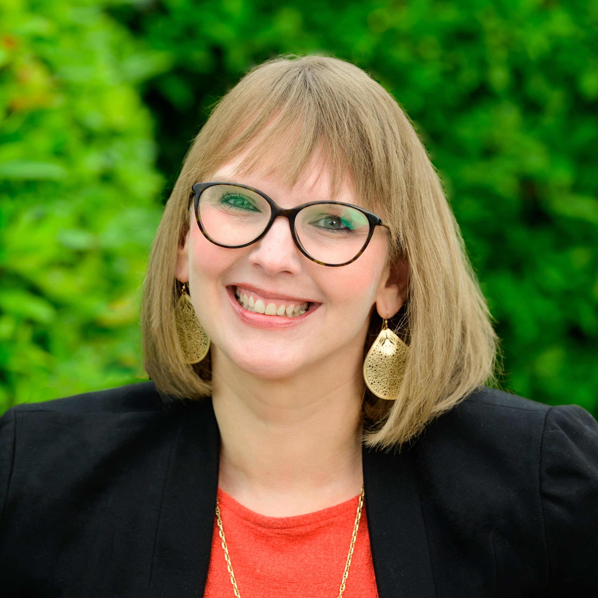
Your Presenters
Jerri Davison
Vice President & Chief Programs Officer
Kimberly Tissot
President & Chief Executive Officer

Slide 3
Learning Objectives
Today You Will Learn:
The resource development requirements for CILs
Our path to growth!
The importance of diversifying funding
More about the core services and incorporating them into outside funding opportunities
Program ideas for seeking funding from non-disability specific funding streams
To focus on IL within all funding opportunities
Shared tips and support!

Slide 4
CIL Requirements
Resource Development Activities—CILs shall conduct resource development activities to obtain funding from sources other than Chapter 1 of Title VII of the Act.
Compliance—CILs shall provide evidence in its most recent annual performance report that it has conducted resource development activities within the period covered by the performance report to obtain funding from sources other than Chapter 1 of Title VII of the Act. 29 U.S.C. 796f-4

Slide 5
The Benefits of Diversifying Funding
Mitigating risks- Could protect your CIL if you lost funding
Autonomy: Depending on the funding structure, you could perform unallowable activities like lobbying!
Visibility: The more we are doing activities, the more we are known!
Adaptability: Can make adjustments to sustain staff if funding was put on hold or not funded immediately

Slide 6
Able SC’s Growth
2010
Funding: $524,890
Staff: 6
2011:
Funding: $691,802
Staff: 15
2012:
Funding: $714, 841
Staff: 17
2013:
Funding: $813,948
Staff: 21
2014:
Funding: $931,685
Staff: 33
2015:
Funding: $1,216, 425
Staff: 41
2016:
Funding: $1,554,788
Staff: 53
2017
Funding: $2,068,164
Staff: 53
2018
Funding: $2,537,973
Staff: 60
2019
Funding: $3,445,134
Staff: 60
2020:
Funding: $4,039,533
Staff: 58
2021 (projected):
Funding: $6,000,000+
Staff: 59+

Slide 7
What Does Funding Mean for your CIL?

Slide 8
Growth Goals Should Include:
More Impact
Increased services
More needs are being met
The disability voice takes the space
Increased number of consumers served
More community education
More respect for the disability community
Career paths & leadership opportunities
Competitive wages and benefits for staff
More exposure & positive reputation
Attract more funders
Advocacy!!

Slide 9
Sustaining Growth
Starts at day one!
New funding should not be seen as temporary or add more tasks to existing staff. Build evidence to support your services via successful program implementation
Sustainability planning by building your funding so you have more capacity, knowledge and ability to perform services
Make your impact known– don’t be the best kept secret!
Attract other funders by your impact

Slide 10
Funding within the Five Core Services

Slide 11
Five Core Services (let’s be real, its six core services)
1. Advocacy- BOTH Systems and Individual
2. Independent Living Skills Training
3. Peer Mentoring
4. Information and Referral Services
5. Transition Services 1 – Institution Transition & Diversion
6. Transition Services 2- Youth Transition

Slide 12
Advocacy
Diversity, equity, and inclusion (DEI) funding
DD Council Funding
Corporate partnership & sponsorships
Fee for services
National grants with IL Network
Minority and marginalized focused initiatives
Fundraising
Emergency related opportunities
Affordable & accessible housing efforts
Systems change efforts
ACL partners collaboration
Notes:
Community Leadership Academy
BIPOC COVID-19 Vaccine Outreach
South Carolina Employment First Initiative
Advocacy Day for Access & Independence
SC Disability Emergency Disaster Coalition
Sexual & Domestic Violence Initiatives
Bull Street Project

Slide 13
Independent Living Skills Training
Medicaid waivers
United Way
National grants with your IL Network
BlueCross BlueShield/Centene/Amerigroup
Community foundations
Vocational Rehabilitation Department / DD agencies / Blind agency
Social Security (Ticket to Work, WIPA, etc.)
Emergency related education
Self advocacy
Assistive Technology
Fundraising/Corporate Sponsorships
Adjustment to disability
Notes:
United Way of Greenville Financial Stability
Social Security Ticket to Work & WIPA
Emergency Management
Mobility Management/Transportation

Slide 14
Peer Mentoring
School funding / grant opportunities
College and universities
Corporate sponsorships
Medicaid waivers/reimbursements
Pre-employment transition services
DD Council
Self-advocacy grants
Notes:
Empower Hour, Christopher Reeves, Hangouts

Slide 15
Information & Referral Services
United Way
ACL Partners
Partnership building with likeminded organizations
Education campaigns
Information hub
Training programs
Call centers
Notes:
Monthly trainings, covid call center, education campaigns (covid, education)

Slide 16
Youth Transition Services
Department of Education
Parent Training and Information Centers
Vocational Rehabilitation
Pre-Employment Transition Services
Local school districts – K-12
Colleges/Universities
IDEA Advisory Committee
Corporate Sponsorships
Fundraising
Department of Juvenile Justice
Notes:
Pre-ets, Equip, Youth Leadership forum

Slide 17
Institution Transition & Diversion
Money Follows the Person
Relationship building with hospitals and home care organizations
Collaboration efforts with partners to create a program to meet the needs
Relationships with non-traditional institutions
Medicaid waivers/reimbursements to implement consumer driven services in the community
Assistive technology
Partnerships with the state’s adult protection agency, aging and homeless organizations
Community supports and fundraising

Slide 18
Fee for Service Example
Able Access is a program that educates the community through a variety of technical assistance and training programs to assist businesses with achieving full equity by including disability and fulfilling their legal obligations under disability rights legislation, including the Americans with Disabilities Act, Section 508 of the Rehabilitation Act, SC Persons with Disabilities Right to Parent Act, etc. Fees are on a sliding scale and discounted for nonprofit groups. Able Access includes:
Architectural Accessibility Assessments
Digital/Website Accessibility Training and Testing
Customized Professional Trainings and Keynote Speakers
Policy and Procedure Review to Ensure Inclusiveness
Technical assistance

Slide 19
Tips

Slide 20
Tip One: Disability Intersects with All Populations
Look at non-disability related opportunities and incorporate disability.

Slide 21
Tip Two: Disability Representation
When representation is critical, CILs should be leading the disability space with consumer-driven programs and services.
Nothing about us, without us!

Slide 22
Tip Three: Be Bold
Sometimes it takes creating services to generate funding for services– “you have to spend money, to make money.”

Slide 23
Tip Four: You Won't Win them All
Its ok not to get funding for every effort you try. Save and tweak the program idea for another opportunity in the future!

Slide 24
Tip Five: Avoid Mission Drift
Don’t chase the money. Chase the opportunity to further your mission!

Slide 25
Avoid Mission Drifting
Mission drift is when you secure funding that is outside of your mission.
Avoid mission drift by:
Setting rules and priorities for your CIL. Do not apply for funding unless it fits within those rules
Ensuring your staff and board understands your current mission, values, goals, and vision
Saying “no” (sometimes you have to)
Creating a clear and focused strategic plan on increasing funding and organizational capacity
Understanding the risks of mission drift for disability-led organizations
Using the philosophy and your mission to guide all decision-making practices
Understanding the benefits of being disability-led and using that to attract funders

Slide 26
Examples of CIL’s Mission Drifting

Slide 27
Why does Mission Drift Hurt CILs?
We are disability-led organizations
Stay focused as our movement needs us!

Slide 28
Questions

Slide 29
Stay Connected!
Website: able-sc.org
Email: info@able-sc.org
Phone: 803-779-5121
TTY: 803-779-0949
Join Email List: Text ABLESC to 72572
Social Media:
Facebook: @AbleSC
Twitter: @able_sc
Instagram: @able_sc
LinkedIn: Able South Carolina
YouTube: Able South Carolina

