Slide 1
Effectively Supporting and Accommodating CIL Staff
Kimberly Tissot and Jerri Davison, Able South Carolina
2022 APRIL Conference

Slide 2
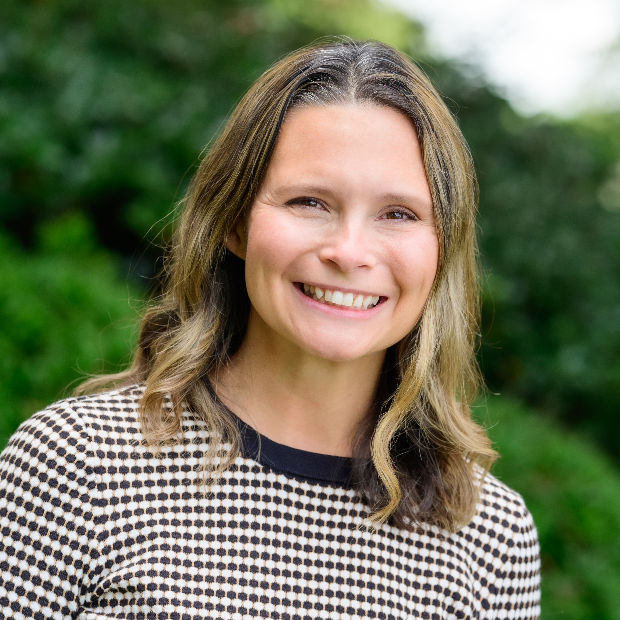
Today’s Presenters
Kimberly Tissot
(she, her)
President and Chief Executive Officer
Jerri Davison
(she,her)
Senior Vice President and Chief Executive Officer

Slide 3
Able SC Staff

Slide 4
Disabilities Represented on Staff
Visual
Hearing
Physical
Health
Respiratory
Depression
Anxiety
PTSD
Intellectual
Developmental
Autism
Autoimmune
Spinal Cord Injury
ADHD
Psychosis
Processing
Speech
Mobility
And more!

Slide 5
In addition to different disabilities…
Different Intersections:
Ages
Races
Religions
Educational Background
Professional Experience
Gender Identities
Sexual Orientation
Life Experiences

Slide 6
Unique individuals call for…
Unique Approaches!
Likely means some trial and error in determining what works.
Employee-Directed
Individual accommodations and available universal options

Slide 7
CIL Employers
As you know, having a disability does not mean employers should:
Give special treatment
Shift essential job functions
Enable any learned helplessness
We are uniquely positioned to offer:
Understanding and encouragement
Peer support and lived experience
A bit of tough love when needed
Creative solutions
Ongoing support and encouragement

Slide 8
Workplace Culture
Leadership talks openly about our own disabilities and strategies we use for support.
Staff, particularly leadership staff, are encouraged to talk about their disabilities and experience with coworkers as a form of peer support whenever they feel comfortable to do so.
We had a staff meeting series where staff volunteered to share the accommodations they use in the workplace. These examples not only helped staff get ideas on how to support consumers but it also helped staff who may benefit from similar accommodations.

Slide 9
Normalize Accommodations
From the start!
In your policies
In your marketing for new positions
In your orientation
For everyone
Job descriptions

Slide 10
Scenarios for Discussion

Slide 11
Scenario 1:
Staff member with intellectual disability was having difficulty with remote work during a hybrid schedule.
Strategies:
Shared Microsoft To-Do List
Step by step instructions for common tasks to refer back to
Increasing days in office where there is more structure and less distractions
Providing strategies to other staff on clear communication when working with her

Slide 12
Tools to Stay on Task
For Discussion:
What are some tools, strategies, or accommodations your coworkers or consumers use to help with time management, organization, prioritizing tasks, and remembering processes?

Slide 13
Scenario 2:
A staff member with ADHD and a psychiatric disability had a difficult time with criticism, leading to conflict with supervisors, unfounded fear of being fired, and a prolonged need for reassurance and encouragement.
Strategy that didn’t work: Verbal reassurance that her job was safe and that management believed in her capacity to do well.
Additional information that helped us understand:
Supervisor from previous employment made her feel incompetent and like her job was at risk on a regular basis.
Staff identified as Queer, and some key members of her family were not accepting.

Slide 14
Scenario 2 Successful Approach
Upper management started spending more time with her.
CPO worked on some projects with her.
CEO scheduled regular mentoring/virtual coffee time with her.
The staff member developed trust and confidence through these interactions.
She now appreciates direct, honest feedback.
Emotional Deposits Approach

Slide 15
Strategies to Build Confidence
For Discussion:
What are some tools, strategies, or accommodations that may build confidence and self-esteem in your coworkers or consumers?

Slide 16
Scenario 3:
Staff member with psychiatric disability was experiencing significant mental health symptoms and checked themselves into intensive treatment program.
Other information to note:
Staff member had recently moved to the area and did not have a support network nearby
Staff member’s parents had a history of doubting her ability to live independently due to her disabilities, limiting her trust and ability to use them as a support

Slide 17
Scenario 3 Successful Approach
Since phone use was limited in the facility, leadership remained “on call” after hours to help support the staff at any time
Asked for specific ways we could help--What do you need or wish you had there?
Provided comfy lounge clothes and hygiene items
Access to sick leave pool
Served as an advocate when family was served notice of commitment hearing
With permission, communicated with staff’s mother and her appointed attorney
Upon discharge, helped brainstorm solutions for recognizing concerning symptoms to seek help sooner
Granted request to transfer to office closer to support system when opening became available

Slide 18
Tools for Mental Health Support
For Discussion:
What are some tools, strategies, or accommodations your coworkers or consumers use to help with psychiatric episodes and times when they need additional emotional and advocacy support?

Slide 19
Tools
AskJan
Microsoft To-Do
Shared Live Documents (Share Point)
Outlook Calendar
Encouragement notes
Kudoboards
Teams chats
Assistive Technology
Accessible Offices
Connecting with other CILs!

Slide 20
Stay in touch
Website: able-sc.org
Email: info@able-sc.org
Phone: 803-779-5121
TTY: 803-779-0949
Join Email List: Text ABLESC to 72572
Social Media:
Facebook: @AbleSC
Twitter: @able_sc
Instagram: @able_sc
LinkedIn: Able South Carolina
YouTube: Able South Carolina

