Slide 1



ADA and Substance use disorders in the Workplace
Barry Whaley
Southeast ADA Center

Slide 2
Disclaimer
The contents of this presentation were developed under a grant from the National Institute on Disability, Independent Living, and Rehabilitation Research (NIDILRR grant number 90DPAD0005-01-00. NIDILRR is a Center within the Administration for Community Living (ACL), Department of Health and Human Services (HHS). The contents of this publication do not necessarily represent the policy of NIDILRR, ACL, HHS, and you should not assume endorsement by the Federal Government.
The information, materials, and/or technical assistance provided by the Southeast ADA Center are intended solely as informal guidance and are neither a determination of your legal rights or responsibilities under the ADA, nor binding on any agency with enforcement responsibility under the ADA.
The Southeast ADA Center does not warrant the accuracy of any information contained herein. Furthermore, in order to effectively provide technical assistance to all individuals and entities covered by the ADA, NIDILRR requires the Southeast ADA Center to assure confidentiality of communications between those covered and the Center.
Any links to non-Southeast ADA Center information are provided as a courtesy, and are neither intended to, nor do they constitute, an endorsement of the linked materials.
You should be aware that NIDILRR is not responsible for enforcement of the ADA. For more information or assistance, please contact the Southeast ADA Center via its web site at adasoutheast.org or by calling 1-800-949-4232 or 404-541-9001.

Slide 3

Learning Objectives
Define disability as it applies to alcohol use disorder, substance abuse disorder (SUD), and opioid use disorder.
List the obligations for employers under ADA Title I (Employment).
List the obligations for employees with SUD under ADA Title I (Employment).

Slide 4
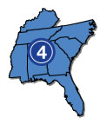
Southeast ADA Center
Funded by the National Institute on Disability, Independent Living and Rehabilitation Research (NIDILRR) through the Administration
for Community Living (ACL) and U.S. Health and Human Services.
Phone: 1-800-949-4232 (voice/TTY/relay)
Email: adasoutheast@syr.edu
Web: adasoutheast.org

Slide 5
Let’s Look at the Numbers

Slide 6
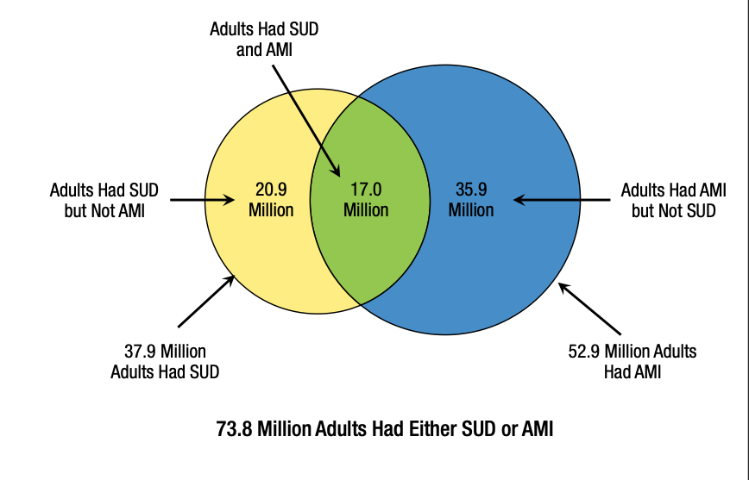
Substance Use Disorder (SUD) and ANY Mental Illness among Adults Aged 18 or Older: 2020
Figure 35.
Past Year Substance Use Disorder (SUD) and Any Mental Illness among Adults Aged 18 or Older: 2020
Source:
Substance Abuse and Mental Health Services Administration (SAMHSA)
Web:
tinyurl.com/2020-SAMHSA-NSUD-Report
Notes:
Changes since 2018
TOTAL: 57.8 million adults had either SUD or Mental Illness (2020: 73.8 million adults either had SUD or mental illness)
Yellow: 10.2 million adults had SUD but Not Mental Illness (2020: this # has more than doubled to 20.9 million)
Blue: 38.4 million had Mental Illness but not SUD (2020: 35.9 million had mental illness but no SUD – number reduced slightly)
Green: 9.2 million had SUD and mental illness (2020: 17.0 million people have SUD and mental illness - almost double the 2018 #)

Slide 7
More Numbers
Over 22 million Americans are currently in recovery from alcohol and other drug use disorders.
More than 70% of individuals who actively use alcohol or drugs continue to function on the job.
Harvard Health Blog: Working on addiction in the workplace
Source: Harvard Health Publishing, Harvard Medical School, Harvard University
Web: health.harvard.edu/blog/working-on-addiction-in-the-workplace-2017063011941
Notes:
The pandemic has led to sharp increases in alcohol and substance abuse in the United States and an increase in behavioral health disorders.
More than 70% of individuals with alcohol or drug use continue to maintain employment.
A study by the American Addiction Center found that 1 in 3 Americans were drinking alcohol during workhours while on lockdown or working from home. (Source: American Addiction Centers. (2021). Drinking Alcohol When Working from Home. Retrieved 9/12/22 from https://www.alcohol.org/guides/work-from-home-drinking/.)
Over 22 million Americans are currently in recovery from alcohol and other drug use disorders. (Source: Working on addiction in the workplace, Harvard Health Blog [link: health.harvard.edu/blog/working-on-addiction-in-the-workplace-2017063011941].
Although addiction affects all demographic groups, drug and alcohol abuse among African American communities is slightly higher than the general population , with rates of substance abuse disorder at 6.9% for African Americans compared to 7.4% of the total population African Americans also have poorer treatment outcomes.
According to the 2020 National Survey on Drug Use and Health (NSDUH), 44.7% of adult African Americans reported illicit drug use in the past year. (https://www.samhsa.gov/data/sites/default/files/reports/rpt37927/2020NSDUHAfricanAmSlides072522.pdf) (Source: https://americanaddictioncenters.org/rehab-guide/addiction-statistics/african-americans)
American Indian and Alaska Natives have some of the highest rates of substance abuse. Twenty-two percent abuse illicit drugs, and 5% report heavy alcohol use. (Source: https://pro.psycom.net/special_reports/bipoc-mental-health-awareness-racism-in-psychiatry/race-and-addiction-treatment-outcomes)

Slide 8


A Snapshot: The Spirit of the ADA
Ensures that people with disabilities have the same rights and opportunities as
everyone else.
Includes people with addiction to alcohol, and people in recovery from opioid and substance use disorders.
Notes:
The ADA is a sweeping civil rights legislation signed into law on July 26, 1990. It prevents discrimination against individuals with disabilities in all aspects of public life, including work, education, transportation, and all public and private places where the public goes to access goods and services. (https://adata.org/learn-about-ada). The law ensures that people with disabilities have the same rights and opportunities as anyone else. This includes people who have addiction to alcohol, and people who are in a recovery program from opioid or substance abuse disorders. This includes illegal drugs, addiction to prescribed medication, and taking medications illegally (https://adata.org/factsheet/ada-addiction-recovery-and-employment).
Under the ADA, disability is defined as a legal term, not a medical term. There are three ways a person can have protection under the ADA. (https://www.ada.gov/regs2016/adaaa_qa.html#:~:text=Therefore%2C%20the%20Department's%20regulation%20retains,regarded%20as%20having%20a%20disability

Slide 9
The Five Titles of the ADA
Title I Employment Protections.
Title II Public Entities and Transportation.
Title III Public Accommodation and Commercial Facilities.
Title IV Telecommunications.
Title V Technical Provisions.
Notes:
It has been reported that 10 percent to 25 percent of the American population is sometimes on the job under the influence of alcohol or some illicit drug. [1] The social and economic costs of substance abuse in America are staggering.

Slide 10
The Definition of Disability
Under the ADA, disability is defined as a legal term, not a medical term.
Has a physical or mental impairment that substantially limits one or more major life activities; or
Has a history of a physical or mental impairment that substantially limits one or more major life activities; or
Is regarded as having such an impairment.
Notes:
An individual has a physical or mental impairment that substantially limits one or more major life activities.
Addiction can substantially limit brain and neurological functioning, the ability to work, and our ability to learn. Addiction also interferes with sleeping, eating, concentrating, caring for oneself, and memory. Each of these is considered a major life activity.
An individual has a history of a physical or mental impairment that substantially limits one or more major life activities.
After an individual has successfully completed alcohol or substance abuse recovery and no longer use drugs, they may still have protection under the ADA because they have a record or history of addiction and recovery.
An individual is regarded as having a disability.
In the third prong, an employer might hear a rumor or have an assumption that an employee has an addiction. Based upon that belief and without substantive proof, the employer takes a negative employment action. In this case, the employer is regarding the employee as an individual with a disability.

Slide 11

Addiction is an impairment that can substantially limit:
brain and neurological functioning
working
learning
sleeping
eating
concentrating
caring for oneself
remembering
Notes:
Have I mentioned that this is a really complicated topic?
Well in fact…

Slide 12

Alcohol Addiction, Illegal Use of Drugs.
What is the Difference?
The ADA makes a distinction between:
an addiction to alcohol;
and the illegal use of drugs.
Notes:
The ADA makes a distinction between alcohol addiction and the illegal use of drugs.
Is the illegal use of drugs covered under ADA?
An individual who is using drugs illegally is not considered to have a disability when an employer takes an employment action based on that use. Individuals do have ADA protections if they are in a recovery program and no longer currently using drugs illegally. “In recovery” means that the individual is no longer engaging in using drugs illegally or the individual is participating in a supervised rehabilitation program and is no longer using drugs illegally. The term “illegal use of drugs” includes the use of illegal drugs such as heroin or cocaine,
the misuse of controlled substances such as opioids or morphine regardless of if the user has no prescription, a fraudulent prescription, or has a prescription but is using more than the prescribed amount. (https://adata.org/factsheet/ada-addiction-and-recovery).

Slide 13
Alcohol Addiction
Is generally a “disability” regardless of whether it is in the present or in the past.
A person still must meet the definition of disability.
Notes:
Alcohol addiction is generally considered to be a disability regardless of whether the addiction is in the present or past.
An individual with alcohol addiction has immediate protection under the ADA.
In the case Williams v. Widnall, 79 F.3d 1003 (10th Cir. 1996) the 10th Circuit Court of Appeals upheld that alcoholism was a covered disability under the ADA. (Also see:
Adamczyk v. Baltimore County, 1998 U.S. App. LEXIS 1331 (4th Cir. 1998),
Miners v. Cargill Communications, Inc., 113 F.3d 820 (8th Cir. 1997), cert. denied, 118 S. Ct. 441 (1997)
and Office of the Senate Sergeant-at-Arms v. Office of Senate Fair Employment Practices, 95 F.3d 1102 (Fed. Cir. 1996).
Other courts, however, have been reluctant to designate alcoholism as a covered disability and urge a case-by-case evaluation of the existence of a major life impairment. (Also see: Burch v Coca Cola 119 F.3d 305 (5th Cir. 1997), cert. denied, 118 S. Ct. 871 (1998) and Wallin v. Minnesota Department of Corrections 153 F.3d 681 (8th Cir. 1998). (https://www.usccr.gov/files/pubs/ada/ch4.htm).

Slide 14

Substance Use Disorders
The ADA protects a person who is:
  in recovery; and
  no longer engaging in the current illegal use of drugs.
Notes:
An individual who is using drugs illegally is not considered to have a disability when an employer takes an employment action based on that use. Individuals do have ADA protections if they are in a recovery program and no longer currently using drugs illegally. “In recovery” means that the individual is no longer engaging in using drugs illegally or the individual is participating in a supervised rehabilitation program and is no longer using drugs illegally. The term “illegal use of drugs” includes the use of illegal drugs such as heroin or cocaine, the misuse of controlled substances such as opioids or morphine regardless of if the user has no prescription, a fraudulent prescription, or has a prescription but is using more than the prescribed amount. (https://adata.org/factsheet/ada-addiction-and-recovery).
Slow Down and Repeat! Only people in recovery are considered “people with disabilities” under the law. So, what does recovery mean?

Slide 15
What does “In Recovery” Mean?
A person is:
  in recovery from substance use disorder and is no longer engaging in the illegal use of drugs; or
  participating in a supervised rehabilitation program and is no longer using drugs illegally
Notes:
If a person meets these conditions, then the person is protected from discrimination.

Slide 16
What Does “Illegal Use of Drugs” Mean?
Use of illegal drugs such as heroin or cocaine.
Use of controlled substances such as opioids or morphine BUT a person:
  has no prescription; or
  has a fraudulent prescription; or
  is using more than prescribed.

Slide 17
What do we mean by “Current” illegal drug use?
“Illegal use occurred recently
enough to justify a reasonable belief that a person’s drug use is a real and ongoing problem.”
Under the ADA, current drug use is decided on a case-by-case basis.
Notes:
Current drug use
What does the term “current” mean when determining if someone is currently using drugs?
The EEOC offers this guidance:
1) If an individual tests positive on a drug test, he or she will be considered a current drug user, so long as the test is accurate;
2) Current means that the illegal use of drugs was recent enough to form a reasonable belief that someone’s drug use is current and presents an ongoing problem;
3) Current is not limited to the day of use, or recent weeks or days, it is determined on a case-by-case basis. (https://www.eeoc.gov/laws/guidance/technical-assistance-manual-employment-provisions-title-i-americans-disabilities-act).
In Zenor v. El Paso Healthcare Systems, Ltd. 176 F.3d 847, 867 (5th Cir. 1999), the 5th Circuit Court of Appeals held that a pharmacist, who was an employee of El Paso Healthcare, was a current user of illegal drugs because he used cocaine five weeks before he was notified of his termination.
In Salley v. Circuit City Stores, Inc. 160 F.3d 977 (3d Cir. 1998), the court remarked that it knew of no case where a three-week period of abstinence would be considered long enough consider someone no longer an illegal drug user.
Finally, in Shafer v. Preston Memorial Hospital Corporation 107 F.3d 274 (4th Cir. 1997), Shafer appealed a lower court ruling in favor of her employer, Preston Memorial Hospital, claiming disability discrimination due to her drug addiction. Shafer had been stealing Fentanyl, a schedule II narcotic analgesic from the hospital and became addicted. She entered a rehabilitation program but was terminated for gross misconduct involving the diversion of controlled substances. A few weeks after her termination, while working at another hospital, she again used Fentanyl while on duty. On appeal the court ruled that Shafer could offer no credible evidence that her termination was the result of disability discrimination (https://caselaw.findlaw.com/us-4th-circuit/1229798.html).

Slide 18
ADA Title I Employment

Slide 19
Does the ADA Apply to all Employers?
Applies to private employers with 15 or more employees and all state and local government employers.
Applies to all aspects of employment: job application, interview, job training, etc.
… and other terms or conditions and privileges of employment.
Notes:
ADA protections for people with addiction who are in recovery are found in ADA title I, the employment protections. Title I of the ADA applies to private employers with 15 or more employees and all state and local government employers. (https://adata.org/learn-about-ada )
Title I applies to all aspects of the employment process:
Phase 1) pre-employment, pre-offer; Phase 2) pre-employment, post-offer; and Phase 3) employed. Title I also applies to all other terms, conditions, and privileges of employment. Under Title I, an employee is considered a qualified individual if he or she meets the skill, experience, education, and other job-related requirements of a held or desired position, and he or she can perform the essential functions of a job, with or without a reasonable accommodation to how the work is performed. (https://askjan.org/publications/ada-specific/Technical-Assistance-Manual-for-Title-I-of-the-ADA.cfm ).

Slide 20
The Three Stages of Employment
The ADA addresses addiction and recovery during in each stage of employment:
  Stage 1: Pre-Employment, Pre-Offer
  Stage 2: Pre-Employment, Post-Offer
  Stage 3: On the job

Slide 21
Stage 1
Pre-Employment, Pre-Offer
The ADA prohibits all disability-related questions, and medical exams, even if they are related to the job.
These questions can reveal
a disability.
Notes:
In Phase 1, pre-employment, pre-offer, the ADA prohibits all disability-related questions and medical examinations, even if they relate to the job. Asking disability related questions in this stage of employment may reveal a disability.

Slide 22
Stage 1:
What Employers Cannot Ask
Are you taking prescription drugs?
Do you have a disability, illness or condition that will prevent you from doing this job?
Have you ever been treated for addiction to alcohol, opioids or other drugs?
Notes:
For instance, employers in this stage cannot ask if the candidate is taking any medication, if they have an impairment, illness, or condition that would prevent the candidate from performing the job. This would include asking if the job candidate had ever been treated for addiction to alcohol, opioids, or other illegal drugs. An employer can ask if the candidate has ever used or currently uses illegal drugs. A positive or negative answer to this question would not reveal an addiction disability. (https://www.eeoc.gov/laws/guidance/enforcement-guidance-preemployment-disability-related-questions-and-medical

Slide 23
Stage 1:
Gaps in Employment
If asked about the gaps, does the job applicant have to mention their addiction?
  It depends…

Slide 24
Stage 1:
How to Respond to Questions About Gaps in Employment?
Applicant can say that she had an illness, is recovered, and excited to get back to work.
If the employer asks a specific question about her disability (addiction), she should:
  tell the truth, even though the question is illegal.
  If she does not tell the truth and is caught lying, this is cause for not hiring.
  The employer, however, can be found liable for asking an illegal question.
Notes:
Often, potential employees who have a history of alcohol or drug addiction have gaps in their work history due to being in recovery. Does the job candidate have to mention their past addiction? One strategy is to explain that the candidate had an illness, is recovered, and is ready to return to work. Should the employer ask more probing questions about a possible addiction, the candidate should be prepared to tell the truth because lying about the addiction would be considered grounds for not hiring, even though the employer’s question is illegal. (https://www.eeoc.gov/laws/guidance/enforcement-guidance-preemployment-disability-related-questions-and-medical )

Slide 25
Stage 1: Questions an Employer Can Ask About
Alcohol/Illegal Drugs
Questions about use of alcohol/illegal drugs that are allowed:
  Have you ever used, or do you currently use ___?
A positive or negative answer does not reveal a disability.

Slide 26
Stage 1: Questions an Employer Cannot Ask About
Alcohol/Illegal Drugs
Questions about extent or frequency of use are unlawful.
  How much alcohol or drugs do, or did you, consume?
  How often do you, or did you, drink alcohol or use illegal drugs?
These questions may reveal an addiction.

Slide 27
Stage 2:
Pre-Employment, Post-Offer
An employer may make medical inquiries, require medical exams, and ask disability-related questions if this is done for all employees within a job category.
All questions about use of alcohol/drugs, or extent of use, or diagnosis of alcohol/drug addiction are allowed.
At this stage, the new hire must disclose a disability,
if asked.
Notes:
In Phase 2, pre-employment, post-offer, meaning after an offer of employment has been made but the candidate has not started work, employers can make medical inquiries, require medical exams, and ask disability-related questions. These questions must be asked of all candidates within the job category. In this stage, employers may ask about the use of alcohol or drugs and the extent of use, or if the candidate has a diagnosis of alcohol or drug addiction. Job candidates must disclose disability at this stage, if asked. (https://www.eeoc.gov/laws/guidance/enforcement-guidance-preemployment-disability-related-questions-and-medical )
In the midst of a global labour shortage, employers around the world are doing away with drug tests in a desperate bid to attract more job applicants, fill more roles and retain more workers.
A survey, conducted by staffing firm ManpowerGroup and released this week, indicated that 9 percent of more than 45,000 employers worldwide were eliminating job screenings or drug tests as an incentive to “attract and retain in-demand talent.” That equates to some 4,050 employers, from 43 countries, who are willing to turn a blind eye to workers’ recreational drug use if it means filling vacant positions.
In June 2021, Amazon, the second-biggest global employer based out of the U.S., announced that it would no longer test for marijuana in its pre-employment drug testing screening for jobs not regulated by the U.S. Department of Transportation.
they don’t test for cannabis use, claiming that the move could increase applications by 400 percent, Bloomberg reported. The company claimed that screening for marijuana cuts the prospective worker pool by up to 30 percent.

Slide 28

Stage 3:
On the Job
An employer may make
disability-related inquiries and require medical examinations
only if they are
job-related and consistent with business necessity.
Notes:
In Phase 3, employment, employers may make disability-related inquiries and require medical examinations only if they are job-related and consistent with business necessity . According to the EEOC, this “job related and consistent with business necessity” means that an employer has a reasonable belief, based on objective evidence, that 1) an employee’s ability to perform essential job functions will be impaired by a medical condition; or 2) an employee’s medical condition results in a “direct threat” to themselves, coworkers, or the public. (https://www.eeoc.gov/laws/guidance/enforcement-guidance-disability-related-inquiries-and-medical-examinations-employees#5 ) Employers may ask if an employee has been drinking alcohol or using illegal drugs. However, employers may not ask about the nature or severity of an employee’s disability or ask about an employee’s genetic information. ( https://www.eeoc.gov/laws/guidance/enforcement-guidance-preemployment-disability-related-questions-and-medical )
Pam - expand and define
Also, look at right to be safe and drug free workplace

Slide 29
Stage 3:
On the Job. Allowable Questions
(slide 1 of 2)
An employer may ask:
about an employee's well being.
  Example: How are you?
about non-disability-related impairments.
  Example: How did you break your leg?
about the employee’s ability to perform job functions.
Notes:
If an individual who has alcoholism often is late to work, or is unable to perform the responsibilities of his/her job, an employer can take disciplinary action on the basis of the poor job performance and conduct. However, an employer may not discipline an alcoholic employee more severely than it does other employees for the same performance or conduct.[53]

Slide 30
Stage 3:
On the Job. Allowable Questions
(slide 2 of 2)
An employer may ask:
if an employee has been drinking.
an employee’s current illegal use of drugs.
for the name and telephone number of a person to contact in case of a medical emergency.

Slide 31
Stage 3:
On the Job. Questions not Allowed
An employer may not ask:
about the nature or severity of an employee's disability;
another person about an employee's disability;
about an employee's genetic information [also not allowed under the Genetic Information Nondiscrimination Act (GINA)]
about an employee's prior workers' compensation history;

Slide 32
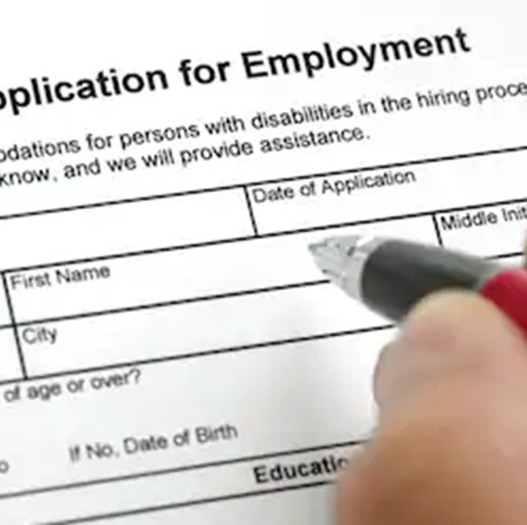
Scenario 1:
Marianna
Marianna has been heroin-free
for 6 years.
She applies for a job that she is qualified to do.
The employer refuses to hire her because she knows about her past addiction.
Is Marianna protected under the ADA?
Notes:
Yes, Marianna is protected under the ADA because
she has:
a history of an impairment (addiction to heroin)
refrained from the use of illegal drugs for six years which is a good indication that there is not an on-going problem.
The potential employer violated the ADA when she refused to hire Marianna because of her recovery status.

Slide 33

Scenario 2
Michael
Michael is often late for work.
His supervisor warns him about his lateness.
The third time Michael is late, his supervisor gives him a written warning, stating that one more late arrival will result in termination.
Michael tells his supervisor that he
is addicted to alcohol.
His late arrivals are due to his drinking,
and he needs immediate time off for
detox and treatment.
Does Michael have protections under the ADA?
Notes:
Yes Michael is a person with a disability (alcohol addiction). 2. Keep in mind that disciplinary actions prior to disclosure of a disability stand and the warning the supervisor gave him stands. The employer can require an employee with addiction to alcohol to meet the same standards of performance and behavior as other employees. The employer must grant Michael’s request to take leave (as a reasonable accommodation) to enter a rehabilitation program, unless the employer can prove that Michael’s absence would cause a great difficulty or expense (undue hardship).
To summarize, alcohol addiction generally is a “disability” regardless of whether it is in the past or in the present. Questions? PAUSE Now, I’ll turn to substance use disorders

Slide 34

Scenario 3:
Julie
Julie has been in recovery for 5 years from addiction to Oxycontin.
She is under medical treatment for
opioid use disorder.
She works in the office at a day care center.
Her boss learns about her former addiction.
She tells her to “get off” methadone
or you will be fired.
Does Julie have protections under the ADA?
Notes:
Individuals receiving treatment for OUD are generally considered disabled under the ADA.
Methadone is a legally prescribed medication used to treat addiction, just like insulin is prescribed to treat diabetes.
Being in medical treatment for addiction is evidence of rehabilitation, not current illegal use of drugs.
Julie’s boss is incorrectly regarding the use of methadone as an illegal drug.

Slide 35
Scenario 3: Julie (a new twist)
What if Julie’s employer found out that she recently used cocaine while in medical assisted treatment (MAT)?
Would Julie have rights under the ADA?
Notes:
No, Julie would not be protected under the ADA because:
the ADA does not protect individuals who are “currently engaging in the illegal use of drugs.”

Slide 36
Scenario 3
Julie
(another twist)
What if Julie’s employer found out that she recently used marijuana while in MAT?
Would Julie have protections under the ADA?
Notes:
Marijuana in any form is still considered a schedule 1 drug under federal law. Even when used with a card, certificate or medical prescription.
A former drug addict may be protected under the ADA because the addiction may be considered a substantially limiting impairment.[12] However, according to the EEOC Technical Assistance Manual on the ADA, a former casual drug user is not protected:
[A] person who casually used drugs illegally in the past, but did not become addicted is not an individual with a disability based on the past drug use. In order for a person to be substantially limited because of drug use, s/he must be addicted to the drug.[13]
However, check your state law.

Slide 37
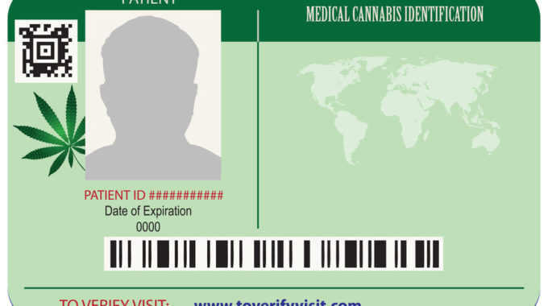
Medical Marijuana and State Law
If medical marijuana is legal under state law, employers may need to consider reasonable accommodations for off-site use of medical marijuana under state law.
**However, an employee who is high in the workplace has NO protections under federal or state law.**
Notes:
Cannabis presents a dilemma for employers.
Although thirty-seven states have legalized medical marijuana and eighteen states permit recreational use, cannabis is still considered a schedule II drug under the Controlled Substance Act of 1970.
Therefore, the ADA excludes people from protection because they are illegally using drugs. Even if an employee has a prescription for medical marijuana, the drug is still considered illegal. But the issue is not so black and white.
Seventeen states have prohibited discrimination against medical cannabis users and six states protect the rights of recreational users. ( https://www.canorml.org/employment/state-laws-protecting-medical-marijuana-patients-employment-rights/ ).
Additionally, in May 2022, Attorney General Merrick Garland reiterated that the Department of Justice (DOJ) will not prioritize prosecutions for marijuana use. (https://www.natlawreview.com/article/attorney-general-garland-reconfirms-doj-s-hands-approach-toward-federal-marijuana ) This reinforces the August 2013 “Cole Memo” issued by Deputy Attorney General James Cole that stated the DOJ would not prioritize prosecution in states with regulated cannabis distribution systems. (https://www.justice.gov/iso/opa/resources/3052013829132756857467.pdf ). The “Cole Memo” was rescinded in 2018 by Attorney General Jeff Sessions by advising federal prosecutors to decide under what circumstances they would prosecute marijuana cases. (https://www.natlawreview.com/article/attorney-general-garland-reconfirms-doj-s-hands-approach-toward-federal-marijuana ).
Without clear guidance, employers may need to consider reasonable accommodations for off premises cannabis use in states where cannabis is legal. However, employers have a “duty of care” to ensure a safe workplace, and employees who are under the influence of cannabis have no protections in the workplace.

Slide 38

Scenario 4
Juan
Juan became addicted to Percocet while taking the medication in a prescribed manner and in prescribed amounts.
  Is Juan protected under the ADA?
Notes:
Yes, James is protected under the ADA because he: is legally using drugs.
However, if he takes more than prescribed, he may not be covered under the ADA.

Slide 39
Scenario 4a
Juan
Juan wants to take a leave of absence from his job to taper off Percocet.
Does Juan have protections under the ADA?
Notes:
Yes, James is protected under the ADA because he:
is a person with a disability and may have rights to an accommodation.
James needs to discuss the possibility of an accommodation with his boss.

Slide 40
Scenario 4b: Juan
What if Juan’s employer found out that he was using heroin on the job?
Would Juan have rights under the ADA?
Notes:
No, James is not protected under the ADA because he:
is illegally using drugs.
An employer is allowed to have a drug-free workplace.
However, the ADA does not limit the employer’s ability to offer leave or other assistance that may enable James to receive treatment.
Last Chance Agreement can be considered only for individuals with addiction.
When an employee can be fired, an employer may choose, but is not required by the ADA, to offer a “last chance agreement.”
An employer agrees not to terminate the employee in exchange for an employee’s agreement to receive treatment and avoid further workplace problems.
A violation of the agreement usually warrants termination because the employee failed to meet the conditions for continued employment.

Slide 41
ADA
National Network Publications
(slide 1 of 2)
The ADA, Addiction, and Recovery Fact Sheet
Web: adata.org/factsheet/ada-addiction-and-recovery
The ADA, Addiction, Recovery, & State and Local Governments Fact Sheet
Web: adata.org/factsheet/ada-addiction-and-recovery-and-government

Slide 42
ADA
National Network Publications
(slide 2 of 2)
The ADA, Addiction, Recovery, & Employment Fact Sheet
Web: adata.org/factsheet/ada-addiction-recovery-and-employment
Reasonable Accommodations in the Workplace
Web: adata.org/factsheet/reasonable-accommodations-workplace
Work-Leave, the ADA, and the FMLA
Web: adata.org/factsheet/work-leave

Slide 43
Southeast
ADA
Center Resources
ADA Live! Podcast: Opioid Addiction and the ADA
Web: adalive.org/episodes/episode-67
ADA Live! Podcast: Opioid Addiction and the ADA with the U.S. Department of Justice
Web: adalive.org/episodes/episode-68
Resource List: Opioid Addiction and the ADA
Web: adalive.org/resources/episode-67-resources

Slide 44
U.S. Equal Employment Opportunity Commission (EEOC) Enforcement Guidance (slide 1 of 3)
Reasonable Accommodation and Undue Hardship Under the ADA
Web: eeoc.gov/policy/docs/accommodation.html
Preemployment Disability-Related Questions and Medical Examinations
Web: eeoc.gov/policy/docs/preemp.html
Disability-Related Inquiries and Medical Examinations of Employees Under the Americans with Disabilities Act
Web: eeoc.gov/policy/docs/guidance-inquiries.html

Slide 45
U.S. Equal Employment Opportunity Commission (EEOC) Enforcement Guidance (slide 2 of 3)
The ADA: Applying Performance and Conduct Standards to Employees with Disabilities
Web: eeoc.gov/facts/performance-conduct.html
Employer-Provided Leave and the ADA
Web: eeoc.gov/eeoc/publications/ada-leave.cfm
Questions and Answers About the Association Provision of the Americans with Disabilities Act
Web: eeoc.gov/facts/association_ada.html

Slide 46
U.S. Equal Employment Opportunity Commission (EEOC) Enforcement Guidance (slide 3 of 3)
Use of Codeine, Oxycodone, and Other Opioids: Information for Employees
Web: eeoc.gov/laws/guidance/use-codeine-oxycodone-and-other-opioids-information-employees
How Health Care Providers Can Help Current and Former Patients Who Have Used Opioids Stay Employed
Web: eeoc.gov/laws/guidance/how-health-care-providers-can-help-current-and-former-patients-who-have-used-opioids

Slide 47
Job Accommodation Network (JAN) Resources
Job Accommodation Network Home Page
Web: askjan.org
Accommodation and Compliance: Alcoholism
Web: askjan.org/disabilities/Alcoholism.cfm
Accommodation and Compliance: Drug Addiction
Web: askjan.org/disabilities/Drug-Addiction.cfm

Slide 48
How to File an ADA Complaint with the EEOC
U.S. Equal Employment Opportunity Commission (EEOC)
How to File a Charge of Employment Discrimination
Web: eeoc.gov/employees/howtofile.cfm
Phone (voice): 1-800-669-4000
TTY: 1-800-669-6820
ASL Video Phone: 1-844-234-5122
Email: info@eeoc.gov

Slide 49
How to File an ADA Complaint with the DOJ
U.S. Department of Justice
How to File an Americans with Disabilities Act Complaint with the U.S. Department of Justice
Web: ada.gov/filing_complaint.htm
Phone (voice): 1-800-514-0301
TTY: 1-800-514-0383

Slide 50

Questions?

Slide 51

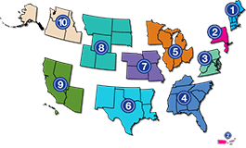
Contact ADA National Network:
Information, Guidance, and Training on the Americans with Disabilities Act (ADA)
Phone: 800-949-4232 (toll free)
All calls are confidential.
Your call will be directed to the regional ADA Center that serves your state
(based on area code of number dialed).
Email (online form): adata.org/email
Web: adata.org
51

Slide 52




Connect and Follow:
ADA National Network
Facebook @adanetwork
Twitter @ADANational
LinkedIn @ada-national-network
YouTube @ADANationalNetwork

