Slide 1
Americans with Disabilities Act (ADA) Youth Training
April 11, 2018
Rene Cummins
Sierra Royster

Slide 2
Drop your answer in the chat box
Share an experience you have had with public transit?

Slide 3
Prep for the Webinar
This is going to be interactive…so get ready to join in!
You will be able to join in the conversation over the phone or microphone…so speak up!
If you would like to ask a question prior to that please raise your hand. You can do that by pressing the image of a person at the top with their hand raised to voice your question or write your question in the chat box.
To mute from home, you can press *#/unmute press *#
We will have Q&A times, if you think of a question before that time please put your question in the chat box and we will come to it during the Q&A break.

Slide 4
Training Outline This is a seven week training covering the Americans with Disabilities Act.
February 14, 2018
Overview of the ADA
Disability Disclosure (1st Key)
February 28, 2018
Overview of Title 1
Reasonable Accommodations (2nd Key)
March 14, 2018
Requesting an Accommodations
(3rd Key)
March 28, 2018
Overview of Title II- State and Local Government
3 Keys
April 11, 2018
Transportation
April 18, 2018
Overview of Title III-Private Entity
3 Keys
May 9, 2018
Overview of Title IV-Telecommunication
Overview of Title V-Miscellaneous Provisions
3 Keys
Review

Slide 5
Title II State & Local government public transit system
Under the ADA, Public Transit Systems must be-
Accessible to people with disabilities
Usable by people with disabilities

Slide 6
Title II State & Local Government Public transit systems
Parallel or Paratransit System
Area ¾ mile on either side of public transit fixed route line
Area ¾ mile radius from endpoint of public transit fixed route line

Slide 7
Barriers/problems with public transit
Inaccessible paths of travel to transit stops & stations
Missing curb cuts
Inaccessible or missing sidewalks
Intersections that lack features for safe crossings
Drivers that fail to identify routes and/or announce stops
Missing pedestrian signals

Slide 8
Barriers/problems with public transit cont.
Drivers who pass by people who use wheelchairs
Drivers who pass by people with service animals
Poorly trained drivers
Inaccessible stops and/or stations
Fail to maintain accessible features
Unavailable Travel Training

Slide 9
Separate is not Equal
Intended to Work Together-Complementary Systems
Cost differs greatly
Independence Differs
Inclusive System vs. Segregated System
Conditional Trips on Both Systems

Slide 10
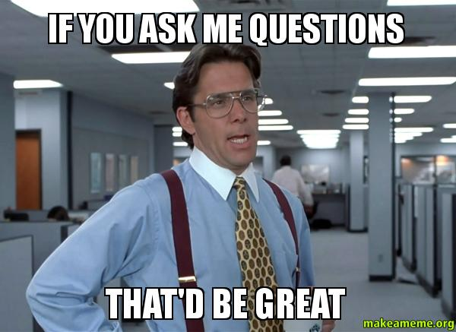
Q&A

Slide 11
Red Light green light
I am going to go through the attendees today and I am going to ask you a question in regards to transportation.
If you get the question wrong you will move back a space.
If you get the question right, but pick the wrong square you will stay where you are in the maze.
If you get the question right you will be able to move forward in the maze, if you pick the right square.

Slide 12
Red light green light
START
FINISH

Slide 13
Wrap Up
Next Training date
April 25, 2018 from 4:00-5:00pm(EST) (3:00-4:00pm CST, 2:00-3:00pm MST, 1:00-2:00pm PST)
Title III Private Entities
Homework
What makes up private entities?

