Slide 1
Some Work… Many Don’t Looking at the Pros & Cons of Complimentary and Alternative Medicine (CAM) for Arthritis Karen Funkenbusch IL APRIL Conversation September 13, 2012 3:00 - 4:30 pm, Eastern Time

Slide 2
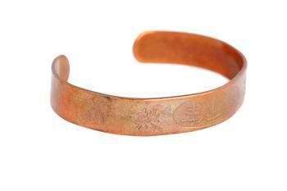
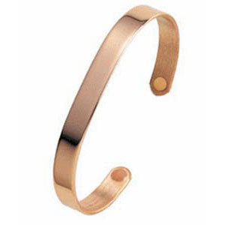
Arthritis complementary and alternative medicine can range from A (acupuncture) to Z (zinc sulfate), with much in between -- from copper bracelets to magnets to glucosamine to yoga, to name just a few.
But, do these therapies for arthritis really work?

Slide 3
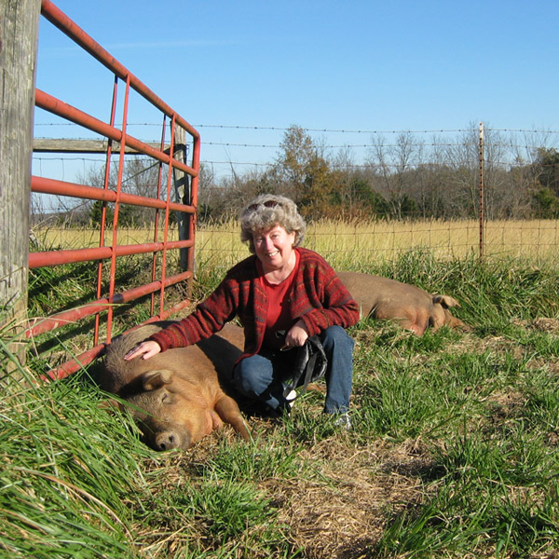
Why complementary And alternative
Persons with arthritis are looking into complementary and alternative (CAM) medicine in an effort to find relief for pain, stiffness, stress, anxiety, and depression that accompany the disease.
The Arthritis Foundation reports that two-thirds of those suffering from the disease have tried CAM.

Slide 4
Points to Consider
Take charge of your health by being an informed consumer.
Find out and consider what scientific studies have been done on the safety and effectiveness of the complementary product or practice that interests you.
Discuss this information with your health care provider before making a decision.
If you are considering a therapy provided by a complementary medicine practitioner, such as acupuncture, choose the practitioner as carefully as you would choose a conventional health care provider.
If you are considering a dietary supplement, such as an herbal product, find out about any potential side effects or interactions with medications you may be taking.
Complementary products or practices that have not been proven safe and effective should never be used as a replacement for conventional medical treatment or as a reason to postpone seeing a health care provider about any health problem.
Tell all your health care providers about any complementary approaches you use. Give them a full picture of what you do to manage your health. This will help ensure coordinated and safe care.

Slide 5
What Is “Complementary”
“Alternative” Medicine

Slide 6
Examples of CAM
Exactly what's considered complementary and alternative medicine changes constantly as treatments undergo testing and move into the mainstream. To make sense of the many therapies available, it helps to look at how they're classified:
Whole medical systems
Mind-body medicine
Biologically based practices
Manipulative and body-based practices
Energy medicine
Something to keep in mind…
The distinctions between therapies aren't always clear-cut, and some systems use techniques from more than one category.

Slide 7
Whole medical systems
A system isn't just a single practice or remedy — such as massage — but many practices center on a philosophy, such as the power of nature or the presence of energy in your body. Examples of whole medical systems include:
Ancient healing systems. These healing systems came about long before conventional Western medicine and include ayurveda (a model that provides guidance regarding food and lifestyle so that healthy people can stay healthy and folks with health challenges can improve their health) from India and traditional Chinese medicine.
Homeopathy. This approach uses minute doses of a substance that causes symptoms to stimulate the body's self-healing response.
Naturopathy. This approach focuses on noninvasive treatments to help your body do its own healing and uses a variety of practices, such as massage, acupuncture, herbal remedies, exercise, and lifestyle counseling.

Slide 8
Diet
Diet affects your overall health and your best bet is to follow one low in saturated fats and calories and rich in fruits, vegetables and grains. However, there is no specific diet for arthritis, despite myths however, there are some ways that diet may affect your arthritis.
Food sensitivities. A small number of people with arthritis might be sensitive to certain foods that could trigger symptoms or cause them to worsen.
Saturated fats. A diet high in saturated fats or vegetable oils can increase the inflammatory response, thereby contributing to joint and tissue inflammation.
Overall health. Diet affects your overall health, as well as affecting any other diseases or conditions you may have (such as diabetes or heart disease). This, in turn, may affect how your body handles arthritis symptoms.
Poor nutrition. Just having arthritis can make your diet worse. You may be unable to shop for and prepare nutritious food for yourself. Pain and fatigue can diminish your appetite, or make it difficult to eat and chew.

Slide 9
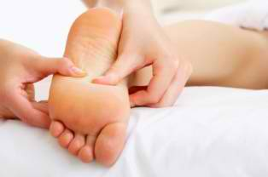
Acupuncture & Acupressure
Acupuncture and acupressure are ancient Chinese pain relief treatments that are gaining popularity in the United States.
In acupuncture, needles are used to stimulate specific points throughout the body.
In acupressure, practitioners use their fingers instead of needles.
Studies suggest it doesn’t change the course of the illness. But it can be helpful in managing pain and reducing stress associated with living with the chronic condition.
But… make sure the practitioner is licensed and certified.

Slide 10
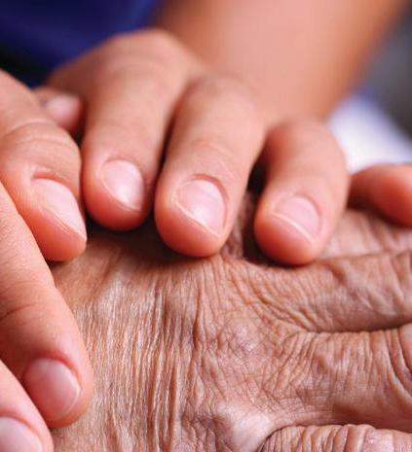
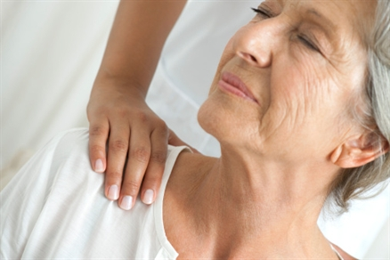
Massage
Massage therapy can be a great way to ease the pain and stiffness associated with arthritis, and many health care providers do recommend massage to their patients.
Research has shown that massage can decrease stress hormones and depression, ease muscle pain and spasms, increase the body’s production of natural pain-killing endorphins and improve sleep and immune function.
But… make sure the massage therapist is experienced and comfortable working with people with arthritis as some elements of massage may not be appropriate.

Slide 11
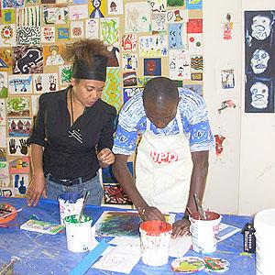
Mind-body medicine
Mind-body techniques strengthen the communication between your mind and your body. Complementary and alternative medicine practitioners say these two systems must be in harmony for you to stay healthy.
Examples of mind-body connection techniques include meditation, prayer, and relaxation and art therapies.

Slide 12
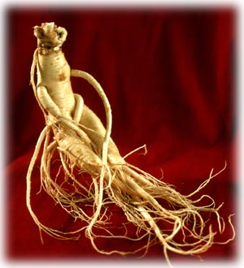
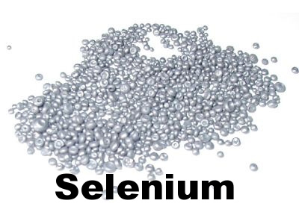
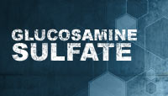
Biologically based practices
Ginseng
Examples include dietary supplements and herbal remedies. These treatments use ingredients found in nature.
Examples of herbs include ginseng, ginkgo and echinacea, while examples of other dietary supplements include selenium, and glucosamine sulfate.
Herbs and supplements can be taken as teas, oils, syrups, powders, tablets or capsules.

Slide 13
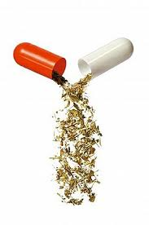
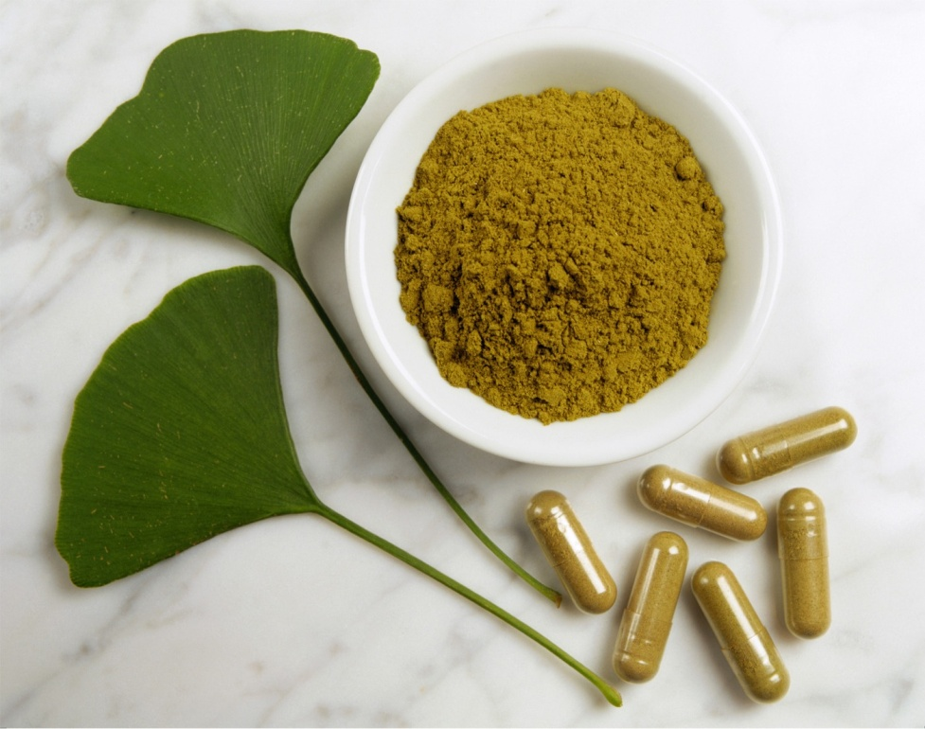
Herbs & Supplements
Herbs, supplements, and other such “natural” remedies are a tremendous attraction.
But… choose wisely and proceed with caution. Because the quality of herbs and supplements can vary, it may not working, it may be the product itself that is flawed, and not the approach.

Slide 14
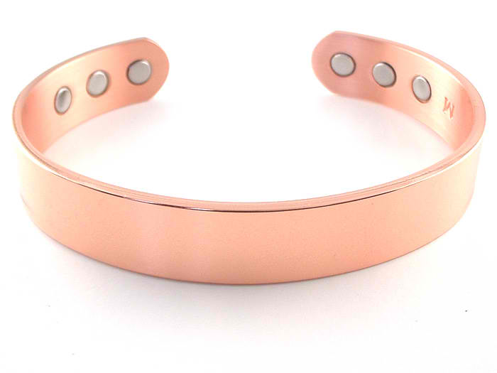
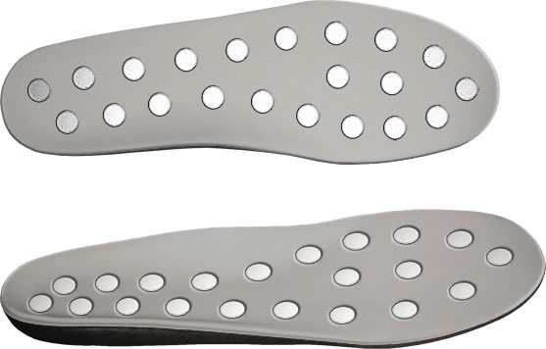
Energy
Copper bracelets or magnets -- may not have much, if any, scientific evidence to back them up or disprove them.
There is a lack of research both for and against the usefulness of alternative therapies.

Slide 15
Tips… Before Heading to the Store
Be cautious of unrealistic claims, such as this product will “cure” or “prevent” arthritis. Also, it is illegal for supplements to make such claims.
Talk to your doctor about a supplement and whether it would be safe for you to try.
Do “not” stop taking your prescription medication unless directed by your doctor!
Find out if the supplement will interact with other medications or other supplements you are taking.
Determine if potential side effects outweigh the potential benefit.
Know how much to take and how often you need to take it.
Shop around for only reputable brands.

Slide 17
Some work… many don’t
Ask questions. Don’t be afraid to ask your doctor, pharmacist or other health professionals for their opinion or a recommendation.
Buy wisely. When purchasing a supplement, buy from a large company, pharmacy or health food chain. They may have more stringent quality controls than small companies to maintain their good reputation.
Read labels carefully. Be aware that no supplement can lawfully claim to treat, cure, diagnose or prevent disease. Look for products with the U.S.P. notation, indicating that the manufacturer followed standards established by the United States Pharmacopoeia.
Try products one at a time. If you try only one you can keep track of its effect (or lack of effect). If you notice any side effects, stop taking the supplement right away.

Slide 18
Some work… many don’t
Many of the alternative therapies cited for the relief of arthritis are considered harmless (other than perhaps to your pocketbook).
Many health care providers suggest… trying the simplest and cheapest regimen first.

Slide 19
Some work… many don’t
Dangerous…
Bee venom could cause a potentially fatal reaction in those allergic to stinging insects.
Glucosamine, generally safe for most people, could be dangerous for people allergic to shellfish. (Shellfish-free glucosamine is now available.) For these reasons, it's important to check with your doctor BEFORE trying any alternative treatment.
It's also important to note that herbs and supplements may have unknown and potentially dangerous interactions with medication.
If you're taking medication, it's best to check with your doctor before trying any supplements.

Slide 20
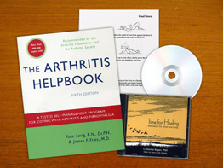
So,
What works…

Slide 21
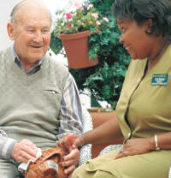
Chronic Disease Self-Management Program (CDSMP)
Stanford University developed and evaluated – 1996
Participants meet for 2-2.5 hours once a week for six-week program duration
Peer-led by trained instructors
Research results show improved health outcomes and reduced healthcare utilization

Slide 22
Tomando Control de su Salud
Structured similarly to CDSMP
Presented fluently in Spanish to Spanish speaking participants
Hispanic and Latino culture specific
Research results show improved health outcomes and reduced healthcare utilization

Slide 23
Arthritis Toolkits
Designed as an individual self-management program
Created based on design of Arthritis Self-Help program
Toolkits are checked out regionally by Regional Arthritis Center or designated center for up to six weeks
Several materials are included in the toolkit

Slide 24
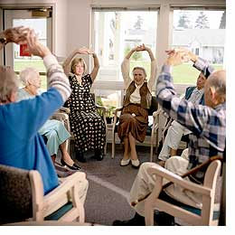
A F Exercise Program
Arthritis Foundation designed exercise program, specifically for individuals with arthritis
Can be ongoing (continuously led year-round) or time-limited (six or eight week sessions)
Participants meet for one hour 2-3 times per week with a trained instructor
Reported benefits to individual health

Slide 25
Walk With Ease
Designed by the Arthritis Foundation specifically for individuals self or medically diagnosed with arthritis
Beneficial to any individual who wants to start a regular walking routine
Group Format - ongoing program, led for 45-90 minutes by a trained instructor three times per week
Independent Format – completed by an individual three times per week for 45-90 minutes
Reported physical activity and health benefits (evidence-based for group format only currently)

Slide 26
Other CDC and A F Supported Programs
Arthritis Self-Management Program (previously Arthritis Foundation Self-Help Program)
Programa de Manejo Personal de la Artritis
Active Living Every Day
Arthritis Foundation Aquatic Program
Enhance Fitness
Fit and Strong
Arthritis Foundation Tai Chi Program

Slide 27
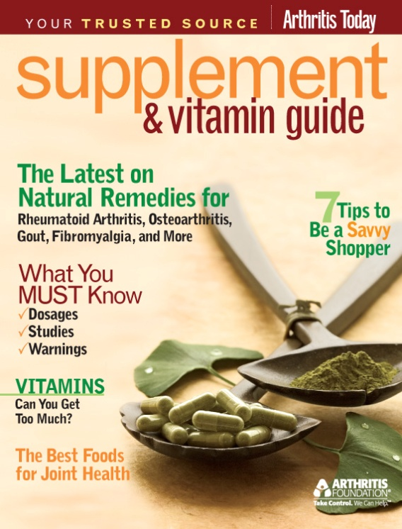
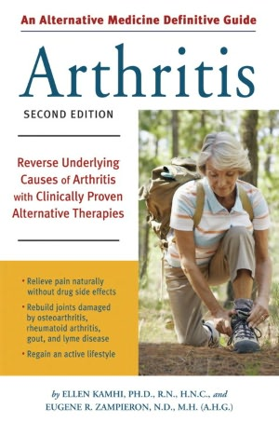
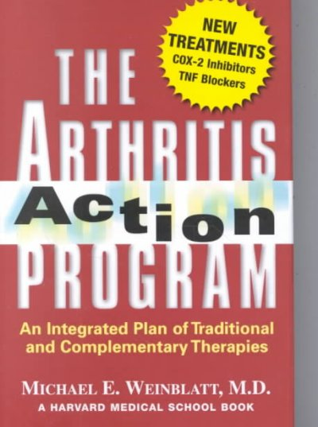
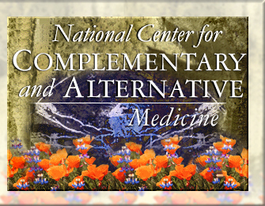
Resources
NCCAM Clinical Digest Newsletter
NCCAM's monthly e-newsletter offers evidence-based information on CAM, including scientific literature searches, summaries of NCCAM-funded research, fact sheets for patients, and more. http://nccam.nih.gov/health/providers/digest

Slide 28
Resources
http://www.cdc.gov/arthritis/funded_science/completed/cam.htm
http://www.arthritis.org/alternatives.php
http://nccam.nih.gov/
http://www.nlm.nih.gov/medlineplus/complementaryandalternativemedicine.html

Slide 29
Contact Information
Karen Funkenbusch
Co-Director, Mo AgrAbility Project
Division of Food Systems and Bioengineering
Department of Agricultural Systems Management Program
232 Agricultural Engineering Building
Columbia, Missouri 65211
573.882.2731 or 1.800.995.8503
funkenbuschk@missouri.edu

