Slide 1
IL Philosophy & Veteran Services: Merging Paradigms in Rural Communities

Slide 2
Overview
The Independence Center
Outreach Program
Veteran in Charge (Veteran Directed Care)
Case Study
Lessons Learned
Best Practices

Slide 3
The Independence Center
Working with people with disabilities,
their families and the community,
we create independence so that all may thrive.
Notes:
The Veteran in Charge Program is very much in line with the mission statement of the IC as well as the five core values of Inclusiveness, Flexibility, Person First, Accountability, and Integrity. Veteran in Charge is about veterans taking charge over their lives, their health, and services. It is about empowering them to be more than a spectator to their health and circumstances. We hope that through their involvement with The IC they will find more services and supports available to them beyond what VIC provides.

Slide 4
The Independence Center
The IC is the local home of civil rights for people with disabilities
Founded by people with disabilities who saw a need for independent living services and home health services in the community
In 1987, home health services began
In 1994, The Independence Center (The IC) joined home health
In December 2015, Veteran in Charge came to The IC

Slide 5
Social Model vs. Medical Model
We strive to educate communities, rather than changing people who have disabilities.
 | Social Model | Medical Model
Problem: | Dependence on others; attitudes and environments create limitations for people with disabilities | Physical or mental impairment; perceived limited skills or abilities
Source of Problem: | Attitudes: disability is a common part of the human condition | Attitudes: individual needs to be “fixed”
Solution to Problem | Barrier removal Civil Rights and advocacy Veteran control over services Peer models and support Self-help | Treatment from professionals

Slide 6
IL Philosophy
Each person with a disability is unique and has the same civil rights as people who do not have disabilities. People with disabilities:
Should live, work, shop and play where they choose.
Are not sick; they may become ill, but disability is not always an illness.
Have the same aspirations as people who do not have disabilities.
Know best what their barriers to independence are and what they need in order to live independently.
Are in the best position to guide, direct, and control programs for people with disabilities.
For people with disabilities to live in the community, the community has a responsibility to be accessible.

Slide 7
Who Can Access Services?
As long as you have a disability, you can access any of the Independent Living (IL) Services
Self-disclosure (no paperwork required)
Person-centered assistance
We do “with” not “for”
All services are no cost to you

Slide 8
What Does Outreach Do?
The Outreach team provides services to consumers in the rural communities and tries to bring all programs offered at the main office to these communities.
Works with consumers to find resources and makes referrals to other agencies. Creates goals and helps them gain independence.
Offers classes and support groups.
Develops a list of resources in their communities.
Networks with community agencies.
Markets The Independence Center in rural communities.

Slide 9
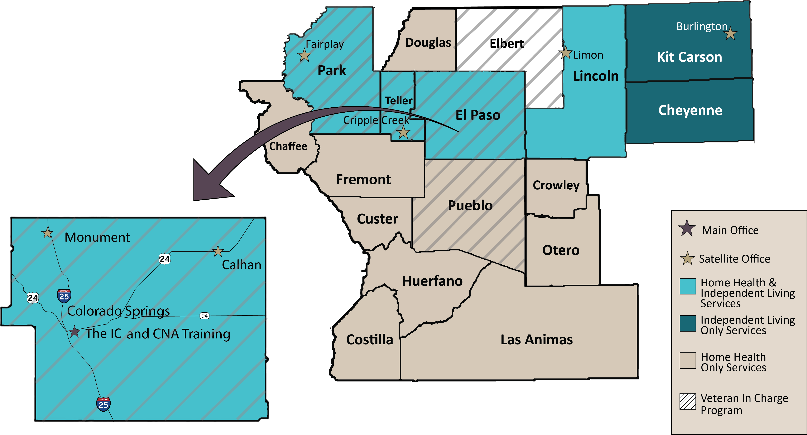
The IC Service Map

Slide 10
Where is Outreach?
Eastern: El Paso, Lincoln, Kit Carson and Cheyenne Counties
Offices – Calhan, Limon & Burlington
Classes – Senior Exercise, Stepping On, Cooking Matters
Front Range: Monument & Fountain
Offices – Monument & Fountain
Support Group / Classes – Cross Disability Group, Stepping On

Slide 11
Where is Outreach Continued?
Western: Park & Teller Counties
Offices – Cripple Creek, Woodland Park, Florissant, Fairplay & Bailey
Support Groups / Classes – Brain Injury, Veterans, Cross Disability, OIB, Stepping On Class
All Counties
Hard of Hearing
Telephone Demonstrations, Hearing Aids, Assistive Technology Needs

Slide 12
Partnerships
Community of Caring / Aspen Mine Center - Cripple Creek
Community Outreach Center - Calhan
Connections 4 Life Center - Fountain
Hub City Senior Center - Limon
Keefe Memorial hospital – Cheyenne Wells
Park Senior Coalition – Fairplay
Prairie Family Services – Burlington
Rocky Mountain Rural Health – Fairplay
Silverset - Bailey
South Park Senior Center – Fairplay
Teller Senior Coalition – Woodland Park
Tri-lakes Cares Center - Monument

Slide 13
Services Available
Information & Referral
Peer Support & Self Advocacy
Skills Classes
Community Organizing
Deaf & Hard of Hearing
Emergency Preparedness
Community Transition
Housing Information
Employment
Benefits Assistance
In Home Health
Low Vision & Blindness
Assistive Technology
Disability Awareness
Veteran in Charge (VIC)

Slide 14
What is Veteran in Charge (VIC)?
Veteran in Charge gives eligible Veterans of all ages the opportunity to self-direct the services they need in their home and community with a flexible budget (VA determined).
Veterans can:
Decide for themselves what services will best meet their needs
Hire their own personal care aides (which can include family, friends, or neighbors)
Manage a flexible, individual budget
Purchase items or services needed to live independently in the community
Notes:
The Veterans Administration found themselves in a place where they had to address the emerging needs of aging veterans. With pressure to find ways to cut costs, increase veterans quality of life and freedom to choose their own services, the VA rolled out several initiatives to give veterans more control over the care they receive. One of these initiatives was Veteran Directed HCBS.
Veterans can:
Select, manage, and dismiss their personal care attendants (which can include family, friends, or neighbors).

Slide 15
Basic Qualifications for VIC
2 ADLs & 2 of the following:
3+ Instrumental ADLs
Hospice enrollment
Recent SNF discharge
75+ years old
3 hospitalizations
Clinical Depression
Lives Alone
3+
Activities of Daily Living (ADLs)
Significant Cognitive Impairment
Or
Or
There are 12 tiers of support/funding determined by the VA.
Notes:
IADLs: medication management, preparing food, money management, housekeeping, transportation
Recent discharge from a nursing facility or a rehabilitation facility
3 hospitalizations or 12 outpatient clinic/emergency evaluations in past year

Slide 16
Overview of Veteran in Charge Process
Eligibility and Monthly Budget
Services & Supports
Care Coordination Service Planning
Guidance & Navigation
Manages payroll for veteran
Notes:
Veteran and/or Authorized Representative:
Direct own services
Train his/her own staff
Is the employer
Veterans Administration:
Determine eligibility/budget for program
Authorize service/spending plans
Veterans Coach:
Conduct assessments
Assist Veteran in care/service plan
Conduct monthly home visits
Review services at six month and one year interval
Financial Management Services:
Responsible for payroll for the veteran’s worker(s). Handle the payroll taxes. They conduct the background checks and establish the veteran or Authorized representative as the employer.
Example: Walk through steps using example client: Rex 75 yo veteran who is being discharged from a rehabilitation hospital after having a stroke. The VA social worker believes he will be a great candidate for the Veteran in Charge Program and refers him to the VA Coordinator who begins the process.
Step 1: VA assesses needs of interested Veteran and determines program eligibility and monies allotted . Referral sent to The IC.
Step 2: Contact is established with Veteran to discuss program and schedule initial appointment .
Step 3: Assessment is conducted to see if program is suitable, Veteran can self-direct services, and needs match VA assessment.
Step 4: Develop a service plan that works within the allotted budget and submit to VA for approval.
Step 5: Once VA approves plan, coach works with Veteran and Fiscal Management Services (FMS) Agency to complete employer paperwork .
Step 6: Assist Veteran with hiring process for service providers (employment ads, job descriptions, interviewing, etc. as needed).
Step 7: FMS processes employee paperwork, conducts background checks, and establishes employment.
Step 8: Veteran trains new employees and services are initiated. Veteran submits timesheets to FMS.
Step 9: FMS pays workers per budget ted amount. Veteran coach continues to monitor Veteran monthly, providing encouragement and feedback as needed and assists Veteran in utilizing services to the maximum.
Step 10: Coach reassesses Veteran at six month and one year marks to discuss any changes in health and services.

Slide 17
What’s in a Plan?
A veteran has the freedom and flexibility to choose his/her services or goods:
Services may include: Homemaker Services, Personal Care Assistance, Transportation, Chores, Home-delivered Meals, Environmental Modifications, Technology for Safety and Independence, Health-related Services or Equipment
Cannot duplicate any services that are already provided through the VA
Notes:
Meets identified needs or outcomes in support plan that assures health and safety of veteran
Provides a feasible alternative to an institution; least costly alternative that reasonably meets identified needs
Must be for the benefit of the veteran.
Services may be monthly or one-time purchases such as equipment or modifications.

Slide 18
VDC By The Numbers …
Number of Operational States
# of Aging & Disability Network Sites
Number of Operational VAMCs
Total number of Veterans currently served
Cumulative Veterans served
Colorado has the second largest
number of Veterans enrolled in VDC.
35 out of 50 (plus DC & PR)
106
65 out of 154
2152
7092 (since 2008)

Slide 19
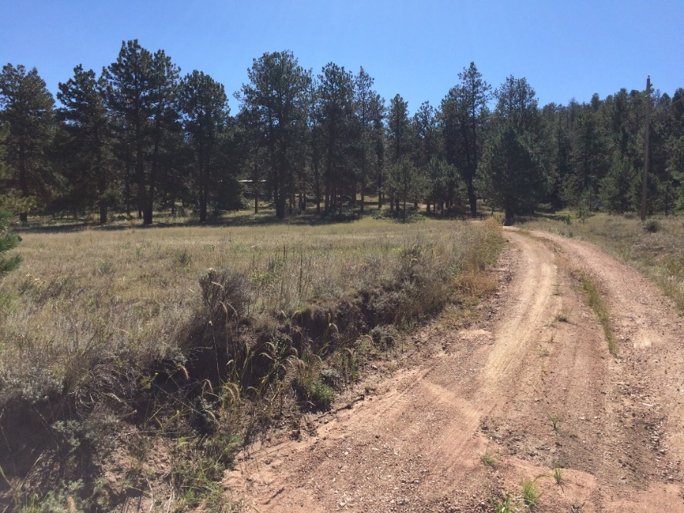
Veteran in Rural Community
Driveway is 3 miles from paved road.
Going to your mailbox is miles away – not walking distance.
Small grocery store is 15 miles away one way.
Walmart is 32 miles away one way.
Colorado Springs VAMC is 40 miles one way.
Denver VAMC is 100 miles one way.

Slide 20
Veteran in Rural Community Cont
71 year old male: On Medicaid and Medicare
Began working with “Johnny” in 2016
Health Issues: Stroke with right side weakness, COPD, Non-compliant with Oxygen, Back Issues, PTSD, Hypertension, Congestive Heart Disease
Challenges to Health: Smoker and Poor Diet
Current Health Issues: (Since 2016) Testicular Cancer, Diabetes, Stage 4 Throat Cancer, 100 Pound Weight Loss

Slide 21
Amplified Phone
Colorado Communications Technology Program – Colorado Department of Human Services
Proof of Residency
Proof of Phone Service
Proof of Annual Gross Income – Less than 300% Government Poverty Guidelines

Slide 22
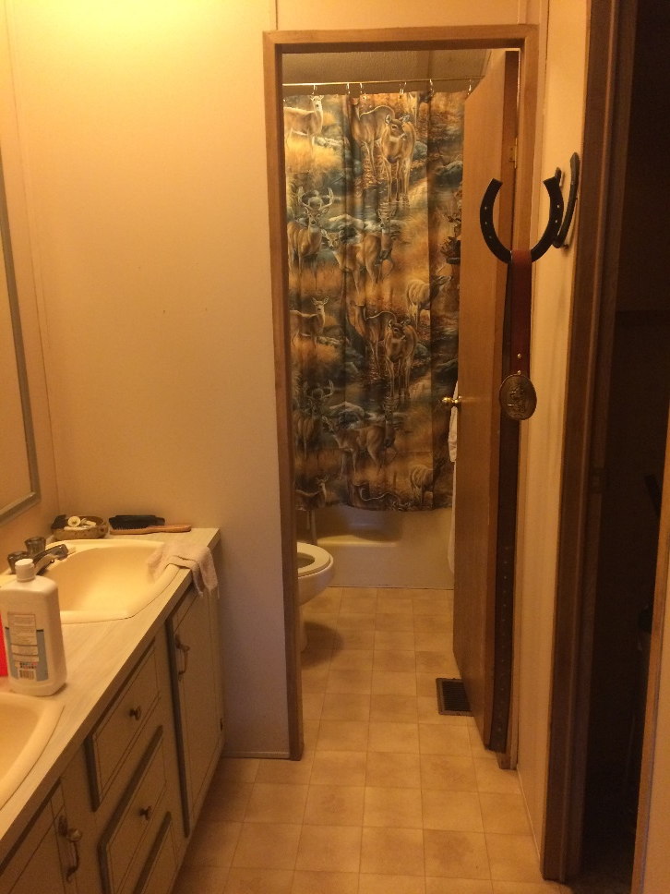
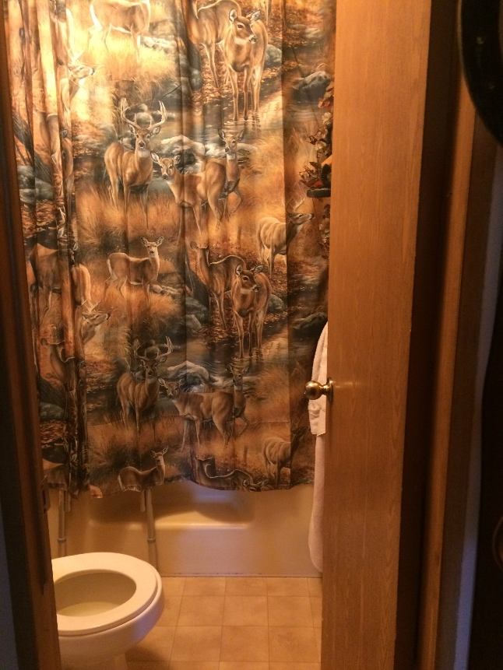
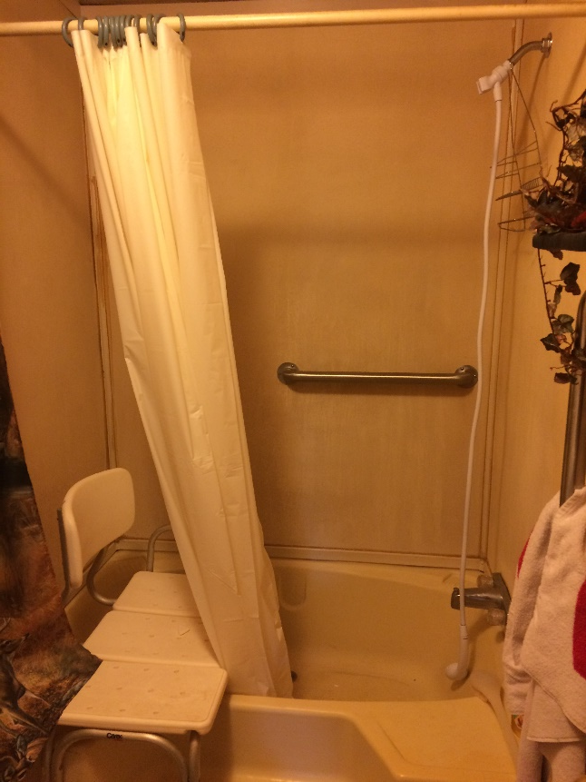
Bathroom Modification
Applications – Friends of Man, A. V. Hunter,
Habitat for Humanity

Slide 23
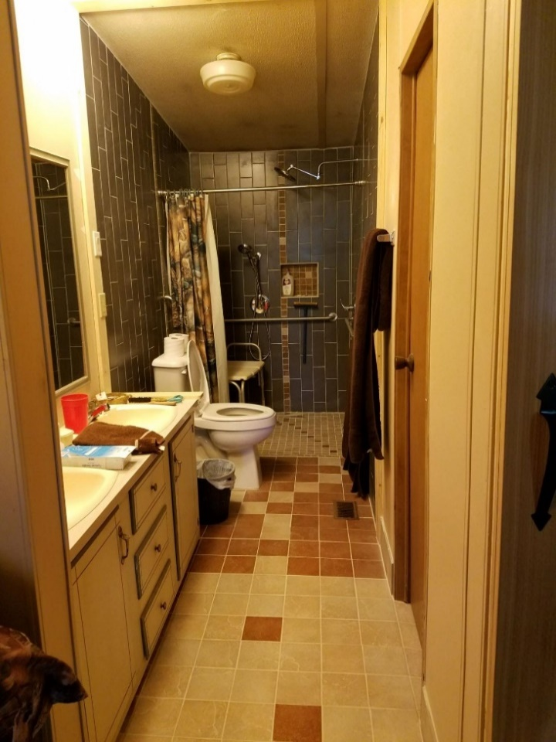
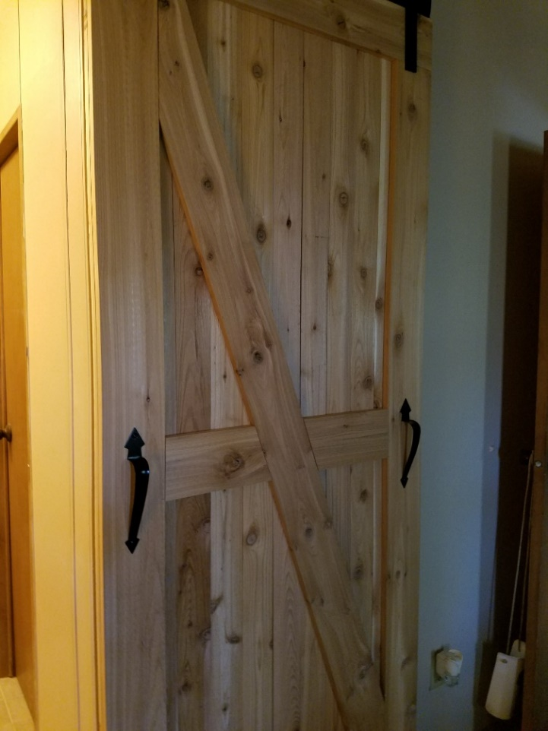
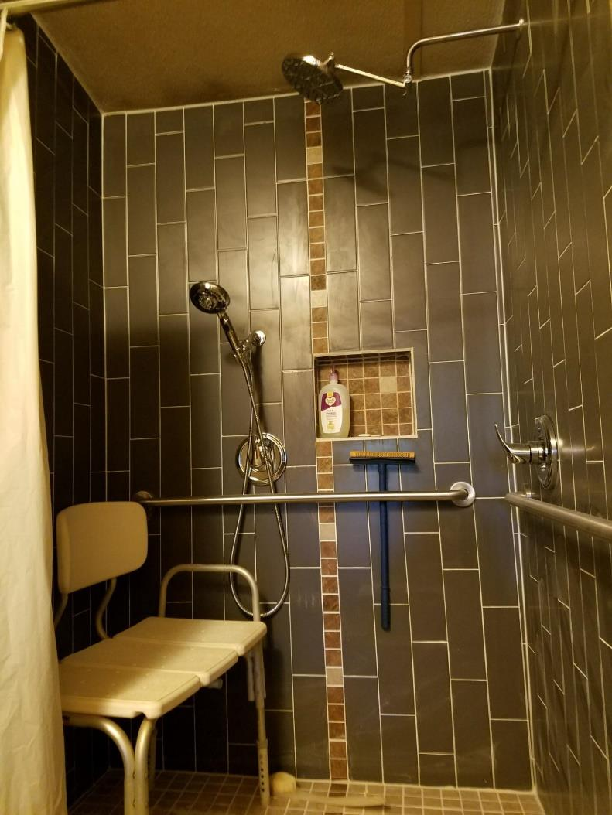
Bathroom Modification

Slide 24
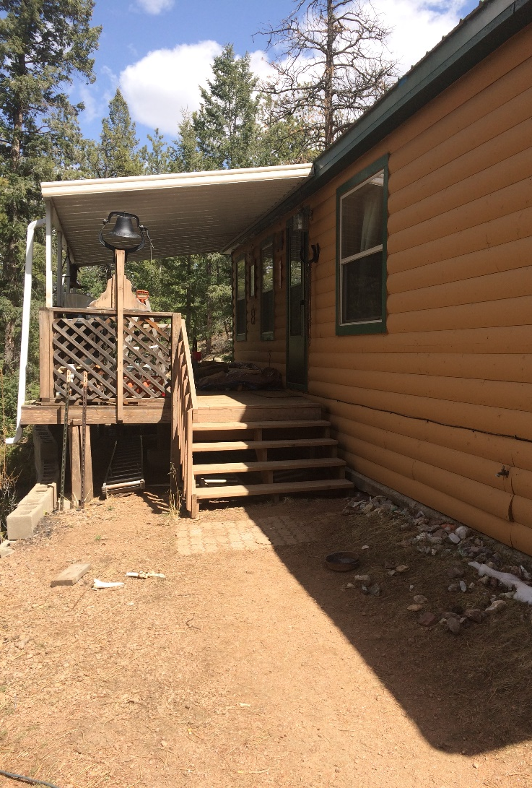
Replace Deck
Habitat for Humanity –
Applied over a year prior to them contacting the veteran.

Slide 25
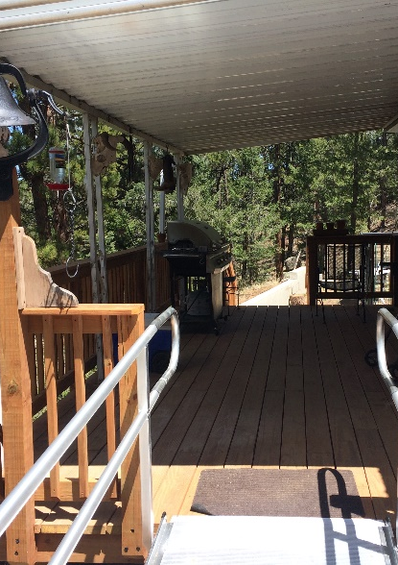
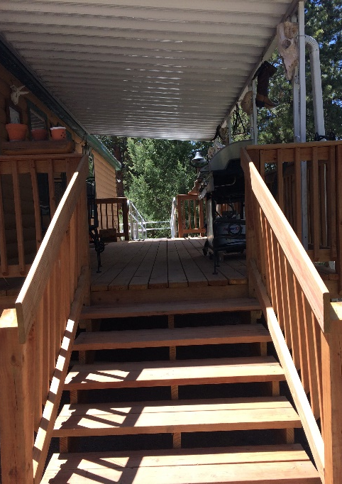
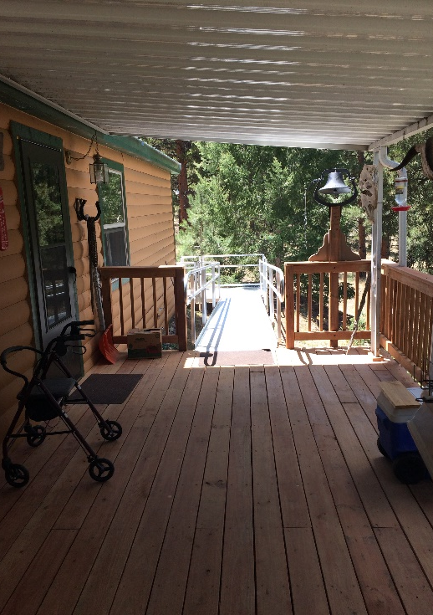
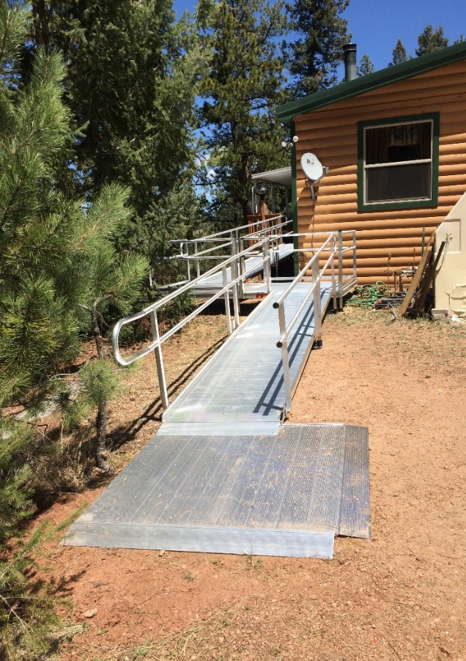
Replace Deck

Slide 26
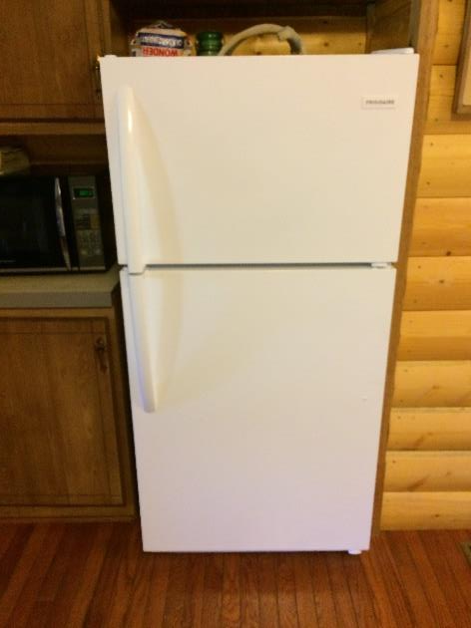
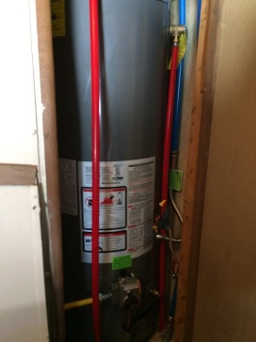
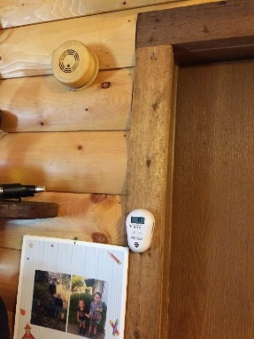
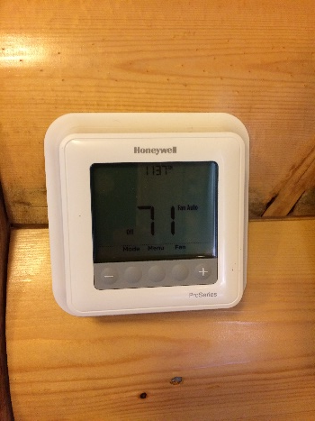
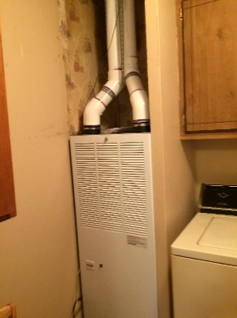
Energy Resource Center

Slide 27
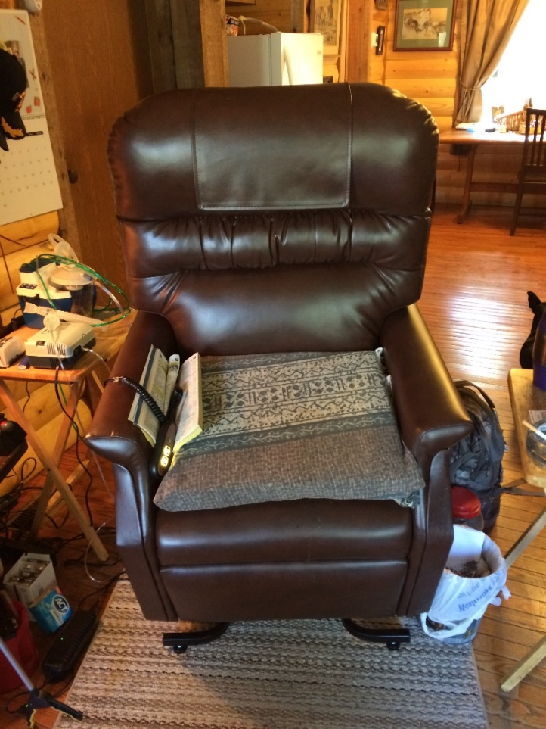
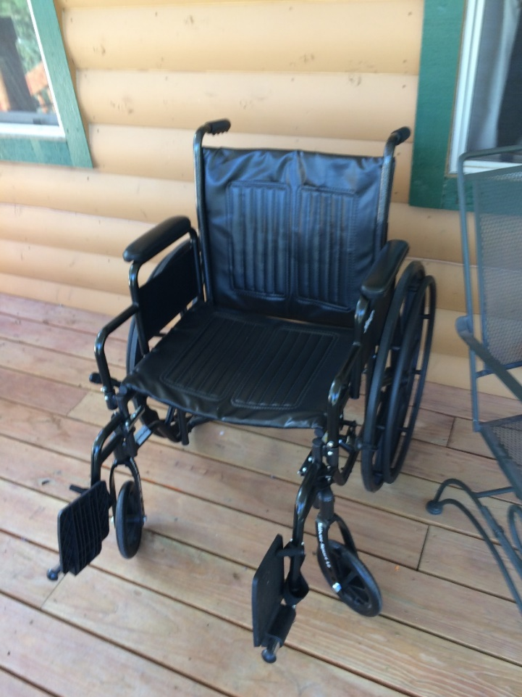
The Independence Center - VIC

Slide 28
Challenges & Lessons Learned - Outreach
Rural Community – Lack of Services
Transportation, Housing, OT Assessment, Isolation
Family Support
Veteran Attitude to Receive Support
Owning Own Limitations
Prior Experience with the VA
Healthcare access
Programming limitations

Slide 29
Challenges & Lessons Learned - VIC
Caregiving in rural communities
Internet access in rural areas
Age of Veterans and internet capabilities
Each VAMC is different and funding is controlled locally
Not all Veterans who are eligible are connected to the VA
VA oversight & compliance vs. Veteran empowerment & dignity of risk
Impact of Veterans using non-VA care on Veteran Directed Care

Slide 30
Best Practices
Outreach
Be ready and available when an opportunity arises
Develop and trust community partnerships
Peer Support residing in the community
Leverage partnerships
Reaching Veterans
Military culture
Advertising to Veterans directly
Word of mouth from Veterans
Have you ever served in the military?
Teaching Veterans self-advocacy and empowerment

Slide 31
The Independence Center
Working with people with disabilities,
their families and the community,
we create independence so that all may thrive.
Notes:
The Veteran in Charge Program is very much in line with the mission statement of the IC as well as the five core values of Inclusiveness, Flexibility, Person First, Accountability, and Integrity. Veteran in Charge is about veterans taking charge over their lives, their health, and services. It is about empowering them to be more than a spectator to their health and circumstances. We hope that through their involvement with The IC they will find more services and supports available to them beyond what VIC provides.

