Slide 1
EVERYBODY
A History of Disability in America
Presented by Disability Action Center NW
www.everybody.si.edu
People with disabilities have been present throughout American history. Sometimes difference mattered, at other times it didn’t.
Notes:
The Smithsonian Institute has been documenting the history of disability for over fifty years. This virtual tour is available at everybody.si.edu and presents encounters with history through the material record of the people who lived it. How the story unfolds depends on how you, the visitor, shuffle it.
When we view history from the perspective of people with disabilities – America’s largest minority group, it deepens our understanding of the American experience. Things like citizenship, work, and even wars challenge our assumptions about what counts as history. Thinking about how we live and work becomes more complicated. It can change our connection with each other and reveals how complicated history really is. Because…
Many stories and events related to people with disabilities never make it into the history books or shared public memories
In addition, when history comes through artifacts, distinct themes emerge—for example, the significance of place, relationships, and technology—that are less apparent when only books and words are used.

Slide 2
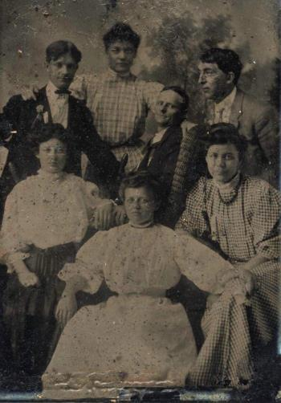
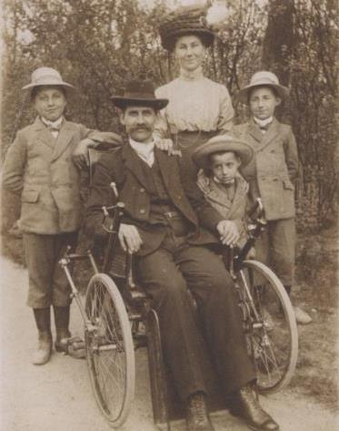
People with disabilities and ideas related to disability are everywhere in American history.
Notes:
So what is a disability? A person is not always disabled or unable to do all things. The generalized categories and words that identify people with disabilities have shifted across eras and locations. For example, concepts of physical beauty were different in a time when physical injury, smallpox marks, and other scarring were more common. How a person uses words has not always been a universal measure of worth. People process information in many different ways. In the past it was common that a person might have left school to work in a mill before ever learning to read. Or they might have used a language other than English, or might have had other differences that made their writing and reading atypical.
These photos shows old tintype from the 1880 with groups of friends or family

Slide 3
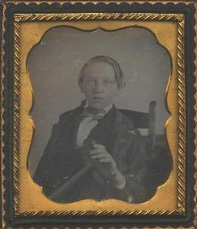
Who is Normal?
What constitutes a disability has depended on who was judging and who was being judged. A lot depends on things such as where you are, what you are doing, and whether you feel safe or excluded.
For example, a beggar, a war veteran, a baby, and a musician may all have shared the experiences of being blind, but stigma, discrimination, and access to resources would be different for each.
Notes:
So who is normal? what constitutes a disability depends on when and who is doing the judging.
For example if we look at 4 very different people with the same disability: a blind beggar, a blind war veteran, a blind baby or blind musician. They all share the same experience of being blind, but stigma, discrimination, and access to resources would be very different for each.
This photo is a daguerreotype from the 1850’s of a boy holding his crutch

Slide 4
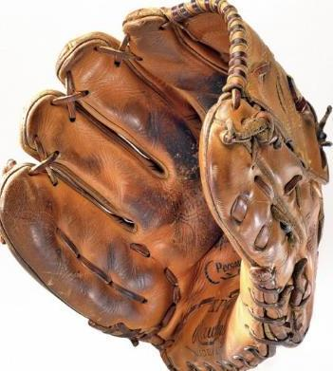
Sandy Koufax, Left Handed pitcher for the Dodgers
Notes:
For instance is there anyone here today who is left handed? At one time being left handed was considered a disability. Teachers and others would push them to change and conform to the right handed norm.
This is a photo of Sandy Koufax’s lefty baseball glove

Slide 5
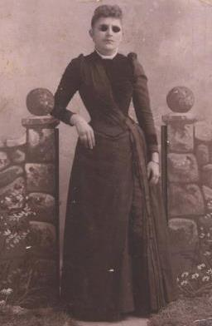
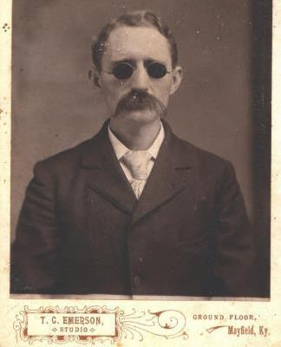
Vision: An individual’s capacity to see and ways to measure, protect, and assist vision vary.
Notes:
Vision - let’s look at what it meant to be blind in history. A buggy or horseback rider in 1770 America had no billboards or road signs to read. Before the beginning of free public schools in the 1840s, very few people could read well, books other than the Bible were rare, and newspapers were scarce. How or if a person could read was not a universal measure of one’s worth. Standards of vision or reading comprehension were not relevant for many kinds of work and activities they could do.
These photos are from the 1880’s and depice a man and woman posing for their portrait wearing tinted lenses

Slide 6
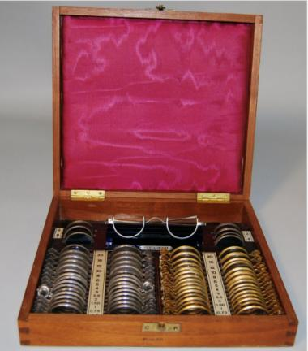
Modern vision testing didn’t begin until the mid 1800s.
Notes:
It wasn’t until 1862 that the introduction of Snellen’s familiar eye chart with letters of various sizes could be used to measure visual acuity. Prior to that spectacles were fitted by trying on lenses until the person found ones that worked. This photo depicts a case of them that could be slipped individually into the testing frames.

Slide 7
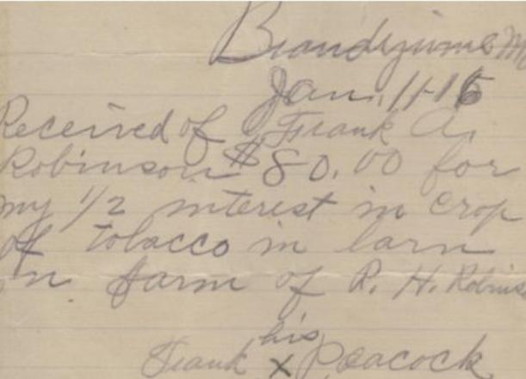
This hand-written receipt from tobacco farmer Frank Peacock is signed with an “X”.
Notes:
Success did not always depend on literacy. This photo shows a hand-written receipt from tobacco farmer Frank Peacock and indicates he was paid $80 for his crop. He could not read or write so he signed his name with an “X”. You still have this option today on ballots and other forms of documentation.

Slide 8
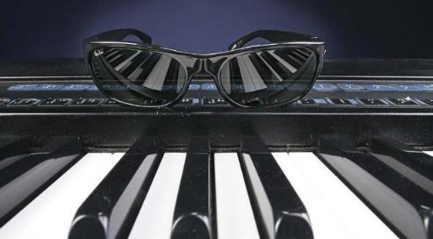
Ray Charles’ keyboard and sunglasses, late 20th century
Notes:
You can look at disability in so many ways. When being musical is valued, those who aren’t, are at a disadvantage. How many here might consider themselves singing challenged? Singer and musician Ray Charles, who was blind, probably faced more discrimination for being black than for being blind. Here you can see his sunglasses and Yamaha keyboard that used a Braille label maker to mark the programming switches

Slide 9
Appearance
Concepts of beauty and comeliness can influence how people are valued and treated.
Notes:
Appearance: The way people judged a person’s appearance was different in the past when physical injury, crooked or missing teeth, smallpox marks, and other scarring commonly affected people. People with such bodies were fairly normal. Think about the Civil War era - losing a limb due to battles or farming accidents was common. It wasn’t until the mid-1800s, some cities began to ban certain people from public streets. These so-called Ugly Laws were directed at people with disabilities who sometimes depended on begging for a livelihood. This photo shows a man on the street selling items from a box because he is blind.
“Any person who is diseased, maimed, mutilated, or in any way deformed so as to be an unsightly or disgusting object, or an improper person to be allowed in or on the streets, highways, thoroughfares or public places in the City of County of San Francisco, shall not therein or thereon expose himself or herself to public view.” —San Francisco “Ugly Law,” 1867
In fact the last ugly law was still in existence in Chicago until 1974

Slide 10
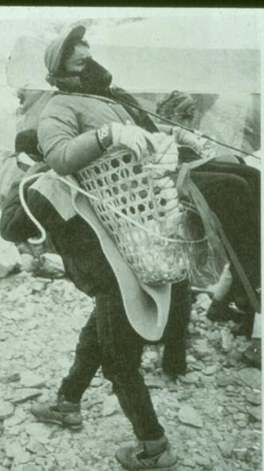
It's Complicated
People often use more than one framework at a time when thinking about disability but it’s more complicated than that.
This tourist, breathing oxygen through a mask and being carried in a basket on the back of a Sherpa guide, is disabled by the mountain altitude.
Notes:
So looking at disabilities is complicated. As a society we have several ways of understanding difference. Sometimes these differences leads to stigma; other times a difference is valued. People may avoid the label of disability at all costs or embrace it. People who are different in similar ways may not identify themselves equally as having a disability.
The lines drawn around disability through words, laws, and customs are largely arbitrary and situational. As a society it has been hard to determine what is a disability and it may always be in flux.
For example: people have heated opinions about whether such things as addiction, epilepsy, obesity, hemophilia, attention deficit disorder, dyslexia, and cancer are considered disabilities. And singling out people who are disabled often depends on their wealth, race, power, talent, and even location. Would you classify these people as disabled? Baseball great Mickey Mantle broke a bone and used a wheelchair. First lady Betty Ford was addicted to painkillers. Boxing legend Muhammad Ali has Parkinson’s disease. The late actor James Earl Jones whom you may know as Darth Vadar, stuttered. President Franklin D. Roosevelt had polio. Scientific genius Albert Einstein had dyslexia. Tennis champion Arthur Ashe had AIDS. So It’s complicated.
This photo is from the 1980’s and depicts a tourist, breathing oxygen through a mask and being carried in a basket on the back of a Sherpa guide. He has been disabled by the mountains altitutde.

Slide 11
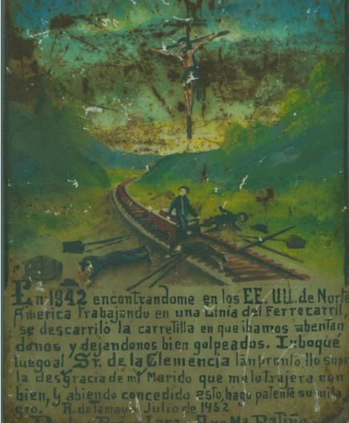
"God is Testing You" Religious beliefs about disability have varied among the world’s traditions.
Notes:
In Colonial America, many Christian people believed that impairment was a punishment from God. Others thought certain disabilities indicated possession by an evil spirit. This could lead to a person with a disability being ostracized from their community. Religious belief has also led people to prayer and asking for divine intervention to produce a cure.
In contrast, some American Indian groups did not have words for disability and instead focused on how a person fulfilled obligations to the community. Some archeological digs have revealed that people with disabilities were cared for by their community for their entire lives.
This is a retablo, from 1952, and depicts workers injured in a train accident with the crucified Christ above them in the sky. One of the workers painted it and also wrote the story of his accident on it and how his wife successfully prayed for his cure.

Slide 12
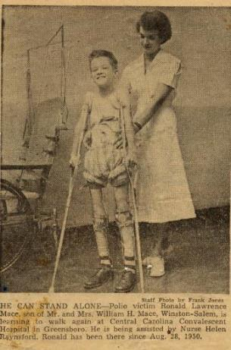
"Help the Handicapped" In the charity tradition, people with disabilities were seen as dependent and in need of help or saving.
Notes:
American charitable efforts directed at people with disabilities began in the early 1800s. Philanthropy has had to contend with the fine line between paternalism and empowerment.
Even the word “Handicapped” once accepted throughout the country is now viewed as derogatory. It is a reference to a person with a disability begging on the street, cap in hand, begging.
On the left is Ron Mace from 1950, in a typical “poster child” pose, wears rolled-up pajama bottoms to expose his leg braces. He beams at the camera while a smiling nurse approves that “he can stand alone.” It was Mace who later helped create the field of Universal Design.
On the right is six-year-old Cindy Jones also from the 1950’s, on crutches and holding a March of Dimes collection card. Jones grew up to be a disability rights activist.

Slide 13
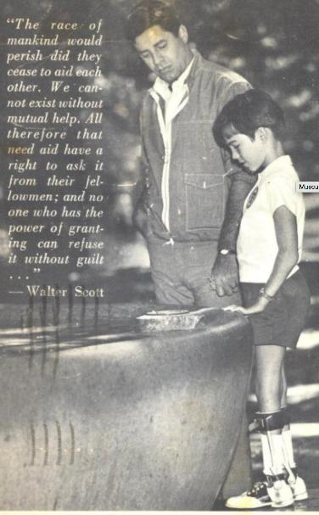
Muscular Dystrophy Association of America Inc. raised millions using poster children.
Notes:
One of the most well known campaign to use children with disabilities is Muscular Dystrophy. This card shows Jerry Lewis holding the hand of the MDA’s Poster Child as they stand by a wishing well.

Slide 14
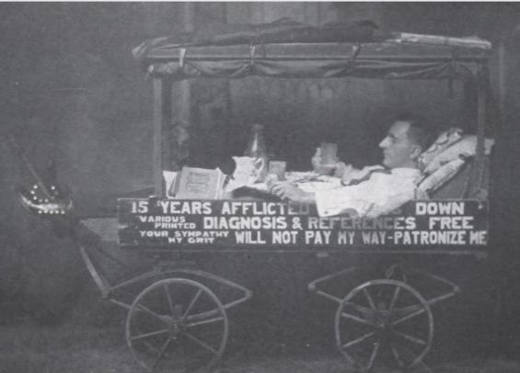
Photo from 1910 – Not all were comfortable with pity
Notes:
This photo from 1910 shows a man reclining in a covered cart. His name was Arthur Fuller, and he is wearing a suit with necktie and is eating a meal from a tray across his stomach. He is selling Diagnosis and References. According to his sign, “Your sympathy will not pay my way.”

Slide 15
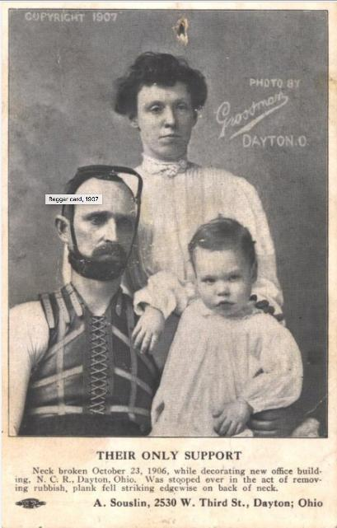
Beggar’s card, 1907
Notes:
Beggars card from 1907. This man with a broken neck is show wearing a brace and sitting with his wife and child. Unlike charities that used depictions of children, beggars controlled their own images and kept all the money they raised.

Slide 16
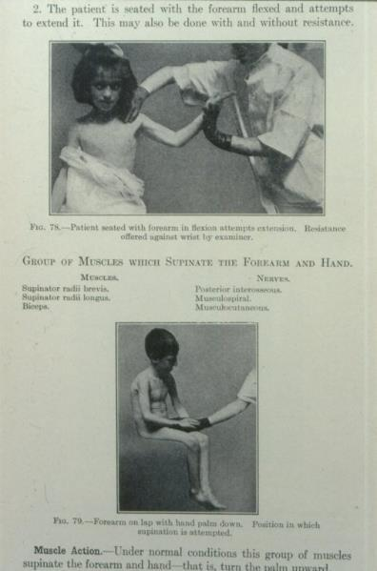
"What Is Wrong with You?“ With the incorporation of medicine into more aspects of daily life in the 20th century, health practitioners and scientists closely studied human variations.
Notes:
We find that variations like disabilities exists throughout nature. But as America modernized, some kinds of variation and human conditions were categorized as deficits, requiring treatment, prevention, or fixing. Scientific advances created expectations that the human body could and should be medically treated. So as we move through history bodily difference gradually became a medical issue. The person became a patient with her or his individuality transformed into a medical case.
Medical textbooks such as this sample page from 1917 typically highlighted the pathology of the patient, often at the expense of the person’s modesty and self-respect. Here, a doctor demonstrates muscle manipulation on two nude children.

Slide 17
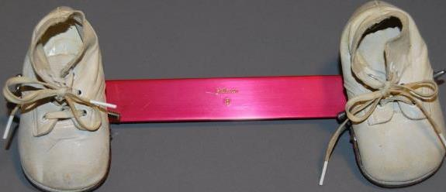
Baby shoes attached to steel bar, 1950s
This orthopedic device, called a Browne splint, was invented in 1931 and is still occasionally used. Toddlers wore it to prevent “in-toeing” by adjusting hip, foot, and tibia angles.
Notes:
So “state of the art” medical intervention in the 1950’s were like this orthopedic device called a Browne splint. The baby shoes are attached to a steel bar and toddlers wore it to prevent “in-toeing” by adjusting hip, foot and tibia angles. It can be something simple like this….

Slide 18
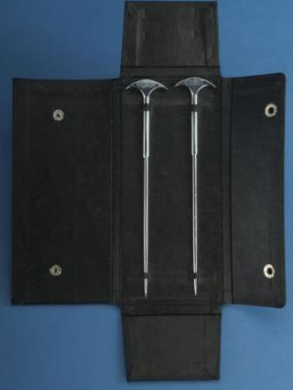
Lobotomy knives, 1960s
A doctor might remove one of these two pointed steel rods from its black leather case, insert behind a patient’s eye and destroy the prefrontal lobe of the brain. Doctors treated unruly or depressed patients by lobotomy from the 1950s to the 1970s.
Notes:
Or as mis-guided as the use of lobotomy’s as a treatment for depression. A doctor might remove one of these two pointed steel rods from its black leather case, insert behind a patient’s eye through the orbital socket and destroy the prefrontal lobe of the brain. Doctors treated unruly or depressed patients by lobotomy in the 1950s and the practice continued through the 1970’s

Slide 19
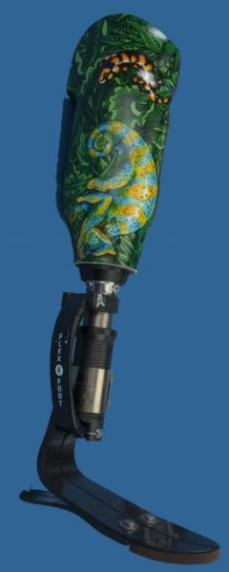
"Crip Is Hip"
Valuing disability as a part of one’s core identity is a principle of social empowerment
Notes:
Having a disability does not necessarily preclude a wish for medical treatment or for being less different. But it is a part of one’s identity.
Understanding that disability is fundamental to human existence and that how we view it is shaped by our society is a thinking that has become more widespread since the 1960s. Disability is now in a category similar to ethnicity, skin color, and gender.
This is an artificial lower limb, socket decorated in jungle motif, 2006
The Flex-Foot design of this limb and the “Cheetah leg” used by Paralympians came from athlete and amputee Van Phillips. Its striking decoration with vines and lizards indicates that the wearer had no intention of hiding it from others.

Slide 20
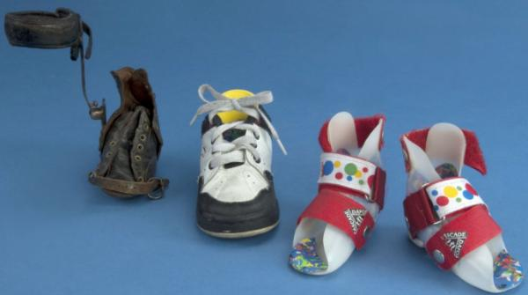
Children’s shoes from the 1880’s and 2002
Notes:
On the left is a worn leather oxford with a 19th century metal brace. The shoe on the right is a contemporary child’s sneaker and the two red polka dotted inserts are the braces made for children whose foot twists inward. The shoes were made over 100 years apart and illustrated the dramatic changes is aesthetics, understanding and stigma related to disability.

Slide 21
Disability history is a people’s history.
1860’s
Comfort Bennett was a wealthy farmer and father of twelve children in western New York State.
Notes:
Disability History is about bodies, minds, and relationships. Being markedly different shapes both individual and community experience in distinct ways.
This photo is from the 1860’s and shows an elderly man in a top hat. His name was Comfort Bennett and he was a wealthy farmer and father of twelve children in western New York State. He is posing in an expensive suit, dark glasses, and holding a cane. His right sleeve is pinned up since he is missing the lower part of his arm.

Slide 22
People
Everyone experiences degrees of independence, dependence, and interdependence
Notes:
Dependence, independence and interdependence. Everyone here has been dependent on someone at some point in time. Everyone here is interdependent with their society. And everyone here wants to be independent as well.

Slide 23
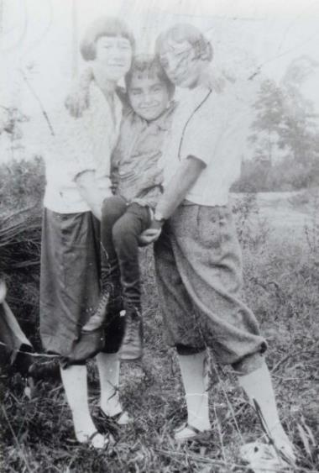
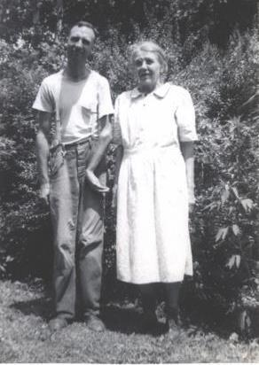
Personal Responsibility
Notes:
One of the most significant historical issues for people everywhere has been that of responsibility for their own lives. We all rely on society for basic needs and use various strategies to get our needs met.
On the left is a photo from the 1940s with a man standing with his elderly mother whom he probably lives with. His left arm and neck are bent.
On the right is little Ben Minowitz. His sister and mother have made a sling with their arms to carry him. He had paralysis from having polio in 1916.

Slide 24
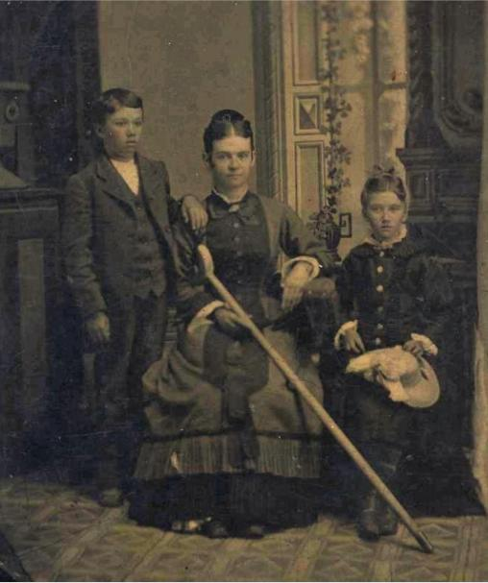
Tintype from 1880’s of a mother and her children
Notes:
This photo from the 1880’s shows a mother seated in a photography studio wearing a long fringed dress, her hair in a bun with a comb, and a crutch resting on her lap. Her son and daughter pose beside her. I’m pretty sure she was a very effective mother!

Slide 25
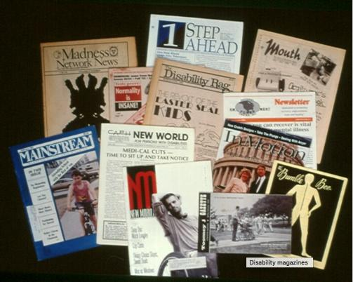
Intentional Communities
Notes:
Just like you all coming together for this conference, friendships have been formed by coming together around common interests, sharing information, and advocating for each other. Historically these affinities have been the seedbed of transformative political and social change.
This photo shows a dozen different publications about disabilities.

Slide 26
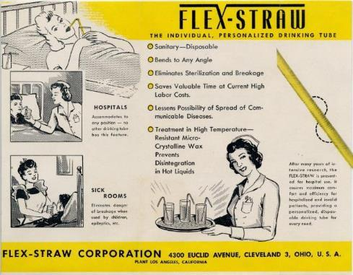
Home and Daily Life Many people with a disability must be pioneers.
Notes:
People with disabilities contribute to society in many different ways. They have to be pioneers and adapt to an environment that was not designed for them. The result is a mixture of improvisation and creativity. You can thank Joseph Friedman who invented a method for bending paper straws in the 1930s. This ad promotes its use in hospitals and sick rooms.

Slide 27
Creative Adaption and Accommodation
Notes:
They have found that many daily activities can be adapted by using different technology. This photo from the 1940’s shows a young man out on the slopes. He lacks gloves and a hat but has created poles with four stabilizing prongs to help him ski. We now refer to devices like these as assistive technology.

Slide 28
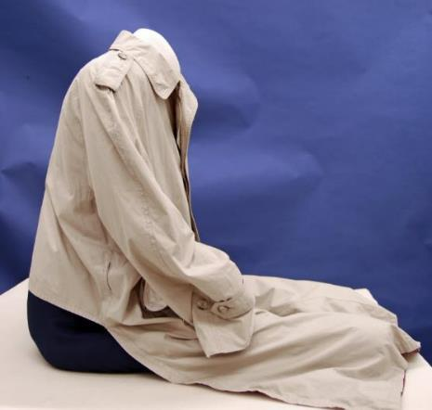
Raincoat, 1990s
Notes:
Washington attorney Charles Ruff was the last Watergate special prosecutor, and he was a member of the team who defended Anita Hill in 1991. He was President Bill Clinton’s chief counsel during his 1999 impeachment trial. He wore this adapted raincoat, cut to accommodate his wheelchair. He would be able to put on and remove this coat without getting up from his chair.

Slide 29
Place
Space is a key factor in the history of disability.
Notes:
Institutions, group homes, schools, nursing homes, camps, and independent living centers generated camaraderie and new ideas as well as rebellion and change.

Slide 30
OUTSIDE Everyone is somewhere.
Notes:
Throughout history people have been legally forced into and out of homes, hospitals and institutions. This is a postcard from 1911 of the main building at the Deaf and Dumb Asylum in Columbus Ohio. The asylum, opened in 1829, was also a vocational training school. These types of buildings were often a point of pride for local communities and a tourist site, worthy of postcard recognition. The existence of so many postcards from so many places indicates the extent to which people accepted institutions as mundane and uncontroversial.
But the architecture and design of these spaces shapes social interactions and sends messages about who is welcome.

Slide 31
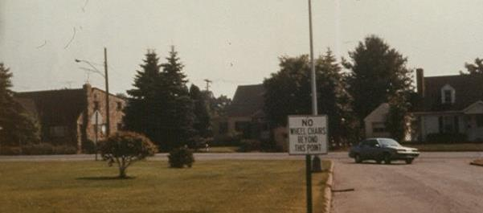
Removal
Questions about where people belong and who decides have created tension throughout American history.
Notes:
For many years in American history, the government made decisions about how and where people with disabilities should live. Some Americans also concluded that those who were different, vulnerable, or less powerful should not even have certain legal protections.

Slide 32
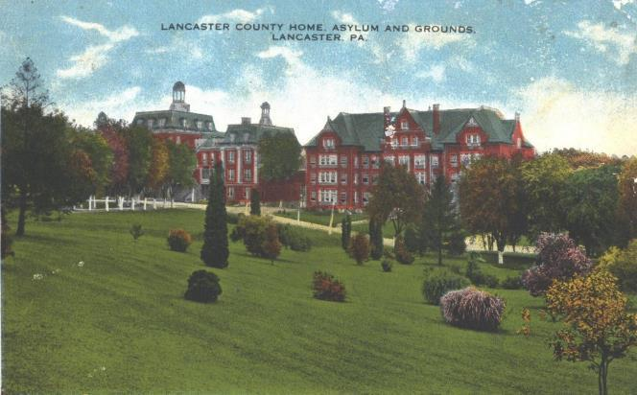
Removal of people with disabilities from their original communities started in the early 1800’s.
Notes:
At the beginning of the 1800’s America formed a cultural agreement on how to deal with differences. That means that everyone thought it was best to remove these people from society, both for them and the rest of the community. Ambitious construction of asylums, hospitals, and specialized schools continued throughout the mid 20th century. Massive brick or stone buildings such as this, the Lancaster County Home and Asylum, were often the most significant structures in town.

Slide 33
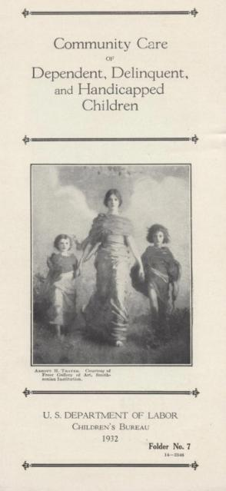
Department of Labor brochure from 1932 laid out the government’s plan to care for the disabled.
Notes:
Disability has often been grouped with other stigmatized categories, including those with disease. Hospitals set aside wards for people with mental illness since the mid 18th century. The government also removed Cherokee, Seminole, and other Indians in the Southeast in the early 1800’s as an example of how to deal with differences. Removal of people with disabilities from their original communities started at this time too. This brochure from the Children’s Bureau in 1932, entitled “Community Care of Dependent, Delinquent, and Handicapped Children, depicts a woman draped in classical flowing garment holding hands with two similarly clothed children and explains the proper way to care for the disabled.

Slide 34
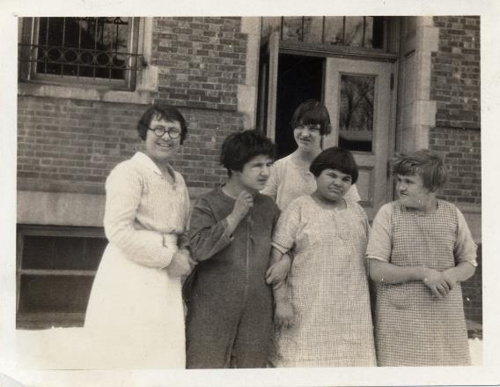
Institutions were formed for different kinds of disabilities and for different purposes.
Notes:
Once arrived, a person might find himself or herself to be a student, worker, inmate, patient, or “consumer.” No matter where people ended up, they grappled with issues of identity, community, and autonomy. This is a photo of students with their teacher at the Onarga School of the Blind, Illinois.
Notice their chopped hair, sack dresses, and the building with barred windows behind them. They were often removed from their homes at a young age, and given no choice what to wear or how their hair should look.

Slide 35
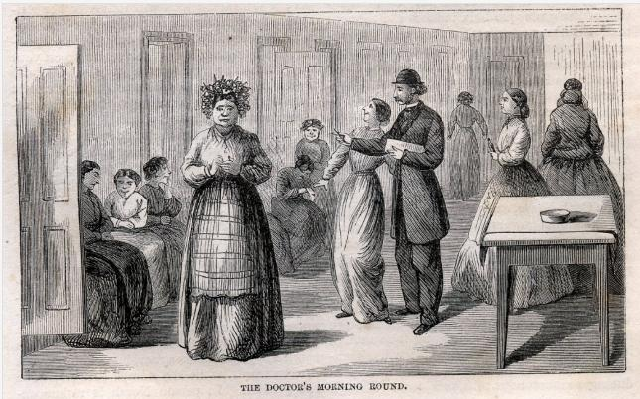
Blackwell Island Lunatic Asylum, in New York, 1866
Notes:
This advertisement from Harper’s New Monthly Magazine published in 1866, shows a drawing of the doctors morning round. The doctor is in a suit and bowler hat and walks among patients drawn in various postures that indicate madness. Keep in mind, at this time a woman could be put in an asylum for “hysteria”. Reasons for admission included political excitement, over taxing mental powers, taking medicine to prevent conception, and novel reading.

Slide 36
Identity
Bertha Flaten (1875-1905) was institutionalized because she had seizures.
Notes:
For many persons with a disability, the greatest struggle is to have others accept them as human. Being one among many could be difficult for people living far from home, without either the capacity for independent action or a means for personal development. Imagine being removed from your family and placed in an asylum right now. People are deciding everything for you without your input. Bertha Flaten’s photo from 1892 (here with the serious expression long braid with bangs, and wearing a long dress) was put there by the state simply because she had a seizure disorder, paralysis on the right side, and was treated with chloroform, which causes cardiac an respiritory arrest. The FDA didn’t outlaw chloroform until 1976.
It was a common practice at state hospitals of burying the dead without name or date. This is an indication of the extreme loss of individuality.

Slide 37
Grave Marker #7
Notes:
When Bertha died, a cast-concrete marker with the number 7 was placed on her grave. There are thousands of such graves around the United States. It wasn’t until many years later that Bertha Flaten’s family was able to remove that marker and replace it with one with her name and dates.

Slide 38
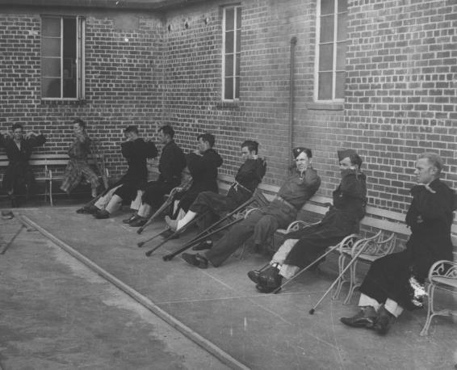
Experiences inside institutions varied widely.
Notes:
These community experiences varied widely. Bonds could be formed around shared routines. People might learn a trade or a language, receive an education, and make lifelong friendships. But at other times, there might be forced medical treatment, punishment, sub-standard care, and even abuse. These 1940’s disabled veterans are in their pajamas and military uniforms and are exercising in a courtyard.

Slide 39
Institutions
It took 20 years to start the change to independent living.
Notes:
In the 1950s, over half a million people with disabilities lived in institutions. The movement to release people into group homes or their own homes, didn’t begin until the 1970s, continues today and is still considered controversial. This photo of children in the 1960’s pose in their classroom with some toys, several children are in wheelchairs.
The very best solution is INCLUSION – where everyone has a chance to interact in the same accessible environment.

Slide 40
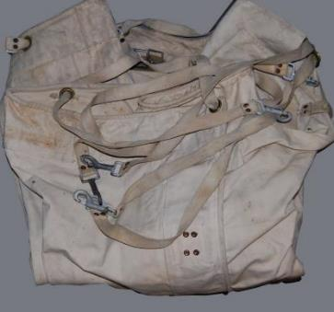
Autonomy
Straight jacket, mid-20th century
Electroconvulsive shock device, 1950s
Notes:
Loss of autonomy and self-determination could be extreme in institutions. Physical restraint of disruptive and rebellious people and as punishment included straight jackets, shackles, and confinement in cells. The stiff canvas bed restraint on the left is from the 1950’s and has webbing ties and weighs about twenty pounds. Physicians used surgical interventions as well. The wooden box on the right contains the heavy regulator for the current and the electrodes that attached to a person’s temples where the electricity disrupted brain activity.

Slide 41
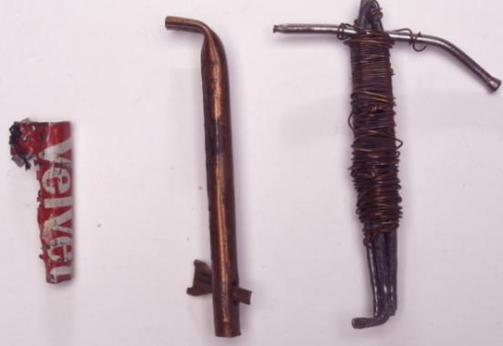
Homemade keys for escape
Notes:
Many patients tried to escape from these institutions. These homemade keys were confiscated from people at the Winnebago Mental Health Institute in Wisconsin. They are made of randomly found materials, on the left is a piece of a tin can, pieces of pipe, and wire and carpenter nails on the right.

Slide 42
Technology
Access to resources often comes through technology.
Notes:
Finding information, purchasing goods, requesting services, getting from place to place—all entail devices, tools, and technology. Historically, technology has played a distinctive role in the lives of people with disabilities. New forms of technology that benefited mainstream society often initially excluded people with disabilities because of inadequate design or planning. The introduction of a new technology, whether movies, telephones, trains, planes, automobiles, or ATMs, created discrimination, exclusion, and new barriers.

Slide 43
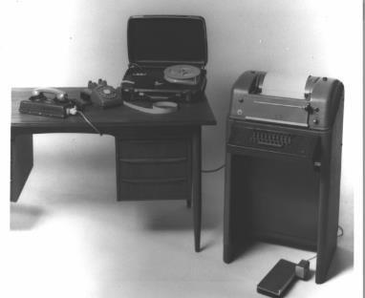
Communication
Communicating with one another is central to human survival.
TTY and Braille converter
Notes:
Access to information not only reduces isolation but is the primary component of education, employment, and success in a community. The telephone, invented in the 1870s, was especially beneficial for people isolated in their homes but it created exclusion for others who were hard of hearing. The teletypewriter, or TTY, which made telephone communication accessible to people who were deaf was not widely available until the 1970s. That’s a span of 100 years!
This photo shows the large mailbox sized device with a keyboard and paper roll. It connects to the paper tape Braille printer on the table on the left. The phone receiver rests on the modem.

Slide 44
Television invented in 1934
Notes:
For instance, television was invented in 1934 and by the 50’s was in nearly every American home. But someone who is deaf couldn’t understand what was said until the invention of Telecaptioner on the bottom, about the size of a VCR, invented in 1980. This has since been replaced by captioning chips included in television sets and has been required by law since 1993.

Slide 45
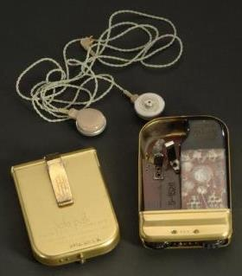
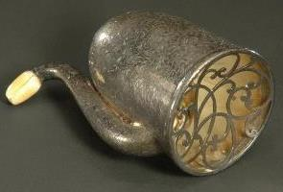
Comparison -
Hearing aid, 1850s
Transistor hearing aid, 1949
Notes:
Here’s a comparison of technology.
On the left - This London Bell-style hearing aid from the 1850’s with engraved decoration and ivory earpiece is held up to the ear for amplification.
On the right - The first commercial application for the transistor, which was developed during World War II, was for hearing aids. This is the first model, by Zenith. The open back shows the circuitry. It was about the size of a pack of cigarettes and could fit in your pocket.

Slide 46
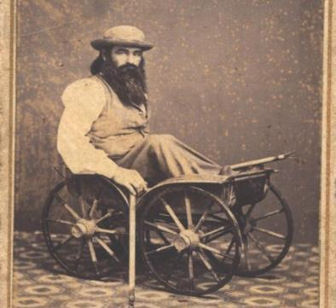
Transportation
Each advance in public conveyance has had the potential for exclusion.
Notes:
Getting around posed problems. For example, wheelchairs, an old mobility technology, were originally not compatible with either city streets or public transportation. Paved streets and sidewalks in the 20th century helped. To circumvent barriers, people frequently made their own devices or adapted existing ones to their liking. This photo from 1860’s shows a man who sits in a cart with four buggy wheels large enough to raise it a few feet off the ground. He has poles for pushing himself along.

Slide 47
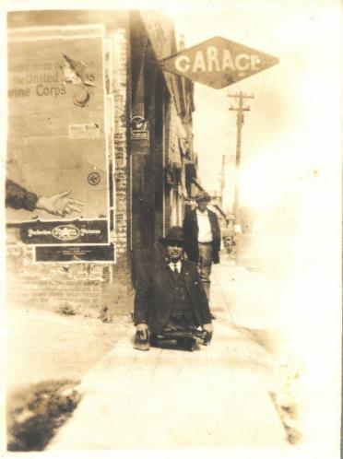
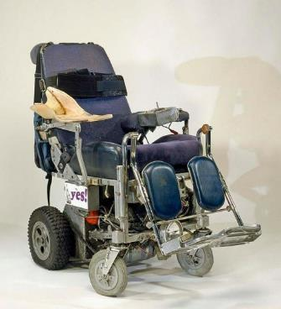
Inventing Mobility
Notes:
On the left is a knuckle board, 1920s-30s
This man travels the sidewalk on a low wheeled board. Hand weights provide propulsion and save his knuckles. He wears a suit and hat and smokes a pipe.
On the right is Disability Rights Activist Ed Roberts’ power wheelchair
He custom-made this chair with go-cart wheels, a joy stick for finger operation, and a headlight.

Slide 48
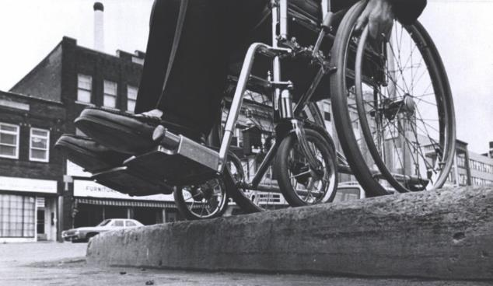
Wheelchair at impassable curb, 1970s
Notes:
So using a chair on sidewalks works until you get to the edge. This photo from the 1970’s shows a wheelchair about to drop off a curb. Curb cuts and ramps didn’t begin appearing until the 1950s. And barriers like this still exist today.

Slide 49
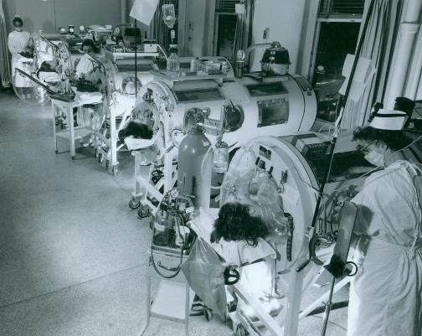
Medicine
Medical technology has had complicated consequences for people with disabilities.
Notes:
Disease epidemics, such as polio, upset established communities and sometimes resulted in widespread disability. The German measles (rubella) epidemics of the 1960s were responsible for many children with deafness. Polio often resulted in permanent paralysis such as this photo of an Iron lung ward of 1955. The iron lungs helped them breath.
It was common for a person to be known, or identified by others, primarily by their medical condition.

Slide 50
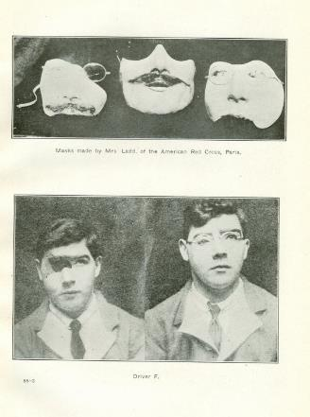
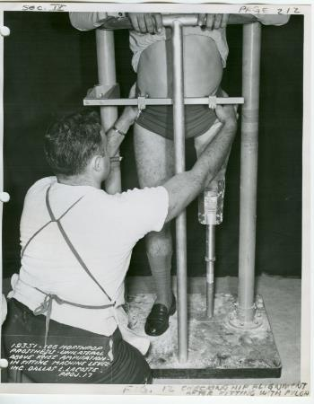
War
Facial prostheses, 1919
Limb-fitting, World War II
Notes:
Wars created new generations of people with disabilities, along with a need to provide for them with major innovations and technologies.
On the left - Anna Coleman Ladd fashioned much-admired face masks for WWI soldiers in the European theater. Facial prosthetics and reconstructive surgery advanced significantly because of this war.
On the right - The U.S. government funded several laboratories tasked with improving prosthetics for disabled soldiers. Here a technician fits a man with a left leg.

Slide 51
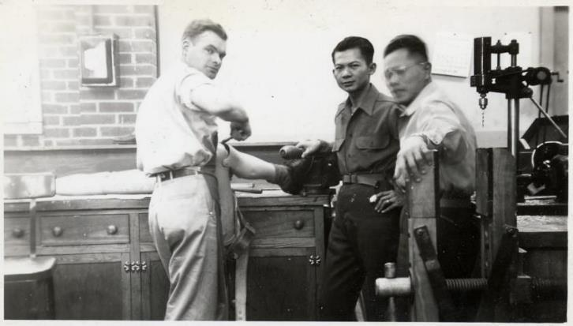
Soldier making limbs, World War II
Notes:
On the home front, World War II brought job openings for people of color, women, and people with disabilities who filled the gap left open by troops off fighting, and new professions were created to care for disabled vets. These Filipino men are making limb prostheses in an army shop.

Slide 52
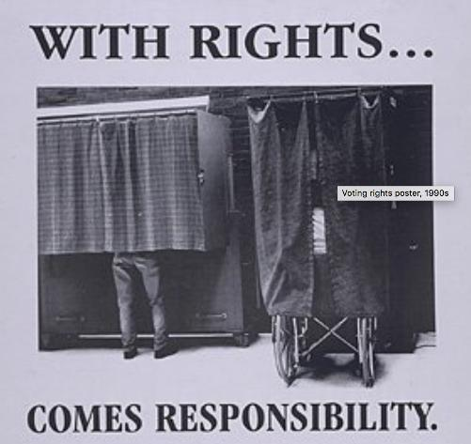
Citizens
Notes:
American citizenship for everyone is the result of centuries of struggle. Under the Constitution, Americans have certain inalienable rights. Full citizenship entails full inclusion – earning an income, being able to visit family and friends, and certain personal freedoms.

Slide 53
Ellis Island inspection, 1890s
These agents are inspecting a group of women for the contagious eye disease trachoma.
Notes:
Immigration laws singled out people with disabilities. For example, Martha’s Vineyard had a thriving community of English immigrants with a recessive gene for deafness who had settled there in the 1630s. Despite the deafness they were very successful but in 1701 the colonial Massachusetts government passed the first of many laws preventing "lame, impotent or infirm persons, or those incapable of supporting themselves" from settling there. Such exclusionary laws forced families to either leave a member behind, fake “normalcy,” or risk deportation. This photo from the 1890s shows agents at Ellis Island inspecting a group of women for an eye disease. Most bans based on race and ethnicity have been removed, but restrictions based on disability continue to this day.

Slide 54
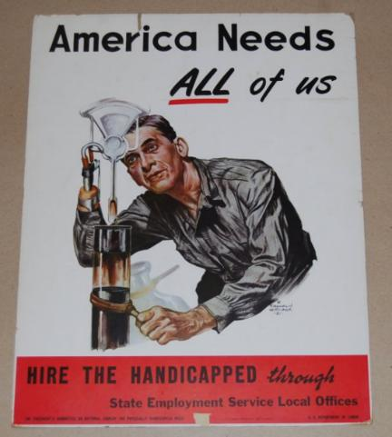
Work
Notes:
Work is an important part of personal responsibility. People with disabilities throughout American history have faced difficulties in getting the skills needed to find jobs. It was common in our history that people with disabilities could only find work that exploited their physical differences.
This photo is of a poster from a 1951 program to employ people with disabilities.

Slide 55
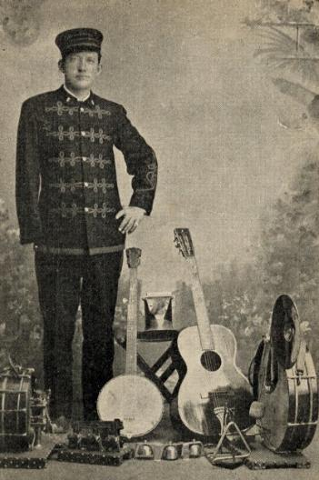
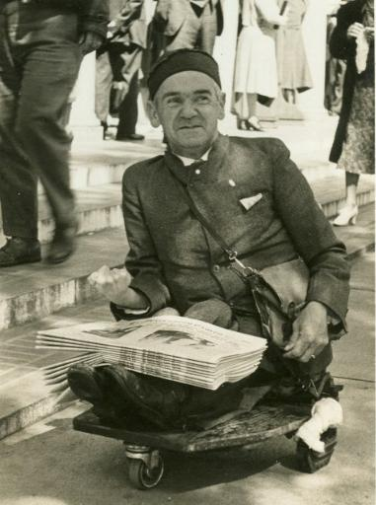
Selling in the streets
Notes:
Low and uncertain wages provided a precaurious living. They often resorted to selling things or begging on the streets with their disability in full view. Music paid the bills for W. C. Williams in the photo on the left from 1910. Wearing his uniform he played the instruments at his feet: guitar, banjo, triangle, drum, bells, and more. On the right, a man in the 1930s is selling newspapers by wheeling around on a board, the papers on his lap.

Slide 56
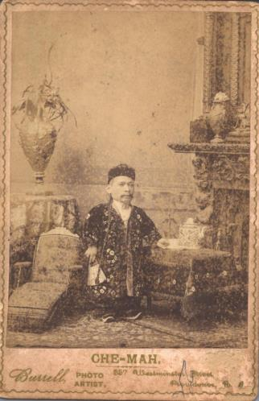
Freak Shows
Notes:
“freak shows” in the circuses were popular from the 1840s clear into the 1960s.
On the left is Circus performer, Che-Mah, from 1891 dressed in Asian clothing who worked for Barnum and Bailey’s circus as a “Chinese dwarf.”
On the right is Mary and Margaret Gibb who sang and played the piano in the 1930’s. They exhibited themselves as “American Siamese Twins.”

Slide 57
Accommodation
Notes:
Despite discrimination people with disabilities have worked in every field.
The woman on the left was blind and found secretarial work in 1911. She typed on a large heavy typewriter while listening to a recorded voice dictating a document.
On the right accommodations in the workplace included a typewriter on the floor and a desk at foot height. This woman from the early 1900’s, in a long skirt and lacy blouse types a document with her feet because she does not have arms.
Accommodation is now a protected right for people with disabilities. If “readily achievable accommodation” can be made so a person with a disability can work, it is the employers job to make sure that need is met or face discrimination lawsuits.

Slide 58
Focus on ability
Notes:
The need to counter pity while acknowledging disability can be difficult to balance. In an effort to change societies attitudes, ad campaigns like this poster of a young woman in a wheelchair typing at an office desk were started in the 1980’s. Notice that “people first” language hasn’t started yet. They are still using the negative image of “handicapped”. Now society dictates that we don’t use words like retard, moron or idiot. Instead we use person with intellectual disability.

Slide 59
Eugenics
Notes:
When we think about Eugenics, we tend to think of other countries. This advertisement in Germany shows a man on a chair with a doctor behind him and states “This person suffering from hereditary defects costs the community 60,000 Reichsmark during his lifetime. Fellow Germans, that is your money too.”

Slide 60
Although citizenship guarantees certain rights, access to them has been unequal.
Notes:
We talked about the ugly laws in the late 1800’s. It was around this time that the acceptance of people with disabilities diminished. Respect for and aid to people with disabilities and the poor had eroded. For example, during this time, some American citizens have been sterilized, warehoused, euthanized, and imprisoned because their voices, brains, and bodies were not acceptable to their communities. Eugenicists justified eliminating the “unfit” by citing the betterment of society. By the 1880’s it had become a popular idea and embraced by scientists, politicians, feminists and many others. Supporters of eugenics included Alexander Graham Bell, Woodrow Wilson and Thomas Edison.

Slide 61
“Feebleminded family,” 1946
Notes:
Eugenic ideas reflected fears about the decline of Euro-American culture, among other things. In this image, six barefoot young people pose with an adult. The children appear to have developmental or cognitive disabilities and would have been interpreted as genetic failures. In 1907, Indiana became the first state with a forced sterilization law, allowing doctors to castrate or sterilize people in institutions against their will. The Supreme Court’s decision in 1927 upheld such laws. By the 1970s more than 60,000 individuals had been forcibly sterilized under 33 state laws. As recently as 1983, 15 states still had sterilization laws related to people with disabilities including New Jersey

Slide 62
Forced Sterilization on people with disabilities
Notes:
This is a poloroid snapshot from 2000 of Junius Wilson wearing pajamas and a santa hat. He was a deaf man from North Carolina and was falsly accused of attempted rape in the early 1900’s. At his trial no members of the deaf-culture community testified. He was incorrectly judged incompetent and sentenced to indefinite imprisonment. In 1931, Wilson was castrated. It wasn’t until the 1990’s that Wilson’s social worker successfully brought a legal suit against the state for wrongful imprisonment and exposed decades of neglect.

Slide 63
Activism
Activism takes many forms. It can be as complicated as a class-action lawsuit or as simple as wearing a T-shirt.
Notes:
By organizing, Americans dealing with disabilities began to make changes. By the 1940’s and 1950’s, parent activists had organized to fight for education and services for children. These same children sometimes confronted their own parents fears and overly protective attitudes. This booklet from 1969 is “Your Rights as Parents of a Handicapped Child”

Slide 64
Architecture Architectural design has entailed barriers that in turn created disability.
Phone booth, 1979
Notes:
By the mid-20th century, activism was getting institutions and local governments to begin adapting public spaces through altering the impassable height of curbs (curbcuts) and other ergonomic features. Urban landscapes were altered as disability activists successfully lobbied for federal legislation to make public buildings, transportation, and education accessible. The ADA was considered an un-funded mandate, and opposition to making places accessible is still around today.
Ron Mace, the young boy used as a poster child, marked on the photograph on the left to show how to position a wall-mounted public telephone so people in wheelchairs can use it.
The Center for Universal Design produced this poster on the right from 1997 that describes seven principles for creating spaces and products that accommodate a wide range of peoples’ capacities.
The idea of Universal Design is: why not make everything accessible to all?

Slide 65
ADAPT
Notes:
So it’s this kind of discrimination that creates activism. Certain kinds of activism are unquestioned as part of social citizenship, such as voting, being informed, and going to school. People engage in other forms of activism, such as petitioning and protest, when rights are denied. This kind of Advocacy and Activism that brought the Civil Rights Movement and women's Equal Rights Amendment into action.
"The notion that any one person is the single cause of any significant social change—that Abraham Lincoln alone freed the slaves—is a devastating stereotype which robs individuals of responsibility and credit, and actually inhibits social change.... You can be a revolution of one. In your living room, in your family, in your community." —Justin Dart, 1998
This photo is of an ADAPT protest in Las Vegas from 1994. Dozens of protestors have hung a wheelchair on a cross and carry signs and an American flag with a wheelchair outlined in stars.

Slide 66
Civil Rights, Disability Rights
Notes:
The Disability Rights Movement, organized in the 1970s, has been similar to other movements in important ways. For instance that attitudes need to change for social change to happen.
But the Disability Rights Movement is different than other movements. For this social change to occur, architectural barriers also needed changing. Necessary accommodation and services were different than those for other groups. And because disability crosses race, class, and gender, and people came to it in many different ways, and expectations also varied.
This photo is from a protest to make public transportation accessible and shows people with signs on their wheelchairs.

Slide 67
Demonstrating the need for curb cuts.
Notes:
It took an organized effort, like the civil rights march, to bring attention to the need for change. Here a group of protesters in Los Angeles California in the mid 1980’s are hammering at a curb to show the need for curb cuts so they can access public areas. The piece of curb on the upper left was removed by protestors because the city of Denver had discontinued its curb-reduction program and people trying to get up impassable curbs frequently were hit by cars.

Slide 68
Inaccessible Greyhound Bus Lines
Notes:
Groups like ADAPT chained themselves to buses, or here they are risking their lives lying under the bus to show how public transportation and over-the-road coach companies like Greyhound were not accessible if you used a wheelchair. As an American citizen with a mobility disability you pay taxes supporting public transportation that you cannot even use.

Slide 69
Nursing Homes
Notes:
Groups like ADAPT and People First protested institutionalization. People with disabilities have the right to choose to be in their own home instead of nursing homes.

Slide 70
The United States Capitol Building
Notes:
Public buildings were and still are not accessible. On March 12, 1990 a group of demonstrators cast aside their wheelchairs, walkers and crutches and crawled or dragged themselves up the steps of the U.S. Capitol to illustrate it’s inaccessibility. This event became known as the Capitol Crawl and was part of a larger campaign to support the passage of the Americans with Disabilities Act. There is power in solidarity!

Slide 71
ADA - Americans with Disabilities Act
Notes:
Laws may not immediately change attitudes but they do direct citizens’ behavior.
The Americans with Disabilities Act (ADA) was signed into law by President Bush (the first Bush) over 25 years ago.
It is one of the most significant civil rights documents of the 20th century. Its purpose was to end discrimination and reduce the barriers to employment and education for people with disabilities. The man on the right with the hat is Justin Dart. His father ran Dart Industries (the maker of Tupperware) his mother was Ruth Walgreen Dart (of Walgreen pharmacies). He contracted polio in 1948. He went to University of Houston and earned a degree in History and education but the university wouldn’t give him a teaching certificate because he was disabled. So he worked for his fathers corporation and was very successful. In 1966 he toured a facility for children with polio in Vietnam. He was horrified at the way they were institutionalized, starving and lying in their own filth. So he came back to the United States and eventually became the chairman of the President’s Committee on Employment of People with Disabilities.
The ADA’s importance lies in how it led to the re-shaping of the physical environment and to communications access, and in the passion of the thousands of people who struggled for the rights embodied in it.
And the struggle continues today, as we try to make our communities accepting and accessible.

