Slide 1
Cutting Edge IL Research on Rural Community Living
Craig Ravesloot
Rayna Sage
Lillie Greiman

Slide 2
Acknowledgements
Rural people who participated in our research
CIL staff who have guided and facilitated what we do
APRIL, Billy and Mary for consistent support
The University of Montana
NIDILRR at the Administration for Community Living
This research was supported by grant #90RT5025 from the National Institute on Disability, Independent Living, and Rehabilitation Research within the Administration for Community Living. The opinions reflect those of the authors and are not necessarily those of the funding agency.

Slide 3
Overview
Satisfaction with rural community engagement
Rural events: Why inclusion matters and how it happens
Rural CIL services [replace with actual title]

Slide 4
Satisfaction with Rural Community Engagement
Craig Ravesloot, Tannis Hargrove, Jennifer Wong

Slide 5
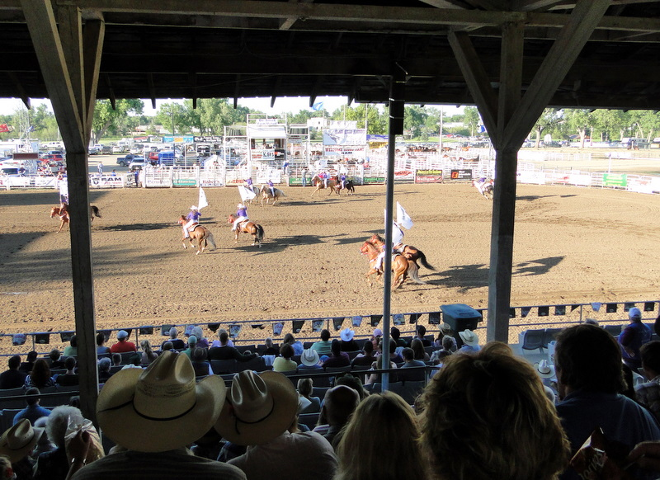
…the Rodeo!

Slide 6
…a Ghost Town Festival!

Slide 7
Check out the old hotel!

Slide 8
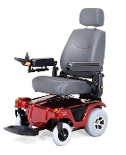
Ok, well maybe I’ll just go to the loo instead.

Slide 9
Background
Rural community participation raises important questions about dependence, independence and interdependence (White et al. 2010).
Rural communities are less accessible than urban communities. People have adapted to lack of accessibility for decades (Seekins et al., 2014).

Slide 10
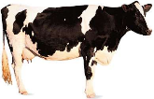
So, what matters (satisfaction) when people with disabilities go out to do things in their rural community?
1
2
3
Disability Severity
Able to just do it!
Needs are met

Slide 11
Research stuff
Where?
Small towns in Montana and Idaho
Who?
People who answered yes to disability questions
“Had difficulty doing errands alone such as visiting a doctor’s office or shopping.” (rating 0-10)
How?
Used smartphones to ask questions when people left home and stayed somewhere for 10 minutes
“How satisfied are you with this activity?”

Slide 12
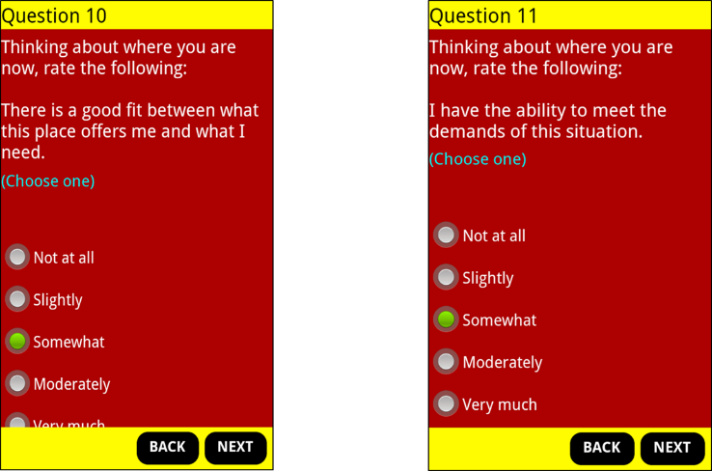
In the moment questions

Slide 13
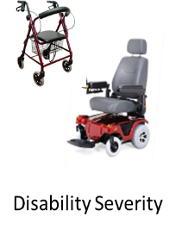
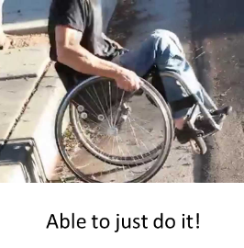
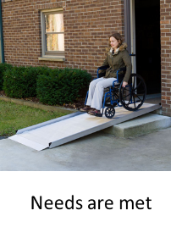
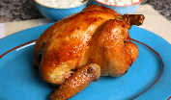
Results: Two of three matter and one does not!

Slide 14
What does this mean?
Difficulty in going out was not related to satisfaction for the people in this study.
Being capable of participating was strongly related to satisfaction, but it was not their ability that mattered the most.
Instead, getting needs met when participating in community matters the most.
Does it matter how needs get met (e.g., ramps versus assistance)?

Slide 15
For your consideration:
What do these results mean for community access and universal design?
How does rural culture create dependence, independence and interdependence?
What is the role of IL in creating rural community culture?
In plain English, what can CILs do to change how rural people’s needs are met when they are out in their community?

Slide 16
Rural events: Why inclusion matters and how it happens
Rayna Sage, Erin Flores, and Craig Ravesloot
October 6, 2018
Annual Meeting of APRIL
Denver, CO
@rayna_sage
@RTC_Rural

Slide 17
Cultural reproduction, rural events, and disability
@rayna_sage
@RTC_Rural
What is cultural reproduction?
Created shared norms that we perform, adapt, or challenge
Example: How do we ask for and receive “help”?

Slide 18
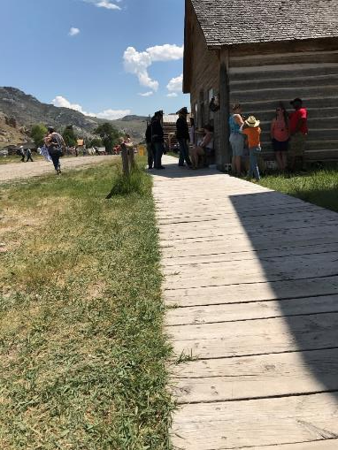
Cultural reproduction in rural community events
@rayna_sage
@RTC_Rural
A physical and social space where culture can be maintained or changed
People with privilege control decision-making processes
Meet the tension between
maintaining tradition and history and
making changes to be more inclusive

Slide 19
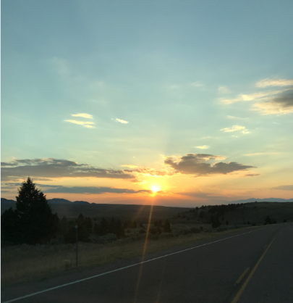
Research Questions
@rayna_sage
@RTC_Rural
What are the benefits of participating in rural community events?
How are people with disabilities included and excluded?

Slide 20
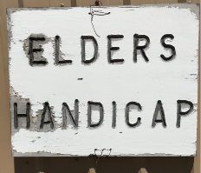
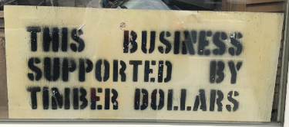
This study, rural Western Montana Identifying characteristics have been changed to protect confidentiality
@rayna_sage
@RTC_Rural
Arts Festival
63 “In the moment” interviews at 6 rural community events in the summer of 2017
Community Picnic
Powwow
Ghost Town Celebration
Rodeo
Hometown Days

Slide 21
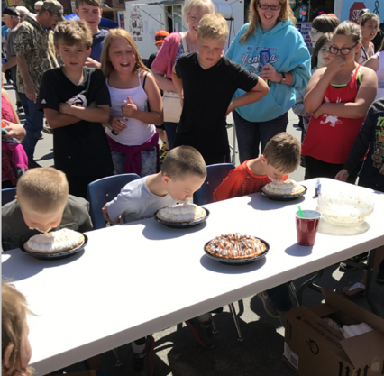
Benefits: Connecting and reconnecting
@rayna_sage
@RTC_Rural
“It's a good way to meet new people, but also reconnect with, you know…”
Cathy, mid-50s, attendee at arts festival
“The people are probably the number one thing. It's just everywhere you go, there are friendly faces. There's no strangers.”
Dan, motorcycle enthusiast, community picnic

Slide 22
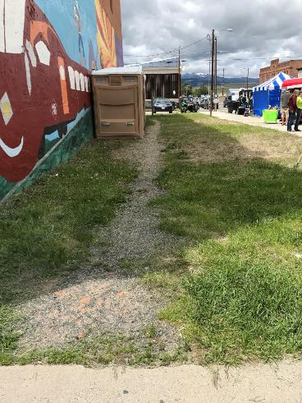
Benefits: Building and maintaining community
@rayna_sage
@RTC_Rural
“I get a lot out of it. I mean it's in you, it's a part of our culture. I'm a strong, strong advocate for our culture and our ways of the Bitterroot Salish people.”
Jennifer, mid-40s, powwow vendor
“I was born and raised here. I don’t remember not coming to this event.”
Sandra, mid-30s pushing brother in wheelchair, hometown days
“Just the whole community.”
Stacey, mid-50s with a mobility disability, rodeo

Slide 23
Benefits: Access to alternative economic networks
@rayna_sage
@RTC_Rural
“I like meeting new people, especially people with the same interest…make those connections with other small business women owners.”
Barbara, mid-40s, arts festivals
“That's how I look at life. You wake up and you don't need to bend over backwards for somebody, you know. A boss. You are doing your job, and you know that you're doing it to the best of your ability. You don't have to bend over backwards. That's just the way I look at things, you don't just bend over backwards for somebody who will just take advantage of you.”
Teresa, mid-60s with mobility disability, powwow

Slide 24
Patterns of inclusion and exclusion
@rayna_sage
@RTC_Rural
“We’ve always had disabled people. Even when it was on the ranch…everybody just says, ‘Oh, I’ll help you with that!’ I mean, you push the wheelchair out, you help them in and out of their trucks.”
Ester, late-50s, Arts Festival organizer
“But if you want to stay authentic, there’s a limited amount that you can do about that and I’m content to send him off with a camera while I sit and wait…”
Ann, late-60s with multiple sclerosis, ghost town celebration
“I mean, it's a ghost town so there are boardwalks and things like that. You're very limited on what you might be able to do...you can just step into most of the cabins so we'll just grab their hands and help them up.”
Laura, mid-20s, lifetime ghost town celebration attendee

Slide 25
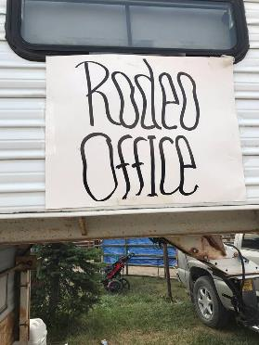
Patterns of inclusion and exclusion
@rayna_sage
@RTC_Rural
“There should be a spot-- There used to be a spot for the-- This used to be a baseball field… There used to be a dugout on that end and a dugout on that end. That's where the handicapped people would sit because they could get in there with their chairs.”
Danny, mid-30s, rodeo vendor and attendee
@rayna_sage @RTC_Rural

Slide 26
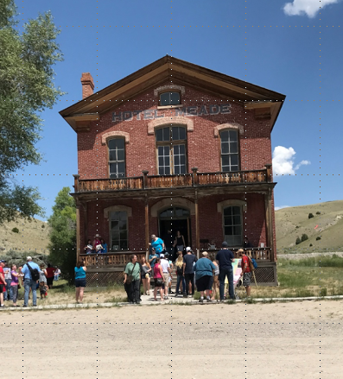
Conclusions and application
@rayna_sage
@RTC_Rural
How do we include people? Who, when, where, and how?
Rural community events as an conduit for action and involvement
Culturally and contextually appropriate accessibility
Meaningful involvement
2018-2019 goals: Work with organizers and peer advocates to develop event report and improve accessibility and participation

Slide 27
Exploring Access to Rural Independent Living Services using a Transportation Network analysis
Lillie Greiman, RTC: Rural, University of Montana
Kourtney Johnson, Dept. of Geography, University of Montana
Billy Altom, Association of Programs for Rural Independent Living (APRIL)
Christiane von Reichert, Dept. of Geography, University of Montana

Slide 28
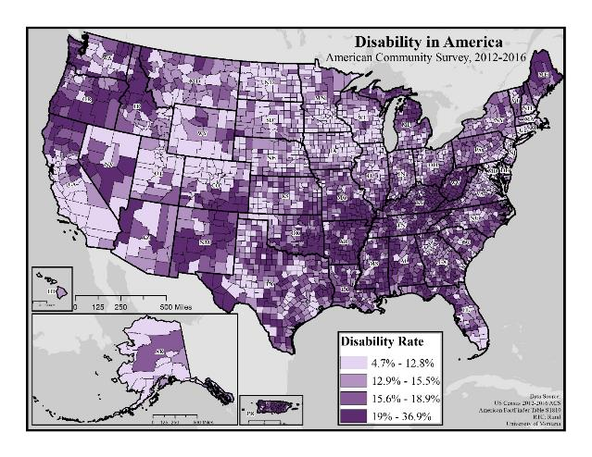
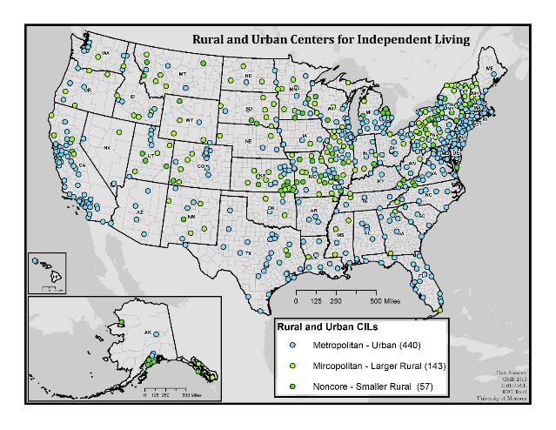
Centers for Independent Living and Disability in Rural America
Notes:
200 rural centers but many more that serve rural areas

Slide 29
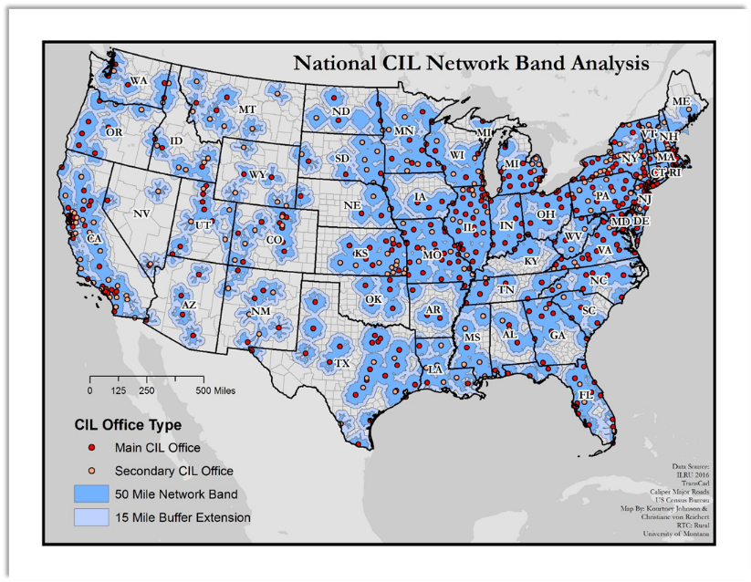
Transportation Network Analysis
Our network analysis uses a national network of roads to measure travel distance from a CIL.
Focus on primary and secondary roads (interstates and highways) to create “travel bands” of 50 miles
Added a 15 miles buffer to capture local road traffic
Feedback at APRIL 2017
Network bands crossed state lines
65 miles wasn’t far enough
Case Studies-MT and AR

Slide 30
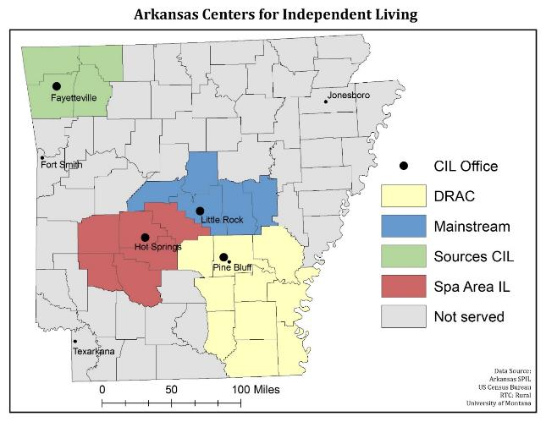
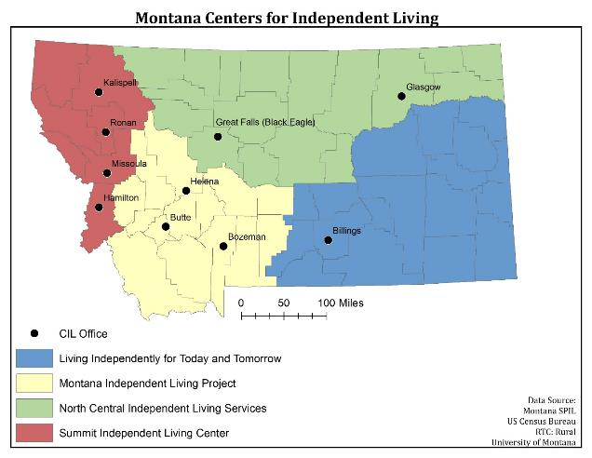

Slide 31
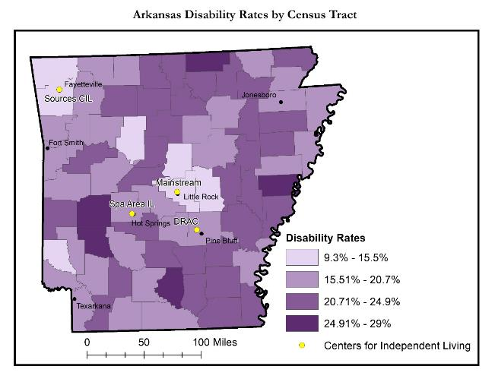
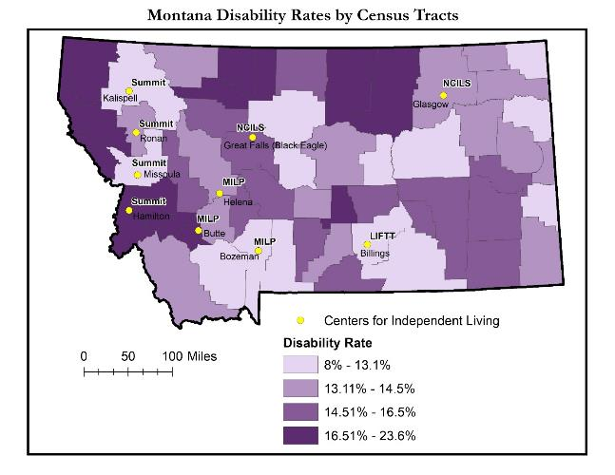

Slide 32
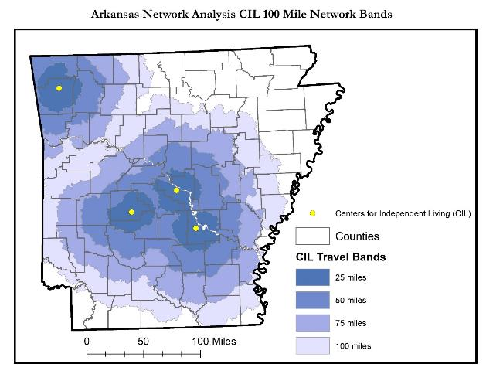
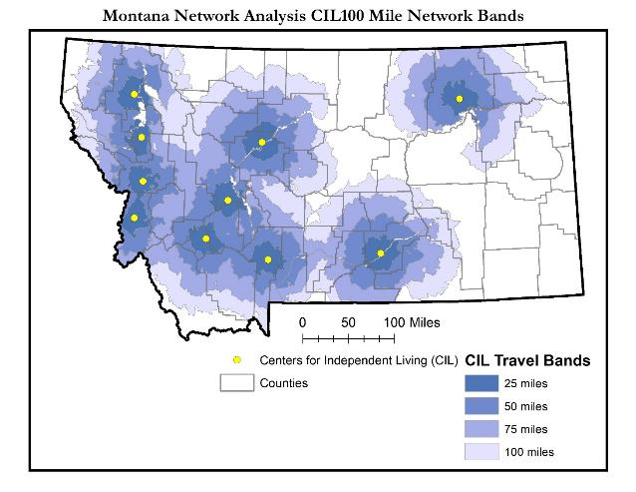

Slide 33
Strategies for expanding access
Increased funding to serve rural communities
Recognition that it costs more to serve rural
Transportation costs
CIL staff traveling out to meet with rural consumers and conduct rural outreach….this leads to lots of windshield time
Funding equations that are tied to population disadvantage CILs in rural states
Partnering with other agencies to leverage funding and services
Example: Area Agencies on Aging
ACL “No Wrong Door”/ADRC initiatives

Slide 34
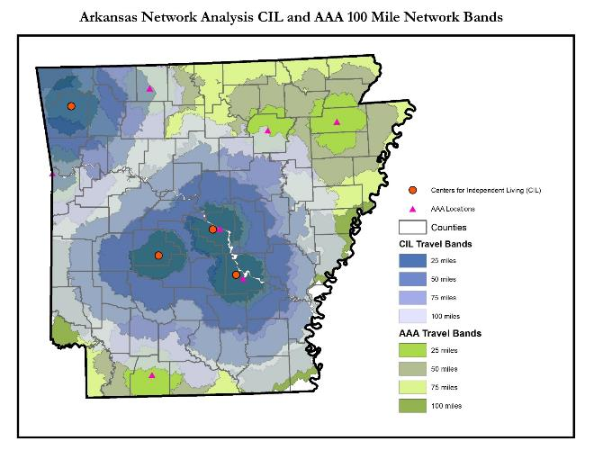
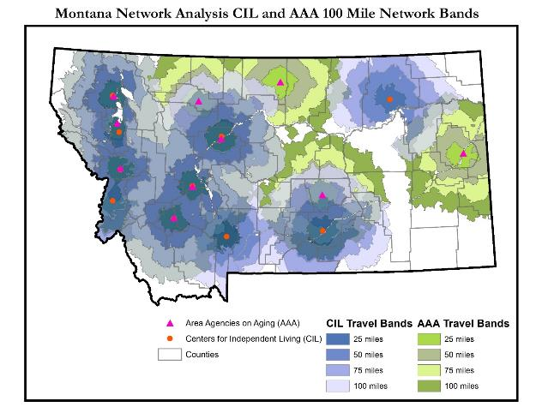
19,391 to 5,086 potentially “unserved” in Montana
108,760 to 3,279 potentially “unserved” in Arkansas

Slide 35
Challenges
No one size fits all
Strategies for expanding rural services will likely vary from state to state
A comprehensive understanding of where and how different services are offered across states
Differences in value systems and philosophy between organizations
Aging and Independent Living
Strategies for effective translation between system?
Transparent and equitable funding
What can these partnerships look like and how are funding decisions made?
Who is at the table and who is on the menu?
What can we learn from existing/past partnerships?
Results from No Wrong Door pilot programs?
Effective strategies from Transition coordination programs (Arkansas-Passages)
Partnerships around specific programs- e.g. transition, transportation
Notes:
How can we do this vs can we do this?
CILs were involved from the VERY beginning
Potential partnerships around specific issues/programs rather that broad program coordination
Identifying opportunities to blend programs and strategies…..around transportation?

Slide 36
Conclusions and Questions
Rural Centers for Independent living face unique challenges in serving rural areas.
Strategies exist for increasing access to services by partnering with other service organizations, such as Area Agencies on Aging
These partnerships need to be strategic, inclusive and equitable
A transportation network analysis is an alternative way of exploring access to CIL services and can provide insight for policy makers

