Slide 1
Be a Hero:
Emergency Preparedness Planning for Persons with Disabilities
Julia Beems, MA
University of Colorado Denver, Assistive Technology Partners
Candiss Leathers
Colorado AgrAbility, Goodwill Industries of Denver

Slide 2
What We Are Going To Cover
The Role of Emergency Management
Hazards, Disasters, and Disruptions
Personal Assessments
Evacuations vs Sheltering-in-Place
Personal Support Networks
Communication Plans
Emergency Kits

Slide 3
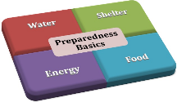
What is Emergency Preparedness?
What does it mean to you?
Having emergency contact numbers
Having a first aid kit
Having a smoke and carbon monoxide detectors
Having a written emergency plan
Having an emergency kit for evacuation
Having a place to go during an evacuation
Having 3 days of food and water to shelter in place
Being completely self-reliant

Slide 4
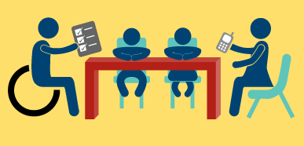
Making a Plan
Know local alerts
Sign up for community alerts
Shelter-in-Place Plan
Power Back-Up Plan
Evacuation Plan
Personal Support Network
Communications Plan
Cybersecurity Plan
Active Shooter/Active Threat Plan
Service Animal Plan
Education Plan
Action Plan

Slide 5
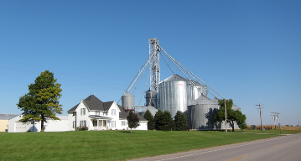
What Should Be Considered
Risk Assessment
Personal Assessment
Personal Support Network
Emergency Contacts
Medical Information
Medications & Supplies
Evacuation Routes
Preferred Evacuation Locations
Smoke/Carbon Monoxide Alarms
Utility Cutoff Valves
Community Resources
Emergency Supply Kit(s)
Training Needs

Slide 6
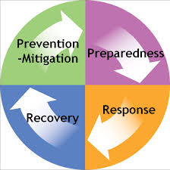
Emergency Management
May be housed in:
County Administration
Fire Department
Law Enforcement
Help pre-plan during various phases of emergency management:
Prevention
Mitigation
Preparedness
Response
Recovery

Slide 7
Rural Challenges
Remoteness and separation
Distance
Weather
Barriers
Entrapment
Allocation of resources
Number of residents
Communication
Reduced outreach
Warning systems are often absent or neglected
Burden on the individual to access emergency information
Others?

Slide 8
Risk Assessment
Natural Disasters/Emergencies
Man Made Disasters/Emergencies
Medical Emergencies
Work-Related Emergencies

Slide 9
Natural Disasters/Emergencies
Drought
Earthquakes
Extreme Heat
Floods
Hurricanes
Landslide and Debris Flow
Power Outage
Severe Weather
Space
Thunderstorms and Lightning
Tornadoes
Tsunamis
Volcanoes
Wildfires
Winter Storms and Extreme Cold

Slide 10
Man Made Disasters/Emergencies
Active Shooter
Biological Threats
Chemical Threats
Explosions
Fires
Nuclear Threat
Power Outage
Radiation Threat

Slide 11
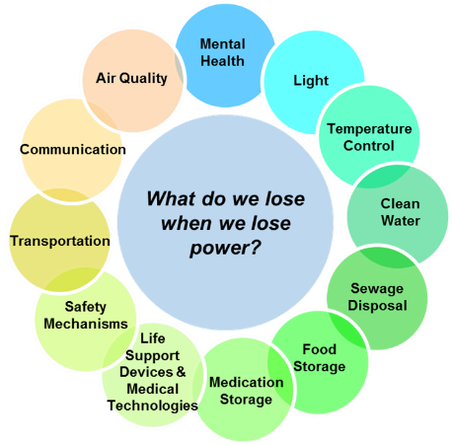
Power Outages
(Public Health England, 2014)

Slide 12
Medical Emergencies
Equipment Failure
Injury and Illness
Allergic reaction
Chronic health condition complications
Heart attack
Seizures
Temperature regulation
Motor Vehicle
Pandemic events
Past – plague, flu, smallpox, measles, tuberculosis
Future – antibiotic resistance, flu, SARS, zika
Biological warfare - anthrax

Slide 13
Work-Related Emergencies
Machinery
Slips & Falls
Bruises and contusions
Entanglement
Amputation
Spinal Cord Injury
Lacerations
Getting struck
Crushing
Long bone fractures
Confined Spaces
Engulfment
Suffocation
Hypothermia
Mechanical
Nitrogen dioxide
Falls
Hydrogen sulfide
Drowning
Ag Chemicals
Asphyxiation
Burns
Poisoning
Chemical reactions
Combustibles

Slide 14
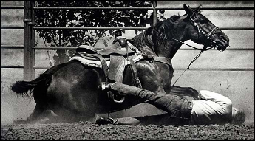
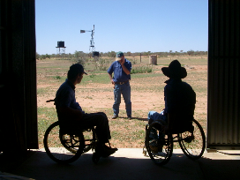
Work-Related Emergencies continued
Animals
Bruises
Cuts and scratches
Fractures
Falling objects
Blunt force chest trauma
Crushing-type injuries/internal injuries
Head injuries
Disease transmission
Other
Over exertion back strain or strains
Noise
Firearms

Slide 15
Personal & Family Disasters/Disruptions
House Fire
Car, Bus, Train Accident
Flat Tire, Car Breakdown
Computer Failure
Unemployment
Chronic Illness
Divorce
Medical Emergency
Domestic Violence
Aging Spouse or Parent
Death of Family Member

Slide 16
Season-Specific Preparations
Plan for hot, cold, wet, dry, and windy weather
Special preparations may include:
Storing extra heating oil
Winterizing cars and lawnmowers
Knowing how to prevent freezing pipes
Packing an umbrella
(Taken from “How to Prepare for Everything” by Aaron Titus)

Slide 17
Personal Assessment
Personal Care
Personal Care Equipment
Power Dependent Equipment
Medical Needs
Water Service
Disaster Debris
Transportation
Building Evacuations
Mobility Aids
Ramp Access
Service Animals and Pets

Slide 18
C-MIST
A framework for emergency planning and management.
Helps everybody speak the same language.
Based on a “Functional Needs Framework”.
Identifies people’s actual needs during an emergency rather than labeling them as “special needs”.
More inclusive as it identifies people with temporary needs or those who do not identify themselves as having a disability.

Slide 19
C-MIST
Communication - people who have limited or no ability to speak, see, hear or understand. During an emergency, people with communication needs may not be able to hear announcements, see signs, understand messages or verbalize their concerns.
Medical – people who require assistance in managing activities of daily living such as eating, dressing, grooming, transferring and going to the toilet. It includes managing chronic, terminal or contagious health conditions (such as ongoing treatment and administration of medications, IV therapy, catheters, tube feeding, dialysis, oxygen, operating life sustaining equipment...) During an emergency, people may be separated from family and friends. Early identification of these needs and intervention can avoid deterioration of health.

Slide 20
C-MIST
Independence - people who are able to function independently if they have their assistive devices and/or equipment. Items consist of mobility aids (such as wheelchairs, walkers, canes, crutches); communication aids; medical equipment, (such as catheters, oxygen, syringes, medications); and service animals. Individuals may become separated from their assistive equipment and/or animals in an emergency. Those at risk whose needs are recognized and restored early are able to maintain their independence and manage in mass shelters. Effectively meeting their functional needs prevents secondary complications.
Supervision - may include those who have psychiatric conditions (such as dementia, Alzheimer, Schizophrenia, depression or severe mental illness); addiction problems; brain injury, or become anxious due to transfer trauma. During an emergency, some people with mental illness may be able to function well while others require a more protected and supervised setting.

Slide 21
C-MIST
Transportation - people who are unable to drive because of disability, age, temporary injury, poverty, addiction, legal restriction or have no access to a vehicle. Wheelchair accessible transportation may be necessary. Pre-planning evacuation needs helps prevent chaos during an emergency and many people can function independently once evacuated to safety.

Slide 22
Disability Implications
Cognition – sensory overload, language, comprehension of message, next steps, time
Hearing – reception of message, language, visual formats
Mobility – time
Vision – reception of message, audible and tactile formats
Deaf-Blind – audible, visual and tactile formats
Age Related – sensory overload, language, comprehension of message, audible, visual and tactile formats, reception of message, time

Slide 23
Shelter-in-Place vs. Evacuation
Is it a watch or an emergency ?
What is the severity & duration of the situation?
Is it day or night?
Do you have the potential to lose power?
Do you have family members out in the community: day care, school, work?
Do you have a way to communicate with others?
Is English your first language?
Do you have food and water for everyone for 3 days?

Slide 24
Shelter-in-Place vs. Evacuation
Do you have medications for everyone for 3 days?
Do you have your medical equipment, supplies, and assistive technology?
Do you have first aid supplies?
Do you have supplies for your service animal/pets?
Do you have transportation?
Do you have fuel?
Do you have a place to stay: family or friends, hotel or public shelter?
Do you have an emergency kit?

Slide 25
Shelter-in-Place vs. Evacuation
Do you have cash available?
Do you have all your important documents available?
Do you know the evacuation routes?

Slide 26
Shelter In Place vs Evacuation
Depends on type of hazard/event
Choosing a safe location
Length of time in shelter
Available supplies
Sheltering in Place
Conditions require immediate protection
Debris in the air or air is contaminated
Evacuation
Authorities tell you to evacuate
Know how long it will take you, you may want to leave before notification
Use community shelters as a last resort

Slide 27
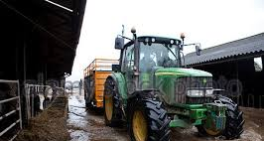
Evacuation Plans
Decide where you will go before hand
Determine at least three locations
Call for transportation if you need assistance
Grab emergency supply kit
Know what equipment you need
Care for pets/livestock
Turn off electricity
Call personal support group
Advocate for yourself
Practice plan
Review and revise plan

Slide 28
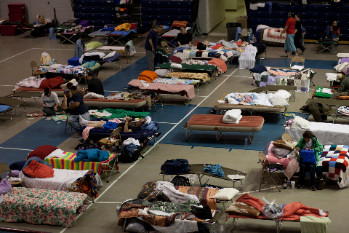
Reasonable Accommodations
Need for power
Special mattress
Quiet room
ASL sign language interpreter
Special diets
Personal assistant
Service animal

Slide 29
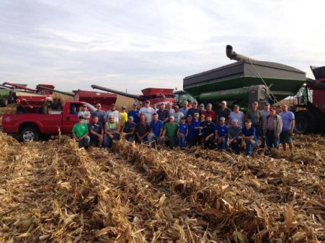
Personal Support Network
Family
Friends
Co-workers
Personal care attendant
Neighbors
Roommates
Fellow parishioners

Slide 30
Personal Support Network
Communication
Trust
Extra keys
Emergency supplies
Escape plan
Emergency documents
Health information
Out of town contacts
Physically strong enough to help
Guide you to safety

Slide 31
Communication Strategies
Personal Communication Plan
How are you going to communicate
Who are you going to call
Multiple contacts
Smart 911
Text to 911
Post Emergency contacts at each phone and building entrance
Keep building street address(es) clearly posted for 911 operator and first responders

Slide 32
Emergency Contacts
Local contacts
Out of state contacts
Emergency Telephone List
Family
Friends/Co-Workers
Doctors
Others

Slide 33
Public Safety Answering Points (PSAPs)
911 Call Centers
Call if you can, Text if you can’t
If text to 911 service is not yet available, you will receive an automatic "bounce-back" message that will advise you to contact emergency services by another means.

Slide 34
Mitch & Lauren

Slide 35
Medical Emergency Message
MEDICAL EMERGENCY
I need medical assistance at (Address).
My phone number is ______________.
Repeat address.
I cannot talk.
I use a communication device and can hear you, but cannot answer questions in a timely manner.
I have ___________ (medical condition).
I am ____________ years old.
My name is (First and Last)
If lock box:
There is a lock box on the front door. The Code is _________.
If you need further information please ask me Yes/No questions.

Slide 36
Fire Message
FIRE EMERGENCY
There is a fire at my house.
My address is __________________.
My phone number is ____________.
Repeat address.
I cannot talk.
I use a communication device and can hear you, but cannot answer questions in a timely manner.
My name is (First and Last)
If you need further information please ask me Yes/No questions.

Slide 37
Gas Leak/Utility Message
UTILITY EMERGENCY
I need the Fire Department for a Utility problem.
My address is __________________.
My phone number is ____________.
Repeat address.
I cannot talk.
I use a communication device and can hear you, but cannot answer questions in a timely manner.
My name is (First and Last)
If you need further information please ask me Yes/No questions.

Slide 38
Police Emergency Message
EMERGENCY LAW ENFORCEMENT – life, bodily harm or property – in-progress (assault, burglary, robbery, vicious dog)
I have a Law Enforcement emergency at (Address).
My phone number is __________.
Repeat address.
I cannot talk.
I use a communication device and cannot answer questions in a timely manner.
My name is (First and Last)
If you need further information please ask me Yes/No questions.

Slide 39
Police Non-Emergency Message
NON-EMERGENCY LAW ENFORCEMENT –
I have a non-emergency Law Enforcement need at (Address).
My phone number is __________.
Repeat address.
I cannot talk.
I use a communication device and cannot answer questions in a timely manner.
My name is (First and Last)
I would like to have an office/deputy contact me at my residence.
If you need further information please ask me Yes/No questions.

Slide 40
Practice, Practice, Practice
Work with Speech Language Pathologist
Utilize icons/photos individual is familiar with
Determine preference for single button message or multiple button message
Contact local PSAP/911 Call Center for a tour
Contact local PSAP/911 Call Center and tell them you want to practice making a call
They may give you a different number to call
Let them know if you will be using a communication device
Practice with different messages
If making a call for the fire department, make sure everyone involved is notified

Slide 41
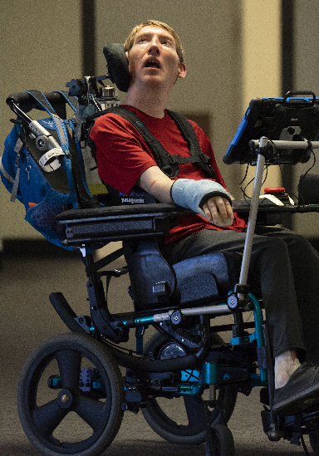
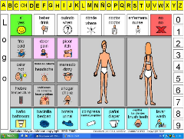
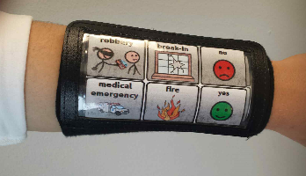
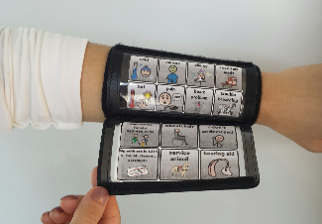
Low Tech Solutions
Body Gestures/Emergency Jewelry
Alphabet Boards
Communication Boards
Pain Scale
Communication Arm Bands

Slide 42
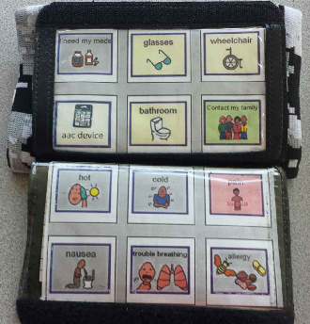
Communication Arm Bands
Search:
Combat Dri-Fit PlayCoach $14.99
Playbook Wristband $6.99
Quarterback Wristband Football Playbook $4.29
Wrist Coach $5.99
Sizes: Adult, Youth, Pee Wee
Colors: All
Comes with single or multiple pages

Slide 43
Pack an Emergency Kit
Personal Kit/Fanny Pack – essential items to keep with you at all times
Grab-and-Go/Workplace Kit – easy-to-carry kit to grab if you have to evacuate your location in a hurry
Home Kit - a large kit that contains essential you need to be self-sufficient for 3-7 days in your home or emergency shelter
Bedside Kit - contains items you need if you are trapped in or near your bed and unable to get to other parts of your home
Car Kit - includes items you need if you have in your vehicle in case of an emergency or during an evacuation
Service Animal Kit - includes familiar items to keep your service animal comfortable and secure 3-7 days in a time of stress
Portable Fireproof Box/Safe Deposit Box/Flash Drive – emergency papers
Children’s Activity Kit – items familiar to child to keep them comforted and entertained

Slide 44
Medical Information
Physicians
Type of Health Insurance
Blood Type
Allergies and sensitivities
Medications and dosage
Specific medical conditions
Physical limitations
Communication difficulties
Cognitive difficulties
Mental health condition
Other
Assistive technology and vendor contacts

Slide 45
Important Papers
Social security card/number
Passport
Map of area
List of medical equipment/supplies
Style/serial numbers of medical devices
Health history information card
Legal papers – wills, deeds, marriage certificate, divorce papers
Bank account information
Insurance policy numbers and contact numbers
Inventory of household goods
School papers – diplomas
Professional certificates/licenses
Military discharge papers
Credit card account numbers and contact information

Slide 46
Disability-Related Supplies & Equipment
Batteries
Glasses
Eating utensils
Grooming utensils
Dressing devices
Writing devices
Hearing devices
Oxygen and flow rate
Suction equipment
Dialysis equipment
Sanitary supplies
Urinary supplies
Ostomy supplies
Wheelchair and repair kit
Walker
Crutches
Cane
Dentures or retainers
Monitors

Slide 47
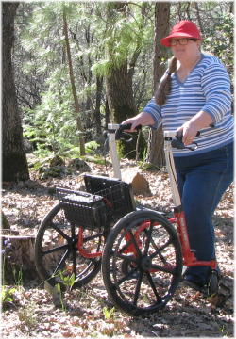
Assistive Technology
Vendor/contact information
Name of device
Serial number
Photo
Power back-up solution
Low tech back-up solution
Replacement Insurance
Other information
Pairing with other equipment

Slide 48
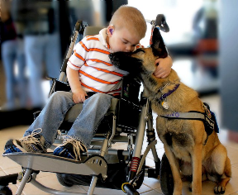
Service Animals & Pets
Post types of animal kept inside house
Current licenses and ID tags
Your telephone number
Out of state phone numbers
Back-up caretaker/assistant
Emergency supply kit
Includes familiar items to keep your service animal comfortable and secure 3-7 days in a time of stress
License
Medical/vaccination records
Photo of animal with you, including distinguishing marks
Food and water with dishes
Collar/ID/Leash
Pooper scooper and/or bags
Toys

Slide 49
Livestock
Risk Assessment
Inventory – locations and vaccinations/testing records
Permanent identification/record of ownership/photos
Durable and visible identification
Alternate water/power sources
Fire Extinguishers
Label hazardous materials
Know contact information for Local Animal Rescue Team
Shelter in place or evacuate
Emergency/Evacuation Kit
Know shelter locations and routes
Make transportation arrangements
Keep 2 week supply of food and water

Slide 50
Action Steps
Know name and contact information for utilities
Gas
Electricity
Water
Sewer
Tree removal
Let utility companies know you have a disability
Let fire, police/sheriff departments know you have a disability
Learn how and when to turn off gas, electricity and water

Slide 51
Action Steps continued
Install separate smoke and carbon monoxide alarms
Make sure public alerts and warnings are accessible
Practice calling 911
Become a HAM or Amateur Radio operator
Join the volunteer Fire Department
Learn community resources – Centers for Independent Living, Red Cross, Salvation Army, Citizens Corps, Medical Reserve Corps, Civil Air Patrol, Amateur Radio Emergency Service, Catholic Charities, Habitat for Humanity, United Way, Farm Aid

Slide 52
Action Steps continued
Take a first aid class
Learn to use a fire extinguisher
Develop a schedule for testing and battery replacement of smoke detectors and carbon monoxide detectors
Take a CPR class
Take a weather spotter class
Make contact with local fire department
Take a self-defense class
Make contact with local utility company

Slide 53
AT Funding $ources
County
Diagnosis (As it relates to your need for assistive technology)
Age
Area of Need (Daily Living)
Type of Device
Type of Assistance (All)
Examples:
Disabled Children’s Relief Fund
Joni and Friends
Variety of Colorado
AV Hunter Trust
Friends of Man
Community Service Organizations (Kiwanis, Elks, Lions, Rotary, Sertoma, Optimists)
Online Fund Raisers (Fundly, GoFundMe, GoGetFunding, Kickstarter, YouCaring)

Slide 54
Planning to Make a Plan IS NOT A PLAN
If You Fail To Plan, You Plan To Fail

Slide 55
Stay Informed,
Stay Prepared, and
Stay Safe

Slide 56
Contact Information
Julia Beems
303.315.1284
Julia.beems@ucdenver.edu
Candiss Leathers
720.539.4435
cleathers@goodwilldenver.org

