Slide 1
Tools and Partnerships for Digital Information Access
Association of Programs for Rural Independent Living (APRIL) 2018
Presented by Danny Housley and Ken Mitchell

Slide 2
A Crash Course in iOS Accessibility
Presented by Danny Housley, Tools for Life
APRIL 2018

Slide 3
AMAC Accessibility
AMAC creates practical solutions that work, with a focus on utility, ease of use, and high quality.
Accessibility Consulting focuses on organizational accessibility needs with evaluation, technical assistance, customer support, and web accessibility solutions.
Braille Services produces customized projects from both print materials and electronic text including partial books and chapters or graphics
Captioning Services makes classrooms, meetings, labs and other audio environments fully accessible for deaf or hard-of-hearing.
Professional E-Text Producers provide high-quality e-text in many formats such as PDF, DOC, DAISY, and HTML.
Certified Assistive Technology team provides on-site and remote assessments, demonstrations, training and technical assistance for education, work, and daily living environments.
For more information: www.amacusg.org

Slide 4
Tools for Life
Tools for Life, Georgia's Assistive Technology Act Program, is dedicated to increasing access to and acquisition of assistive technology (AT) devices and services for Georgians of all ages and disabilities so they can live, learn, work and play independently and with greater freedom in communities of their choice.

Slide 5
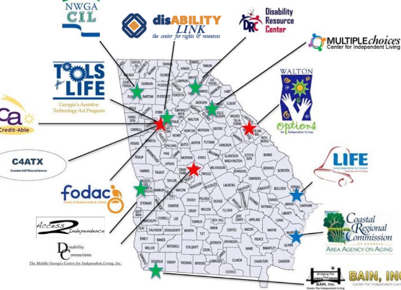

Slide 6
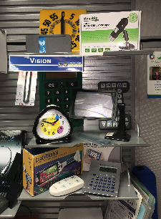
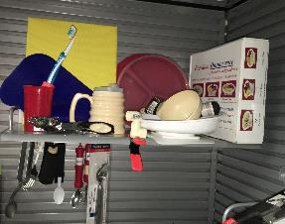
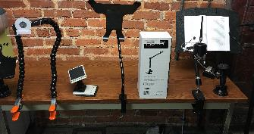
AT Solutions Lab

Slide 7
Apple and Accessibility
Built in, not bolted on
Options for various disability types
Started with non-visual and low vision access
Blossomed

Slide 8
Non-Visual Access

Slide 9
VoiceOver
For users with print related disabilities
iPhone 3GS Debut
Screen Curtain
Voices
Gestures
Privacy
Audio descriptions

Slide 10
The power of the Rotor

Slide 11
Braille Captions

Slide 12
Visual Access

Slide 13
Features for Users with Low Vision
Zoom
Magnifier
Display Accommodations
Dynamic Text

Slide 14
Zoom and Magnifier in Action

Slide 15
Screen Accommodations
Invert colors
Color filters
Reduce white point

Slide 16
Physical Access

Slide 17
Switch Access
Offered on all iOS (and MacOS) devices
Bluetooth or wired with adapter
Can use camera or keyboard to control scanning

Slide 18
Assistive Touch
Very customizable
Gestures
Menus
Functions

Slide 19
Input Options
One handed keyboard
Type to Siri
Dictation
Voice commands
Handwriting with and without VoiceOver

Slide 20
Siri: Your Digital Frenemy
Open apps
Send messages
Ask questions
Control settings

Slide 21
Apple HomeKit
Your native environmental control unit
Control with voice or manually
Interacts with dozens of devices (lights, doors, outlets, switches, alarms, etc…)

Slide 22
Hearing Access

Slide 23
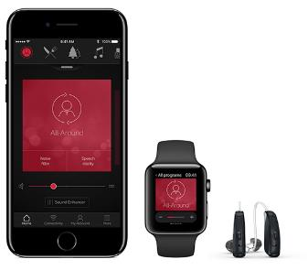
Supports for Hearing
MFi hearing devices
Live listen
Flashing alerts
Customized vibrations
Software TTY
Mono audio
FaceTime
iMessage

Slide 24
Emergency SOS

Slide 25
Best Practices
Never be afraid to explore and customize!
Peer support groups offer lessons
Contact us!
Can’t find an accessibility feature? Try a third party app

Slide 26
What features to you want to see?
(call the Apple Accessibility line and tell them)

Slide 27
Disclaimer
Disclaimer: Produced by Tools for Life (TFL), which is a result of the Assistive Technology Act of 1998, as amended in 2004. TFL is a program of the Georgia Institute of Technology, College of Design, AMAC Accessibility Solutions and Research Center and was made possible by Grant Number H224C030009 from the Administration for Community Living. Its contents are solely the responsibility of the authors and do not necessarily represent the official views of HHS.

Slide 28
The Tools for Life Team
Carolyn Phillips
Director, Tools for Life
carolyn.phillips@gatfl.gatech.edu
Danny Housley
AT Acquisition Manager
danny.housley@gatfl.gatech.edu
Liz Persaud
Program and Outreach Manager
liz.persaud@gatfl.gatech.edu
Martha Rust
AT Access Team Manager
martha.rust@gatfl.gatech.edu
Sarah Endicott
Research Scientist
sarah.endicott@design.gatech.edu
Tori Holder
Outreach Specialist
tori.holder@gatfl.gatech.edu
Ben Jacobs
Accommodations Specialist
ben.jacobs@gatfl.gatech.edu
Annabel Joyner
Graphic Design Intern
ajoyner8@gatech.edu

Slide 29
The Tools for Life Team (continued)
Asha Kumar
AT Lab Specialist
asha.kumar@gatfl.gatech.edu
JR McCall
CFII Administrative Assistant
jmccall32@gatech.edu
Ciara Montes
Direct Services Inter
ciara.montes@gatfl.gatech.edu
Krista Mullen
Speech-Language Pathologist
krista.mullen@gatfl.gatech.edu
Sam Peters
Program Specialist
speters37@gatech.edu
Rachel Wilson
AT Specialist
rachel.wilson@gatfl.gatech.edu

Slide 30
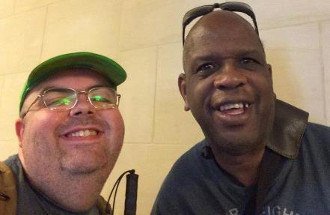
Your Presenters

Slide 31
Media Access
Information access is important for staying connected to your community
Variety of methods for accessing information, some programs are disability specific
In Georgia, the CILS and ATAP work closely with the Georgia Radio Reading Service

Slide 32
Georgia Radio Reading Service

Slide 33
Georgia Radio Reading Service
(GARRS)
The mission of the Georgia Radio Reading Service (GaRRS) is to improve the quality of life for every Georgian who is blind, visually-impaired, or has difficulty with the printed word. Volunteer readers from across Georgia record approximately 200 different programs each month including essential local information, local and national newspapers, popular books, and an array of magazines and quality-of-life programming. The programming is broadcast 24 hours a day, 7 days a week and accessed by using a special radio, through our online webstream, by telephone, or by using a mobile app. Through these means we are able to provide our listeners with information, entertainment, and connections to their local communities.

Slide 34
Access Methods
Radio
Online
Telephone
Mobile App

Slide 35
disABILITY LINK and GARRS
10 years
Advocacy updates, transportation, youth and AT
Played 3 times/week

Slide 36
Tools for Life and GARRS
Assistive Technology
Reviews
Financial Education
AMAC promotions
70 recordings (and counting)

Slide 37
BARD

Slide 38
Braille and Audio Reading Download
Free program from NLS
Braille or electronic format
Variety of access methods
Free!

Slide 39
Devices for BARD

Slide 40
“That All May Read”
To sign up for the BARD program visit:
www.nls.org/thatallmayread
1-888-657-7323

Slide 41
NFB Newsline

Slide 42
Audible Universal Information Access Service
For people with print related disabilities
500+ publications
Weather alerts
TV listings
Retail Ads

Slide 43
How to Access NFB Newsline

Slide 44
Bookshare

Slide 45
Read Your Way
Free for Students
$1/week for qualifying applicants
Some accessible library services can help with cost

Slide 46
Access Your Way

Slide 47
Other Access Options

Slide 48
Reading on the Go
Audible
Texture
Kindle
Overdrive

Slide 49
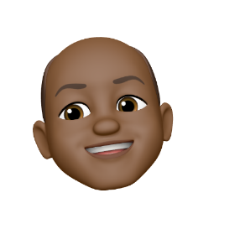
Thank You!
Ken Mitchell
kmitchell@disabilitylink.org
www.disabilitylink.org
Danny Housley
danny.housley@gatfl.gatech.edu
www.gatfl.gatech.edu

