Slide 1
The Americans with Disabilities Act Participation Action Research Consortium (ADA-PARC): Tracking Participation Disparities and Promising Practices post ADA Presentation by Lewis Kraus and Jacqueline Kish APRIL, 2018

Slide 2
Funding
ADA-PARC is funded by the National Institute for Disability, Independent Living, and Rehabilitation Research (NIDILRR) under grants 90DP0026 and 90DPAD0001.

Slide 3
ADA Participation Action Research Consortium adaparc.org
Notes:
This slide shows the many collaborators involved in ADA PARC, including all ten ADA Centers (Southwest, Southeast, Great Lakes, Pacific, Rocky Mountain, Mid Atlantic, Northwest, Great Plains, Northeast and New England ADA Centers), The ADA National Network KT Center, and four universities & research organizations (TIRR Memorial Hermann, The University of Illinois at Chicago, Syracuse University and the University of Northern Colorado) that have come together to document participation disparities and opportunities in ways that can be used by the community to take action.

Slide 4
Purpose of ADA-PARC
To collaboratively examine participation disparities experienced by people with disabilities post ADA & Olmstead
To identify & examine key environmental factors contributing to these disparities
To benchmark participation disparities and highlight promising practices at state & city levels
To action-plan strategies for dissemination and utilization of findings to be used by ADA Centers and others in community capacity building & systems change initiatives
Notes:
Emphasize that we are handing data and information back to communities in order to improve the day to day living conditions of people with disabilities through policy change and community action.

Slide 5
Tracking 3 ADA Participation Areas (see details at: adaparc.org )
Community living (CL) Community vs. institution living, HCBS spending, Money Follows the Person Transitions
Community participation (CP) Health insurance, affordable & accessible housing, access to community & disability resources, transportation, crime rates, livability indicators
Work/economic participation (WE) Employment, economic status, poverty rates, cost of living

Slide 6
Community Living

Slide 7
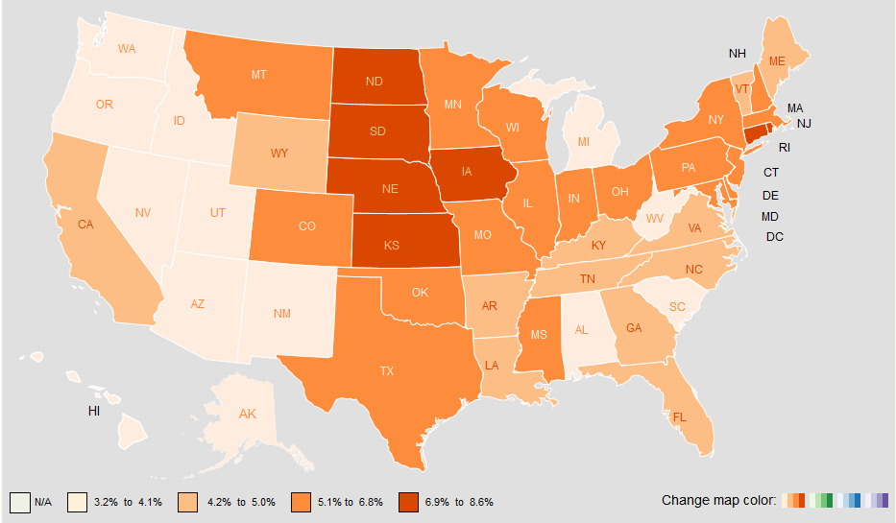
Percentage of People with Disabilities Living in an Institution, 2016
Notes:
This slide contains a map of the United States showing the percentage of people with disabilities living in institutions. The States are portrayed with a color gradient where the darker the color, the higher the percentage of people in institutions and the lighter the color the lower the percentage in institutions. The higher percentage of states in the dark orange color are clustered in the center of the country with a few on the east coast including North Dakota, South Dakota, Nebraska, Delaware, Rhode Island and Kansas with 6.9-8.6% of people in institutions. The states with lower percentages in light orange are clustered in the west and include Hawaii, Alaska, Arizona, New Mexico, Utah, Nevada, Idaho, Oregon, Washington, Michigan, West Virginia, South Carolina and Alabama with 3.2-4.1%. The United states average is 5.1%.

Slide 8
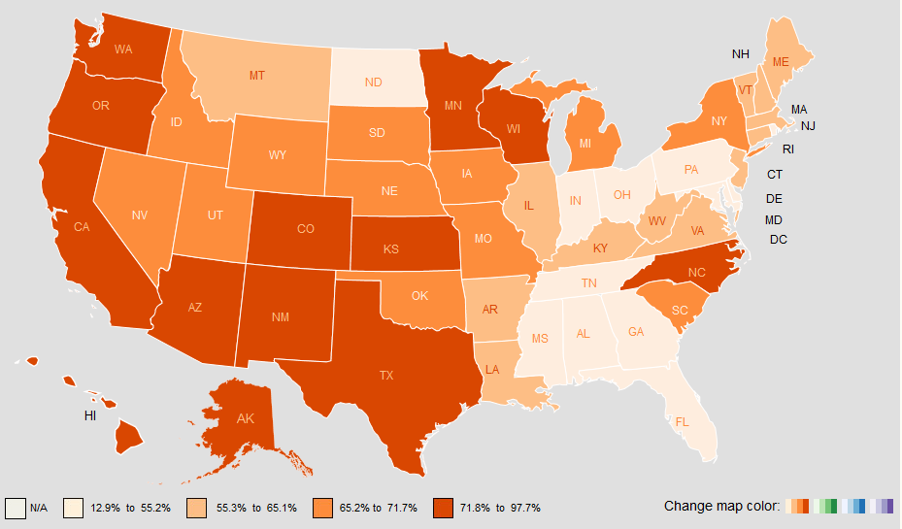
Ratio of HCBS Expenditures to Total LTSS, 2015
Notes:
This slide contains a map of the United States for the ratio of Health and Community-Based Services (HCBS) spending to the total spending on Long Term Services and Supports (LTSS) which includes institutional and community spending. The States are portrayed with a color gradient where the darker the color, the higher the proportion of spending for community living and the lighter the color and lighter color showing a lower the proportion of spending on community living indicating higher spending for institutional living. The states that spend more for community living as a percentage of total LTSS spending, displayed in the dark orange color, are clustered in the west and south west with some additional scattered states including Washington state, Oregon, California, Arizona, Hawaii, Alaska, New Mexico, Colorado, Kansas, Texas, Minnesota, Wisconsin and North Carolina with 71.8-97.7% of spending on HCBS. The lower percentages in light orange are clustered in east and south east including Missouri, Alabama, Georgia, Florida, Tennessee, Indiana, Ohio, Pennsylvania, Maryland, Rhode Island and North Dakota with spending between 12.9-55.2% on HCBS. The US Average is 68.4%.

Slide 9
Work and Economics

Slide 10
Percentage of People with and without Disabilities Below the Poverty Level, Age 18 to 64, 2012 to 2016
Notes:
This slide depicts two United States maps side by side with the map on the left showing people with disabilities below the poverty level and on the right people without disabilities below the poverty level. States are portrayed on a color gradient with the darker the color indicating a higher percentage of people below poverty and lighter color a lower percentage of people below the poverty level. The map of people with disabilities as a whole is darker indicating a higher percentages of people with disabilities throughout the country living below the poverty level than people without disabilities. This measure allows us to see that people without disabilities have a lower poverty rate (US Average is 12.6% with a range of 6.9% in New Hampshire to 18.4% in Mississippi) than people with disabilities (US average is 27.7% with a range of 17.7% in Alaska to 38.5% in the District of Columbia). For people with disabilities, higher percentages in a dark color (27.7 to 38.5%) are seen in the south east and north east while for people without disabilities higher percentages are seen in the south east, south west and west coast (12.5 to 19.5%).

Slide 11
Community Participation

Slide 12
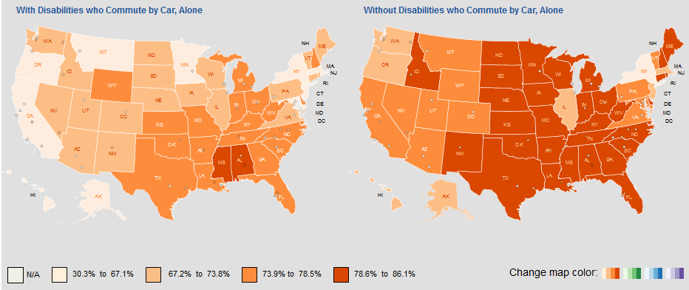
Percentage of People with and without Disabilities who Commute by Car, Alone, 2016
Notes:
This slide depicts two United States maps side by side with the map on the left showing people with disabilities who commute by car and on the right people without disabilities who commute by car. States are portrayed on a color gradient with the darker the color indicating a higher percentage of people commuting by car and lighter color a lower percentage of people commuting by car. The map of people with disabilities as a whole is lighter indicating that use of private car for work is lower among people with disabilities throughout the country than people without disabilities. For people with disabilities, lower percentages of commuting by car alone are shown in a light color (30.3 to 67.1%) in California, Oregon, Montana, Minnesota, New York, Massachusetts with high percentages noted in Missouri and Alabama (78.6 to 86.1%) . People without disabilities have high percentages of commuting by car throughout the country from the great plains and throughout the south (78.6 to 86.1%).

Slide 13
Ohio: Percent People with and without Disabilities that Commute to Work by Public Transit, 2016
*No data for Athens, Chillicothe, Zanesville
Data Source: US Census, ACS 5-year, 2016
Notes:
ADA PARC is beginning to dive deeper and plan to add more cities in order to provide information within states. This bar graph depicts the percentage of people with and without disabilities that commute to work by public transit in 8 cities in Ohio, the entire state of Ohio, and the national average. People with disabilities use public transportation at a higher rate than people without disabilities in every state. The largest differences between people with and without disabilities are approximately 10 percentage points in Cincinnati and Youngstown.

Slide 14
Ohio: Percent People with and without Disabilities that Commute to Work by Car, 2016
*No data for Athens, Chillicothe, Zanesville
Data Source: US Census, ACS 5-year, 2016
Notes:
This bar graph depicts the percentage of people with and without disabilities that commute to work by car in 8 cities in Ohio, the entire state of Ohio, and the national average. People with disabilities use a private car at a lower rate than people without disabilities in every city. The largest gap between people with and without disabilities are approximately18 percentage points in Youngstown with people without disabilities utilizing a car more than those with disabilities.
When combined with the previous slide, we see that people with disabilities are more reliant on public transportation and utilize a private car less frequently. This data is specifically related to commuting to work and we are exploring additional data regarding transportation access, availability and quality in a national transportation survey.

Slide 15
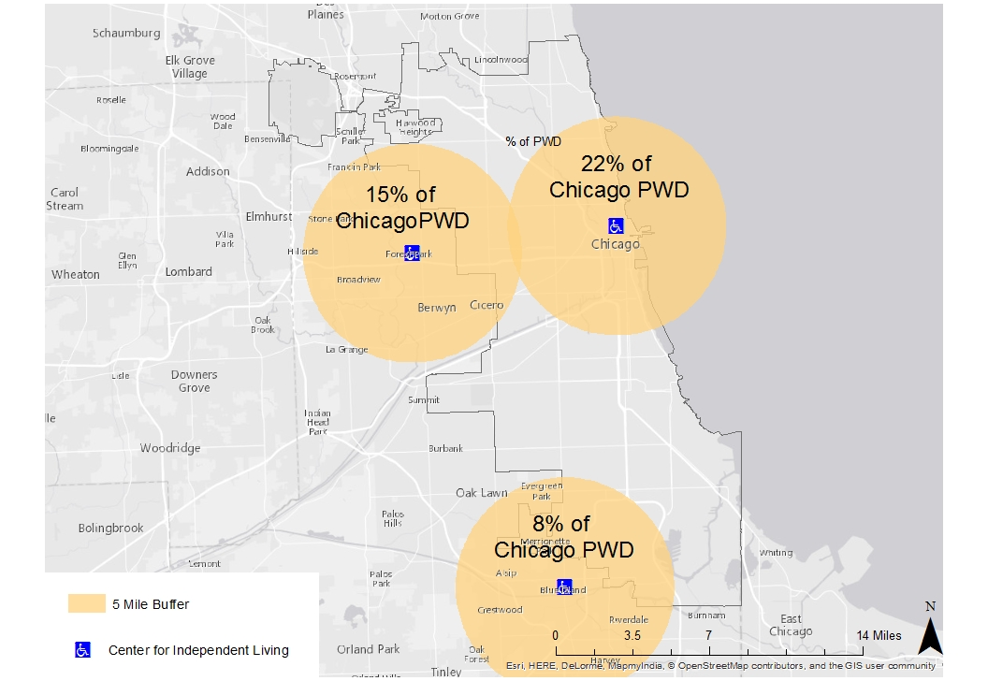
Proximity to Community Resources: Centers for Independent Living Access
Chicago IL
43% of PWD in Chicago are within 5 Miles of a CIL
Data Source: US Census, ACS 5-year, 2013; ARC GIS CIL shapefile
Notes:
This map of Chicago shows a circular buffer zone of the the percentage of people with disabilities that live within a 5 mile distance of a Center for Independent Living disability resource. This doesn’t mean they actually use and are referred to CILs, just that they exist. Only 43% of PWD in Chicago live within 5 miles of a CIL.

Slide 16
Percentage of PWD Living within 5 miles of CIL, 2013
Data Source: US Census, ACS 5-year, 2013; ARC GIS CIL shapefile
Notes:
We looked at the percentages of people with disabilities living within 5 miles of a CIL and was calculated manually using GIS mapping and ACS disability population data. The bar graph above shows a select 13 of the 48 cities included in our pilot study listed along the bottom axis with the percentage of people living within 5 miles of a CIL along the side. These were included as they have similar population sizes around Denver ranging from 50 to 70 thousand people. Cities that have low percentages of people living near the CIL include Baltimore, MD, Detroit, MI, Memphis, TN and Nashville, TN.

Slide 17
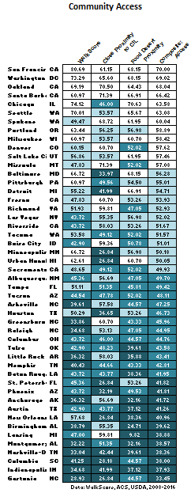
Scorecards of Community Participation Resource Availability
Heatmaps show a score on a scale of 0 (worst) to 100 (best) to compare states or cities on any indicator
Proximity to resources
CIL access
Healthy food access
Transportation access
Composite score is a summary across many Community Participation indicators
Disparities
Promising Practices/Opportunities
Notes:
This slide shows a heatmap for city benchmark performance for community access. These are not currently published on our website but will be upcoming in our re-design and will be expanded beyond the initially selected 48 cities. Community living includes walk score, close proximity to CIL, Food desert proximity and a composite summary score. Top scoring cities closer to 100 for community access are depicted in white with a color gradient by quartile down to with poorer performing cities in darker blue with scores closer to 0. Poorly performing cities in dark blue include Columbia SC, Indianapolis, IN and Gastonia, SC. High performing cities in white include San Francisco, CA, Washington, DC and Oakland, CA.

Slide 18
Where are we headed?
Immediate access web engine for mapping 3 areas of participation by nation, state and city
GIS maps & accessible tables
Summary scorecards
City level action planning tools
Transportation access & accessibility atlas
Affordable, integrated and accessible housing atlas
ADA Center Action Toolkits with resources on rights, resources and promising practice cases
Community town halls to prioritize disability community priorities & participatory voting for action & KT impact
SDH research on intersecting disparities by age, race/ethnicity, gender, economic status & type of disability

Slide 19
ADA-PARC is seeking feedback to help steer the next phase of this research project:
How could you use this information to take action to advocate for improved inclusion of people with disabilities in your community?
What questions or concerns do you have related to the ADA-PARC project?
Notes:
“We are seeking feedback about this project to be used internally to guide our future efforts. Please answer questions on note cards provided or via the link on ada parc.org found mid page. Please return notecards to ADA National Network or ILRU Booths.”

Slide 20
Acknowledgments
Thank you to all of our ADA-PARC consortium collaborators and participants
For more information, go to: adaparc.org
Contact Lex Frieden: lfrieden@bcm.edu or Joy Hammel: hammel@uic.edu

