Slide 1
Asking questions leads to solutions
Tools for today and tomorrow

Slide 2
Why do we ask questions?
Because we are curious
To find out more information
To get clarification
To get a need met
To find an answer to help solve a problem

Slide 3
What do you do with the answers to the questions you ask?
Share them with others
Are they the answers you were looking for?
What do they mean?
Ask more questions
Apply them to something and try them out to see if they work

Slide 4
RTC:Rural does this through research and development projects
We ask questions…
Explore and test for possible answers…
Apply possible solutions based on those answers to see if they work…
Develop useful tools and resources that can help others to apply the solutions

Slide 5
A review of tools and resources
Advocacy Skill Building Toolkit-Lauren Smith
Maps and Data Finder Tool-Lillie Greiman
Living and Working Well with a Disability-Maggie Lawrence
Employment Tools-Catherine Ipsen
Health Community Living Program-Tannis Hargrove
Rural Disability Resource Library-Kerry Morse
Questions and Discussion

Slide 6
Advocacy skill building toolkit
Introducing advocacy through improv and practice

Slide 7
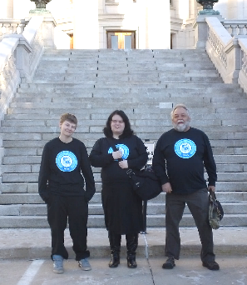
A bit of history
Community Leadership project from early 80s
Tools included:
How to write letters to the editor, public officials
How to provide personal testimony
Etiquette guidelines for consumer group advocacy
Guidelines and recommendations for involving people with disabilities as active members of advisory groups
Notes:
Community Leadership project was a collaboration among several researchers from UMT and U of Kansas that looked at civic engagement by people with disabilities and what is needed to support and facilitate the inclusion of people with disabilities in community leadership and advocacy.

Slide 8
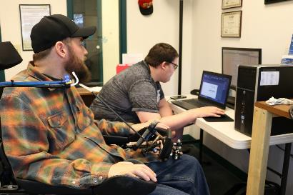
Were these tools and resources useful?
Yes!
But… Can they be better?
Updates?
Expansion?

Slide 9
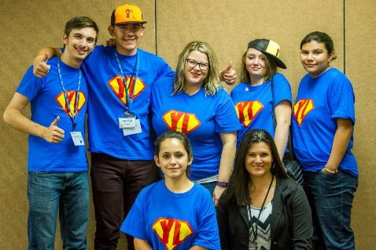
feedback
DO IT!
Need for training to engage youth/emerging IL leaders

Slide 10
We explored opportunities with partners
What could be updated?
More useful?
Why do CILs need them?
What is the best way to get them to those who need and want them?
How do we make the training engaging?

Slide 11
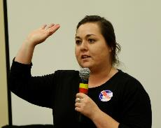
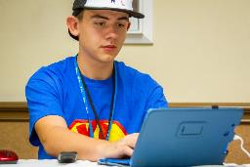
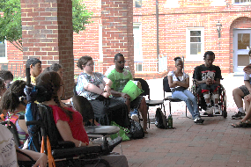
Possible answers and solutions
Update the tools into worksheets
Provide in-person training
Work with current youth advocacy trainers to develop a facilitator guide
Integrate improv
Put it in a toolkit

Slide 12
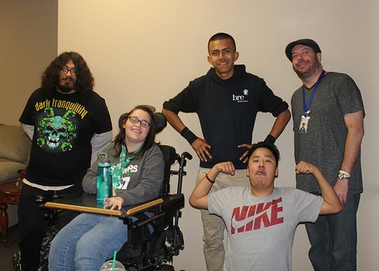
Why Improv?
Improv: performance without script
Hones communication, public speaking, fast thinking, engagement with ideas
Supportive environment

Slide 13
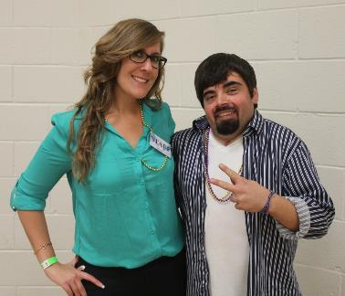
Quote- Mike beers
“Life is inherently improv.
When you go into a meeting or to give testimony to advocate, you’re not given a script of who will say what, and this is how you respond. Nor is it anarchy, where you have no idea what to expect. But you are given a loose set of instructions, and your ability to be successful is based on keeping the conversation going forward within those parameters.
And that’s basically improv.”

Slide 14
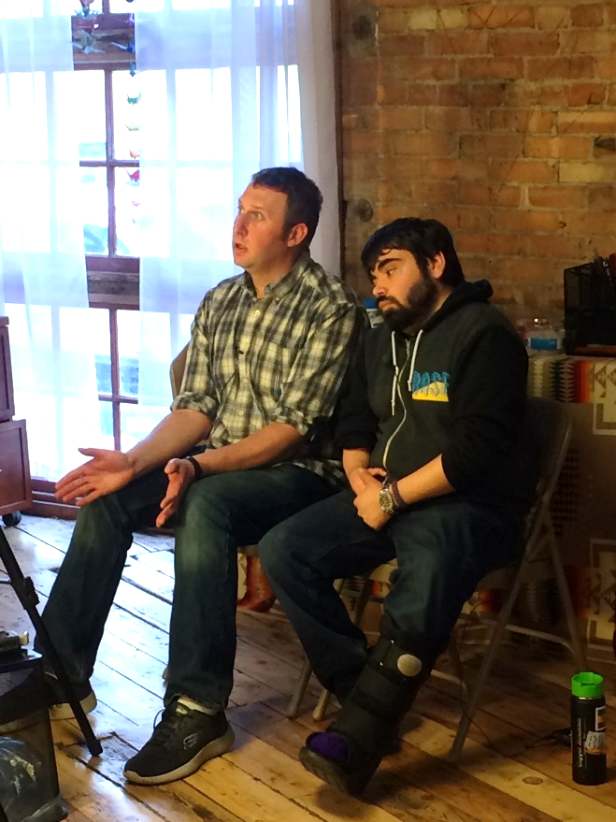
Quote- John Howard
“Improv makes you think on your feet.
When you do improv in the classroom, it puts everyone on the same level, allowing everyone to learn from the same place.”

Slide 15
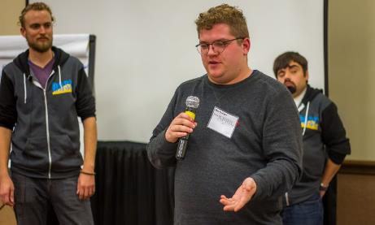
Collaborative testing
Updated worksheets
Tested with youth in schools and at BASE
Collected feedback from youth at BASE
Integrated the worksheets with advocacy improv activities
Tested at 2016 APRIL Youth Conference

Slide 16
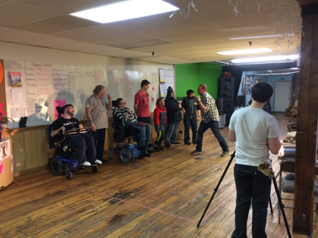
Collaborative development
Demonstration videos
Facilitator guide
Online toolkit

Slide 17
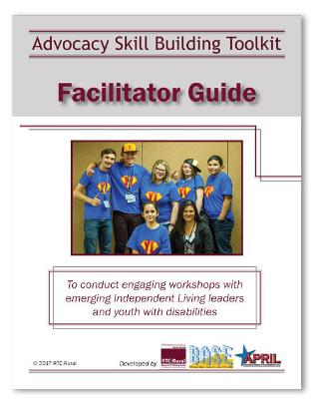
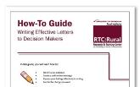
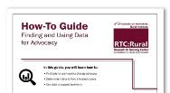
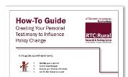
What’s in the toolkit?
Facilitator Guide
Facilitator tips video
Workshop slides
Improv demonstration videos
Worksheets and Handouts
How-To-Guides
Writing Letters
Personal Testimony
Finding and Using Data

Slide 18
Tell us what you think!
How is the toolkit used?
Any issues?
Formatting
Accessibility
Clarification
Share your story!
Lauren Smith, Knowledge Translation Associate, lauren.smith@mso.umt.edu

Slide 19
Maps and Disability Data finder: Accessing and Using Rural Disability Data

Slide 20
Data, definitions and delays
Data from the American Community Survey (ACS)
New Disability Definitions in 2008
Hearing difficulty: Having serious difficulty hearing or deaf
Vision difficulty: Having serious difficulty seeing, even when wearing glasses or blind
Cognitive difficulty: Because of a physical, mental, or emotional problem, having difficulty remembering, concentrating, or making decisions
Ambulatory difficulty: Having serious difficulty walking or climbing stairs
Self-care difficulty: Having difficulty bathing or dressing
Independent living difficulty: Because of a physical, mental, or emotional problem, having difficulty doing errands alone such as visiting a doctor’s office or shopping
Delays
2013 first rural disability data available (13 years since the 2000 Census)
Still waiting to make comparisons

Slide 21
So what’s the point?
What can data do?
Inform policy at the state and federal level
Inform the public-Outreach
Data can help tell the story
How do you use data?

Slide 22
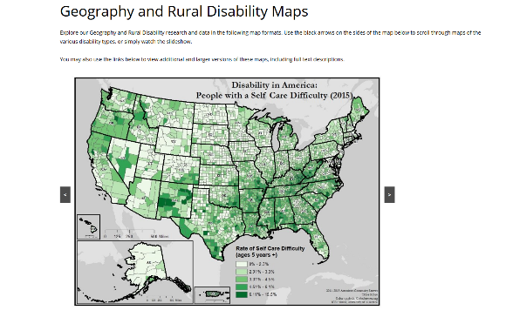
Maps and data visualization!
Check out our Disability in America Map Series on our website (and some at our table)!

Slide 23
Finding data for your county
All the map data is also available for download on our Disability Counts Data Finder
For more detailed info seek out the American Fact Finder run by the U.S. Census Bureau
Notes on Accessibility:
AFF is not screen reader accessible
Most interactive maps are not accessible
Ensure that the data is available to download in an accessible format (i.e. csv file)
Provide detailed alternative text descriptions for maps
Be sure to use contrasting colors

Slide 24
For more Information:
Lillie Greiman
Research Associate
RTC: RURAL
University of Montana
406.243.6102
Lillie.Greiman@umontana.edu
http://rtc.ruralinstitute.umt.edu/

Slide 25
Living And Working Well With A Disability
The healthier you are, the more you are able to do

Slide 26
Independent living & health promotion
Health promotion: empowering people to increase control over their health and its determinants
Social, environmental, cultural, economic, behavioral determinants
Focus on prevention and quality of life
What might a health promotion program for people with disabilities look like that is grounded in Independent Living philosophy?
Notes:
Health promotion programs have been shown to help people improve their overall health and wellness, and better manage chronic health conditions
People with disabilities experience greater health disparities,
Access to health-promotion programs is limited for many people with disabilities due to employment, financial, transportation and insurance barriers.

Slide 27
Living well with a disability
Community-based participatory research (CBPR) process, involving Centers for Independent Living and consumers, resulting in the development of Living Well with a Disability
The Living Well workshop is a ten week course grounded in consumer choice and peer support, held at Centers for Independent Living and similar organizations
“The healthier you are, the more you are able to do”
Notes:
RTC: Rural researchers began a community-based participatory research (CBPR) process about health promotion, involving Centers for Independent Living and consumers. This process shaped the development of the Living Well with a Disability workshop.
The Living Well workshop is a ten week course grounded in consumer choice and peer support, held at Centers for Independent Living and similar organizations. It helps people build skills and use tools that help them continue or begin to do the things they enjoy, and it emphasizes healthy lifestyle changes as a way to address barriers and increase opportunities. Workshop participants begin by developing goals that are meaningful to them, and then they are supported to make the connection between health, wellness, and reaching their goals.
The workshop content is premised on the idea that:
People who pursue meaningful goals are more likely to learn and practice skills for healthy living.
The healthier a person is, the more they can do.

Slide 28
Is this a useful tool?
Participants have achieved a great variety of goals, including arranging transportation to access community resources, changing their living arrangements, getting new jobs, engaging in new social and recreational activities, and pursuing an education
Living Well participants may experience health benefits that include fewer health complications, increased physical activity, decreased stress levels, and improved mood
Notes:
It is crucial to ask, is this actually useful?
Program effectiveness was evaluated by collecting data on secondary conditions, symptom days, life satisfaction, health care use, and healthy lifestyle habits.
Participants have also achieved a great variety of goals, including arranging transportation to access community resources, changing their living arrangements, getting new jobs, engaging in new social and recreational activities, and pursuing an education.
In addition, Living Well participants may experience health benefits that include fewer health complications, increased physical activity, decreased stress levels, and improved mood.

Slide 29
Working well with a disability
Working Well with a Disability is a six-week peer-facilitated workshop that builds on the content of Living Well and considers health in the context of employment
Participants in the workshop learn the skills to maintain life balance, manage stress, and improve their health in support of looking for or maintaining employment
Implemented at Centers for Independent Living and with Vocational Rehabilitation clients

Slide 30
Is this a useful tool?
People who participate in the workshop have reported:
Improved health and capacity to work
Enhanced peer support and less isolation
Appreciation for the supportive peer community developed during the workshop
Participants who attended over half of the Working Well sessions reported significantly fewer health complications over the 1 year study span

Slide 31
expanding the impact
From February 1995 to July 2017, RTC: Rural staff trained 1,218 Living & Working Well with a Disability facilitators in 46 states, who have conducted workshops with more than 9,744 adults with disabilities

Slide 32
Meeting changing needs
How can we better meet organization, facilitator, and consumer needs?
How do we expand the program’s reach and potential impact even further?
How can we facilitate knowledge-sharing between program providers?

Slide 33
Living well facilitator training website
Having 24-7 access to the facilitator training means that trainees:
Can work at their own pace
Can have the flexibility to meet organization needs
Can return to multimedia content at any time
Notes:
This year, we developed a self-guided training website. Trainees can access the training at any time, anywhere, with an internet-connected device.
Having 24-7 access to the facilitator training means that trainees:
Can work at their own pace
Can have the flexibility to meet organization needs
Can return to multimedia content at any time
This new training platform also allows organizations to register up to 15 facilitators within the license period (one year), which means that organizations can have greater flexibility and greater capacity for training.

Slide 34
Technical assistance webinars
Knowledge and experience sharing
Peer support
Technical assistance from RTC: Rural

Slide 35
Resources
Program website: http://livingandworkingwell.ruralinstitute.umt.edu/
Email: livingwell@ruralinstitute.umt.edu
Come talk to RTC: Rural! (Maggie Lawrence and Tracy Boehm Barrett)

Slide 36
Rural Employment
Expanding Opportunities and outcomes

Slide 37
Vocational Rehabilitation
Why VR?
Primary service system that supports employment for rural consumers
Systematic access point:
To shape practice
Reach multiple locations
Why do almost 50% of VR consumers drop out of the program while receiving services?
Consumer feedback (n = 355)
Almost 50% felt VR service delivery was “too slow”
Satisfaction with VR services associated with # of contacts with VR counselors (both in-person and phone/email methods)
Narrow range of employment opportunities in rural locations promoted exit
Notes:
We conducted a study of 355 VR consumers and tracked them for up to two years through the VR program. We learned some things about there experiences in the program and the barriers that some experiences while receiving services.
In some cases these barriers encouraged drop-out from the VR program. By learning about these barriers, they provided a starting point to explore and test
Based these parameters, I am going to share two tools that we have developed to address rural employment barriers.

Slide 38
Increasing Counselor-consumer contact
Alternate methods of communication
Expand use of email, text, and video for rural engagement
Alternate methods of job exploration
Expand job-search capacity
Counselor feedback
Lack of knowledge and capacity
Fears
Telecom Toolbox
http://telecomtoolbox.ri.umt.edu/
Notes:
Telecom Toolbox has four major sections that can be used to expand services and overcome counselor and consumer reluctance and lack of knowledge while using online resources to communicate and engage in job search.
Communication
Increased opportunities for counselor-client contact
Online Career Development
Building an online presence with social media to expand job search opportunity
Ethics
Improving knowledge and overcoming fears about using telecommunications during VR practice
Blogs
Tools for expanding employment and online job search opportuniteis.

Slide 39
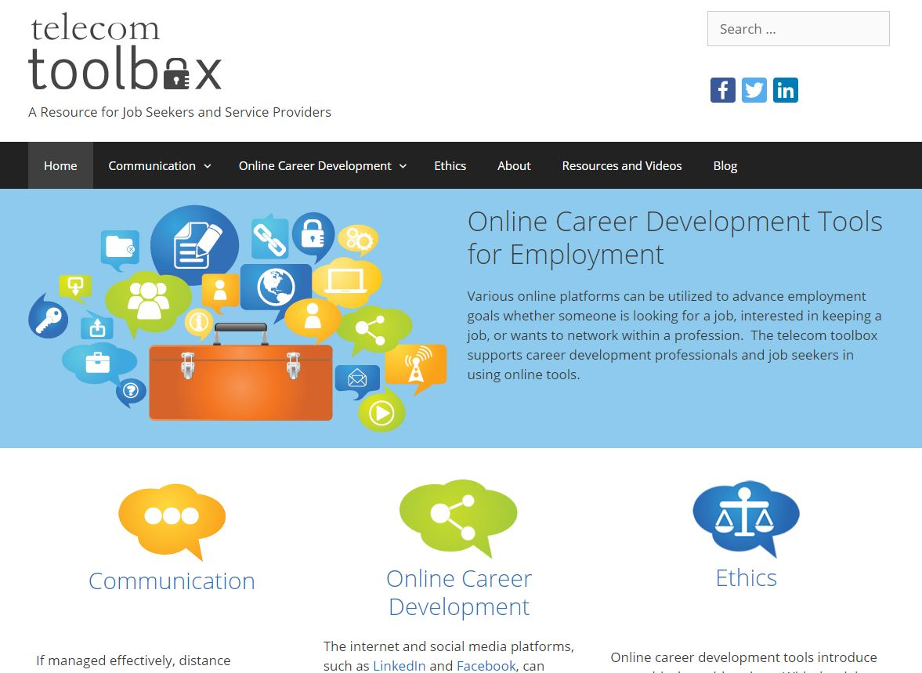

Slide 40
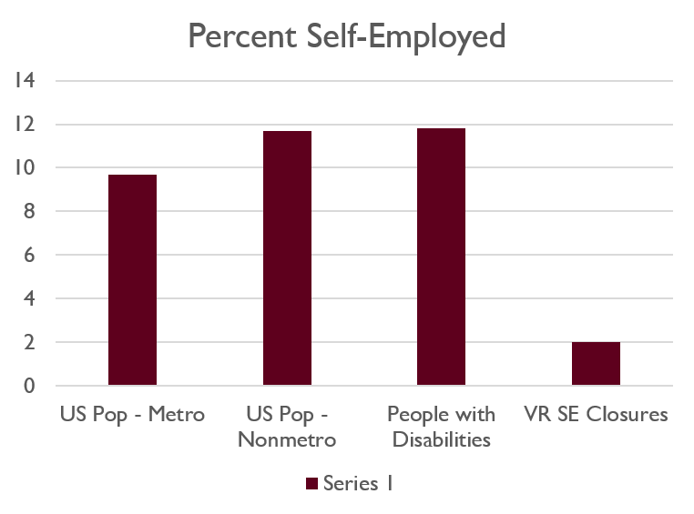
Increasing rural Employment Options
Why self-employment?
Narrow range of employment opportunities in rural locations
Employment alternative for rural places and people with disabilities
9.7% metro vs. 11.7% non-metro self-employment rate (2012)
People with disabilities are self-employed at a rate of 11.8% nationally (ODEP, 2013)
Notes:
Self-employment is an underutilized employment option within VR.

Slide 41
Low Rates of Self-Employment Closures
Counselor unpreparedness to assist consumers with self-employment exploration
Not trained in business start-up
Third-party providers not in place to support these services
Confusion about process
Collaboration with USOR to develop materials.
VR Self-Employment Guide
Self-guided content
Classroom format
Business owner interviews
Audio and video examples
http://vrselfemployment.org
Notes:
We wanted to find out why VR agencies did not utilize self-employment as often as expected when looking at national rates.

Slide 42
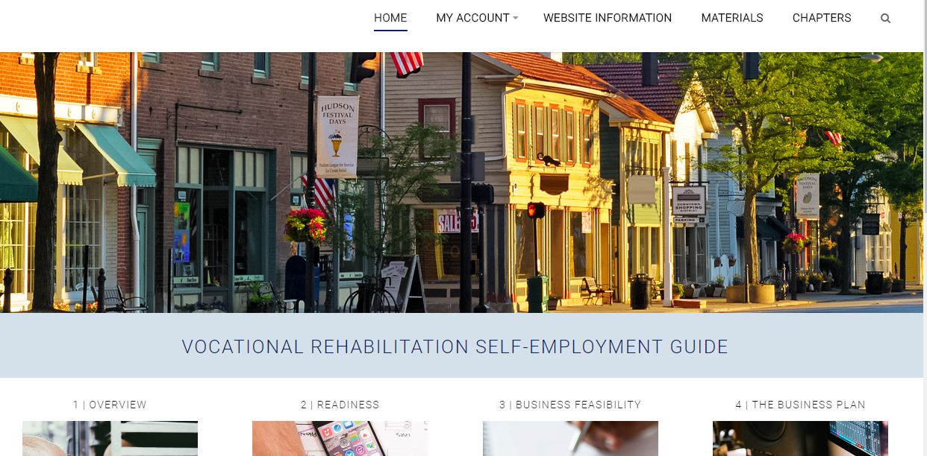

Slide 43
Contact information
Catherine Ipsen
406-243-4562
catherine.ipsen@mso.umt.edu
Lauren Smith
406-243-2515
lauren.smith@mso.umt.edu
Come visit us at the RTC:Rural table if you are interested in visiting more about these tools!

Slide 44
Healthy Community living
Tannis Hargrove

Slide 45
What is Healthy Community Living (HCL)?
Healthy Community Living is a grant funded project dedicated to creating two separate peer-led independent living skills programs
We heard from CIL staff that some people were not ready to work on health related goals
Living Well with a Disability was well received but has some limitation (workbooks, clipart, not everyone is ready)
There seemed to be a need for a group based program that was focused on independent living skills a program focused on skill building rather than health goals
We received a 5-year grant to develop 2 peer-led programs

Slide 46
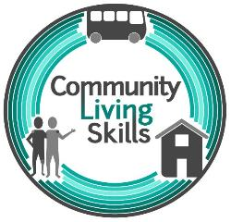
What is Healthy Community Living? (Continued)
Creation of two multi-media curriculums
Living Well in the Community
Focused on healthy lifestyle habits, wellness and quality of life goals
Community Living Skills
Focused on building skills for independence
Group based, peer-led programs
90minutes to 2 hour weekly sessions

Slide 47
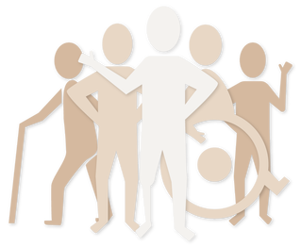
Participatory Curriculum Development
We wanted to stay true to the nothing about us without us philosophy of Independent Living
We have been brainstorming, outlining and drafting the content for these programs with the help of several Independent Living Center staff their consumers and the staff at APRIL
Our collaborators or development teams have provided us with resources, ideas, mini-focus group, and on the ground feedback about content, activities and the information in the curriculums

Slide 48
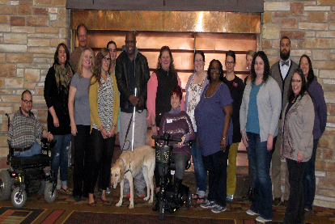
Thank you to Our development teams
Community Living Skills Development Team
Pam & Jamie from Independence Inc. in Minot, ND
Rich & Liz from North Country CIL in Superior, WI
Dustin Gibson from CIL of South Central Pennsylvania, Altoona, PA
Kimberly Heymann from Alliance of People with disAbilities in Seattle, WA
Living Well in the Community Development Team
Ken, Kim & William at disAbility Link in Tucker, GA
Sharon & Christine at Blue Water CIL in Port Huron, MI
Dori at Able South Carolina in Columbia, SC
Brittany Hepler at Dayle McIntosh Center in Anaheim, CA

Slide 49
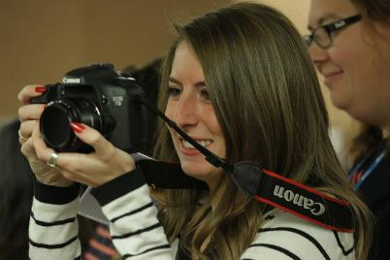
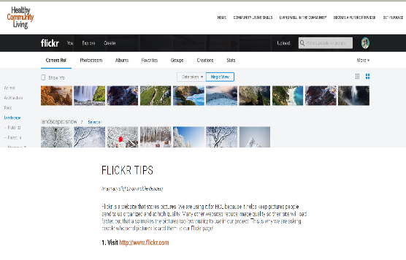
Flickr – Media Bank
Part of the Healthy Community Living project is gathering and sharing media of real people in real places (that’s our tag line)
We have a Flickr group anyone can access and use photos or the videos as resource
The Flickr group is known as Healthy Community Living: https://www.flickr.com/groups/healthycommunityliving/
Over 4,000 photos and videos of PWD are available on our Flickr page
Please submit your photos or use this as a resource

Slide 50
The Curriculums
Currently in the 3rd year (out of 5)of the Healthy Community Living Project
We are wrapping up the writing and adaptations of the curriculums and beginning to pilot the curriculums at CILs
We have recruited 4 pilot sites throughout the United States to help us pilot
For the pilot we will have CILs recruit consumers for the program, have the work through the program, and then make changes to the content of the curriculums as needed
The pilot for this project will last about 1.5 years (approximately)

Slide 51
Community Living skills

Slide 52
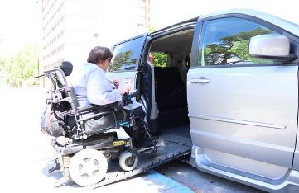
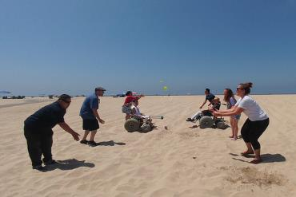
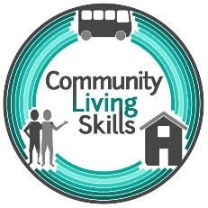
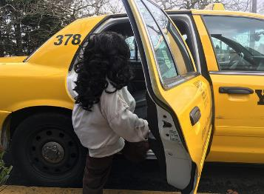
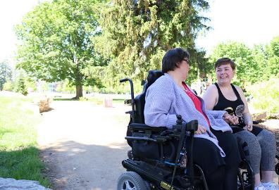
Community Living skills sessions
Disability Identity
Peer Support
Self-advocacy
Self-care
Housing
Technical Skills
Budgeting & Finance
Transportation
Time Use & Management

Slide 53
Living Well in the Community

Slide 54
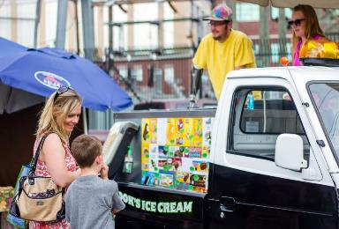
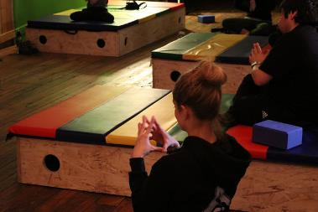
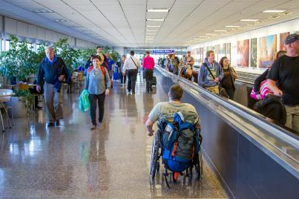
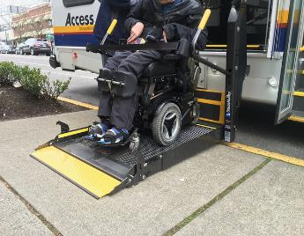
Living Well in the Community sessions
Goal Setting
Building Support
Healthy Reactions
Staying On Course
Healthy Communication
Seeking Information
Eating Well
Physical Activity
Advocacy
Maintenance

Slide 55
Next steps in the research process
Recruit Partners
Form Development Teams
Draft Curriculums
Publish Drafts on Website (Screenshots earlier)
Pilot the Content
Evaluate the Curriculums to Demonstrate their Effectiveness (Evidence Based)

Slide 56
Excited to Begin with our pilot Sites & Partners
Gwen & Josh at Alabama Disability Rights and Resources – Birmingham, AL
Chanell & Rob at Southeastern Minnesota CIL – Rochester, MN
Stacey & Leanne at Ability 360, - Phoenix, AZ
Carole & Luke at Alliance CIL – Edison, NJ

Slide 57
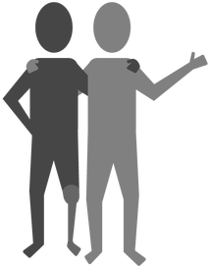
When will the programs be available?
We hope to launch the programs after our evaluation of the programs in 2020
Join us on Facebook to stay informed
Join our Newsletter
Check out our website for more details

Slide 58
Healthy Community Living Resources
Website: www.healthycommunityliving.com
Newsletter: http://healthycommunityliving.com/get-involved.html
Flickr: https://www.flickr.com/groups/healthycommunityliving/
Facebook: https://www.facebook.com/HealthyCommunityLiving/
Twitter: https://twitter.com/WeAreHCL
Email us: healthycommunityliving@mso.umt.edu

Slide 60
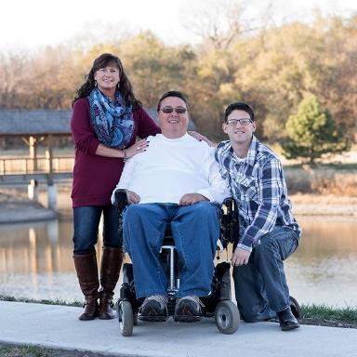
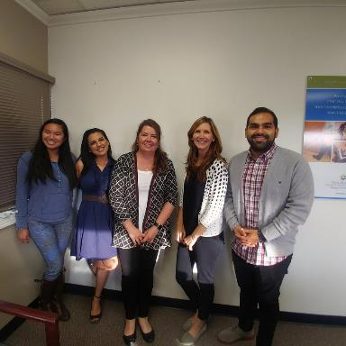
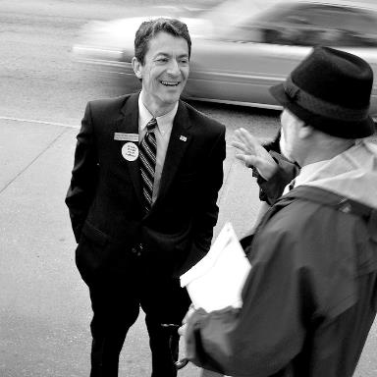
Individuals & Families
Service
Providers
Policy Makers
& Advocates

Slide 62
Get involved!
Testimonials
Send feedback
Suggest other resources!

Slide 63
Thank you!
Kerry Morse: kerry.morse@mso.umt.edu

Slide 64
Questions and discussion

Slide 65
What’s next?
Ask
Explore
Share
Engage
Learn
Visit our vendor table, and engage with us about questions and potential answers that matter for real people in real places in rural America.

Slide 66
Acknowledgements
RTC:Rural research is funded by National Institute on Disability, Independent Living, and Rehabilitation Research (NIDILRR) Grant No. 90RT5025.
Healthy Community Living is funded by NIDILRR Grant No. 90DP0073.
NIDILRR is a Center within the Administration for Community Living and Department of Health and Human Services. The contents do not necessarily represent the policy of NIDILRR, ACL, or HHS, and you should not assume endorsement by the Federal Government.

