Slide 1
Advocacy Through
Social Media
Copyright © • Property of Rooted in Rights • All Rights Reserved

Slide 2
What to Expect For Today
Discuss the mission & work RiR does
Why video storytelling matters
The importance of getting youth in front of & behind the camera
Hands on - YOU become the filmmaker!

Slide 3
Introduction
Vilissa Thompson
Been on the RiR team since May
Digital Manager - get to be on social media all day
Handles the video campaign launches on our social media pages
Clark Matthews
Joined RiR in January
Creative Production Assistant
Involved in every step of making video - pre-production (planning), production (shooting), and post-production (editing)

Slide 4
What is Rooted in Rights?
Mission - To tell authentic, accessible stories that empower our community to advocate for disability rights
What we do - produce videos and social media campaigns exclusively on disability rights issues
Values - We are rooted in rights because we believe all people deserve equal rights, and our work is dedicated to the people, communities and causes that seek to guarantee those rights for everyone, everywhere

Slide 5
The Power of Social Media
The power of social media cannot be underestimated when it comes to advocacy & activism
I know the possibilities due to my work outside of RiR
How I mesh those two worlds together

Slide 6
Why Is Video Storytelling So Important?
Why use video to tell our stories?
What power is there in filming the diversity of the largest minority group in the world?

Slide 7
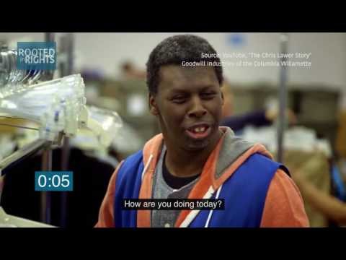
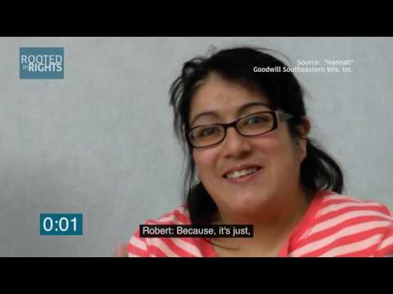
Media Representation
Invisibility of our experiences
Lack of news coverage on our issues
Youth self-advocacy is not widely seen or supported

Slide 8
Advantages Video Brings to Advocacy
Strong connection to audience
Fun, entertaining, popular
Quick and easy to consume
Easy to share via social media
Contain a lot of information
(Can be) very accessible

Slide 9
Storytellers Series
The Rooted in Rights Storytellers Series features videos by and for people with disabilities.
Storytellers work with the Rooted in Rights team to develop scripts, shoot videos, edit the final product and share them with the world.
Since 2016, videos on a range of disability rights topics have been produced by Storytellers from around the world.

Slide 10
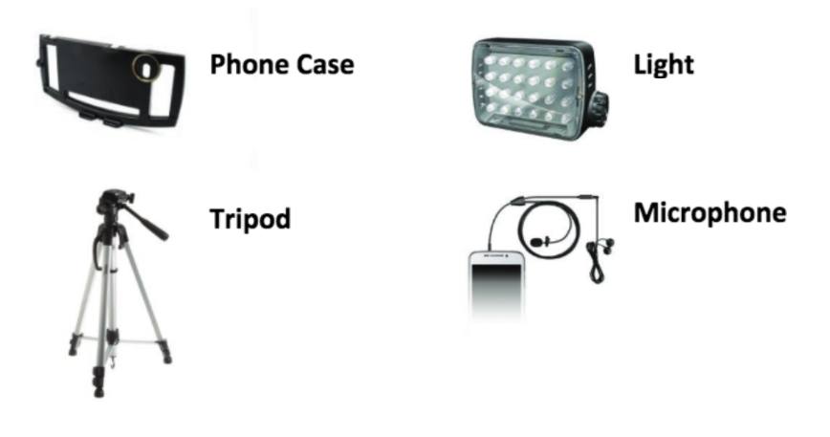
Storytellers Kit
Kit Includes:
Phone Case
Smartphone
Tripod
Light
Lavalier Mic
Headphones

Slide 11
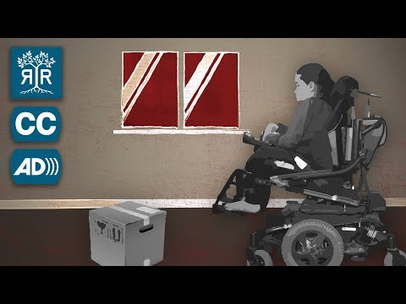
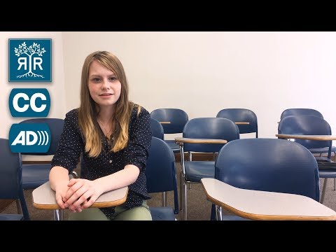
Storytellers Examples
Institutionalized as a Teen
with Jensen Caraballo
Still Segregated
with Courtney Cole

Slide 12
When Writing A Script...
Questions to ask yourself when writing a script:
What is your topic?
Why is it important?
Who is your audience?
What is your call to action?
Why are you the one to tell this story?

Slide 13
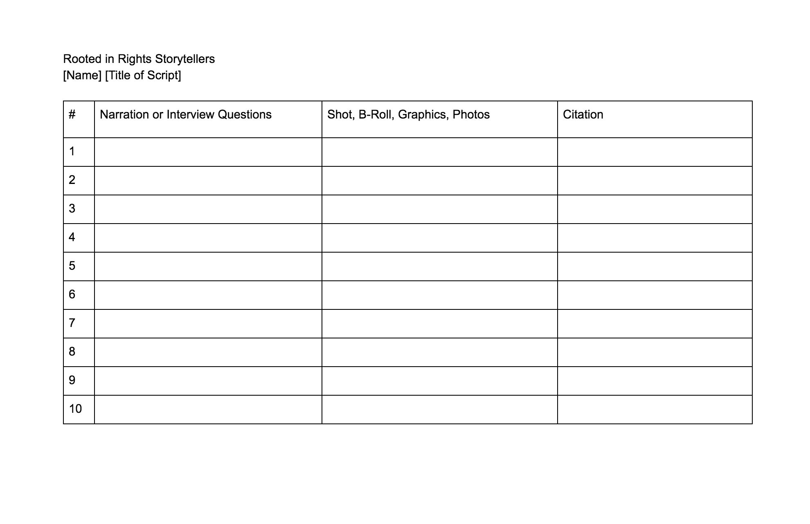
Script Template

Slide 14
Sharing Your Stories at APRIL
Coming together to share your stories
Equipping young people with the tools to tell your experiences at APRIL

Slide 15
Tips for Filming
B-roll
Shoot horizontally
If you want better quality - the Filmic Pro App will film as high as 4K resolution. Can download using smartphone/Tablet

Slide 16
Editing Software
iMovie - also on your phone
Final Cut
Premiere / Premiere Clip (for the iPhone)

Slide 17
Social Media Livestreaming
Periscope
Facebook Live
Instagram Live

Slide 19
Where to Find Us
Website: rootedinrights.org
Facebook: /rootedinrights
Twitter: @rootedinrights
Instagram: @rootedinrights
YouTube: https://www.youtube.com/user/RootedInRightsVideo

