Slide 1
North Country Independent Living Native American Grant
Indivisible with Liberty and Justice for All:
23rd Annual National Conference on Rural Independent Living
October 20-23, 2017
Spokane, WA

Slide 2
Overview
Introductions
North Country Independent Living – History
Native American Project – History
Our Four Tribes & Maps
Structure
Culture
What have we done so far?
John Nousaine
Doug Defoe
Sunshine Lemieux
What have we learned so far?
Strengths & Struggles & Tips
Questions?

Slide 3
North Country Independent Living
Established 1988
Our Service Area
Geographic Diversity
Staff

Slide 4
Native American Project
Goal - Weave the tenants of Independent Living philosophy into the realm of Native American Culture.
Objectives - 1. Native American staff 2. Advisory board 3. Develop a continuation plan
Outcomes - 1. Consumers gain greater ability to make informed decision concerning their lives. 2. Tribal service providers will develop greater awareness of resources, connections and collaborations. 3. Consumers become more empowered

Slide 5
IL in Indian Country
Isolated & Rural Communities
Disability Rate
Underfunded CILS
Cultural Competency Issues
NCIL/APRIL Response

Slide 6
Giiwedin
Wisconsin
Indigenous
Network on
Disability
N
O
R
T
H

Slide 7
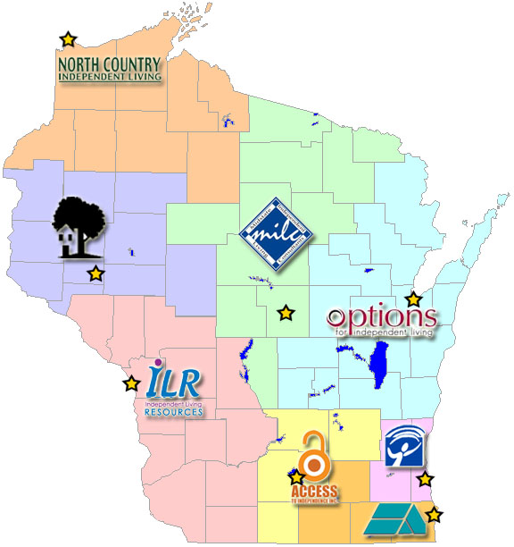

Slide 9
Red Cliff Band of Lake Superior Chippewa
The reservation is approximately one mile wide and 14 miles long, located at the top of the Bayfield Peninsula, on the shores of Lake Superior in northern Wisconsin. Approx 1400 acres of tribal land.
The number of Enrolled Tribal Members to date are as follows:
1783 Total in Bayfield County (reservation & county)
5238 Off-reservation (Non Bayfield County)
7021 Total Enrolled (Living) Tribal Members
Most current info as provided on the website www.redcliff-nsn.gov

Slide 10
Red Cliff
Tribe is governed by 9 member council - Chairman, Vice Chairman, the Secretary the Treasurer, and five council members.
The Red Cliff Tribal Administration is divided into several divisions
Operates own Tribal Court
Notes:
Education Family Services Health Services Human Services Treaty Natural Resources Protective Services Public Works

Slide 11
Bad River Band of Lake Superior Chippewa
The Bad River Band of the Lake Superior Tribe of Chippewa Indians is located on a 125,000+ acre reservation in Northern Wisconsin on the south shore of Lake Superior in Ashland and Iron Counties.
The tribe has over 7,000 members, the majority living off the reservation, about 1,500 live on the reservation in one of four main communities.
All info provided from:
http://www.badriver-nsn.gov

Slide 12
Bad River
Tribe is governed by a seven member council - Chairman, Vice Chairman, the Secretary, the Treasurer, and three council members.
The administration is divided into departments which are managed by professional tribal administrators.
The tribal court system oversees civil cases while criminal cases are overseen by state courts and enforced by state/county police officers.
Notes:
Accounting Education Enrollment Health & Wellness Housing & Realty Human Resources Natural Resources Public Service Social & Family Services Transit Emergency Management

Slide 13
Lac Courte Oreilles Band of Lake Superior Chippewa
The Lac Courte Oreilles Band of Lake Superior Chippewa Indians is located in Northern Wisconsin about 70 miles south of the shores of Lake Superior.
The tribe occupies approximately 69,000 acres and has recently purchased 8,000 acres adjacent to the Chequamegon National Forest.
With around 7950 enrolled tribal members, 60% of tribal members live in LCO in 23 different community villages.
Info provided from - www.lco-nsn.gov & www.glitc.org

Slide 14
Lac Courte Oreilles
Tribe is governed by a seven member council - Chairman, Vice Chairman, the Secretary/Treasurer, and three council members.
The tribe owns and operates enterprises, businesses, and programs and is the largest employer in Sawyer County.
The tribal administration is divided into departments and operates its own tribal Voc Rehab.
The tribe operates the LCO Community College, a 40 acre cranberry marsh, a health clinic, youth centers, and a forest products and lumber mill.
Notes:
LCO HEALTH CENTER
LCO LEGAL DEPARTMENT
WAADOOKODAADING
LCO OJIBWE SCHOOL
ICW & FAMILY SERVICES
CHILD SUPPORT PROGRAM
HIGHER EDUCATION
VOCATIONAL REHABILITATION
PUBLIC WORKS
Conservation
Housing
Employment/HR
LCO TANF/Economic Services

Slide 15
St. Croix Chippewa Indians of Wisconsin
St. Croix’s boundaries include about 4,700 acres (mixed trust & fee land) of forested land and part of what is known as the "northwoods" of North Eastern Wisconsin.
There are about 1,300 enrolled members in the St. Croix Chippewa Tribe. Many tribal members reside in one of the Tribe's communities: Big Sand Lake, Danbury, Round Lake, Maple Plain, Gaslyn, Bashaw, Clam Lake, and Balsam Lake.

Slide 16
St. Croix
The St. Croix tribe is governed by a five-member council elected for two-year terms. The Tribal Council is responsible for the general welfare of tribal members and the management of day-to-day tribal business
St. Croix is the largest employer in Burnett County and the 2nd largest employer in Barron County
Like our other tribes, they are divided into departments – Education, Health Services, Social Services, Legal, Tribal Court and Environment and Natural Resources
*Info provided from - www.lco-nsn.gov & www.glitc.org

Slide 17
Outreach

Slide 18
Outreach

Slide 19
Outreach

Slide 20
2017 Tribal Youth Conference
Red Cliff, WI

Slide 29
What have we learned so far?
Strengths - Staff, CIL Support, Familiar, Established Contacts, Opportunity for Independence, Trust and Comfortable
Struggles – Patience, Differentiating services, Division of Duties, Board Recruiting, Nursing Home Fallacy, services eligibility

Slide 30
TIPS TO REACHING OUT
Patience
Culture
Respect
Repeat

Slide 31
Questions?

