Slide 1
CIL Services for Parents WITH Disabilities

Slide 2
What Got Us Started?
Legislation
DSS Policies
Personal Stories
Notes:
Barriers:
Legislation – our state’s laws
Lack of Policies
Personal Stories

Slide 3
Take the Lead!
Relationships
Programming
Become the Expert
Focus Groups
Legislation

Slide 4
Start Educating

Slide 5
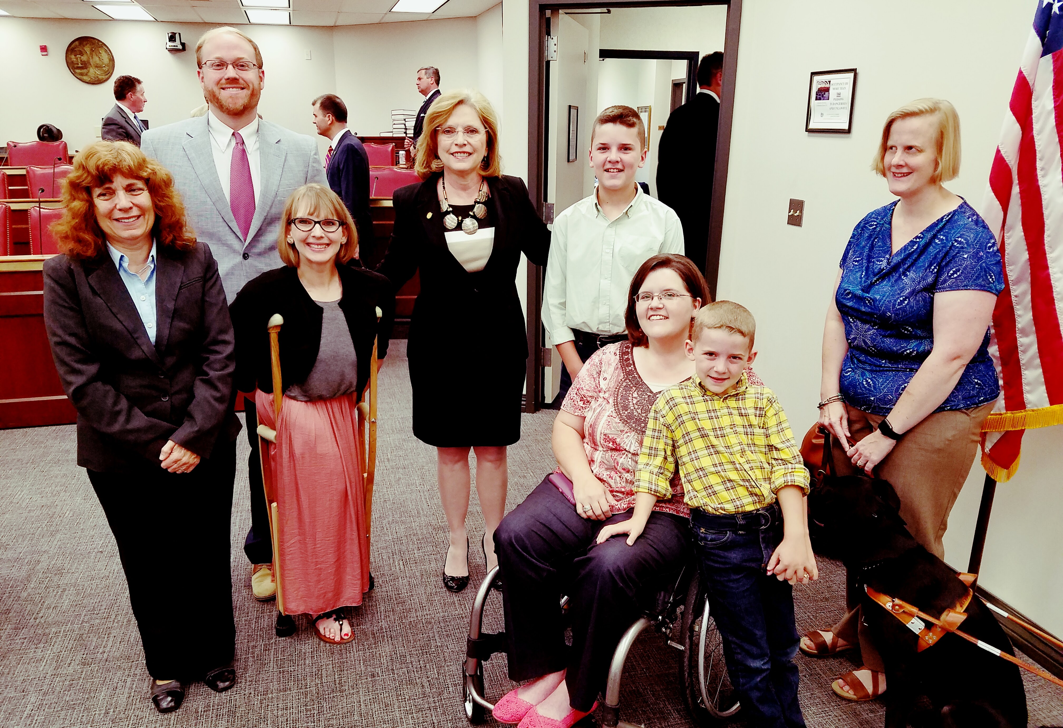
Change the Laws!
(2015-2016) H. 3989- Persons with Disabilities Right to Parent Act– Included legislation for child welfare, family law, and reproductive health.
Notes:
If no one else is going to do it– go for it! CILs can lobby if they use unrestricted funding– and as long as it stays within a percentage of your overall budget
First time it was Too complexed– Senate amended the blind persons right to parent act to include all disabilities– weak law. The bill died on the senate floor

Slide 6
2017- H. 3538 and S. 291- Persons with Disabilities Right to Parent Act
REMOVES DISCRIMINATING LANGUAGE FROM THE LAW
-the parent has a diagnosable condition unlikely to change within a reasonable time including, but not limited to, addiction to alcohol or illegal drugs, or prescription medication abuse, mental deficiency, mental illness, or extreme physical incapacity,
Prohibits Discrimination
H. 3538 & S. 291 would prohibit discrimination for parents and prospective parents with disabilities (will protect all individuals with any type of disability).
accommodations to parents with disabilities
H. 3538 & S. 291 will require SCDSS to make reasonable accommodations to a parent or legal guardian with a disability as part of placement and visitation decisions; preventive, maintenance, and reunification services; and evaluations or assessments of parenting capacity.
Adoption
H. 3538 & S. 291 will require that a child placing agency not deny a person with a disability the right to pursue adoption of a child solely on the basis of the disability, without considering whether adaptive parenting equipment, instruction in adaptive parenting techniques, and other supportive services could enable the person to parent adequately.
Notes:
Introduced in the House and had a Senate Companion bill.
We drafted the bill wit P&A and DSS–
Discuss how we worked with DSS, DDC, and P&A on this bill; Lots of different personalities between a CIL, P&A and a Child Welfare Agency, DSS. DSS wanted to amend the bill to keep disabilities in the bill and remove “prohibits discrimination on basis of disability” language.

Slide 7
Continued--- H. 3538 and S.291-
Child welfare
H. 3538 & S. 291 will require that the SC Department of Social Services, and any other covered entity, must not terminate the rights of a parent or legal guardian with a disability solely on the basis of the disability.
ADAPTIVE PARENTING
H. 3538 & S. 291 will require the SC Department of Social Services to make reasonable efforts to avoid removal of a child from the home of a parent or legal guardian with a disability, including referrals for access to adaptive parenting equipment, referrals for instruction on adaptive parenting techniques, and reasonable accommodations with regard to accessing services that are otherwise made available to a parent or legal guardian who does not have a disability.

Slide 8
Persons with Disabilities Right to Parent Act PASSED in May of 2017!!
Notes:
Title: Persons with Disabilities Right to Parent Act PASSED in May of 2017!!
-- First Bill
Persons with Disabilities Right to Parent Act
Opposition

Slide 9
Parenting with a Disability: Present

Slide 10
Parenting with a Disability Today
Removal rates of parents with psychiatric disabilities are as high as 70-80%
Removal rates of parents with intellectual disabilities are as high as 80%
Extremely high removal rates and loss of parental rights for parents with sensory or physical disabilities
More than two-thirds of dependency statutes include disability as grounds for termination of parental rights (TPR)
In every state, disability may be considered when determining the best interest of a child for purposes of a custody determination in family or dependency court

Slide 11
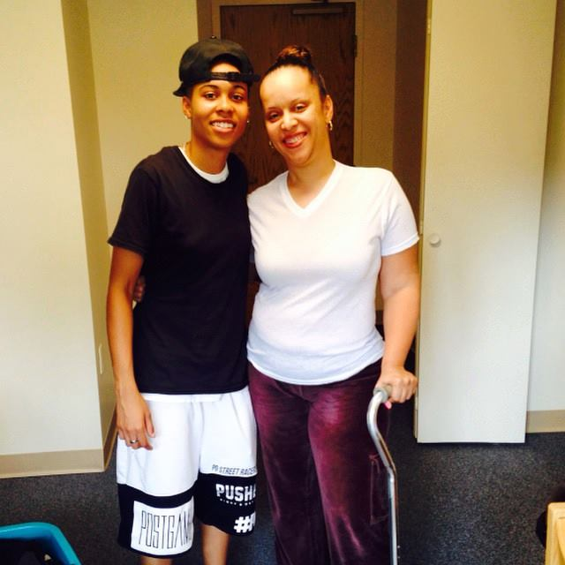
Parenting with a Disability Today
Parents with disabilities are more likely to lose custody of their children after divorce
Prospective adoptive parents with disabilities regularly encounter barriers erected by discrimination and bias
People with disabilities face significant barriers to receiving assisted reproductive technologies

Slide 12
Who are Parents with Disabilities and Their Children?
At least 4.1 million parents with reported disabilities in the United States have children under age 18; meaning that at least 6.2 percent of American parents who have children under age 18 have at least one reported disability.
Estimates indicate 6.1 million children in the U.S. have parents with disabilities – Nearly 1 in 10, almost 10% of the population.
Source: Kaye, H. Steven. (2012). Current Demographics of Parents with Disabilities in the U.S. Berkeley, CA: Through the Looking Glass.

Slide 13
Overall Barriers
Recurring barriers include:
State statutes that include disability as grounds for TPR
Perceived limits on the application of the ADA, especially at the termination phase
Bias and speculation
A lack of training regarding parents with disabilities
Not understanding resources
Parents with disabilities are unaware of their rights
Notes:
The child welfare system is ill-equipped to support parents with disabilities and their families, resulting in disproportionately high rates of involvement with child welfare services and devastatingly high rates of parents with disabilities losing their parental rights.
ASFA: 15/22 rule, reasonable efforts, fast track/bypass, concurrent planning

Slide 14
ONLY 14 states do not consider ANY disability when terminating parental rights
Arkansas
California
Idaho
Illinois
Kansas
Maryland
Missouri
Oregon
Rhode Island
South Carolina (ah, yes!)
Tennessee
Utah
Vermont
West Virginia

Slide 15
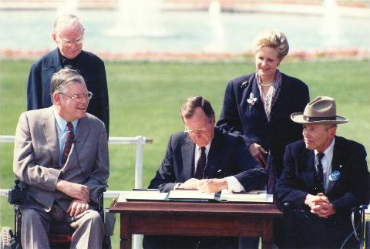
Disability Law & Child Welfare
Both the ADA and Section 504 of the Rehabilitation Act (for agencies receiving federal funding) apply to the child welfare system.
The ADA was passed with the intent of ensuring “full and equal opportunity” for Americans with disabilities.

Slide 16
Rehabilitation Act (Section 504) – 29 U.S.C. § 794
“No otherwise qualified individual with a disability in the United States…shall, solely by reason of her or his disability, be excluded from participation in, be denied the benefits of, or be subjected to discrimination under any program or activity receiving Federal financial assistance…” 29 U.S.C. § 794(a).

Slide 17
Americans with Disabilities Act (ADA)
Title II applies to public entities, which include state and local governments, and their departments and agencies 42 U.S.C. § 12131(1)
Accordingly, the child welfare system must comply with Title II’s mandate: “No qualified individual with a disability shall, by reason of such disability, be excluded from participation in or be denied the benefits of the services, programs, or activities of a public entity, or be subjected to discrimination by any such entity.” 42 U.S.C. § 12131 et seq.

Slide 18
The ADA, Continued…
Child welfare agencies must…
Provide parents with disabilities an equal opportunity to participate in programs, services, and activities, including reasonable modifications, unless such modifications would fundamentally alter the nature of the service, program, or activity. 28 C.F.R. § 35.130(b)
Administer services, programs, and activities in the most integrated setting appropriate to the needs of qualified parents with disabilities. 28 C.F.R § 35.130(d).
Not impose or apply eligibility criteria that screen out or tend to screen out any parents with a disability from fully and equally enjoying any service, program, or activity…28 C.F.R. § 35.130(b)(8).

Slide 19
The ADA, Continued…
Child welfare agencies must…
Furnish auxiliary aids and services when necessary to ensure effective communication. 28 C.F.R. § 35.160(a)(1),(b)(1), 28 C.F.R. § 35.164.
Provide, as needed, benefits, services, or advantages beyond those required by the regulation. 28 C.F.R. § 35.130(c).
Not impose surcharges on parents with disabilities to cover the costs of measures to ensure nondiscriminatory treatment. 28 C.F.R. § 35.130(f).
Not deny the benefits of programs, activities, and services to parents with disabilities because entities’ facilities are inaccessible. 28 C.F.R. § 35.149.
Provide services, programs, and activities that, when viewed in their entirety, are readily accessible to and usable by parents with disabilities. 28 C.F.R. § 35.150.

Slide 20
How to File Complaints with DOJ & HHS
DOJ – Civil Rights Division, Disability Rights Section
ADA.Gov Filing Complaint Form
HHS – Office for Civil Rights
HHS Office for Civil Rights Portal

Slide 21
Adaptive/Modified Parenting Techniques
-means strategies for accomplishing childcare and other parenting tasks that enable a person with a disability to execute a task safely for themselves and their children alone or in conjunction with adaptive parenting equipment.
Notes:
Title: Adaptive/Modified Parenting Techniques

Slide 22
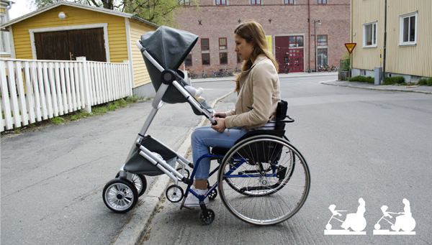
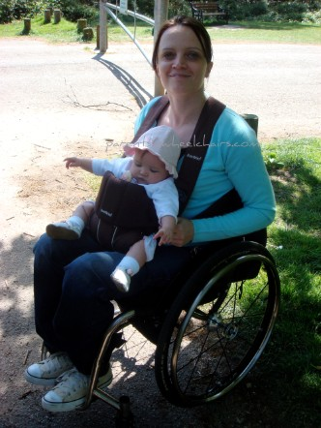
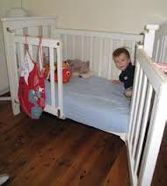
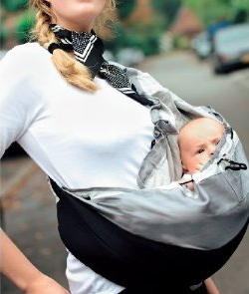
Examples of Adapted Tools
Notes:
Title: Examples of Adapted Tools

Slide 23
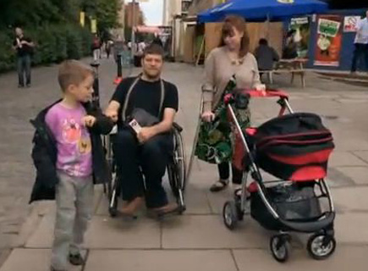
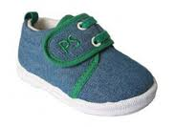
Examples of Adapted Tools Continued…

Slide 24
Other Examples of Reasonable Modifications
Increase frequency/extend length of service provision
Provide in-home parent modeling
Links of parent with a co-parent or mentor
Tailor parenting education to the needs of the parent
Provide services at an individual’s home or alternative accessible site
Give frequent reminders for appointments/services
Provide accessible transportation
Provide all information in large print, audio tape, Braille, or digital format
Offer note-taking or transcriptions of meetings and court activities
Assist in reading materials
Provide interpreters
Notes:
Title: Other Examples of Reasonable Modifications

Slide 25
Examples of Reasonable Accommodations
Day care services
Respite care
Family or informal support networks (church, neighbors)
Parent helper/child care assistant
Aide or personal assistant
Supported housing
Pictorial representation or reminders of tasks (step by step)
Housekeeping services
Adaptive equipment (e.g. adaptive cribs and child care equipment, communication devices, specialized computer software, cooking/feeding equipment)
Adaptation to physical environment (e.g. ramps, lower counters, level handled door knobs)
Notes:
Title: Examples of Reasonable Accommodations

Slide 26
Resources
Notes:
Title: Resources

Slide 27
Rocking the Cradle: Ensuring the Rights of Parents with Disabilities
Notes:
Title: Rocking the Cradle: Ensuring the Rights of Parents with Disabilities.

Slide 28
Department of Justice/HHS Technical Assistance
U.S. Department of Health And Human Services
Office for Civil Rights Administration for Children and Families
U.S. Department of Justice
Civil Rights Division Disability Rights Section
Protecting the Rights of Parents and Prospective Parents with Disabilities:
Technical Assistance for State and Local Child Welfare Agencies and Courts under Title II of the Americans with Disabilities Act and Section 504 of the Rehabilitation Act
Notes:
Title: Department of Justice/HHS Technical Assistance

Slide 29
ABA Resolution 114
ABA urges federal, state, territorial, and tribal governments to enact legislation and implement public policy providing that custody, visitation, and access shall not be denied or restricted, nor shall a child be removed or parental rights be terminated, based on a parent’s disability, absent a showing—supported by clear and convincing evidence—that the disability is causally related to a harm or an imminent risk of harm to the child that cannot be alleviated with appropriate services, supports, and other reasonable modifications.
ABA urges federal, state, territorial, and tribal governments to enact legislation and implement public policy providing that a prospective parent’s disability shall not be a bar to adoption or foster care when the adoption or foster care placement is determined to be in the best interest of the child.
Notes:
Title: ABA Resolution 114

Slide 30
Incorporating Parenting Programs in Your CIL
Notes:
Title: Incorporation Parenting Programs in Your CIL

Slide 31
Centers for Independent Living’s Role
Advocacy
Independent Living Skills Training
Transition
Information & Referral
Peer Mentoring
PARENTING WITH A DISABILITY
Notes:
Title: Centers for Independent Living’s Role

Slide 32
Advocacy
Advocacy Efforts with Child Welfare agency, family court, law enforcement, etc.
Teaching self-advocacy skills to parents
Educating attorneys and judges
Providing testimony in hearings
Educating about the impact a bill can have on people with disabilities
Custody Issues
Notes:
Title: Advocacy

Slide 33
Independent Living Skills Training
Parenting Skills
Child Development
Teaching about and trying out adapted equipment
Family Planning– what steps will it take to have a family
Teaching disability rights
Household Management
Notes:
Title: Independent Living Skills Training

Slide 34
Peer Mentoring
Networking with parents with disabilities
Reproductive Health
Adoption
Child Birth
Peer Support
Adjusting to parenthood
Navigating child welfare system
Notes:
Title: Peer Mentoring

Slide 35
Information & Referral
Connecting to community resources
Service provider resources
Equipment & equipment modification resources
Providing outreach
Developing your own resources
Sharing information about rights
Notes:
Title: Information & Referral

Slide 36
Transition
Family planning with youth – you can be a parent one day!
Developing goals
Teen pregnancies
Institution transition/custody
Notes:
Title: Transition
Institution transition

Slide 37
Go Change the World!
Notes:
Title: Go Change the World!
CILs can be powerful– if you are seeing issues in your community– do something about it!

Slide 38
Thanks!
Any questions?
You can find me at…
Kimberly Tissot, Executive Director
803.779.5121 ext. 124
ktissot@able-sc.org
Notes:
Title: Thanks!

