Slide 1
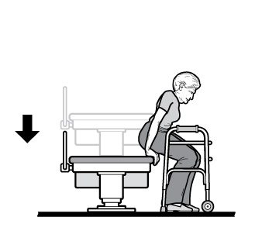
Accessible Healthcare: Rights and Responsibilities under the Americans with Disabilities Act
Michael Richardson, MPA

Slide 2
Learning Objectives
Learn about the resources available through the ADA National Network
Understand the basics of the Americans with Disabilities Act (ADA) and how it applies to healthcare
Understand the requirements of ‘effective communication’ and physical access in healthcare facilities and programs

Slide 3
Technical Assistance
Training
Material Dissemination
Research
Public Awareness

Slide 4
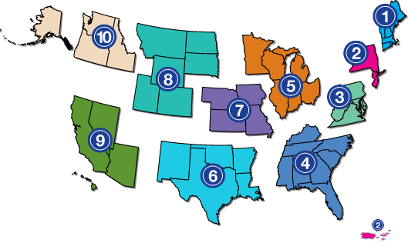
Where are the ten regional ADA Centers located?
Located throughout the United States in order to meet the specific needs of their regions.
Notes:
ADA National Network - 10 regional Centers with over 2,200 affiliates at the local, state, and regional level

Slide 5
Congressional Purpose of ADA
"The purpose of the ADA ... is to provide a clear and comprehensive national mandate to end discrimination against individuals with disabilities and to bring those individuals into the economic and social mainstream of American life."
- A CIVIL RIGHTS ACT!

Slide 6
Who and what does the ADA cover?
Title I - Employment
Title II - State and Local Governments and Transportation
Title III - Public Accommodations (“Businesses”)
Title IV - Telecommunications
Title V - Miscellaneous
Notes:
Title I protects qualified applicants with a disability from discrimination in employment.
Title II is designed to protect people with disability in all services, programs and activities provided or made available by state or local governments and their affiliate agencies (i.e. public schools, government meetings, transportation services, and public recreation facilities).
Title III states that owners of public accommodation facilities must remove physical barriers to accessibility when it is readily achievable to so do.
Title IV requires accessibility in telecommunications such as relay services, TDD, and closed captioning services.
Title V includes miscellaneous provisions and covers items such as state immunity from suits for damages and paying attorney’s fees. It further states that the federal government can sue states and assess financial penalties for non-compliance with the ADA. It protects people with disabilities from retaliation when an ADA complaint is filed. Also, it states that stricter non-discrimination laws will always apply in states that have enacted stricter laws.

Slide 7
Federal Disability Discrimination Laws
Title II of the Americans with Disabilities Act – applies to all public (state and local) healthcare providers.
Title III of the Americans with Disabilities Act – applies to all private healthcare providers.
Section 504 of the Rehabilitation Act of 1973 – applies to federal healthcare services and facilities; and healthcare providers who are also recipients of federal financial assistance, (such as federal Medicaid funds) or by federal research grants.
Notes:
Also:
Title VI of the Civil Rights Act of 1964: This federal law mandates appropriate language access in the health care setting to individuals who have limited English proficiency.
State laws often mirror the above federal laws and provide separate remedies.

Slide 8
How does the ADA view “aging?”
Some age-related impairments will meet the ADA definition of disability, others will not.
What makes a physical or mental impairment a disability under the ADA is that it:
Substantially limits one or more major life activities, or
There is a record of such an impairment, or
The individual is regarded as having an impairment.

Slide 9
Healthcare Providers under Title III
Hospitals, nursing homes, psychiatric and psychological services, offices of private physicians, dentists, health maintenance organizations (HMOs), and health clinics are included among the healthcare providers covered by the ADA.

Slide 10
Common Scenario
One woman with low vision reported that she learned only after years of taking her thyroid medication at dinnertime that taking the medication with food weakened the drug’s effects, which may have compromised her treatment.

Slide 11
Effective Communication
Disabilities that affect hearing, seeing, speaking, reading, writing, or understanding may use different ways to communicate.
Information must be as clear and understandable to people with disabilities as it is for people who do not have disabilities.

Slide 12
Effective Communication
Health care providers have a duty to provide appropriate auxiliary aids and services when necessary to ensure that communication with people with disabilities is as effective as communication with others.
28 C.F.R. § 36.303(c)
Notes:
2008 Amendments Act (went into effect 2011)
Qualified reader: new definition.
Qualified interpreter: revised definition.
Companions with disabilities.
Types of auxiliary aids and services that are necessary to ensure effective communication.
Use of individuals or children as interpreters.
Performance standards for video remote interpreting services.

Slide 13
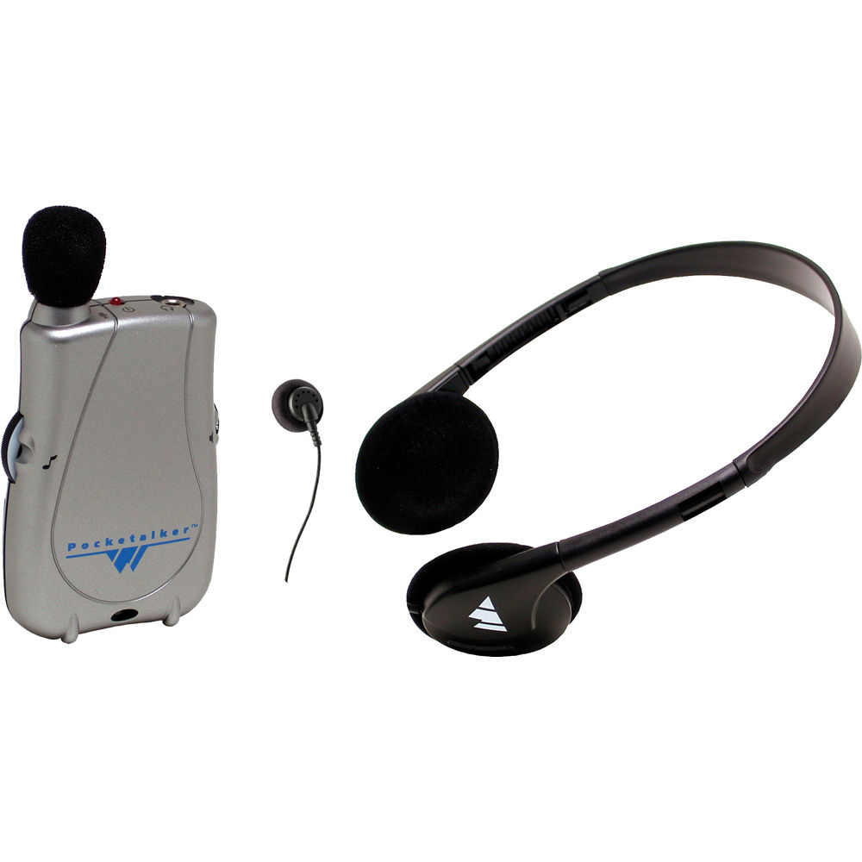
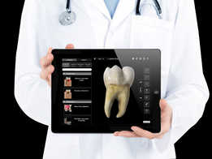
Effective Communication
“Auxiliary aids and services” are devices or services that enable effective communication for people with disabilities.
Notes:
When choosing an aid or service, title II entities are required to give primary consideration to the choice of aid or service requested by the person who has a communication disability. The state or local government must honor the person’s choice, unless it can demonstrate that another equally effective means of communication is available, or that the use of the means chosen would result in a fundamental alteration or in an undue burden (see limitations below).
Title III entities are encouraged to consult with the person with a disability to discuss what aid or service is appropriate. The goal is to provide an aid or service that will be effective, given the nature of what is being communicated and the person’s method of communicating.
You also must make information about the location of accessible services, activities, and facilities available in a format that is accessible to people who are deaf or hard of hearing and those who are blind or have low vision.
Generally, the requirement to provide an auxiliary aid or service is triggered when a person with a disability requests it.
The healthcare provider has the final say in which aid or service will be appropriate, as long as the result is effective communication for the individual, given the nature and context of the information being conveyed.
Example: Blood pressure check

Slide 14
Effective Communication: Who?
Customers, clients, and other individuals with disabilities who are seeking or receiving the services of the medical center.
May not always be "patients" of the healthcare provider – Auxiliary aids and services may need to be provided to spouses, partners, family members, etc. with disabilities.
Notes:
Deaf parent of child patient
Lamaze classes – partner participation
Peripheral interviews with family members in psychotherapy
Another note: Classes, support groups and other activities that are open to the public must be accessible to participants with disabilities

Slide 15
Effective Communication
The means used to provide effective communication is determined on a case-by-case basis – person’s needs and situation.
Consult with the individual to determine what communication method or technology will be effective for him or her.
Notes:
When choosing an aid or service, title II entities are required to give primary consideration to the choice of aid or service requested by the person who has a communication disability. The state or local government must honor the person’s choice, unless it can demonstrate that another equally effective means of communication is available, or that the use of the means chosen would result in a fundamental alteration or in an undue burden (see limitations below).
Title III entities are encouraged to consult with the person with a disability to discuss what aid or service is appropriate. The goal is to provide an aid or service that will be effective, given the nature of what is being communicated and the person’s method of communicating.
You also must make information about the location of accessible services, activities, and facilities available in a format that is accessible to people who are deaf or hard of hearing and those who are blind or have low vision.
Generally, the requirement to provide an auxiliary aid or service is triggered when a person with a disability requests it.
The healthcare provider has the final say in which aid or service will be appropriate, as long as the result is effective communication for the individual, given the nature and context of the information being conveyed.
Example: Blood pressure check

Slide 16
People with Visual Impairments
People with visual impairments often receive important health care-related information in standard print, which they can’t read.

Slide 17
People with Visual Impairments
medical exam, test, and lab results
information explaining diagnoses or treatment
prescription medication instructions
explanations of informed consent or end-of-life policies and procedures
physical therapy instructions and instructions for the management of chronic conditions
childbirth preparation resources, prenatal care materials
Notes:
Examples of comunication needs

Slide 18
Visual Impairments
Where information is provided in written form, ensure effective communication for people who cannot read the text.
Consider the context,
the importance of the information,
the length, and
complexity of the materials.

Slide 19
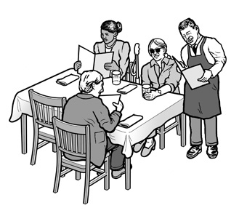
Communication - Print materials
Alternative formats - Braille, large print text, electronic format, audio recordings.
If little time to have it produced in an alternative format, reading the information aloud may be effective (Qualified Reader).
Example – reading what services you provide, etc.
Notes:
adjustable lighting, or a location with better lighting
assistance in filling out forms
Qualified reader is defined as “a person who is able to read effectively, accurately, and impartially, using any necessary specialized vocabulary.”
A health care provider cannot require a blind person to bring someone with them to interpret or facilitate communication

Slide 20
Common Scenario
Confidentiality Issues
Individuals with vision loss report feeling frustrated and embarrassed after being forced to reveal their confidential financial information or details about highly personal and private physical and mental health concerns out loud in public, in front of strangers.

Slide 21
Common Scenario
Deaf woman giving birth: Her partner, who is also deaf, was also not provided an interpreter. He also was excluded from the delivery room during the birth because woman’s mother (who was attempting to provide basic ASL interpretation to her daughter) was counted as complainant’s choice of “companion” during the birth.

Slide 22
Cognitive Disabilities
Allow plenty of time to teach a new task.
Use repetition with precise language and simple wording.
Treat adults as adults and children as children.
Do not pretend to understand if you do not.
Notes:
DEFINITIONS:
An intellectual disability is a disability characterized by significant limitations both in intellectual functioning (reasoning, learning,
problem solving) and in adaptive behavior, which covers a range of everyday social and practical skills and originates before the age of 18.
Cognitive impairments are not caused by any one disease or condition. Alzheimer’s disease and other dementias and conditions such as stroke
and traumatic brain injury can cause cognitive impairment.
Taking extra time for patient appointment = reasonable accommodation = Modification of policies and procedures

Slide 23
Cognitive Disabilities
Ask additional questions to clarify any information a patient may be sharing with you.
Reduce distractions.
Use pictures or objects to convey meaning, if appropriate.
Allow a “wait time” for the patient to process information or respond to a question or to make a comment.
Notes:
DEFINITIONS:
An intellectual disability is a disability characterized by significant limitations both in intellectual functioning (reasoning, learning,
problem solving) and in adaptive behavior, which covers a range of everyday social and practical skills and originates before the age of 18.
Cognitive impairments are not caused by any one disease or condition. Alzheimer’s disease and other dementias and conditions such as stroke
and traumatic brain injury can cause cognitive impairment.
Taking extra time for patient appointment = reasonable accommodation = Modification of policies and procedures

Slide 24
Auxiliary Aids and Services for Individuals who are Deaf of Hard of Hearing
qualified interpreters
note-takers
written materials
assistive listening systems/devices
captioned media, transcripts, etc.
Communication Access Real-time Translation (CART)
exchange of written notes
Notes:
Ineffective methods of communication
Lip/speech reading is frequently ineffective. Many factors reduce lip reading abilities (e.g. lighting, facial hair, foreign or regional accents). Many sounds cannot easily be read on the lips. Additionally, patients who are anxious, scared, fatigued, affected by medication, may all hinder the patient’s ability to effectively lip/speech read. Many deaf people, particularly in medical settings, will feign to understand and nod their heads in agreement. This is usually not an indication that they are understanding but as a result of feeling embarrassed to inform the health care professional that they are NOT able to understand. Teach-back is extremely important in assessing and ensuring patient’s understanding.
Hearing loss in older patients – baby boomers
Do not assume note writing is an effective communication tool. American Sign Language is not based on written or spoken English. The syntax and grammatical structure are very different from English. English is often a second language for many deaf people just as it is for people coming from other countries. Writing is also labor intensive and for many deaf people as well as health care providers, writing may be found to be cumbersome and inefficient in a medical setting.
Other Considerations:
Visual Medical Aids
Where necessary to facilitate patient education and communication use charts, diagrams, models and aids in the office to help explain certain concepts and basic anatomy. In addition, provide a list of online resources to reinforce teaching and understanding.

Slide 25
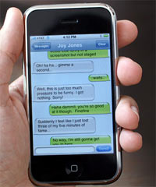
Communication - Simple situations
Brief or simple face-to-face exchanges - very basic aids are usually appropriate and effective.
For example, exchanging written notes may be effective when a person asks for a copy of a form to fill out.
Using a “smart phone” to write and exchange messages.
Notes:
For brief or simple face-to-face exchanges, very basic aids are usually appropriate.
For example, exchanging written notes may be effective when a deaf person asks for a copy of a form at an office or for ordering food at a hospital cafeteria.
For more complex or lengthy exchanges, more advanced aids and services may be required. Consider how important the communication is, how many people are involved, the length of the communication anticipated, and the context.

Slide 26
Communication - Complex situations
Complex or lengthy exchanges
an interpreter (sign language, oral, cued speech) or
CART (Communication Access Real-time Translation)
Examples – interviews, counseling sessions, community events, meetings, etc.
Written transcripts or captions on video for pre-scripted situations such as speeches, presentations, etc.

Slide 27
Communication Access Realtime Translation
For individuals with significant hearing loss but do not rely on sign language for communication and who have good levels of reading comprehension, the appropriate auxiliary aid or service is usually the use of transcription services, such as Communication Access Realtime Translation (CART). 28 C.F.R. § 35.104.
Notes:
CART converts spoken words instantly into text using a stenotype machine, computer, and special software.

Slide 28
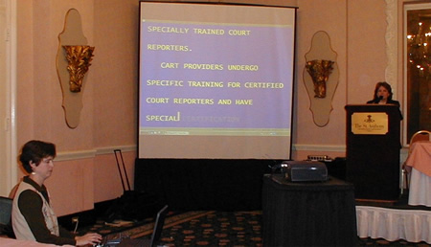
Communication Access Realtime Translation

Slide 29
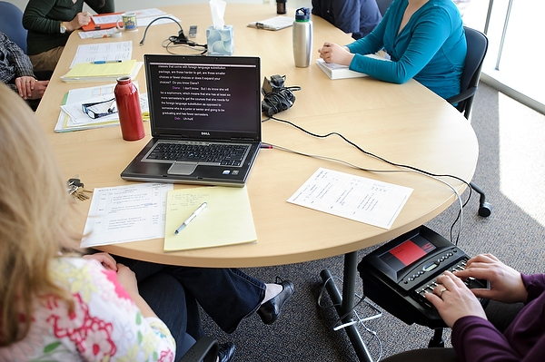
Communication Access Realtime Translation
Notes:
More likely used in a conversational type of appointment.

Slide 30
Undue Burden and Fundamental Alteration
The ADA does not require the provision of any auxiliary aid or service that would result in an undue burden or in a fundamental alteration in the nature of the goods or services provided by a health care provider.
An individualized assessment is required to determine whether a particular auxiliary aid or service would be an undue burden.
Notes:
A fundamental alteration is a change that is so significant that it alters the essential nature of the goods, services, facilities, privileges,
advantages or accommodations offered by a business. In health care settlements, the Department of Justice has indicated that very
rarely will this be a legitimate defense for failing to provide effective communication.
State and local governments: in determining whether a particular aid or service would result in undue financial and administrative burdens, a title II entity should take into consideration the cost of the particular aid or service in light of all resources available to fund the program, service, or activity and the effect on other expenses or operations. The decision that a particular aid or service would result in an undue burden must be made by a high level official, no lower than a Department head, and must include a written statement of the reasons for reaching that conclusion.
Businesses and nonprofits: in determining whether a particular aid or service would result in an undue burden, a title III entity should take into consideration the nature and cost of the aid or service relative to their size, overall financial resources, and overall expenses. In general, a business or nonprofit with greater resources is expected to do more to ensure effective communication than one with fewer resources. If the entity has a parent company, the administrative and financial relationship, as well as the size, resources, and expenses of the parent company, would also be considered.

Slide 31
“But it Costs too Much!”
A health care provider is expected to treat the costs of providing auxiliary aids and services as part of the overhead costs of operating a business.
As long as the provision of the auxiliary aid or service does not impose an undue burden on the provider’s business, the provider is obligated to pay for the auxiliary aid or service.
Notes:
For example, a payment may be considered an undue burden or fundamental alteration if it would cause your doctor to go bankrupt or go out of business.
A loss on a single appointment or even providing ongoing care for a patient does not establish an undue burden or fundamental alteration. The overall financial circumstances of your doctor's practice must be considered.
Settlement agreements negotiated with the Department of Justice are clear. Being reimbursed less than the cost of services for a sign language
interpreter is not considered an undue burden.
A health care provider cannot charge a patient for the costs of providing auxiliary aids and services, either directly or through the patient's insurance carrier.
Medicaid

Slide 32
Accessible Exam Rooms, Chairs, and Medical Diagnostic Equipment

Slide 33
Common Scenario
A woman with a significant disability, and a wheelchair user, was not able to get routine reproductive healthcare services due to physical and attitudinal barriers. Subsequently, she was discovered to have advanced endometrial cancer only after significant symptoms warranted attention.

Slide 34
U.S. Access Board
“Issued accessibility standards for medical diagnostic equipment under section 510 of the Rehabilitation Act. These standards provide design criteria for examination tables and chairs, including those used for dental or optical exams and procedures, weight scales, radiological equipment, mammography equipment and other equipment used for diagnostic purposes by health professionals.”
Notes:
the standards are not mandatory on health care providers or equipment manufacturers. The U.S. Department of Justice may adopt them as mandatory requirements under the Americans with Disabilities Act. Other federal agencies may implement them as well under the Rehabilitation Act which requires access to federally funded programs and services.

Slide 35
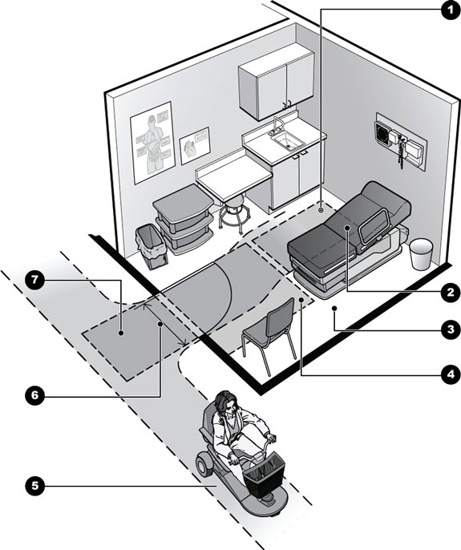
Clear floor space
Adjustable exam table
Space to assist with transfers
Floor space
Accessible route
Accessible entry
Maneuvering clearances at entrance

Slide 36
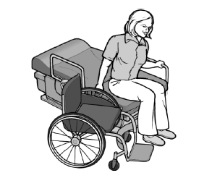
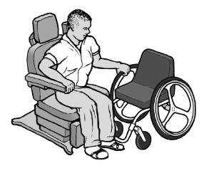
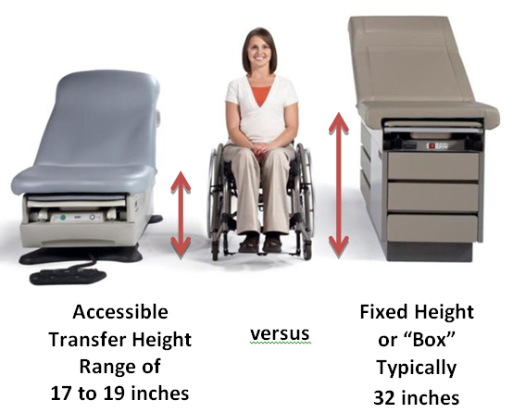
Accessible Medical Diagnostic Equipment
Examination Tables and Chairs
adjustable transfer surface height
transfer surface size
support rails
armrests
space for floor lift

Slide 37
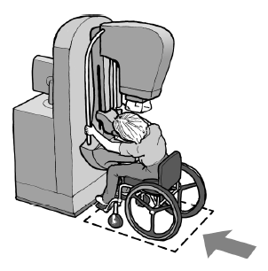
Accessible Medical Diagnostic Equipment
Mammography equipment
breast platform height
space for approach
knee and toe clearance

Slide 38
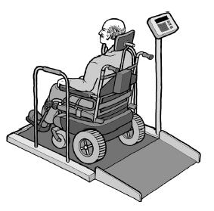
Accessible Medical Diagnostic Equipment
Weight scales
minimum space for wheelchair
ramps
edge protection
support rails

Slide 39
Resources
Regulations, appendices, standards are available at DOJ’s ADA web site at www.ada.gov
For answers to specific questions, DOJ toll-free ADA information line:
800-514-0301
U.S. Access Board www.access-board.gov

Slide 40
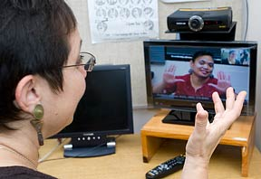
Contact the ADA National Network
Telephone 800-949-4232
Website ADAta.org
Michael Richardson
mike67@uw.edu

