Slide 1
Disability Advocates Taking Action (DisDATA):
Ask questions, get data, take action!

Slide 2
Introductions and Workshop goals
RTC:Rural Data nerds
  Lillie Greiman
  Arin Leopold
Learn about Disability Data Advocates Taking Action and how you can get involved.
Learn about the advocacy work DisDATA has been involved in over the past year.
Let’s start thinking about data differently!
  WE ARE ALL DATA PEOPLE
  Asking questions and demanding action.

Slide 3
What is DisDATA?
DisDATA formed in Fall of 2020 in response to the countless disabled lives lost to the COVID-19 pandemic, particularly in institutions and congregate settings. Our national inability to count those lives and prevent their loss exposes a long-standing issue that disabled people are missing from data design, collection, and decision-making. This problem is preventable through collective action.
  cross-disability
  national collaborative
  committed to making data about disability equitable, actionable, and transparent.

Slide 4
Who are DisDATA?
We are a community of people with shared values about justice, equity and compassion
DisData are a group of
  Advocates and activists
  Service providers
  Researchers
  Community members
  With and without disabilities
work in solidarity with all disabled people, disability led organizations and other groups of people who are systemically marginalized due to structural ableism and racism to collect the data needed to advocate for and affect change

Slide 5
Why Data?
There is power in data
  Who gets represented and how?
  What questions get asked and why?
Data systems can be used to marginalize and exclude as much as they can be used to include and understand
  Good data, bad data, no data
  All matter and have impacts on marginalized groups
Disabled people are made invisible across federal policy through the lack of data collection and representation leading to a disability data inequity.
  In congregate settings (expand)
  In intersectional spaces/identities
We are seeking data equity for disability justice
  Improved representation across all levels of data collection
    How questions are asked
    How surveys are implemented
    How/which data are used to inform policy

Slide 6
What does DisDATA do!?
Advocate for disability data representation
  Disabled people, and disability led organizations MUST be included across all levels of data collection
  Presented at United National Regional Consultation of the Committee on the Right of Persons with Disability (June, 2021)
  Public comment to Biden Harris Health Equity Task Force (July, 30th 2021)

Slide 7
Analyze data to support local and national advocacy efforts
National analysis of COVID-19 deaths in nursing homes
Using data from Center for Disease control on COVID-19 cases and deaths in Centers for Medicare and Medicaid funded nursing homes
Developed research brief to communicate impacts of COVID on people in nursing facilities
Created dynamic data visualizations at both the national and state level

Slide 8
Data in action
Supported two CILs in state and national advocacy efforts
  Atlantis
  Roads to Freedom
Communicated state level disproportionate impact to secure funding streams for emergency transitions pilot programs
increased community awareness of the pandemic's effect on congregate settings to support current and future advocacy efforts to increase access to HCBS services and housing
used to show necessity of accessing state funded housing vouchers for emergency transitions from congregate settings
Communicated state level disproportionate impact to advocate for federal emergency funding to be used for transitions and relocation out of facilities
  PEMA and FEMA
  National Council on Disability
Identified major data limitations and discrepancies
Identified major disparities between CDC, CMS, and state data discounts validity and trustworthiness of data accuracy
lack of consistency between definitions of congregate setting types across data sets

Slide 9
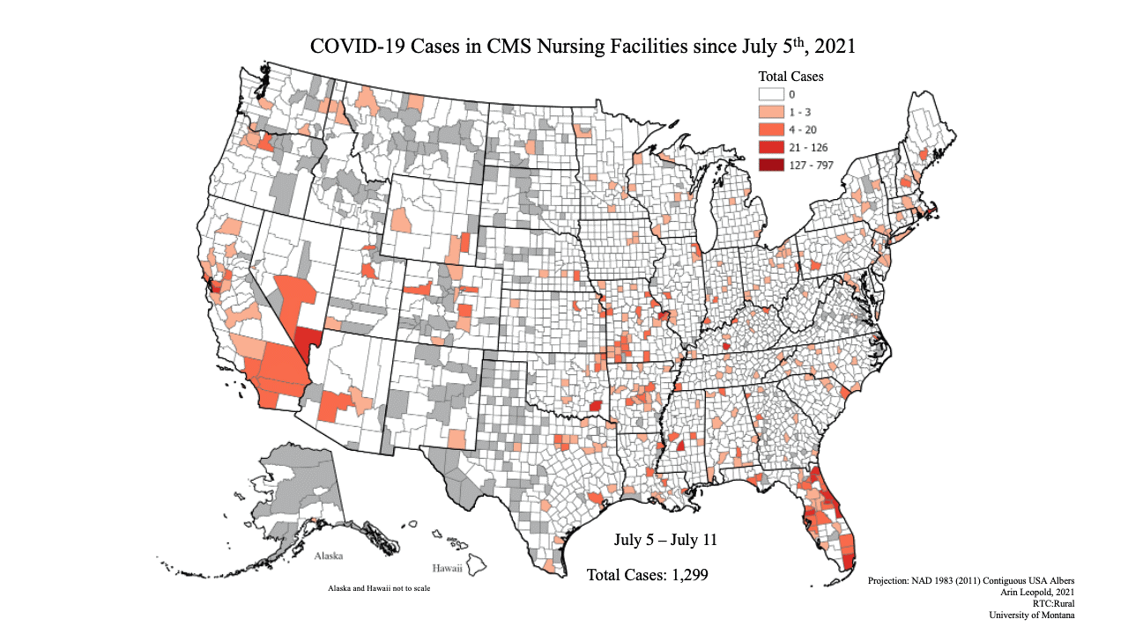

Covid-19 Cases in CMS Nursing Facilities since July 5th 2021
Notes:
This video graphic illustrates the change in weekly COVID 19 cases in CMS Nursing facilities, by county, over a period of 10 weeks from July 5th to September 19th 2021. Counties are shaded from white, to light orange, to red, on a scale from 0 to 797. White or light orange counties have fewer cases and red counties have more cases. Counties for which we don’t have data or where there are no nursing facilities are shaded grey. The first map represents the week of July 5th and a majority of counties across the US are white or light orange, with zero or 1 cases. Over time clusters of counties all across the country grow progressively darker until the final week of Sept 13th shows considerably more of the country in darker red, with red counties in every state and some counties reaching levels up to 797 new weekly cases. Over the course of these ten weeks a total of 36,535 new cases were reported in nursing facilities across the country.

Slide 10
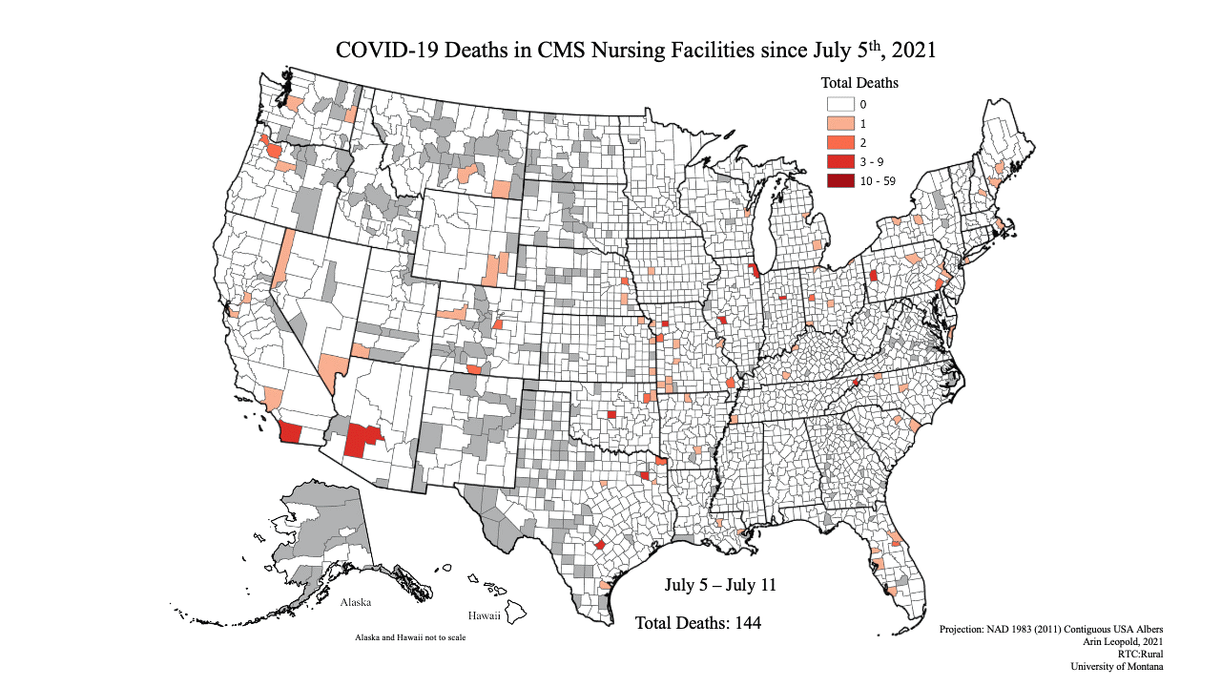
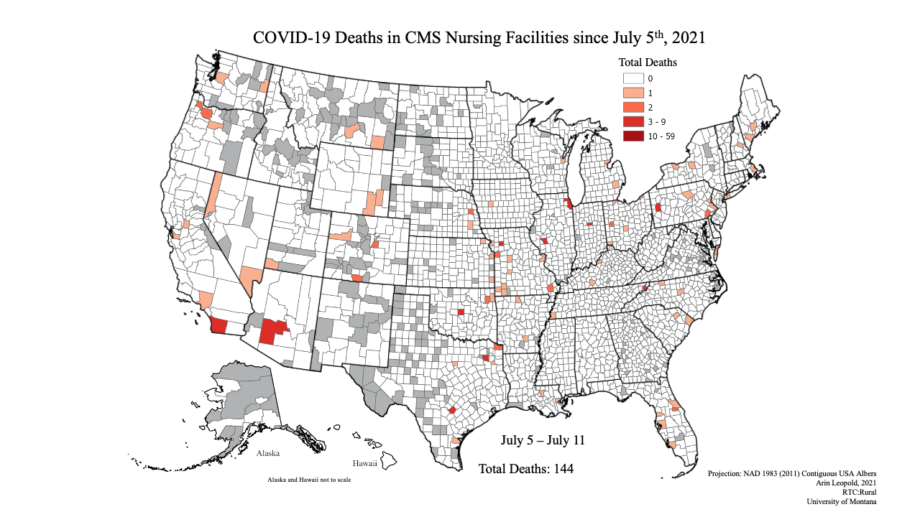
10
Notes:
This video graphic illustrates the change in weekly COVID 19 deaths in CMS Nursing facilities, by county, over a period of 10 weeks from July 5th to September 19th 2021. Counties are shaded from white, to light orange, to red, on a scale from 0 to 59. White or light orange counties have fewer deaths and red counties have more deaths. Counties for which we don’t have data or where there are no nursing facilities are shaded grey. The first map represents the week of July 5th and a vast majority of counties across the US are white or light orange, with zero or 1 cases. Over time clusters of counties across the country grow progressively darker until the final week of Sept 13th shows considerably more of the country in darker red, with red counties in every state and some counties reaching levels up to 59 new weekly deaths. Over the course of these twn

Slide 11
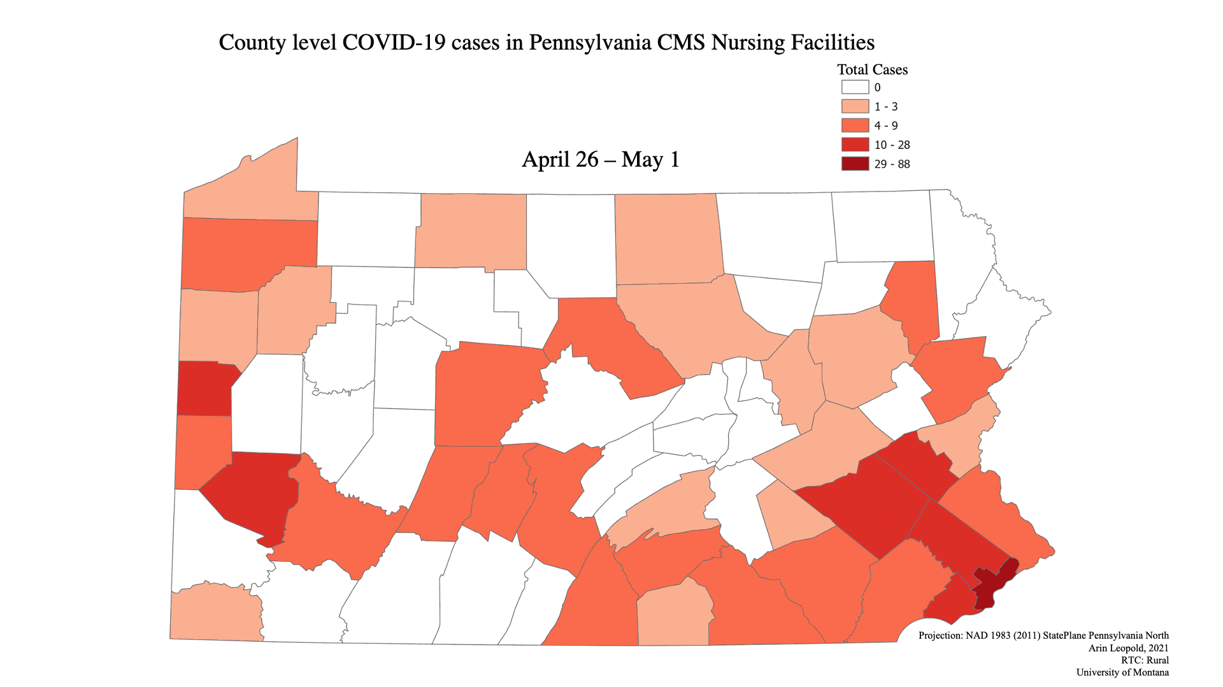

County Level Covid-19 cases in Pennsylvania CMS Nursing Facilities
Notes:
A video graphic of a map of Pennsylvania counties showing the increasing numbers of COVID-19 cases in nursing facilities across the state. Starting the week of April 26th a majority of counties are white or light pink, indicating zero or few new cases with some counties in the Southeastern part of the sate reporting more cases (29-88 cases). As the weeks pass increasing numbers of counties across the state report increasing numbers of cases. By August 14th substantially more counties report cases in the highest category (29-88) cases.

Slide 12
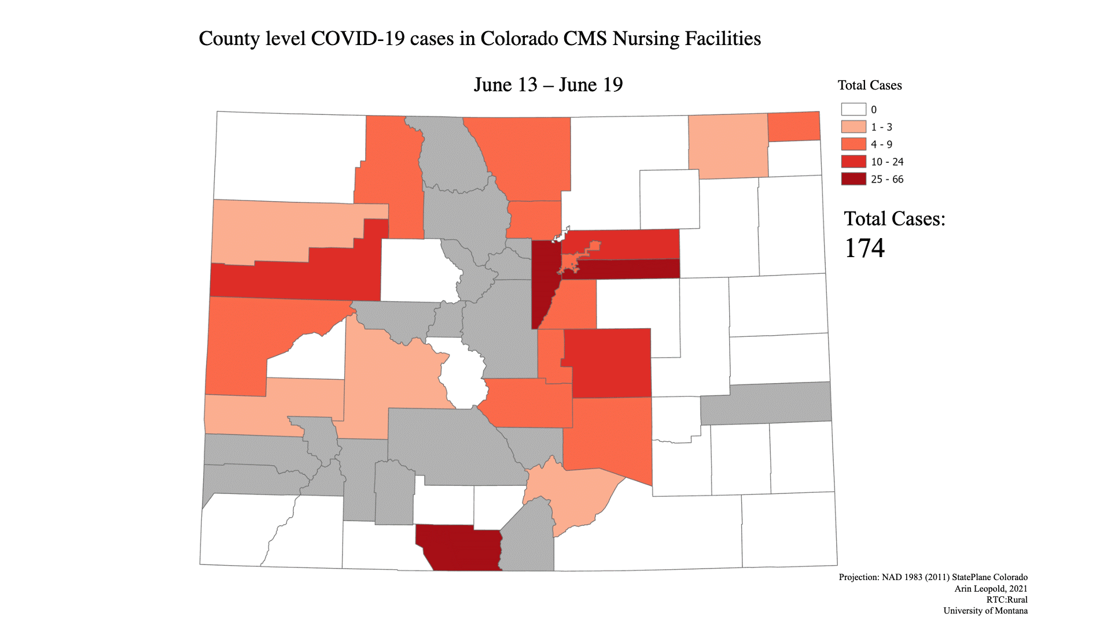
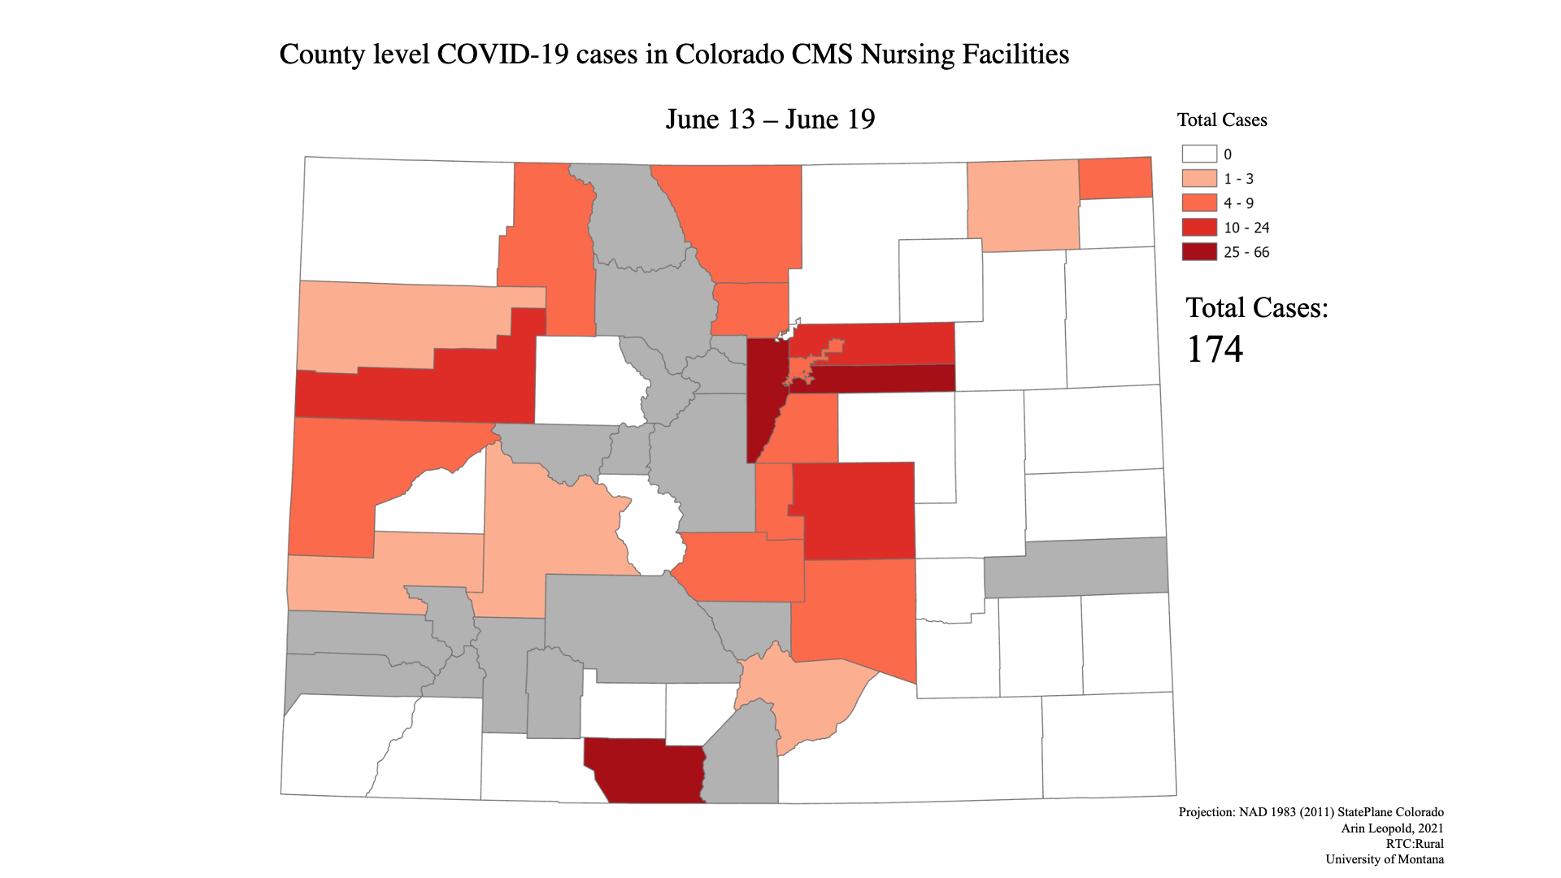
County Level Covid-19 cases in Colorado CMS Nursing Facilities
Notes:
Video graphic map of Colorado counties showing the increase in cases of COVID 19 in CMS funded nursing homes over ten weeks, from June13th to August 28th cases increase across counties steadily across the weeks. Over these eleven weeks there are a total of 349 new COVID cases in nursing facilities in Colorado.

Slide 13
Discussion
How does your center use data for advocacy?
What data GAPs have you encountered in trying to advocate for the needs of the community?
What are the barriers you have experienced in trying to access/use data for advocacy?
What are the risks associated with using data for advocacy?

Slide 14
What is next!?
Expand the network
  EMAIL: DisDATA@umt.edu to join the network!
Help support the community to identify data needs and ask questions and get involved
  Disability inclusion/representation
  Data analysis, visualization and translation
  Data accessibility, usability and transparency
Data equity for disability justice!

