Slide 1
Christopher & Dana Reeve Foundation
ChristopherReeve.org
@ReeveFoundation

Slide 2
Rural Unserved & Underserved Populations Grants Program
APRIL Annual Conference
October 11, 2022

Slide 3
Session Overview
Introduction to the Reeve Foundation’s National Paralysis Resource Center
Rural Unserved & Underserved Populations Grants Program
Other Reeve Foundation Grant Opportunities
Questions

Slide 4
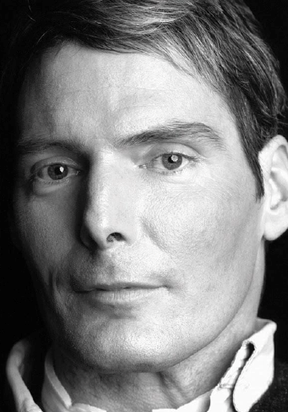
Quote by Christopher Reeve
A hero is an ordinary individual who finds the strength to persevere and endure in spite of overwhelming obstacles.”
– Christopher Reeve
photo credit: Timothy Greenfield-Sanders

Slide 5
Introduction to the Reeve Foundation
Dual Mission: Today’s Care. Tomorrow’s Cure
We are dedicated to curing spinal cord injury by advancing innovative research and improving quality of life for individuals and families impacted by paralysis.

Slide 6
Definition of Paralysis
The Reeve Foundation uses a functional definition of paralysis:
Difficulty and/or inability to use arms and/or legs due to neurological conditions including (but not limited to) spinal cord injury, traumatic brain injury, stroke, cerebral palsy, spina bifida, ALS, post-polio syndrome, etc.

Slide 7
National Paralysis Resource Center
Once you
choose hope,
anything’s
possible.”
— CHRISTOPHER REEVE
National Paralysis Resource Center
With partnership from the Administration for Community Living, the Paralysis Resource Center (PRC) provides much-needed free educational information, programs, emotional support and individualized assistance to Americans living with paralysis, along with their caregivers, families and medical professionals.
*Cooperative Agreement Grant Number: 90PRRC0002

Slide 8
Snapshot of Impact
Snapshot of Impact
Information Specialists
117,000+ families have received one-on-one assistance in 170 languages
Quality of Life Grants
$37 million+ awarded to over 3,550 non-profit programs in all 50 states
Reeve Summit:
Where Care, Cure and Community Connect
Annual summit with a spectrum of care and cure topics designed for the community and professionals
Paralysis Resource Guide 225,000+ copies distributed to the Reeve Foundation’s community
1st call made when loved one is diagnosed with paralysis
Virtual Community
3M+ users visit ChristopherReeve.org and social media channels annually
Health-Related Materials
250,000+ pageviews, video views and downloads of educational content annually
Military and Veterans Program
Supports the unique needs of service men and women regardless of when they served or how they were injured
Peer & Family Support Program
20,000+ people have received support from 500+ certified peer mentors who are also living with paralysis
PAGE 8

Slide 9
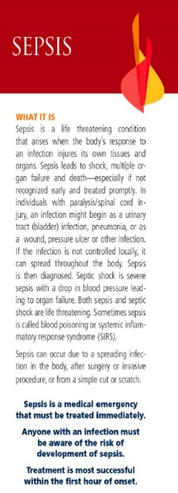
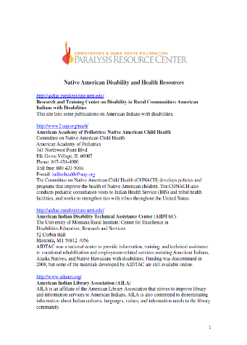
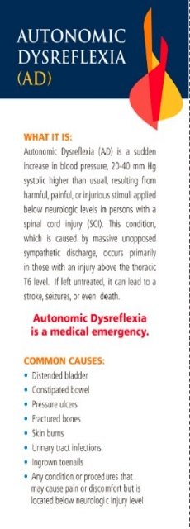
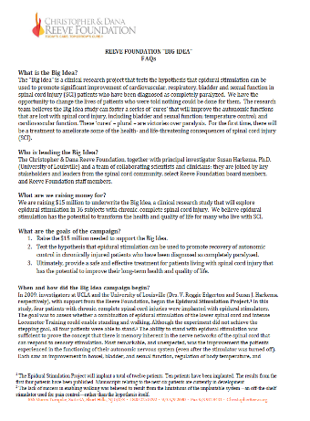
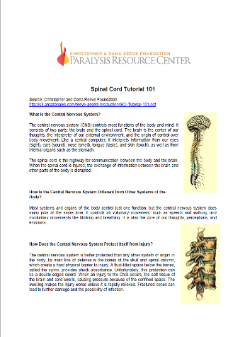
Free Materials and Resources
Free Materials & Resources
Books
Wallet Cards
Fact Sheets
Publications

Slide 10
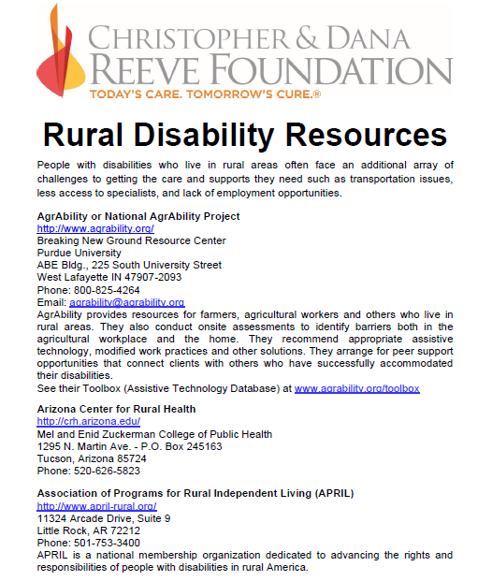
Rural Disability Resources
Rural Disability Resources

Slide 11
Native American Disability and Health Resources
Native American Disability Resources

Slide 12
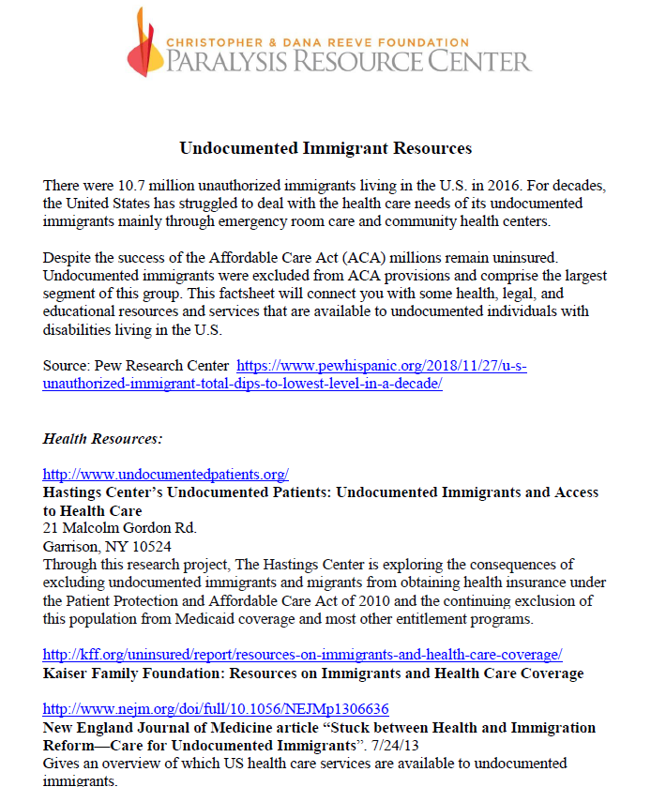
Undocumented Immigrant Resources
Undocumented Immigrant
Resources

Slide 13
What We’ve Learned
Rural Communities are STRONG
Rural Communities are RESILIENT
Rural Communities have the ability to gather around a purpose and solve problems

Slide 14
Rural Inequities
Rural Americas experiences many inequities compared to the nation as a whole:
Housing
Transportation
Access to Healthcare
Limited Healthy Food Options
Lack of Access to Broadband and Other Technology
Historical Trauma

Slide 15
Rural Communities and Environmental Challenges
Hazardous materials often end up in remote areas where the land is cheap
Environments impacts and dangers of rural industries (mining and farming)

Slide 16
Rural Communities and Health
Chronic diseases
Hearth disease
Obesity
Diabetes
Health Insurance

Slide 17
The Intersection of Rural Communities and Disability
Rural Americans represent a higher proportion of people with a disability
17.1% of rural Americans report a disabling condition compared with 11.7% of urban-dwelling Americans
Higher rates of disability persist across gender, race, impairment type, and all age groups
Veterans and people in poverty living in rural areas report higher rates of disability than those in urban areas

Slide 18
Why We Created This Program
Rural Communities are STRONG
Rural Communities are RESILIENT
Rural Communities have the ability to gather around a purpose and solve problems

Slide 19
Aim of the New Grants Program
Fund projects that explicitly benefit people living with paralysis in unserved and underserved rural communities.
Projects will focus on promoting accessibility and participation in rural communities.
Grants are up to $40,000
18-month project period

Slide 20
Potential Projects
Transportation
Providing access to safe and affordable transportation options
Providing accessible driver’s education/training programs
Assistive Technology and Durable Medical Equipment
Short-term AT Equipment Loan Programs
Ramps
Broadband internet
AT Demonstration Centers

Slide 21
Potential Projects Continued
Health
Rural Community Health Centers or Veterans Hospitals
Care Coordination
Telehealth
Agriculture and access to healthy foods
Employment and education
Peer and Family Support Groups

Slide 22
Quality of Life Grants Program
The Quality of Life Grants Program impacts and empowers people living with paralysis, their families and caregivers by providing grants to nonprofit organizations whose projects and initiatives foster inclusion, involvement and community engagement, while promoting health and wellness for those affected by paralysis in all 50 states and U.S. territories.

Slide 23
Quality of Life Tiered Grants Structures
Quality of Life Tiered Grants Structure
Direct Effect (Tier 1)
Priority Impact (Tiers 2, 3, & 4)
Tier 1- Up to $25,000 (must be completed within 12 months)
Tier 2- $30,000 (must be completed within 12 months)
Respite/Caregiving
Open-Focus
Assistive Technology
Covid-19 Addressing Social Isolation
Expanded Impact (Tier 5)
Tier 3- $40,000 (must be completed within 18 months)
Tier 4- $50,000 (must be completed within 24 months)
Nursing Home Transition
Racial Equity
Rural Underserved and Unserved Populations
Tier 5- Grants of $100,000 (must be completed within 24 months)
For previously awarded Quality of Life grantees whose programs and/or projects have achieved demonstrable, successful impact.
Employment
Examples of previously funded programs:
Sports wheelchairs for wheelchair basketball team; adapted glider in a community playground; kayak for a rowing program; hydraulic lift at a pool; electronic door openers at a community pool; workshop education on sex and sexuality with a spinal injury; wheelchair accessible picnic table at a county fairground; camp programs; support groups, etc.
PAGE 23

Slide 24
The Grant Cycle
The Grant Cycle
September 1, 2022
Cycle Opened
October 13, 2022
Proposals Due
External Review
October 17th
November 3rd
Internal Review
November 17th
December 4th
PAGE 24

Slide 25
Direct Effect – Examples of Funded Projects
Accessibility Modifications
Adaptive Sports
Accessible Playground/Ball Field
Accessible Trail/Tree House/Beach
Assistive Technology
Advocacy
Arts
Camp
Caregiving
Consumer Education
Durable Medical Equipment (see
funding restrictions)
Education
Employment
Facility Accessibility Modifications
Fitness and Wellness
Healthcare
Media Development
Medical Professional Education
Peer Mentoring and Support
Service Animal Program
Therapeutic Horseback Riding
Transportation
Transition from Institution to Home

Slide 26
Types of Direct Effect (Tier 1) Projects Funded
Sports wheelchairs for a wheelchair basketball team
Adapted glider in a community playground
Kayak for a rowing program
Accessible gym equipment
Hydraulic lift at a pool
Electronic door openers at a community center
Workshop education series on sex and sexuality with a spinal cord injury
Wheelchair accessible picnic table at a county fairground
Program for preventing abuse in adaptive sports
Camp programs
Subsidized lessons for therapeutic riding
Transportation costs for an inclusive afterschool program
Support groups

Slide 27
Priority Impact Tiers 2-4
The Priority Impact Grant Tiers (Tiers 2, 3, & 4) offer three increasing levels of grant funding. Priority Impact grants fund priority issues for individuals living with paralysis. Grantee organizations will demonstrate capacity to implement the grant without intensive technical assistance and capacity building, as well as demonstrate capacity for program development, evaluation and sustainability.
.

Slide 28
Priority Impact Tier 2
Tier 2 – Grants of up to $30,000. (Grants must be completed within 12 months.)
Respite/Caregiving
Assistive Technology
COVID-19: Addressing Social Isolation
.

Slide 29
Priority Impact Tier 3
Tier 3 – Grants of up to $40,000. (Grants must be completed within 18 months)
Nursing Home Transition
Racial Equity
Rural Underserved and Unserved Populations
.

Slide 30
Priority Impact Tier 4
Tier 4 – Grants of up to $50,000. (Grants must be completed within 24 months)
Employment
.

Slide 31
Feedback
In adherence with federal OMB requirements we are unable to comment on denied applications or provide programmatic direction to organizations applying for Quality of Life grants, as giving feedback/direction would be providing unfair advantage over other applicants.

Slide 32
Thank You
Thank You
Mark Bogosian
Director, Quality of Life Grants Program
www.ChristopherReeve.org

