Slide 1
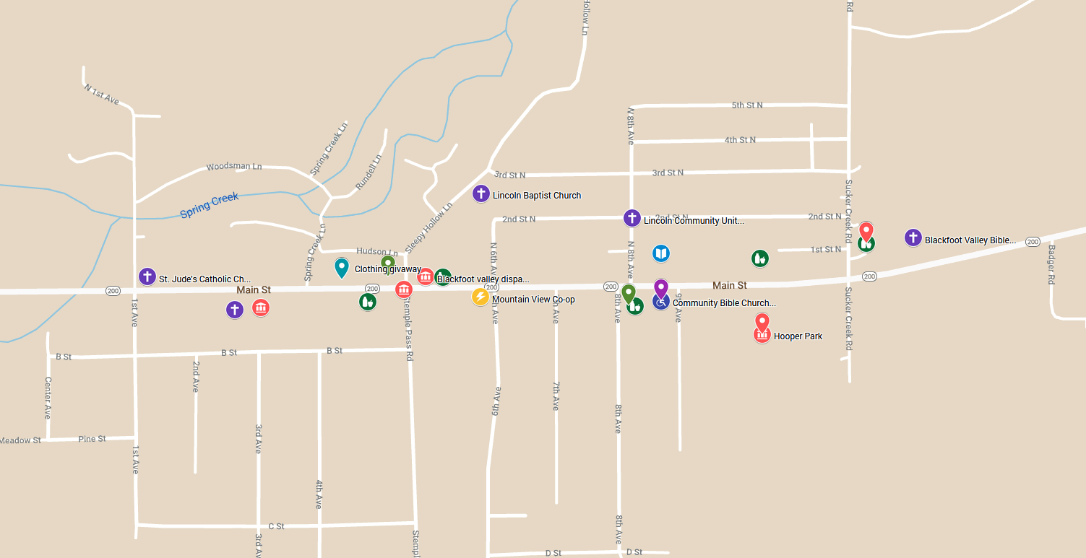
Rural Resource Mapping: A Demonstration of Mapping Community Resources
Lillie Greiman and Genna Mashinchi
The Research and training Center on Disability in Rural communities (RTC:Rural)

Slide 2
In this workshop we will:
Provide an overview of Resource mapping and the project that the RTC:Rural is engaging with CILs on
Discuss different types of community living resources
Discuss how to identify resources in your community
Demonstrate how to build your own community resource map
Learn how to get involved in this project

Slide 3
What is Resource Mapping?
Resource mapping is a strategy that communities can use to build local partnerships, and plan activities, and promote shared values.
A resource map is a tool that engages local stakeholders in activities to identify the services and supports that are available to people with disabilities in the community.

Slide 4
Why map?
To better understand the communities you serve
To make expand your community connections
Connect consumers to local resources
Communicate to funders about resources and community connections
Provide timely support in disasters

Slide 5
Defining Community Living Resources
A community living resource is anything that can be used to improve the quality of community life for people with disabilities. It can be:
An organization
A community service
A place
A person or group of people
A local business
MORE!?

Slide 6
Community Living Needs
Independent living skills training
Housing (affordable/accessible)
Home modification/repair
Accessible health care
Home health care
Personal assistance services
Transportation options
Employment opportunities
Food security
Peer support
Mental health care
Opportunities for community engagement
Others?

Slide 7
Let’s get mapping!
If you have a google account, you can map alongside me!
Otherwise follow along using the materials you can download from the conference website.
Google my maps: https://www.google.com/maps/about/mymaps/
Notes:
This is where I will start to share the screen and go through the tutorial

Slide 8
Get involved and join our project!
What will you do?
What will you get?
Meet with RTC team weekly (initially)
Devote 1-2 additional hours a week to identify resources and develop connections
Help coordinate 1-2 community meetings (virtually right now) to engage with community resources on the project
Learn about disability in the rural communities you serve
Data and statistics
Develop a local community living needs resource list and interactive map
Connect with other organizations in the community
Receive a final report with local disability data and information about local resource connections.

Slide 9
Questions, contact info and resources
A video of this presentation will be available for you to access
You can download all the materials on the APRIL conference website
Questions/want to get involved?
Lillie.Greiman@umontana.edu
Funding statement: This work was supported by the Research and Training Center on Disability in Rural Communities (RTC:Rural) under a grant from the National Institute on Disability, Independent Living, and Rehabilitation Research (grant number 90RTCP0002-01-00). NIDILRR is a Center within the Administration for Community Living (ACL), Department of Health and Human Services (HHS). The research does not necessarily represent the policy of NIDILRR, ACL, or HHS and one should not assume endorsement by the federal government.

