Slide 1
Realizing Rural Relationships: Peer Support for Rural Outreach and Organizing
The Rural Community Living Development Peer Mentoring Team October 11, 2022

Slide 2
What you can expect today
Brief introduction to the Rural Community Living Development Peer Mentoring Program
Focused discussions on three rural outreach and organizing topics
Outreach through new programming
Reaching underserved communities
Building non-traditional relationships
Wrapping up and how to get involved

Slide 3
The RCLD Peer Mentoring Program
Rayna Sage
Lillie Greiman
The RCLD curriculum and peer mentorship model

Slide 4
Activity
What is one word you would use to describe rural outreach?

Slide 5
Outreach through new programming
Stephanie Deible, Disability Network West Michigan
Dori Tempio, Able South Carolina

Slide 6
Advocacy Day for Access and Independence

Slide 7
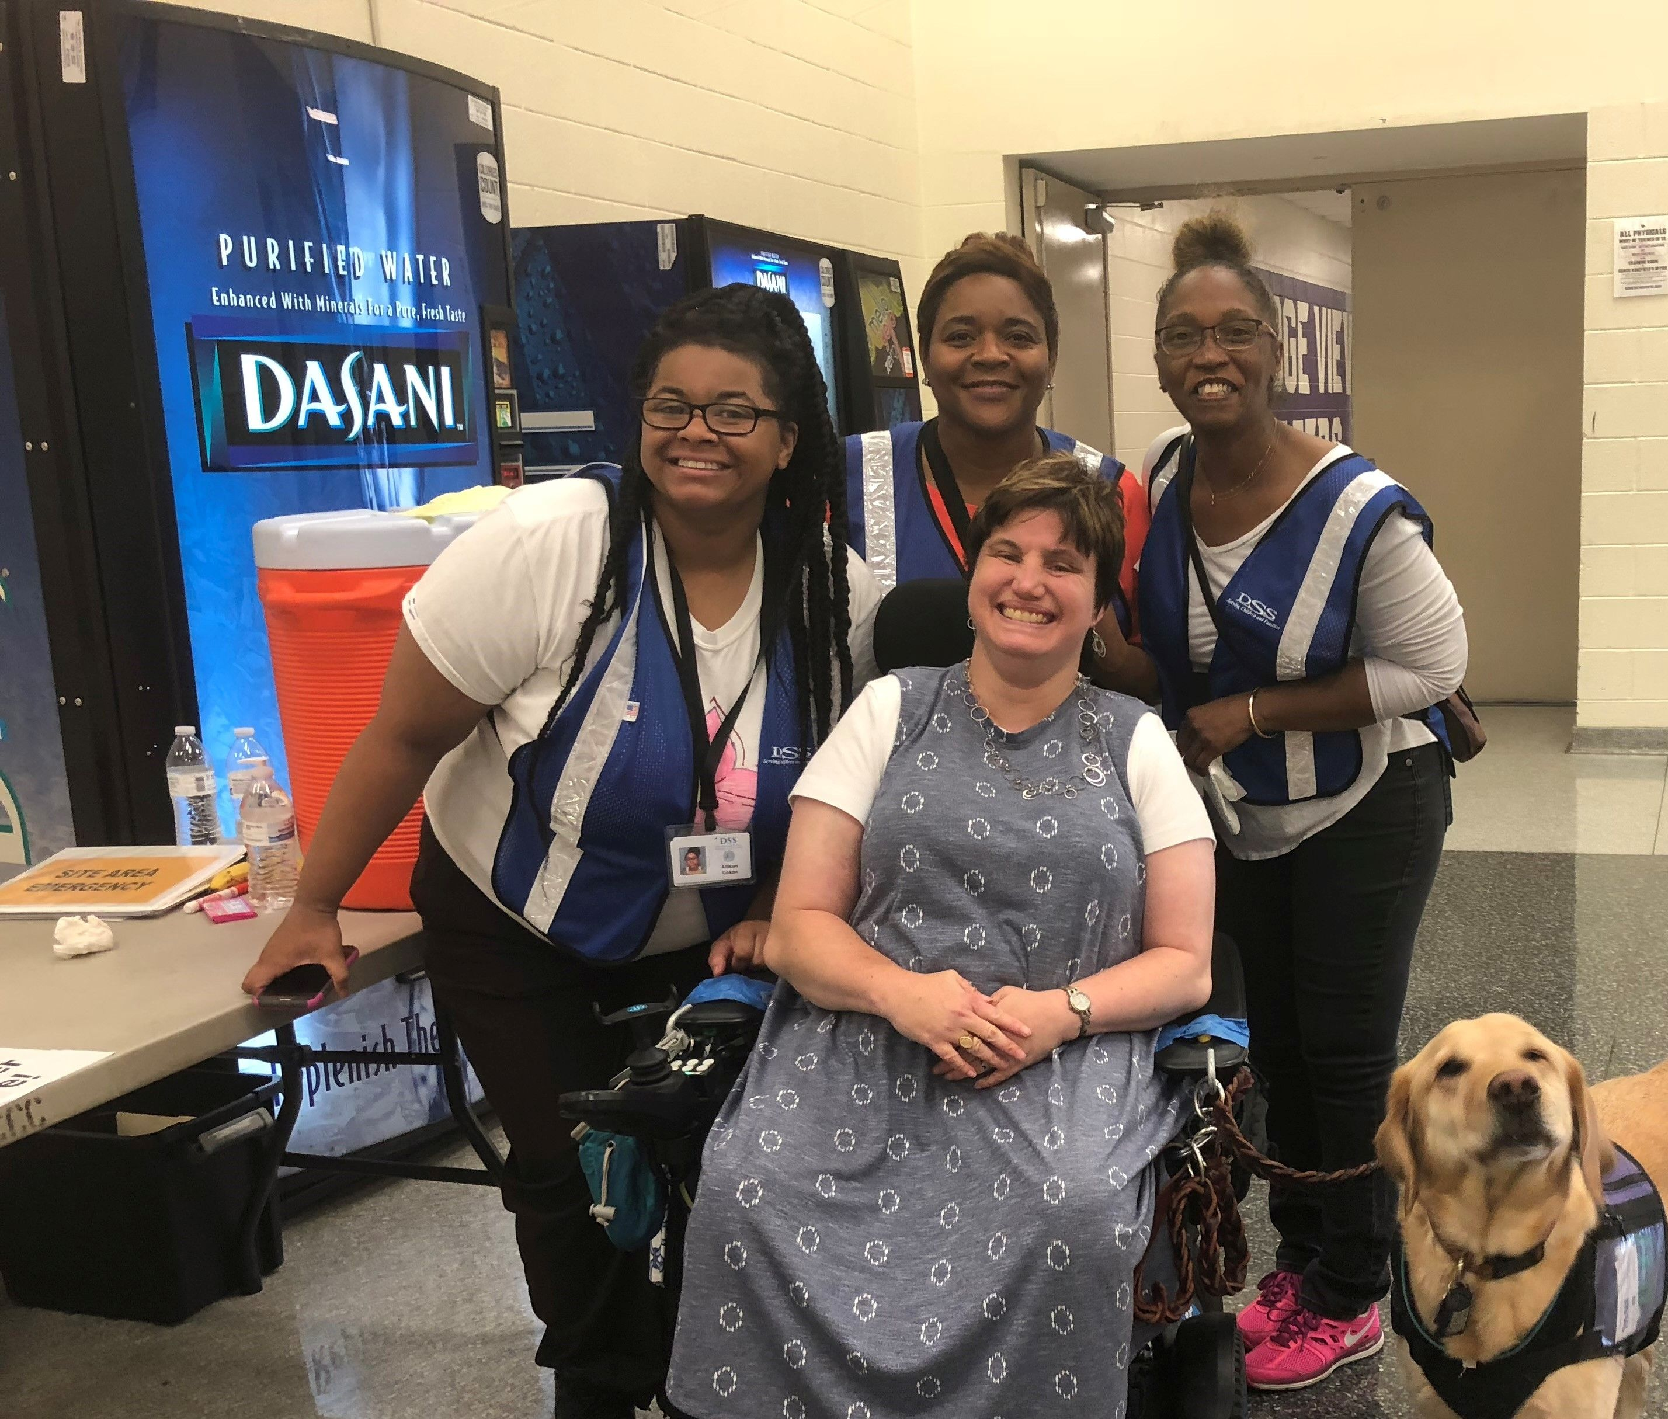
South Carolina Disability Partners in Disaster Coalition

Slide 8
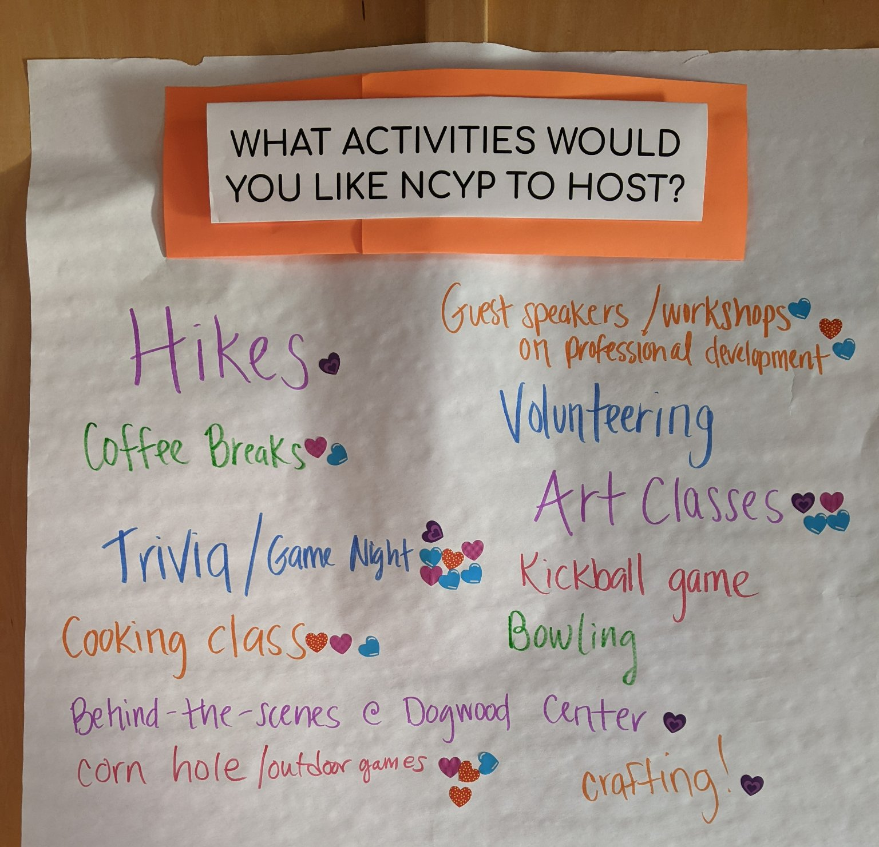
Young Professionals Group

Slide 9
Reaching underserved communities
Sequoia Commins, Tri-County Independent Living
Tessa Hickman, Valley Associates for Independent Living

Slide 10
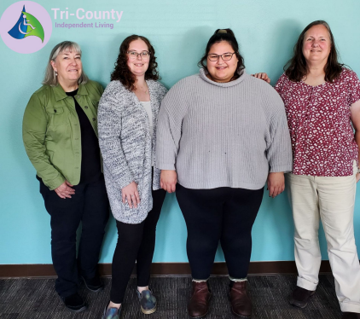
Your Del Norte Team
Carolyn Webb
Office Manager
Sequoia Commins
Independent Living Skills Specialist
Trish Cottrell
Program Development Specialist
Samantha Nickles
Youth Coordinator

Slide 11
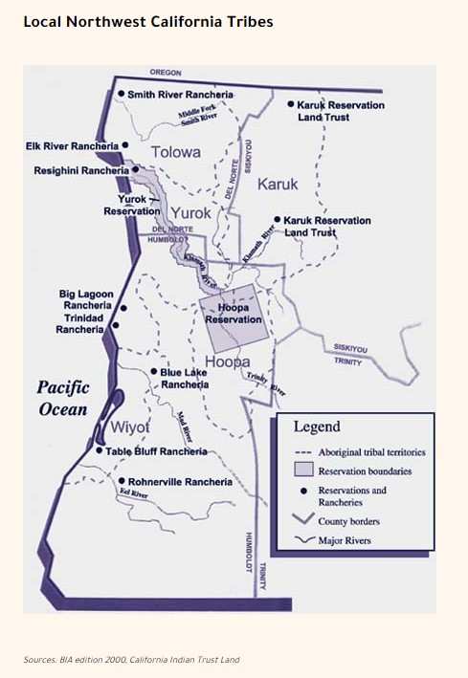
Del Norte and Tribal Adjacent Lands (DNATL)
Del Norte and Tribal Adjacent Lands (DNATL)
Tolowa Dee-Ni’ Nation
https://www.tolowa-nsn.gov/
Elk Valley Rancheria
https://elk-valley.com/
Yurok Tribe
https://www.yuroktribe.org/

Slide 12
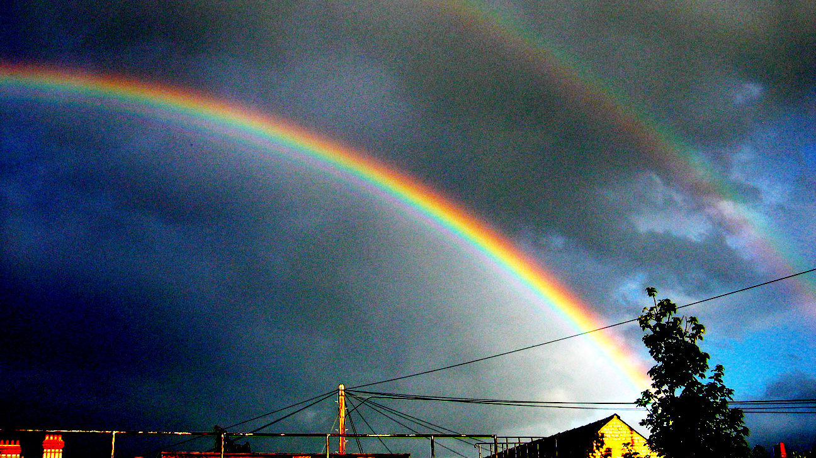
A Quick Fact
Del Norte County has 9.7% reported demographic of Native American persons (April 2021)
Our Work is Important!

Slide 13
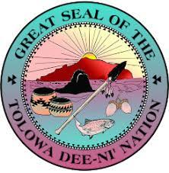
Coordinating with Tolowa Dee-ni’ Nation
Authenticity
Respect
Patience
Humility
Left: Seal of Tolowa Dee-Ni’ Nation Right: Tolowa Dunes State Park

Slide 14
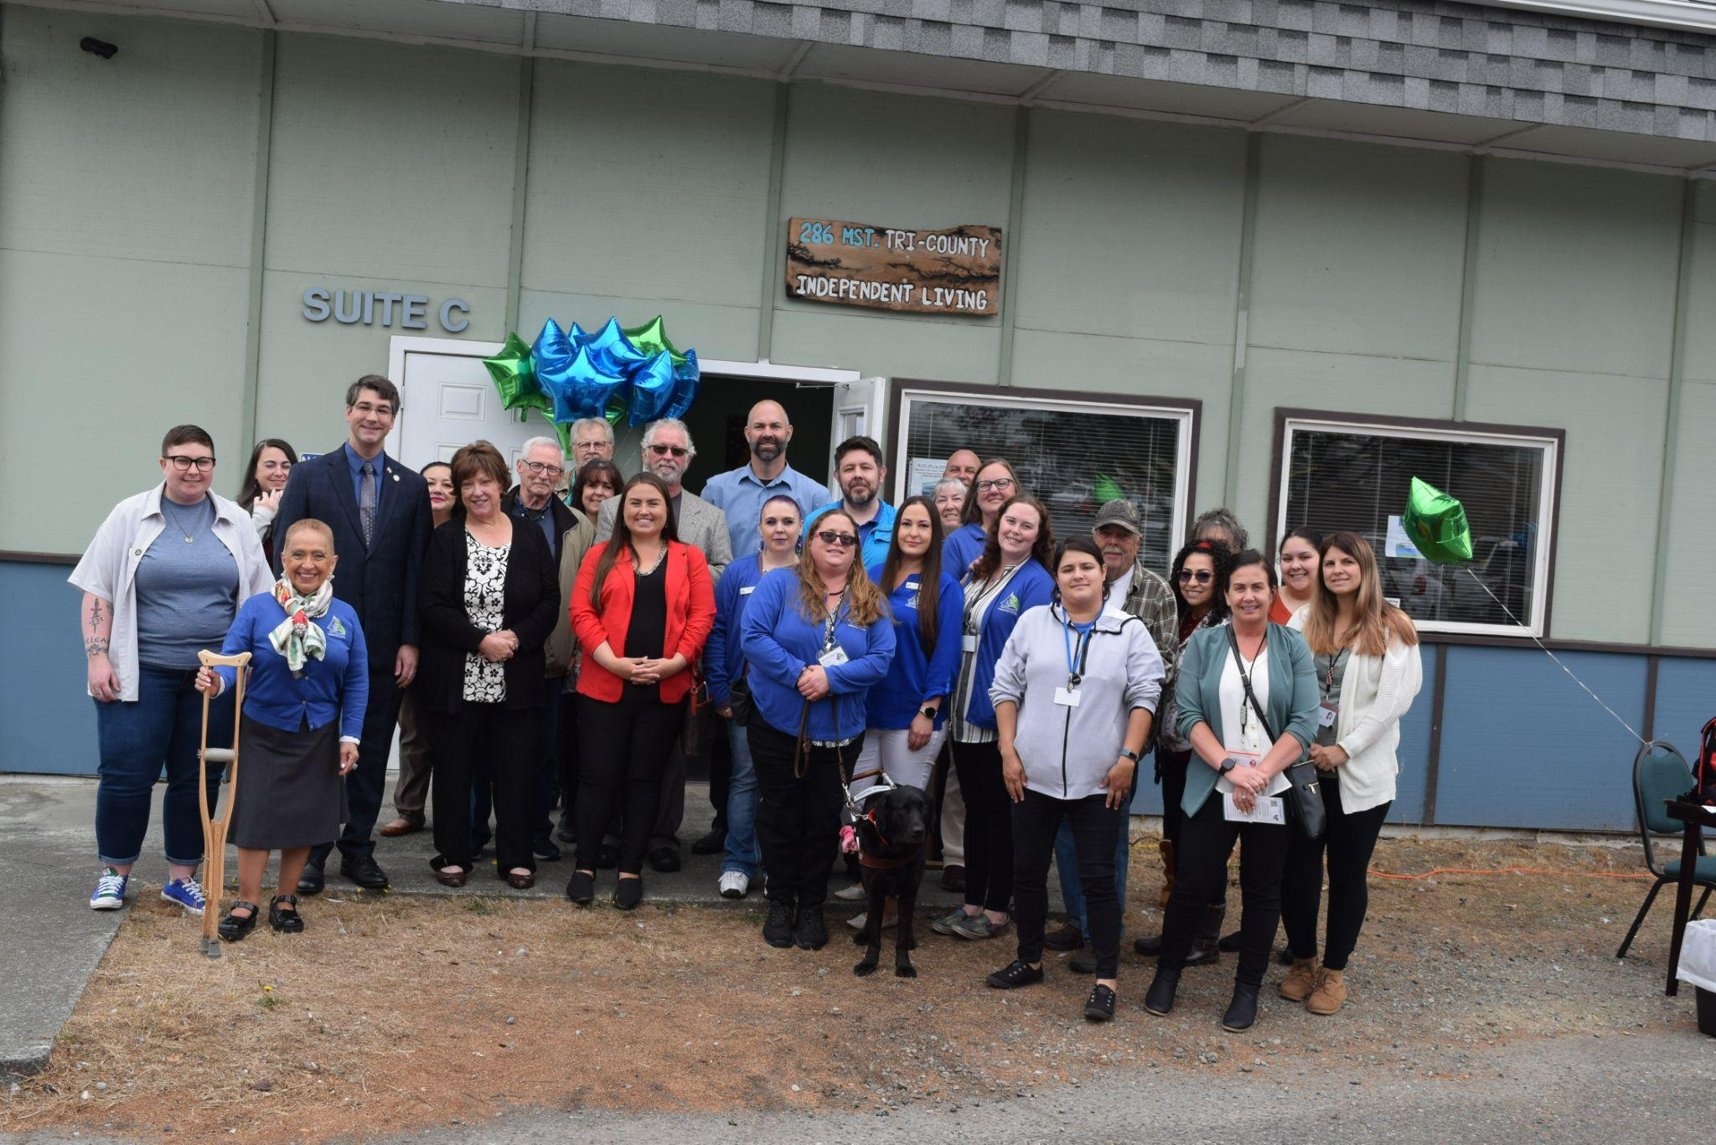
Community is Everything
Left: Tri-County Independent Living Del Norte Grand Opening
Honoring communities that came before us honors the future as well

Slide 15
Examples of Collaboration
Examples of Collaboration
Sharing Resources Direct advertisement to proper tribal connections. Public facing and agency facing education and cultural priming
Participating in Tabling Events Starting from the Elder Resource Fair
Being Teachable

Slide 16
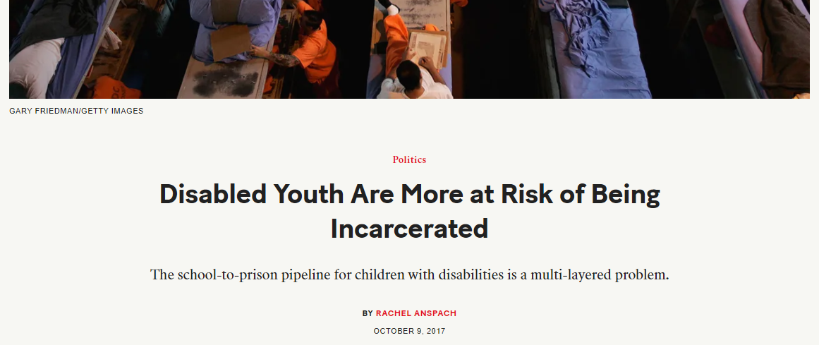
Reaching underserved communities
Tessa Hickman, Valley Associates for Independent Living

Slide 17
Building non-traditional relationships
Hank Bostic, Disability Network Southwest Michigan
Quinn Durrant, North West Georgia Center for Independent Living

Slide 18
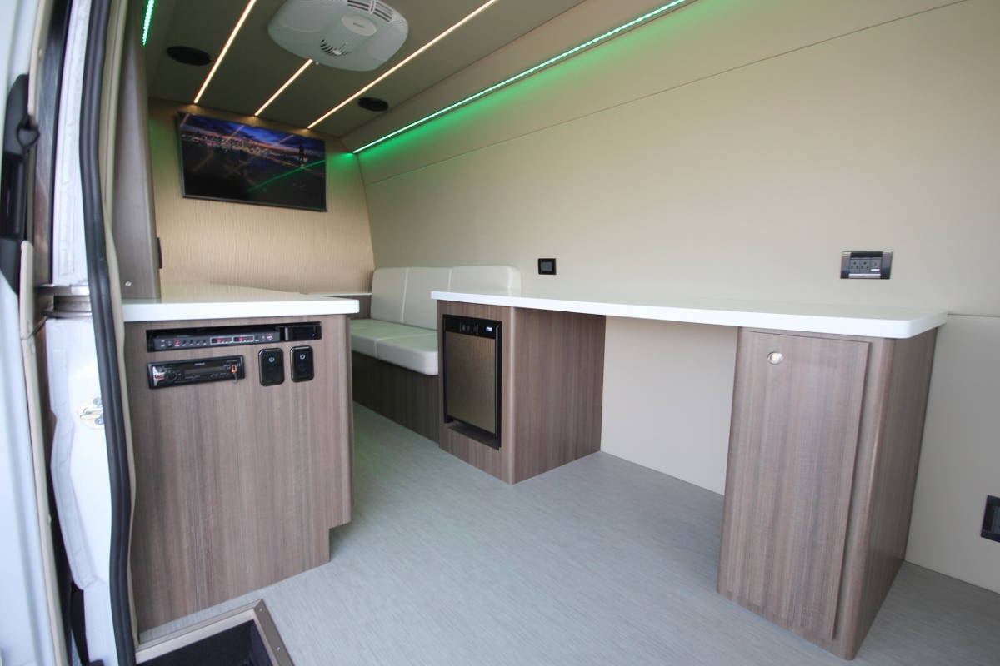
Building non-traditional relationships
Hank Bostic, Disability Network Southwest Michigan

Slide 19
Building non-traditional relationships Continued
Quinn Durrant, North West Georgia Center for Independent Living

Slide 20
Main takeaways and open discussion
Rural outreach is thinking outside the box
Non-traditional partners outside of disability network
Bringing people from disability community together with non-disabled people
Raising awareness that disability impacts us all
Elevating disability culture and pride, especially with underserved and marginalized communities

Slide 21
How to get involved
Become a mentee and join us for an in-person meeting in April!
Problem-solve and strategize with the RCLD team
Get support to use RCLD resources
Contact Rayna Sage rayna.sage@umontana.edu or drop your contact in the chat

Slide 22
Grant Acknowledgement
The contents of this presentation were developed under a grant from the National Institute on Disability, Independent Living, and Rehabilitation Research (NIDILRR grant number 90DPKT0005). NIDILRR is a Center within the Administration for Community Living (ACL), Department of Health and Human Services (HHS). The contents of this fact sheet do not necessarily represent the policy of NIDILRR, ACL, or HHS, and you should not assume endorsement by the Federal Government.

