Slide 1
History of Disabilities Portrayal in Media
By Noah Russell
Notes:
Media in all forms affects how we view culture and how the world perceives it. Media has always had an effect on culture whether we know it or not. When we discuss media for this presentation we will be focusing on visual media which include Theatrical, movie, and tv displays.

Slide 2
How the Media Affects Culture
Notes:
Media in all forms affects how we view culture and how the world perceives it. Media has always had an effect on culture whether we know it or not. When we discuss media for this presentation we will be focusing on visual media which include Theatrical, movie, and tv displays.

Slide 3
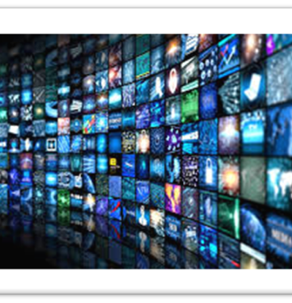
How Media Negatively Affects Culture
Notes:
While Media can affect culture, it can also be a negative force on it as well. When people talk about negative stereotypes they often make it more towards race, gender, sexuality, and intelligence. This is due to how people actively perceive the media and how they allow it to influence their views on the things and others that are not themselves.

Slide 4
1960’s era

Slide 5
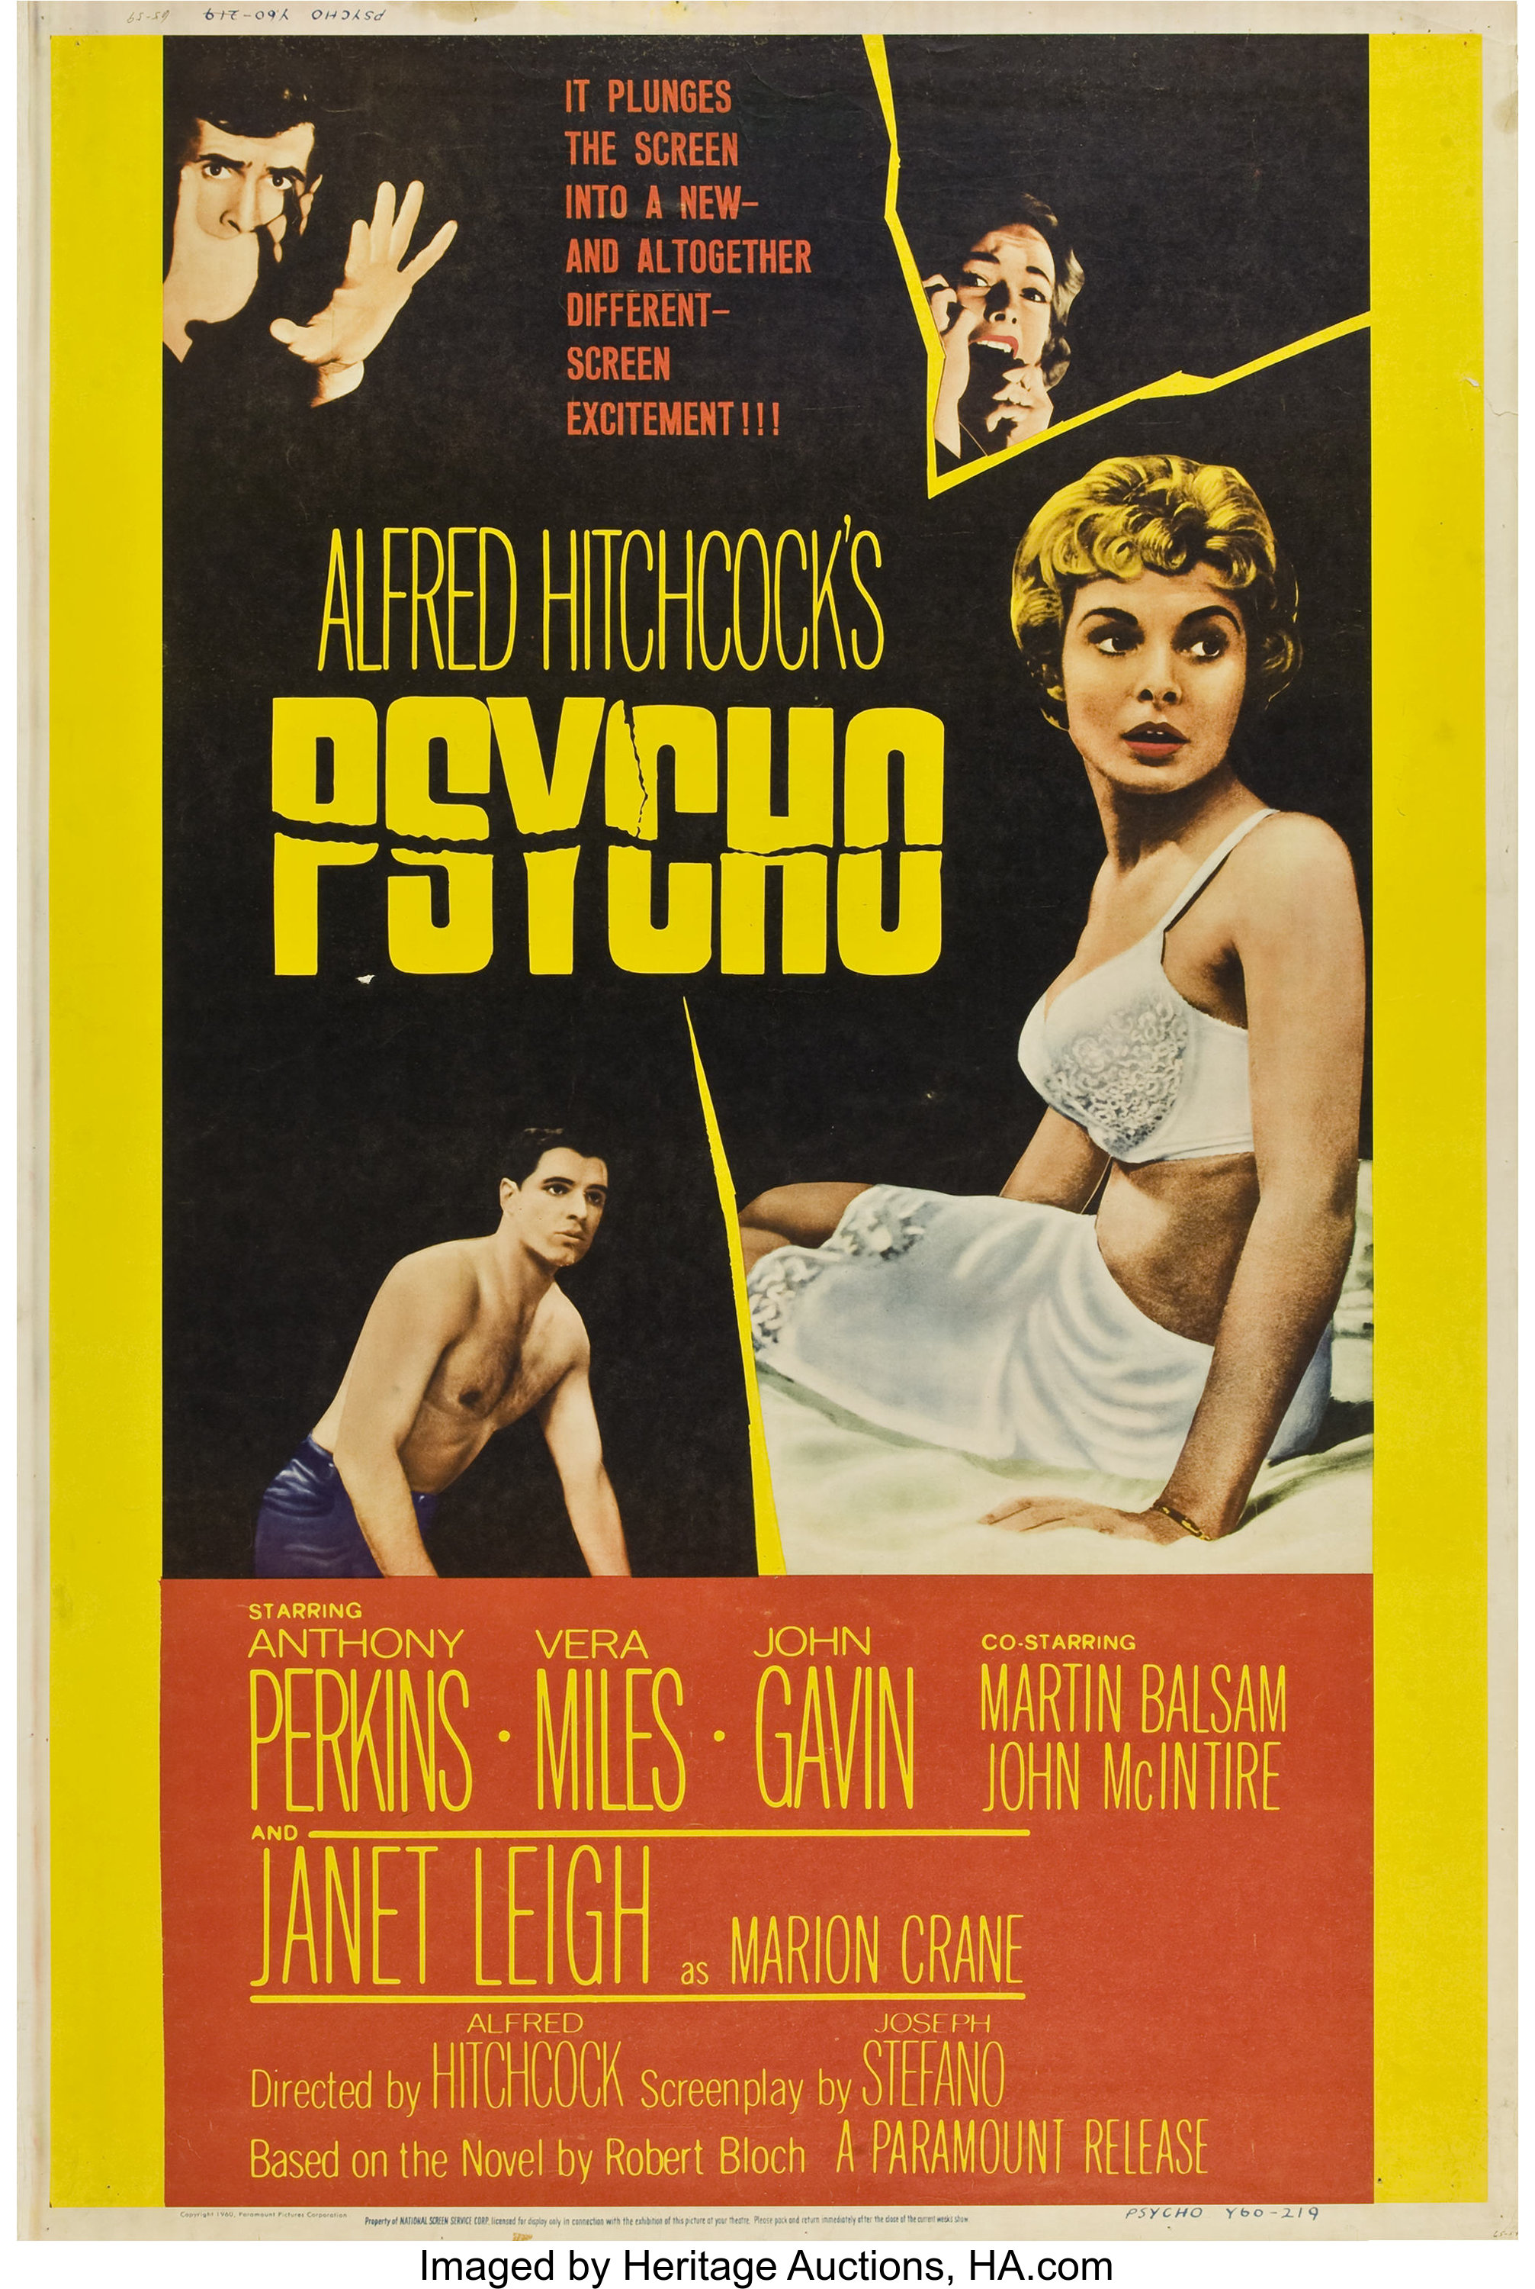
Psycho

Slide 6
Sesame Street

Slide 7
1970’s era

Slide 8
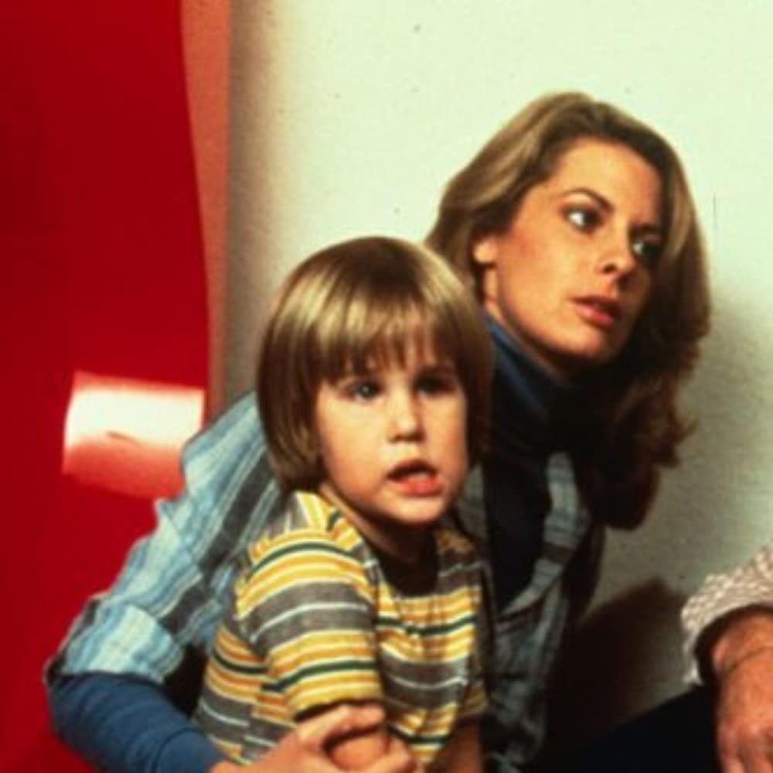
Son-Rise: A Miracle of Love

Slide 9
1980’s

Slide 10
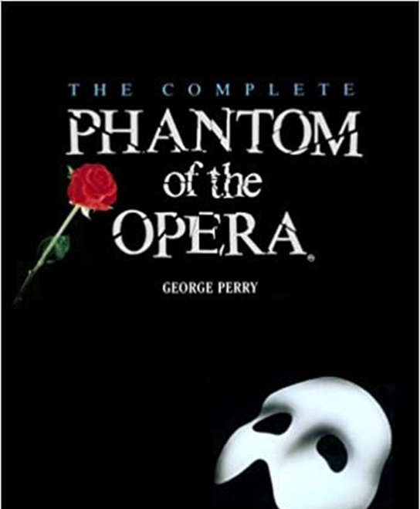
Phantom of the Opera

Slide 11
1990’s

Slide 12
Musical Media

Slide 13
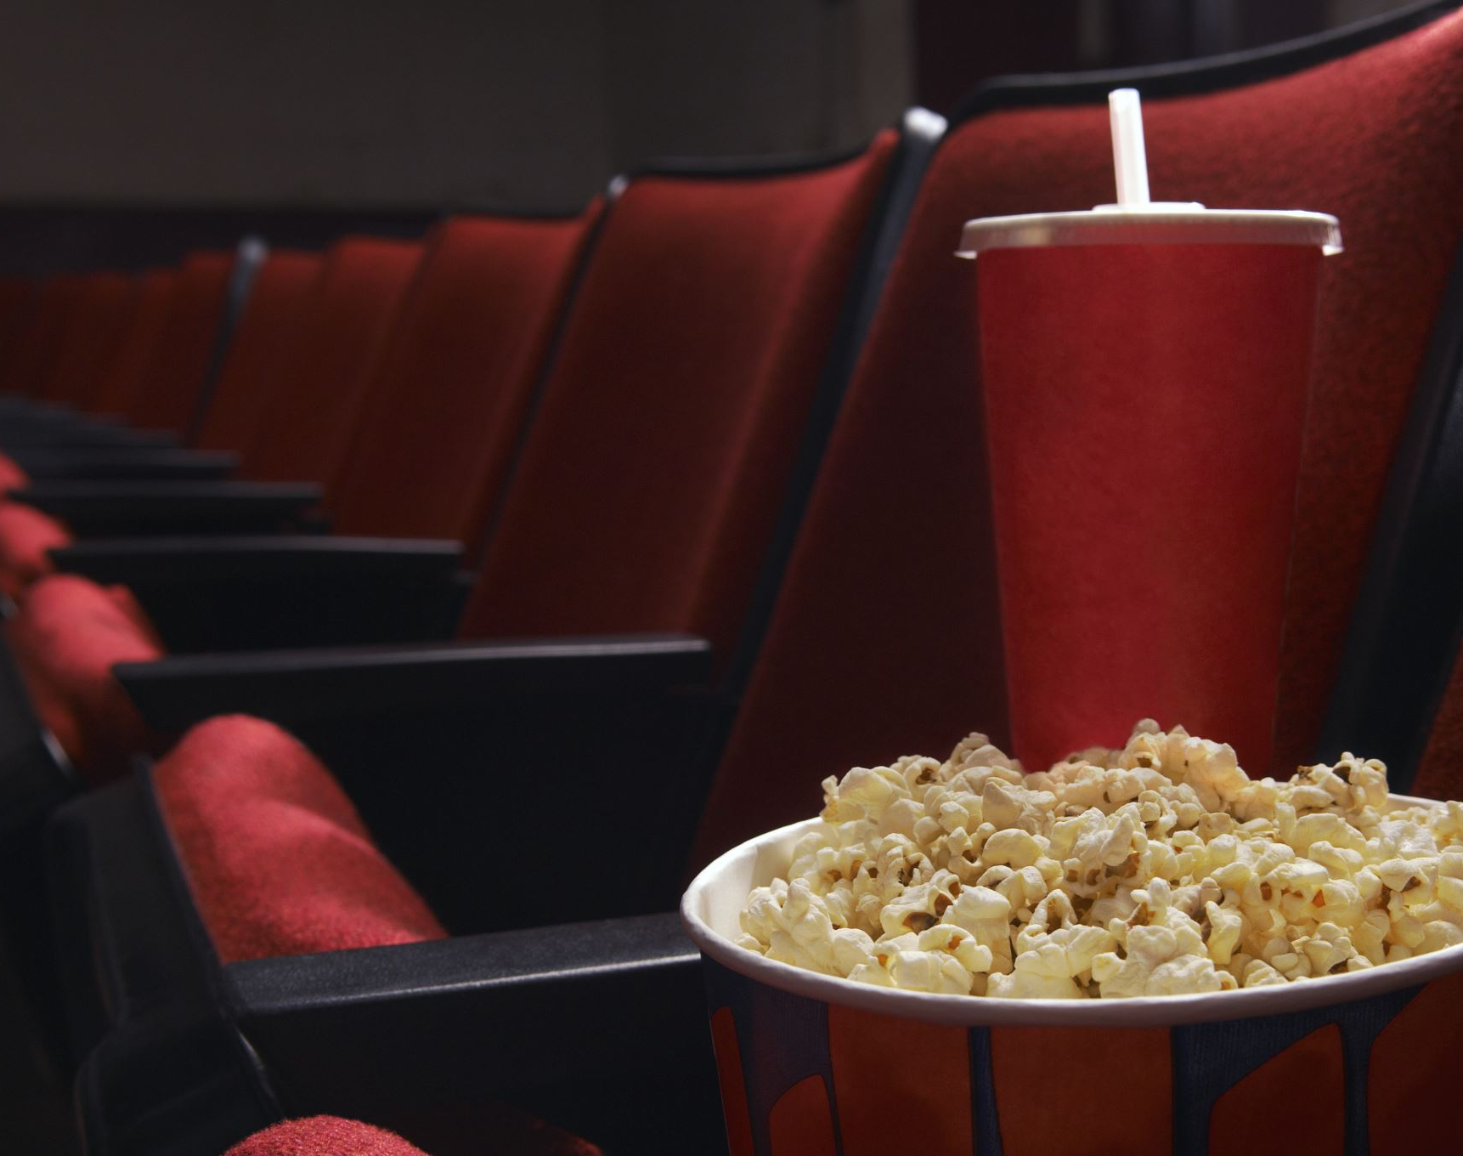
TV and Movie Media

Slide 14
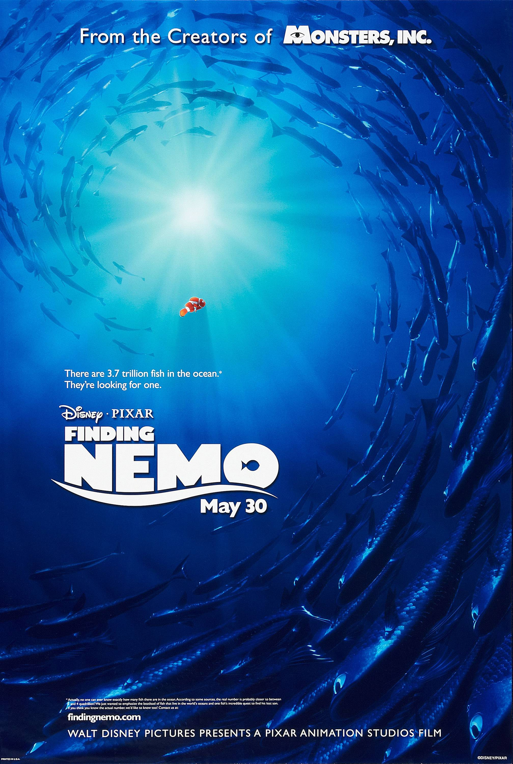
2000’s Era

Slide 15
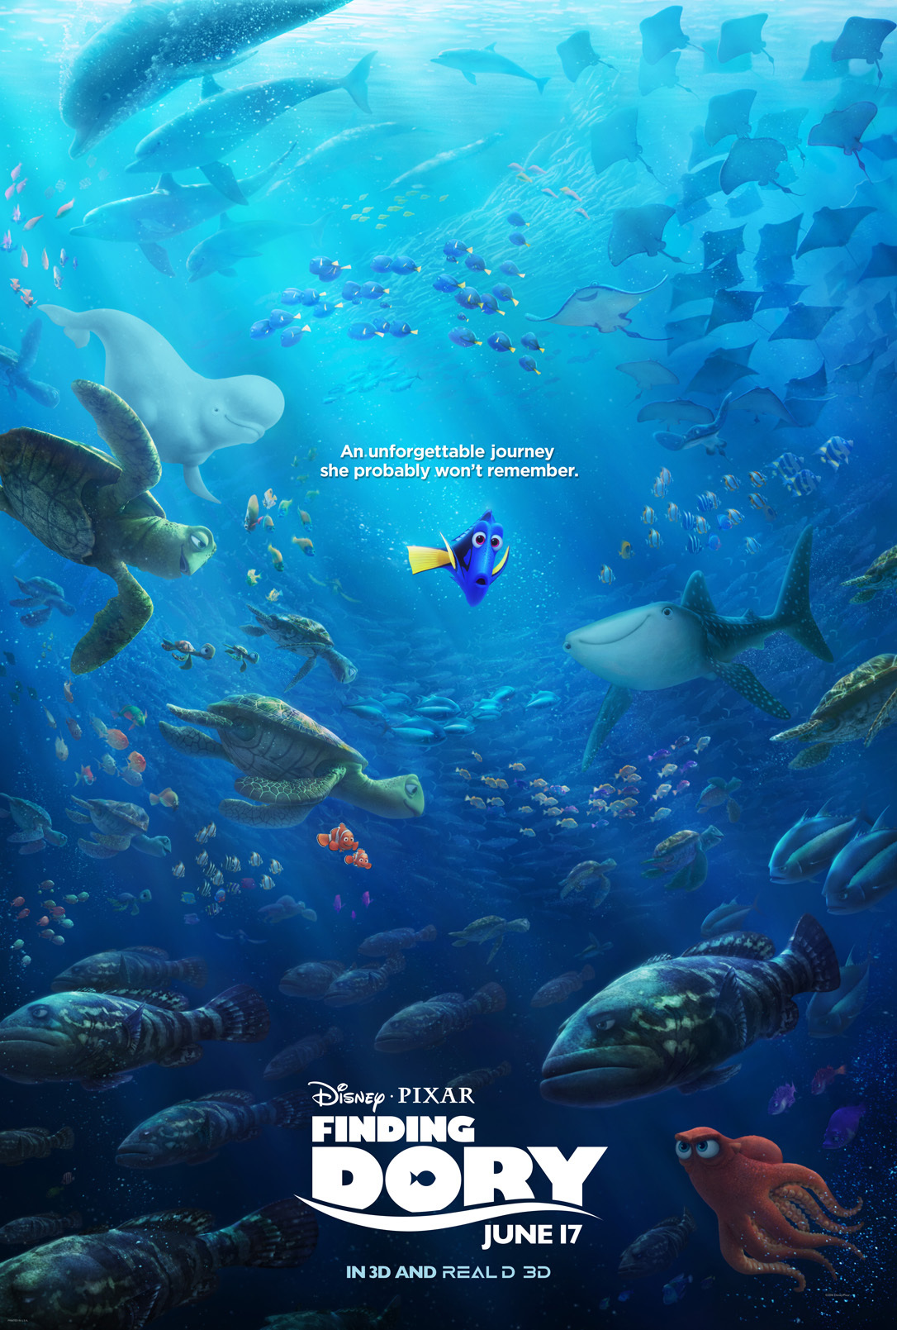
2010’s Era

Slide 16
Conclusion

Slide 17
Questions
321-543-6657
Email
nzr2526fl@gmail.com
Discord
Scorpion521678#2408
Contact me here if you want to learn more and want to discuss what we were talking about
Noah Russell

