Slide 1
Healthy Community Living

Slide 2
Hosting Independent Living Workshops Online
Tannis Hargrove & Amy Lariviere
Project Director & Training Associate at RTC:Rural

Slide 3
WELCOME
Thank you for joining us today!

Slide 4
Disclosure
The contents of this presentation were developed under a grant from the National Institute on Disability, Independent Living, and Rehabilitation Research #90RTCP0002-01-00. NIDILRR is a Center within the Administration for Community Living (ACL), U.S. Department of Health and Human Services (HHS).
The contents and opinions expressed reflect those of the authors, are not necessarily those of the funding agency, and should not assume endorsement by the Federal Government.

Slide 5
Today’s Presentation
Independent Living Workshops
What is Healthy Community Living?
Overview of Workshops & Trainings
Hosting Workshops at your CIL
Consumer Outreach & Recruitment
Facilitating Online Workshops online, in-person & hybrid
Demonstration of Living Well Orientation

Slide 6
Hosting Workshops
One staff member can facilitate, or two staff members co-facilitate the workshop together as a team
Workshop can happen online, in-person, or a combination of both (hybrid)
Schedule a start date - for example: Wednesdays at 1 p.m.
Plan to meet each week for 11-weeks

Slide 7
Facilitator Training
For our Healthy Community Living program, we provide facilitator training and resources for each workshop specifically
We also offer a Facilitating Groups Training for individuals who are new to workshop facilitation or would like to brush up their skills
Whatever workshop you are providing, start by becoming familiar with the content you would like to discuss in your group

Slide 8
Now Offering Live Facilitator Trainings
Facilitator trainings for all of our HCL programs will be conducted with a live trainer, Amy Lariviere
Trainings will be hosted on Zoom and include 4, 2-hour sessions
Trainings will provide an opportunity for facilitators to meet and connect with one another, and gain live feedback from our trainer
Trainings are new this year and will begin with the Living Well in the Community training
Please check our website for complete details
www.healthycommunityliving.com

Slide 9
Recruitment & Outreach Strategies
Email flyers to current consumers and community partners
Let all the IL Staff in your organization know about the workshop as they may know individuals who will be interested
Contact other organizations or referral agencies and let them know about the workshop

Slide 10
More Recruitment & Outreach Strategies
Post workshop details on social media
Call your consumers and ask them about joining a workshop
Attend outreach events virtually (conferences, community events)
Sign up page via your website (Eventbrite, etc.)

Slide 11
What is Healthy Community Living?
A group of online workshops ready to use online, in-person, or hybrid
A series of workshops for people with disabilities that include group discussions on topics relevant to their lives
Facilitators present slides from the HCL website to consumers, either in-person, online, or some combination of both

Slide 12
What does Healthy Community Living do for Participants?
Focuses on improving quality of life and building self-determination, relatedness, autonomy & supports
Fosters peer connections and peer support in an independent living setting

Slide 13
Healthy Community Living Includes which Workshops and Trainings?
Includes three peer-led IL skills workshops & facilitator trainings for each:
Community Living Skills
Living Well in the Community
Working Well with a Disability
As well as a general facilitation training for any group peer-led workshop:
Facilitating Groups Training

Slide 14
Who is Healthy Community Living For?
Healthy Community Living is for anyone
It can be a great way to connect with consumers, reduce isolation, and help people meet their goals while staying at home

Slide 15
Community Living Skills
11-week workshop within the HCL program
Focused on building skills for living independently
Includes an online Facilitator Training

Slide 16
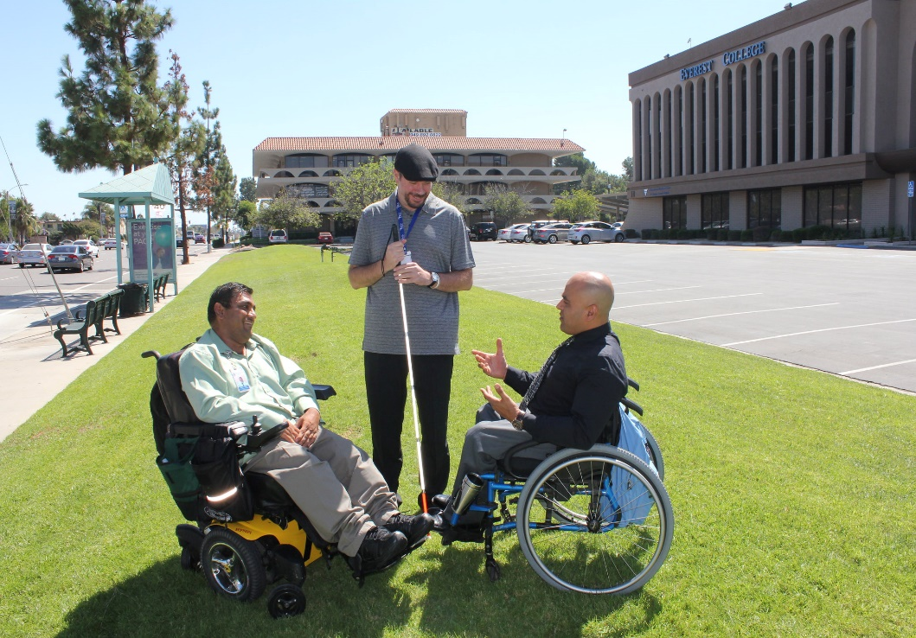
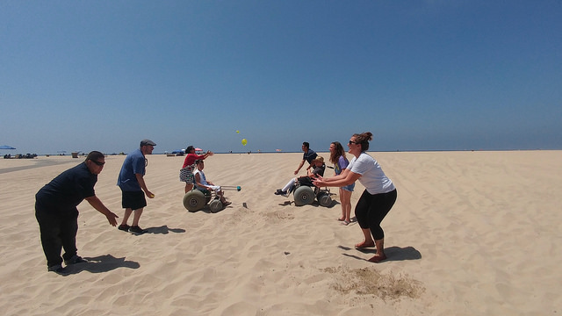
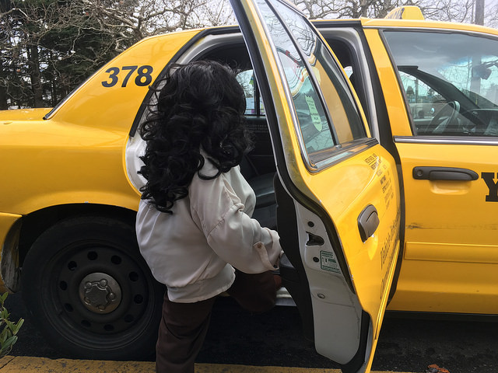
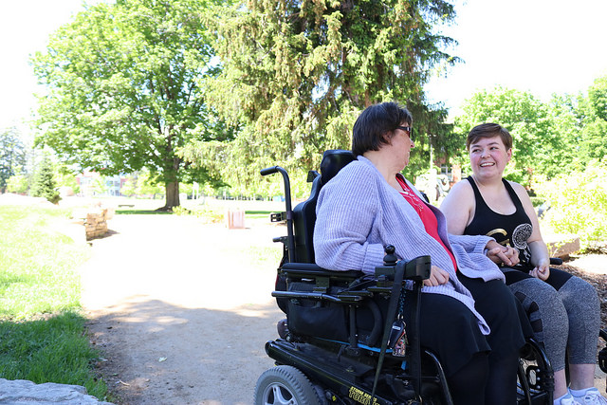
Community Living Skills Workshop Topics
Orientation
Disability Identity
Peer Support
Self-Advocacy
Self-Care
Housing
Technical Skills
Budgeting & Finance
Transportation
Time Use

Slide 17
Living Well in the Community
11-week program within the HCL program
Focused on setting goals to improve overall quality of life and wellbeing
Adapted from our older workbook-based program Living Well with a Disability

Slide 18
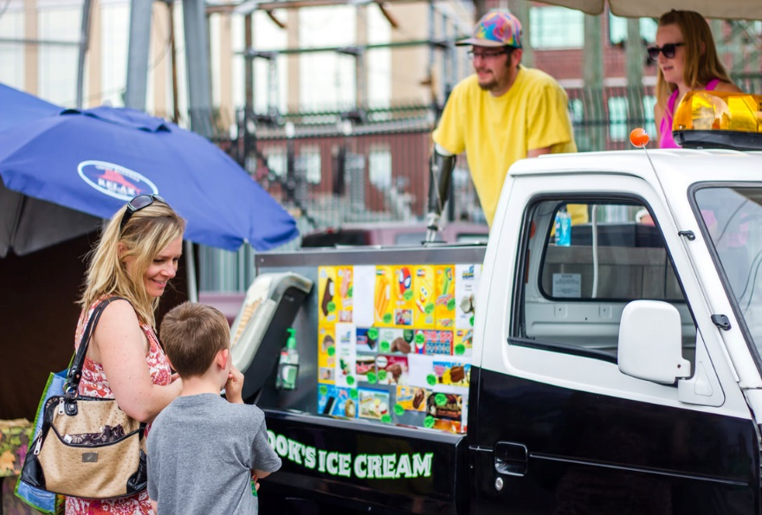
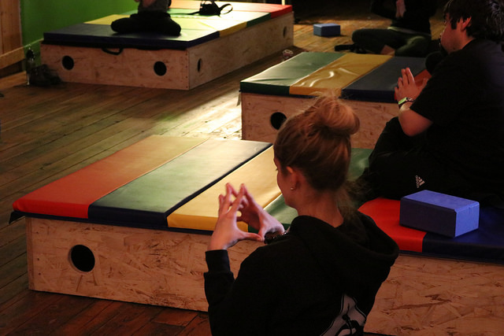
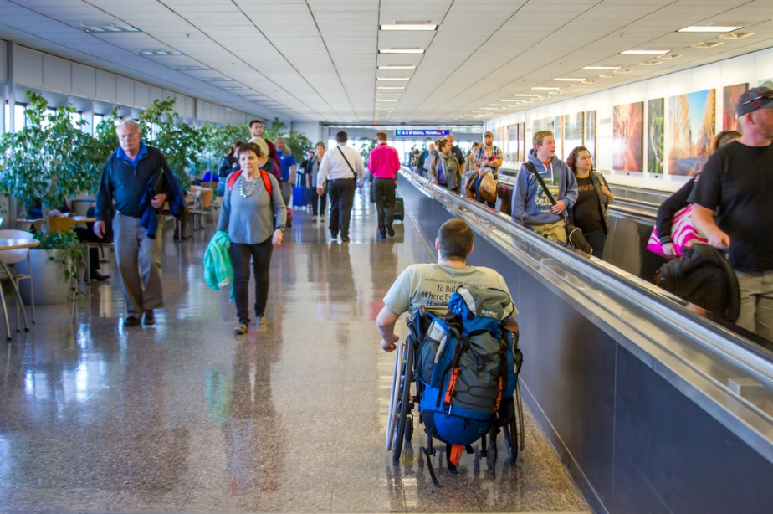
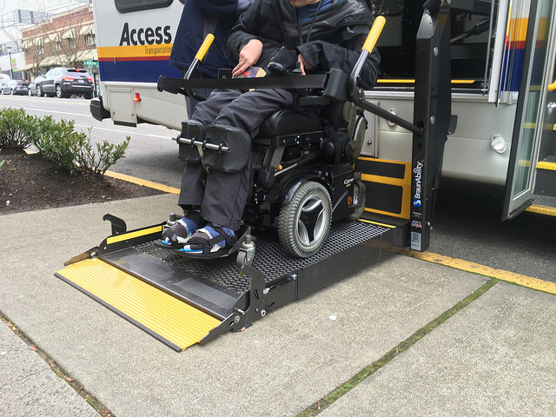
Living Well in the Community Workshop Topics
Orientation
Goal Setting
Building Support
Healthy Reactions
Staying On Course
Healthy Communication
Seeking Information
Eating Well
Physical Activity
Advocacy
Maintenance

Slide 19
Working Well with a Disability
Working Well with a Disability is meant to build on the Living Well in the Community program
Working Well focuses on the balance between health and transition to employment
Focus on balancing health and employment

Slide 20
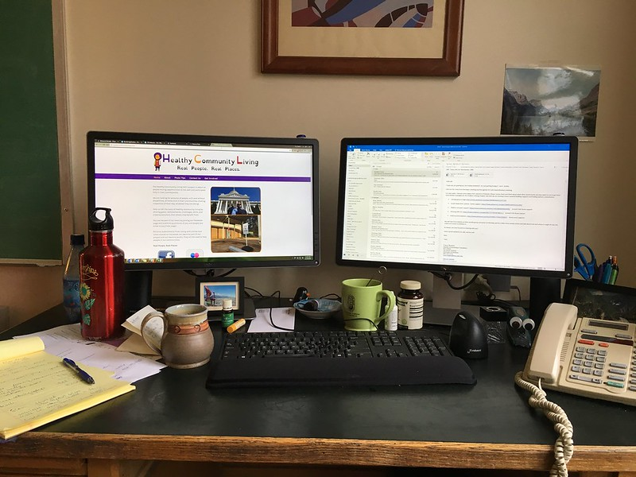
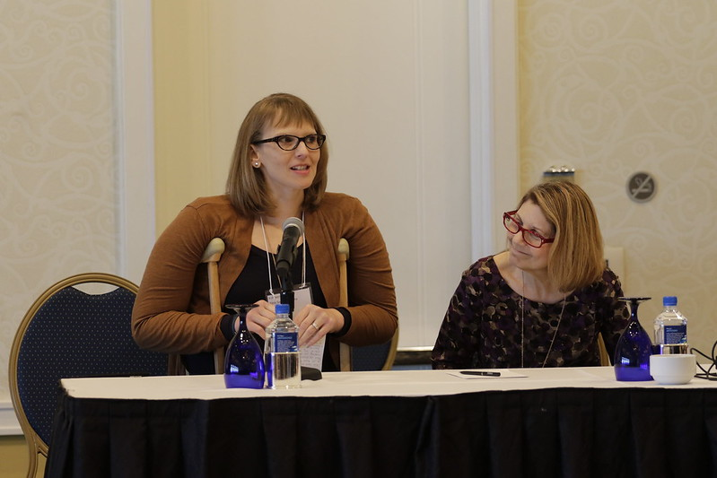
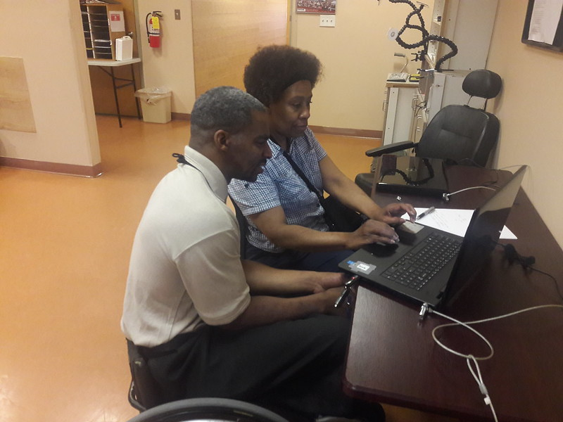
Working Well Workshop Topics
Orientation
Working for Your Values
The Great Balancing Act
Stress & Working Well
The Power of Advocacy
Balancing through Physical Activity
Eating Well to Live Well
Maintaining a Healthy Balance

Slide 21
Facilitating Groups Training
Facilitating Groups is about learning general tips and skills to be a facilitator in peer-led settings
Develop skills, such as asking questions to facilitate positive behavior change

Slide 22
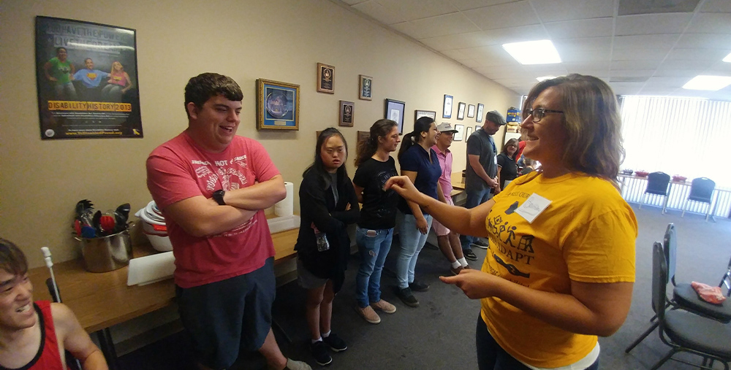
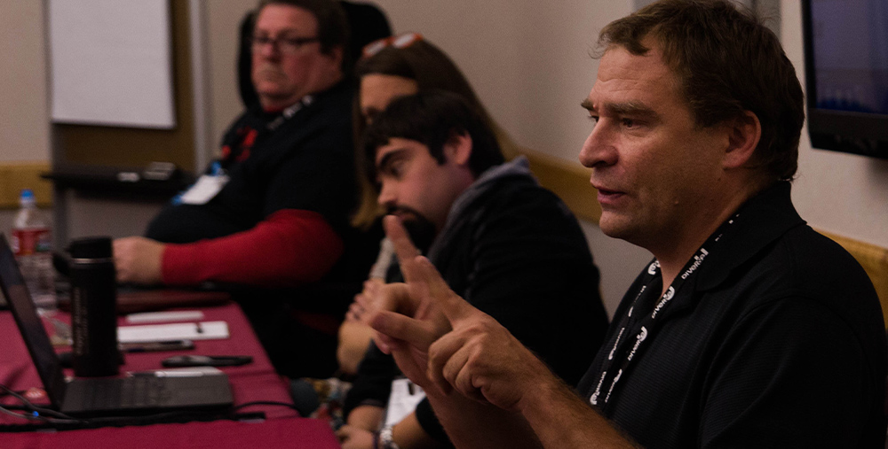
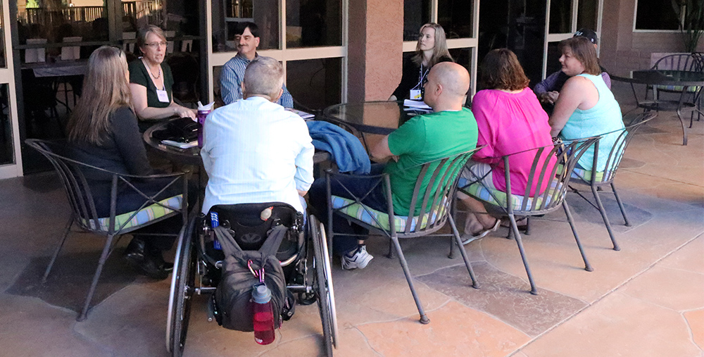
Facilitating Groups Training Topics
Foundations
Relationships
Active Listening
Behavior Change
Sharing Your Story
Asking Questions
Direct Communication
Referrals
Facilitating Self-Care
Accessibility

Slide 23
Living Well in the Community Demonstration of Orientation Session

Slide 24
Living Well Orientation – Introduction Tab

Slide 25
Disability & Health Is a Healthy Lifestyle Important?

Slide 26
Disability & Health People with Disabilities Can be Healthy

Slide 27
Disability & Health The Healthier You are, The More You Are Able To Do

Slide 28
Living Well Orientation – What is Health? Tab

Slide 29
Health is… Quality of Life

Slide 30
Health is… Quality of Life Continued

Slide 31
Health is… A Means to an End

Slide 32
Health is… Habits and Health

Slide 33
Health is… Creating New Habits

Slide 34
Health is… Habits Discussion

Slide 35
Health is… Conscious Choices

Slide 36
Living Well Orientation – Ready for Change? Tab

Slide 37
Evaluating Your Readiness Are you Ready?

Slide 38
Are You Ready? Importance and Confidence

Slide 39
Are You Ready? Readiness

Slide 40
Are You Ready? Becoming Confident
Notes:
Last slide for Orientation Demonstration

Slide 41
What have participants said?
“I learned I can help others if they need help by giving them resources.”
“The classes were rewarding and resourceful.”
“I learned how to advocate and eat healthier. I also learned how to identify reactions and how to converse with others.”
“I learned that inside disabilities are important to keep in mind and advocate for myself.”
“Our material was very useful and informative!”

Slide 42
Additional Resources Included
Facilitator training for all three workshops
Recruitment brochures and materials
Certificates of completion for consumers and facilitators
Additional resources for each weekly session including full length videos, additional worksheets, and supplementary information
Photos and videos of real people in real places

Slide 43
APRIL Facilitator Interview Montage Video Description
Montage of staff from Centers for Independent Living who facilitated Healthy Community Living workshops sharing their experiences, alternating speakers throughout.
Charles Oaks - Disability Partners - A man with brown-grey hair, and a short mustache and beard
Casey Schmidt - Wyoming Independent Living - A man with short brown hair, a thick brown mustache and beard, and glasses
Kelly Ritter - Future Choices Inc. - A woman with long brown hair and glasses
Jessica Adkins - Access II - A woman with long, wavy red hair

Slide 44
Video from Workshop Facilitators
Notes:
Remember to click CC for captions

Slide 45
Questions or Comments?
www.healthycommunityliving.com
healthycommunityliving@mso.umt.edu
tannis.hargrove@mso.umt.edu
amy.lariviere@mso.umt.edu

