Slide 1
Expanding, Engaging & Energizing Peer Support Groups
Expanding, Engaging & Energizing Peer Support Groups

Slide 2
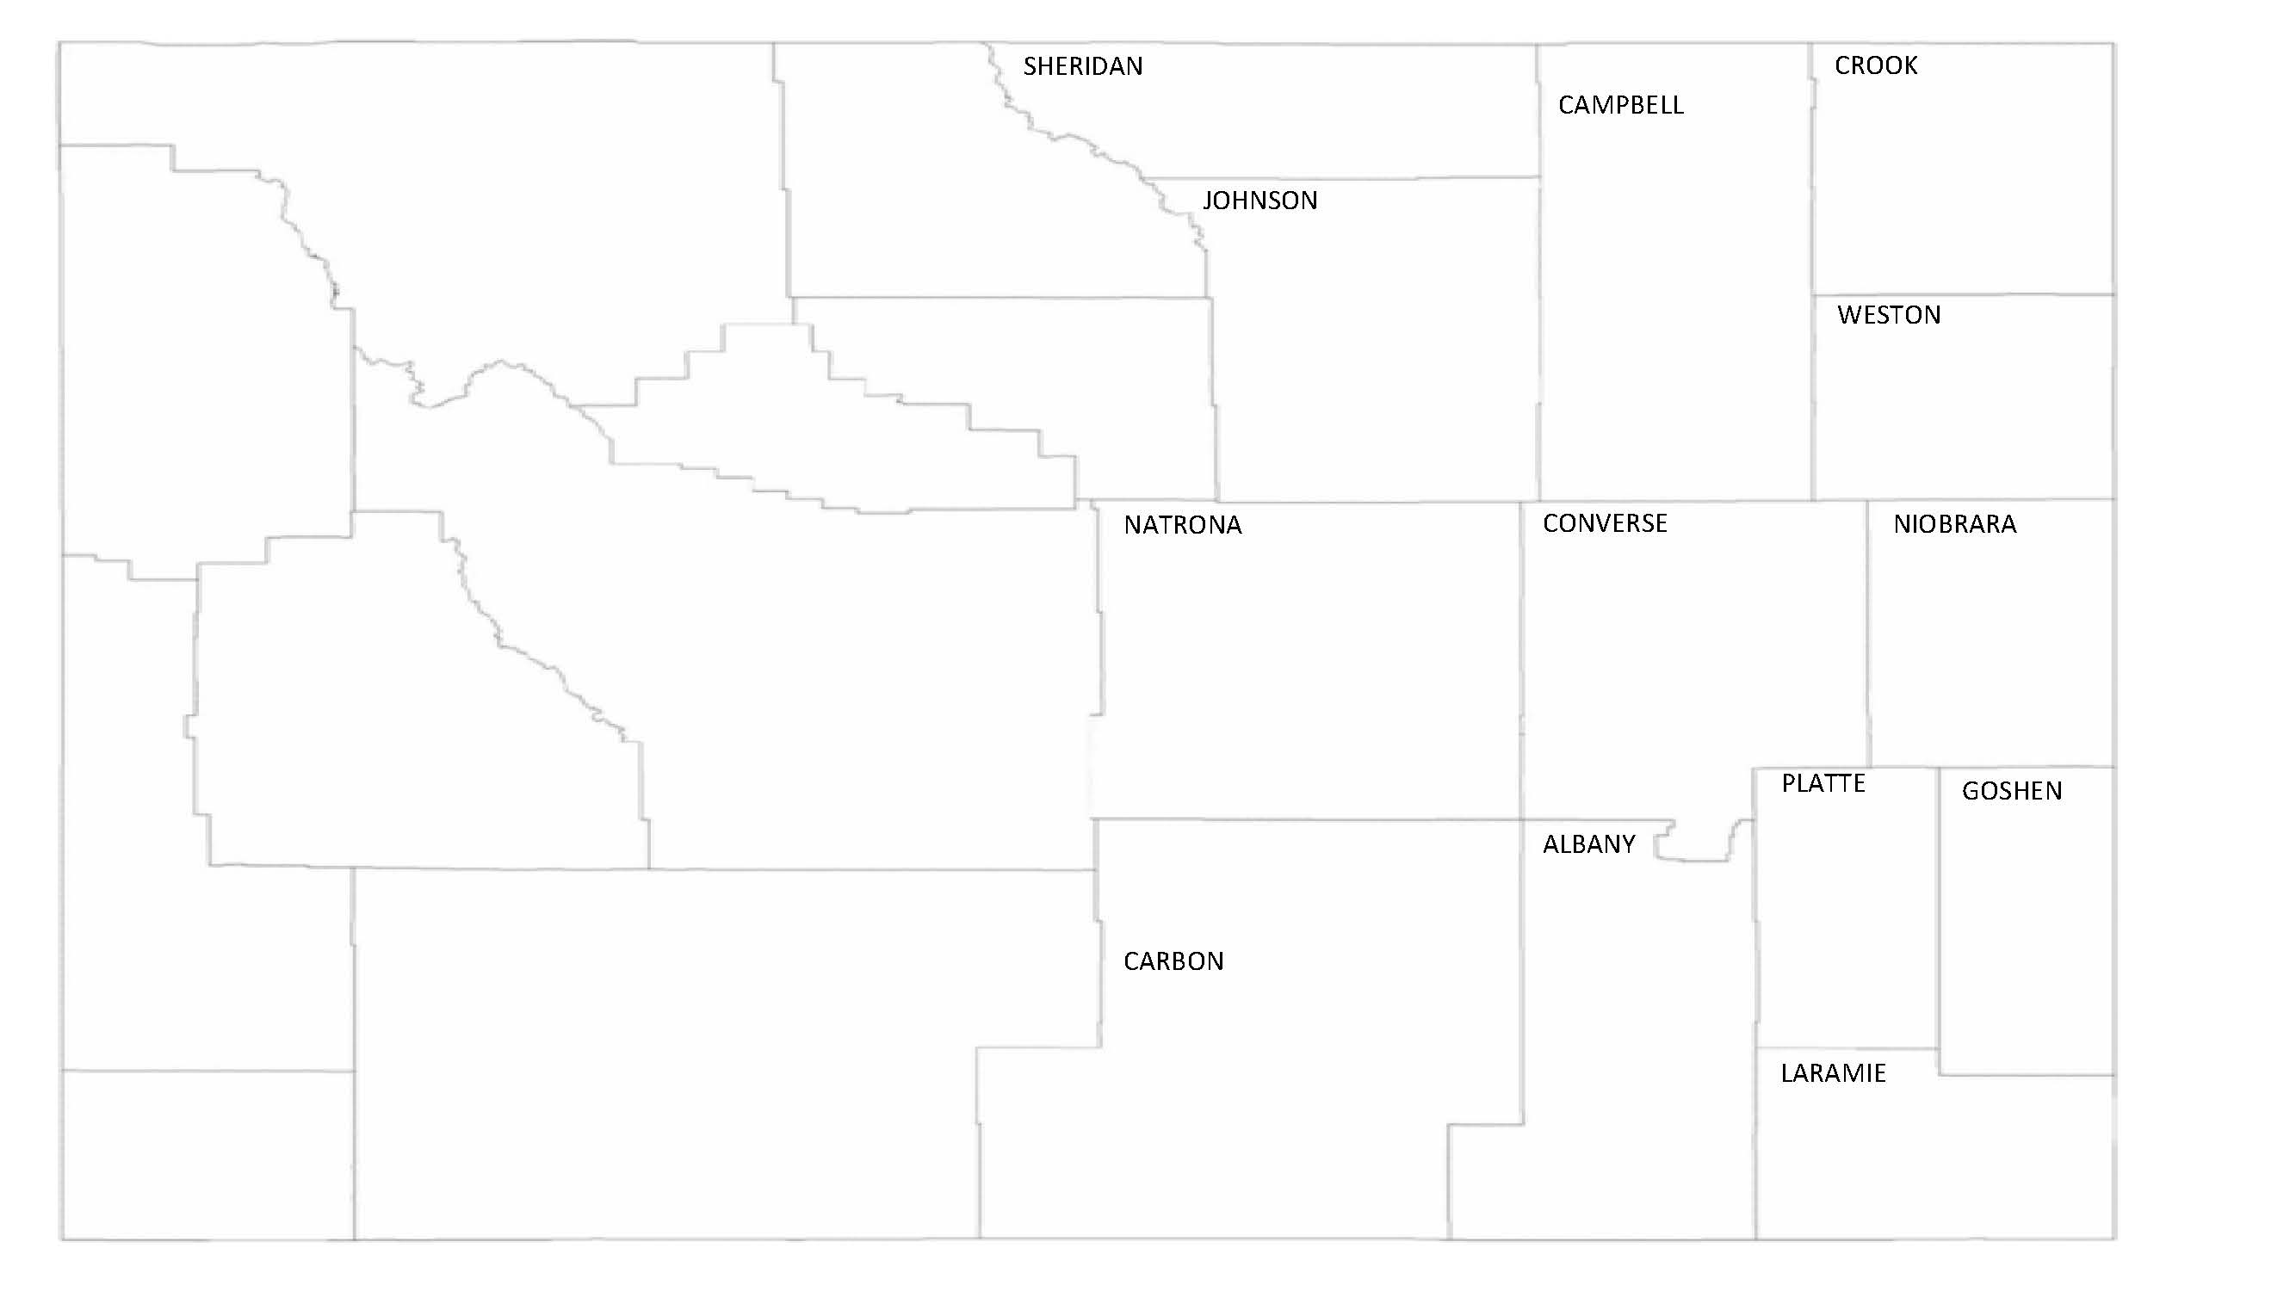
Wyoming Independent Living Service Area

Slide 3
Perplexing Pandemic
How do we keep any type of peer group going when we can’t meet in person?
How do we use this time to educate on disability and how our CIL can help?
How do we get more consumers to be involved instead of losing consumers?
How do we help consumers with social isolation?
How are we going to get through this and not only just survive but thrive?
Perplexing Pandemic

Slide 4
Pandemic Pluses
IL team weekly Zoom meeting
Cheyenne Advocacy Group into Eastern WY advocacy group WyDPAC
Embraced Zoom
IL Specialist to Facilitator Lead
Pandemic Pluses

Slide 5
Change is HARD
No Change to Peer Groups
-Zoom only needed for a few months to “get by”.
-Technical problems
-Awkward silences
-Inappropriate Conversations
-Attendance down
Change is HARD

Slide 6
Lightbulb Moment
Zoom wasn’t going away & needed to embrace it and learn how to navigate
Needed to become better facilitators
IL team needed to come together and decide what the goals of Peer Support should be
Attendance increased with consistent message structure, engagement, and flexibility

Slide 7
Engage & Energize: Facilitator Training
Facilitator Training
-Healthy Community Living Facilitator Training (UMT, RTC)
-WIL Facilitator Training
-Evidence Based videos
-”How to avoid death By PowerPoint” (David JP Phillips, TEDxStockholmSalon)
-Zoom Training
-Via Hope Peer Facilitator Training
IL Team Values
Engage & Energize

Slide 8
Engage & Energize: Peer Support Groups and Workshops
Peer Support Groups/Workshops
-Renamed
-Consistent Format
*Engaging
*Energizing
*Directly disability related
*Peer involvement in all decisions
-Two facilitators in different centers
Engage & Energize

Slide 9
Expand
65% increase in attendance
Average of 2-3 attendees in specific centers to 6-9 across eastern Wyoming
Increase in referrals from other entities, case managers, transition coordinators, high schools & colleges
Almost doubled new consumers requesting other services and completing goals
IL Specialists are ready & trained to develop new groups
Expand

Slide 10
Disability Connection
Name change from Disability Peer Support Group
Changed from unstructured format to peer support through structured activities
Move it, Learn it, Do it
Share knowledge & support for adapting to and living with disabilities
True “peer support” group creating a community of connection & acceptance
Disability Connection

Slide 11
Ammo for Advocating
Name change from Monthly Advocacy Peer Support Group
Moved from “talking” about change to specific educational topics on individual & systems advocacy
Peers collaborate with WyDPAC
Group discussions on how to move disability advocacy forward
Ammo for Advocating

Slide 12
Moving Forward
Hybrid Structure
-Groups offered via Zoom and in person
-OWL set up in all Centers
-Flexibility increases access
Increase outreach & public awareness
Ongoing assessment of consumer/community needs
Implement other Peer Groups as needed
Moving Forward

Slide 13
Thank You! Wyoming Independent Living 1-800-735-8322 wilr.org Joell Austin – jaustin@wilr.org Jenna Rector – jrector@wilr.org

