Slide 1
ASIAN CULTURES
How Disability Might Be Perceived

Slide 2
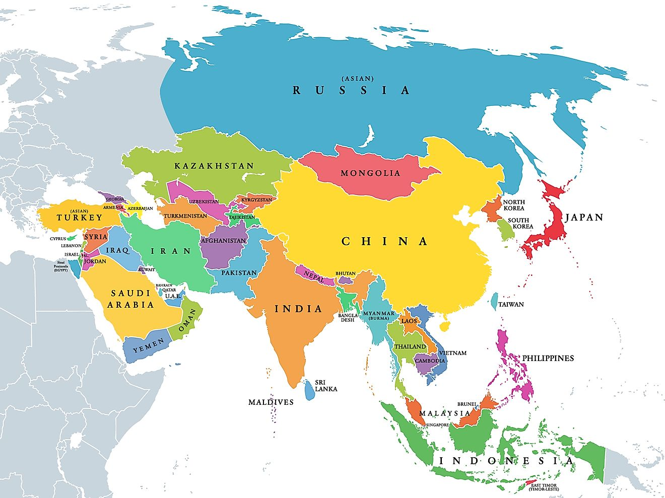
Map of the Five Regions of Asia

Slide 3
Adults with Disabilities: Ethnicity and Race

Slide 4
Cultural Stigma
Taboo subject
Something to hide, be ashamed of or to get rid of through finding a possible cure
Traditional views often rely on superstitions that disability is a form of punishment
Karma
Shame and Blame
CULTURAL STIGMA

Slide 5
Individualistic – Collectivistic Cultures
U.S Denmark Germany UK Poland France Italy Mexico Brazil Saudi Arabia
Netherlands Finland Spain Russia Thailand India
Australia Austria Japan Turkey China Nigeria
Individualistic
Collectivistic
The concept of Face-Saving

Slide 6
Recommendations and Resources
RECOMMENDATIONS
Provide resources for Asian Americans on how to have conversations about disability with their families and in their community.
Train staff to be culturally sensitive when interacting with disabled Asian Americans.
Make handouts and readings accessible in the person’s desired language.
Conduct more research on the unique struggles of disabled Asian Americans as a product of both disability and Asian American identities.
RESOURCES
Asian Americans with Disabilities Initiative (AADI)
Asians and Pacific Islanders with Disabilities of California (APIDC)
Asian Center Southeast Michigan (AC-SE MI).

