Slide 1
Deadline 2023: No More Waiting for the Home and Community Based Services Settings Rule

Slide 2
Welcome
Donna Meltzer, CEO
National Association of Councils on Developmental Disabilities
Welcome

Slide 3
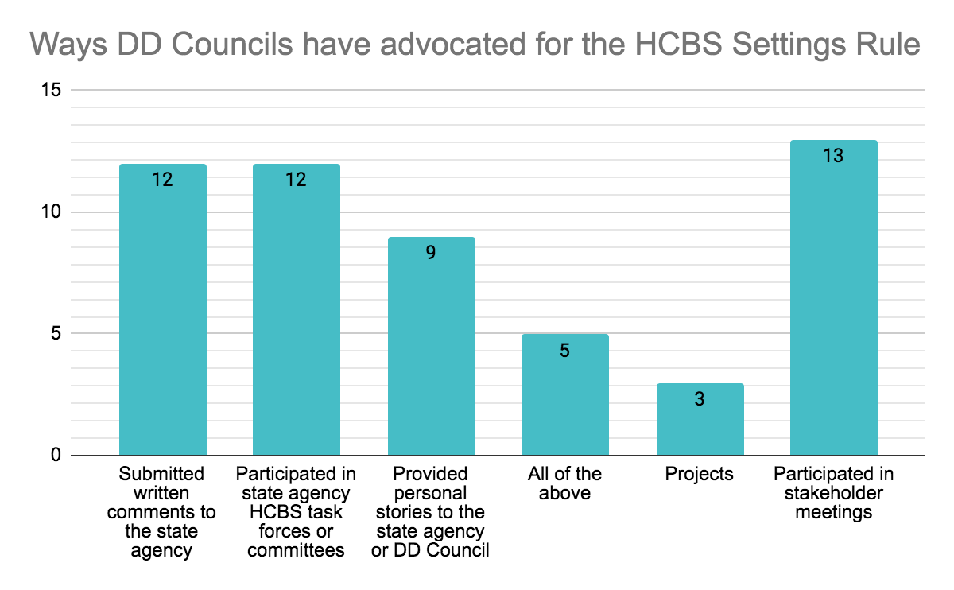
Webinar Participants – 36 State DD Councils

Slide 4
HCBS Settings Rule Webinar
HCBS Settings Rule Refresher
National Efforts to Engage Stakeholders
Advocacy in Action: Vermont and Michigan
Panel Question and Answers

Slide 5
Speakers
Erin Prangley, Director, Policy, National Association of Councils on Developmental Disabilities
Kate Brady, PhD, ABD is Project Manager for NCAPPS & HCBS Setting Rule Engagement at Human Services Research Institute (HSRI)
Kirsten Murphy, Executive Director for the Vermont Developmental Disabilities Council
Brett Williams, Public Policy Analyst for the Michigan Council on Developmental Disabilities and NACDD Public Policy Committee Chairman
Kirsten
Brett
Kate
Erin

Slide 6
HCBS Settings Rule Refresher
HCBS Settings Rule Refresher
Erin Prangley, Director, Policy
National Association of Councils on Developmental Disabilities

Slide 7
HCBS Overview Video

Slide 8
HCBS Settings Rule Timeline
1990: Americans with Disabilities Act community integration mandate. People with disabilities may not be excluded from participating in, or denied the benefits of, governmental services, programs, or activities. The ADA’s regulations require state and local governments to “administer services, programs, and activities in the most integrated setting appropriate” to the needs of people with disabilities and that such a setting “enables individuals with disabilities to interact with non-disabled persons to the fullest extent possible.”
1991: Olmstead v. L.C. ex rel. Zimring, (“Olmstead“) the United States Supreme Court held that it is discrimination to deny people with disabilities services in the most integrated setting appropriate. Accordingly, the Court found that individuals with mental disabilities are entitled to live in the community, whenever appropriate, and to receive treatment there, rather than in institutions.
2014: CMS amended the HCBS rules for person-centered planning, which included HCBS settings requirements.
2023: The March 17, 2023, transition period deadline for modified compliance, subject to corrective action plans.

Slide 9
Goals and Scope of HCBS Rule
To “ensure that individuals receiving services through HCBS programs have full access to the benefits of community living”
To “further expand the opportunities for meaningful community integration in support of the goals of the ADA and the Supreme Court decision in Olmstead”
Applies to all HCBS authorities – residential, non-residential, day services, employment services, etc.

Slide 10
May 2022 Modifications to Rule Timeline
Not every setting in the country will be fully compliant with all requirements of the settings rule by March 17, 2023.
May 2022 CMS guidance to states says state plan requirements must be "both meaningful for individuals receiving services and reflective of realities that states and providers have been facing in addressing and living through the COVID-19 PHE."

Slide 11
Rule Requirements by March 2023 (cannot be waived)
1. States must receive final Statewide Transition Plan approval.
2. All states and settings will be fully compliant with the following regulatory settings criteria that are not impacted by the COVID-19 PHE, including its exacerbation of the workforce shortage, by the end of the transition period.
– Privacy, dignity, respect, and freedom from coercion and restraint; and
– Control of personal resources.
3. All states and provider-owned and controlled residential settings will be fully compliant with the following regulatory settings criteria that are not impacted by the COVID-19 PHE, including its exacerbation of the workforce shortage, by the end of the transition period.
– A lease or other legally enforceable agreement providing similar protections;
– Privacy in their unit, including lockable doors, and freedom to furnish or decorate the unit;
– Access to food at any time;
– Access to visitors at any time;
– Physical accessibility; and
– Person-centered service plan documentation of modifications to relevant regulatory criteria.

Slide 12
Required documentation by January 1, 2023 (cannot be waived)
Description of how the state’s oversight systems (licensure and certification standards, provider manuals, person-centered plan monitoring by case managers, etc.) have been modified to embed the regulatory criteria into ongoing operations*;
Description of how the state assesses providers for initial compliance and conducts ongoing monitoring for continued compliance*; and
Description of a beneficiary’s recourse to notify the state of provider noncompliance (grievance process, notification of case manager, etc.) and how the state will address beneficiary feedback.
*Information should already be contained in the state’s STP

Slide 13
Corrective Action Plans (State Flexibilities)
CMS will authorize CAPs to continue federal reimbursement of HCBS beyond the end of the transition period, if states need additional time to ensure full provider compliance with the regulatory criteria NOT mentioned above. These include for example:
– Access to the broader community;
– Opportunities for employment;
– Option for a private unit and/or choice of a roommate; and
– Choice of non-disability specific settings.
States must be able to show that their policies and procedures reflect the settings criteria and they have made efforts to implement the criteria to the fullest extent possible and work with CMS on a concrete, time-limited plan to come into full compliance with remaining criteria.
States should seek stakeholder input when developing CAPs.

Slide 14
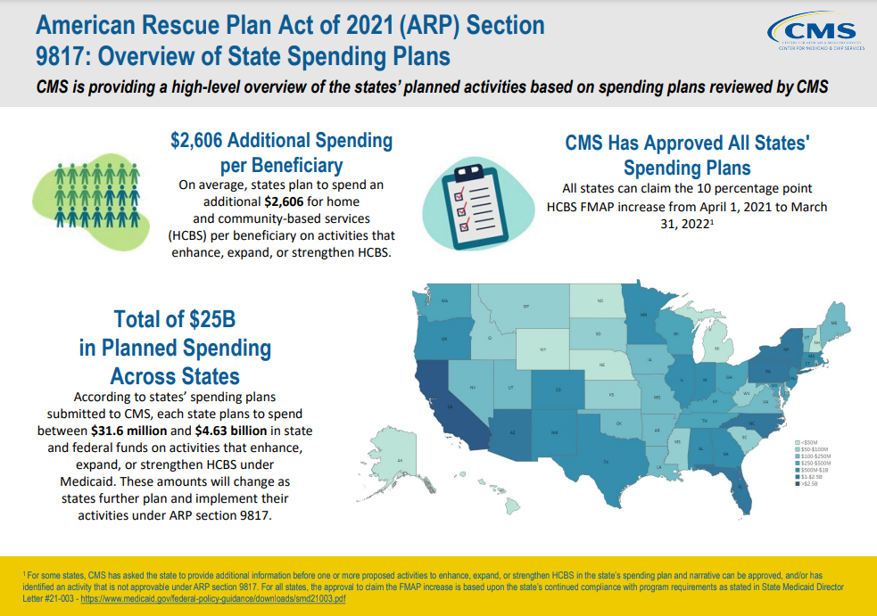
ARPA Federal Funding for HCBS is Available!
States currently have an unprecedented opportunity to access additional HCBS funding through Section 9817 of the American Rescue Plan Act of 2021.
States can and should be leveraging this opportunity to increase their capacity to offer services in compliant settings (particularly non-disability-specific residential settings), and to expand services that are truly integrated to support individual autonomy and community participation
See your state plan at https://www.medicaid.gov/medicaid/home-community-based-services/guidance/strengthening-and-investing-home-and-community-based-services-for-medicaid-beneficiaries-american-rescue-plan-act-of-2021-section-9817/index.html

Slide 15
Call to Action: NACDD HCBS Settings Project
Problem: ACL identified states with final state transition plans (STPs) that had NO STAKEHOLDER input.
Solution: Engage DD Act partners to put HCBS settings rule on the front burner.
Goals: 1) DD Act sister organizations in all states partner to draft comments on pending STPs and engage stakeholders to extent possible; 2) Re-educate self-advocates and stakeholders about the game-changing new rule; 3) Prepare for March 2023 effective date.
Tactics: 1) NACDD webinar on July 13; 2) NACDD state policy committee/mentors; 3) Technical assistance on strategies to analyze STPs and engage state stakeholders; 4) DD Council Survey and white paper.

Slide 16
Each State Status
Initial Approval | CMIA | Final Approval
Alabama | Illinois | Alaska
Arizona | Maine | Arkansas
California | Massachusetts | Connecticut
Colorado | Nevada | Delaware
Florida | New Jersey | District of Columbia
Georgia | Texas | Hawaii
Indiana |  | Idaho
Iowa |  | Kentucky
Kansas |  | Minnesota
Louisiana |  | Missouri
Maryland |  | North Dakota
Michigan |  | Ohio
Mississippi |  | Oklahoma
Montana |  | Oregon
Nebraska |  | South Carolina
New Hampshire |  | South Dakota
New Mexico |  | Tennessee
New York |  | Utah
North Carolina |  | Virginia
Pennsylvania |  | Washington
Rhode Island
Vermont
West Virginia
Wisconsin
Initial Approval (AKA) "Heightened Scrutiny Package." CMS notified the state that while the STP is sufficient, but the state needs to identify settings that are presumed to have institutional characteristics and any information the state may wish CMS to consider under the heightened scrutiny process.
CMIA: The communication CMS sends to the state notifying the state that public comment, input and summary requirements are met, but CMS has identified issues that must be resolved in the STP prior to initial approval.
Final Approval: The communication CMS sends to the state notifying the state that public comment, input and summary requirements are met, the STP has provided all necessary information including but not limited to; systemic assessment, site specific assessment, settings presumed to have institutional characteristics, information regarding heightened scrutiny or the state’s decision to let the presumption stand, and clear remedial steps with milestones are delineated.
View STPs: https://www.medicaid.gov/medicaid/home-community-based-services/statewide-transition-plans/index.html

Slide 17
Resources and Toolkits
Resources and Toolkits
Designed for state programs to strengthen their infrastructure and develop stronger HCBS for beneficiaries
Toolkit contains four modules
State strategies to help increase the share of long-term services and supports (LTSS) provided in community-based settings (history/context of LTSS reform and rebalancing)
Tools designed to assist states with policy and programmatic strategies (describes key elements of HCBS systems that are economically sustainable and equitable for all individuals with LTSS needs)
Cases studies of innovative programs and creative ways states are leveraging available federal authorities to transform LTSS systems (describes the various Medicaid authorities that states can choose from to cover their HCBS programs)
Links to resources (provides examples of state models of care and strategies to reform LTSS systems and expand HCBS)
Go to https://www.medicaid.gov/medicaid/home-community-based-services/guidance/home-community-based-services-final-regulation/index.html
Published a toolkit for advocates, families, and administrators on how to ensure that people with disabilities receive Medicaid-funded HCBS in integrated settings that offer full access to the community
Includes four different resources
A resource for advocates and their families that explains what the new HCBS rule means and how to make their voices heard as their states make their transition plans. It also includes scripts for writing to their state's Medicaid agencies on how they think their state's HCBS program needs to change
A resource for state administrators and professionals on how to come into compliance with the new rule. It includes detailed guidance on the implications of the new rule, suggestions for elements to be included in the transition plan, and examples of useful tools and questionnaires for accessing provider compliance.
A research brief explaining how scattered-site supported housing can help states meet the integration and choice standards in the new rule.
A fact sheet on integrated housing for people with disabilities.
Go to https://autisticadvocacy.org/policy/toolkits/hcbsrule/

Slide 18
Additional Resources ICDD and CQL
Additional Resources ICDD and CQL
VIDEOS
HCBS Video: Overview (7:26 minutes) at https://www.youtube.com/watch?v=xnbtb5Jpz7c
HCBS Video: What does the Rule Guarantee? (5:17) at https://www.youtube.com/watch?v=8sJl-LF5ufg
HCBS Video: Provider Requirements for Residential Settings (6:32) at https://www.youtube.com/watch?v=sjy334aMXXk&feature=youtu.be
HCBS Video: Rights Restrictions & Modifications (3:44) https://www.youtube.com/watch?v=Vg5DA_ouOwY
HCBS Video: Your Services Should Be All About You – for people receiving HCBS that discusses rights and choice. https://www.youtube.com/watch?v=-xqttlDcAkM
INTERACTIVE GUIDES
HCBS Guide: Your Right To A Community Life (for people receiving HCBS) https://www.c-q-l.org/resources/guides/hcbs-guide-your-right-to-a-community-life/
HCBS Guide: Supporting The Right To A Community Life (for staff who support people receiving HCBS – focuses on community) https://www.c-q-l.org/resources/guides/hcbs-guide-supporting-the-right-to-a-community-life/

Slide 19
For More Information
For more information contact Erin Prangley at eprangley@nacdd.org.

Slide 20
National Efforts to Engage Stakeholders
National Efforts to Engage Stakeholders
Kate Brady, PhD, ABD Project Manager for NCAPPS & HCBS Setting Rule Engagement at Human Services Research Institute (HSRI)

Slide 21
HCBS Settings Rule Stakeholder Engagement Partnership Funded by ACL and administered by NCAPPS at HSRI.
Kate Brady, PhD ABD
Project Manager, NCAPPS at HSRI
Notes:
Notes Page Title Here
(edit this in notes view)

Slide 22
The goal of NCAPPS is to promote systems change that makes person-centered principles not just an aspiration but a reality in the lives of people across the lifespan.

Slide 23
Agenda
HSRI’s Partnership
Questions/Ideas
Why Engagement?
Resources

Slide 24
Why focus on Stakeholder Engagement now?
Many factors seems to have produced a lull in response to submitted STPs
Changes in deadlines and settings interpretation from CMS
Covid-19
Competing demands for advocacy
This dip in momentum is what we are hoping to change!

Slide 25
Scope of HSRI’s contributions
Improving engagement with state agencies implementing the rule
Reviewing state drafts of transition plans and setting specific heightened scrutiny packages and submitting public comments, including the review of and comment on state settings assessment tools
Building community-level awareness of the rule and its implications for individuals receiving HCBS
Raising setting-specific issues with ACL and creating a better pathway to surface issues the individuals are experiencing in each state.
With support from ACL, HSRI is collecting and organizing existing informational and training resources related to the HCBS final rule based on assessed needs of subcontractors.

Slide 26
Subcontractors
APRIL
NACDD
NASILC
AUCD
ASAN
NDRN

Slide 27
HSRI is partnering with the subcontractors to:
Collect and organize existing informational and training resources related to the HCBS regulation for use in training and technical assistance.
Facilitate the lead organizations for the P&A network, CILS, DD Council and UCEDs, ASAN and SARTAC to plan and support advocacy efforts that will feedback to the state and CMS regarding the State Transition Plan and the state’s efforts to implement the HCBS settings rule.
Provide guidance on organizing cross disability efforts
Provide guidance on prioritizing stakeholder feedback
Assist in identifying training materials appropriate for the groups
Provide guidance on developing capacity among self-advocates and families to engage meaningfully in stakeholder feedback and surfacing issues the individuals in the state experience

Slide 28
Opportunities for Engagement
Statewide Transition Plans
Heightened Scrutiny Packages:
CMS Site Visits
ACL Stakeholder calls
Corrective Action Plans
Waiver Amendments and Renewals

Slide 29
Where are the Stakeholders?
Individual People with disabilities their families, and neighbors
Advocacy groups:
Parent Groups
Sibling groups
Self-advocate groups.
Protection from Harm resources:
State P&A
Ombudsman
Adult Protective Services
Provider Organizations and Associations

Slide 30
Engagement Activities
Show up and give in person public comment
Submit written comments from your council
Coordinate templates for others to use in submitting comments.
Consult partners about submitting joint comments
Call your legislators and other elected officials

Slide 31
Thank You.
For more information visit the NCAPPS website at:
NCAPPS.acl.gov
or
Contact Kate Brady directly at: KBrady@HSRI.org
NCAPPS is funded and led by the Administration for Community Living and the Centers for Medicare & Medicaid Services and is administered by HSRI.
The content and views expressed in this presentation are those of the presenters and do not necessarily reflect that of Centers for Medicare and Medicaid Services (CMS) or the Administration for Community Living (ACL) .
Notes:
Notes Page Title Here
(edit this in notes view)

Slide 32
Vermont Advocacy in Action
Vermont Advocacy in Action
Kirsten Murphy, Executive Director Vermont Developmental Disabilities Council

Slide 33
Vermont Stakeholder Engagement
How the Green Mountain State is influencing implementation of the HCBS Settings Rule

Slide 34
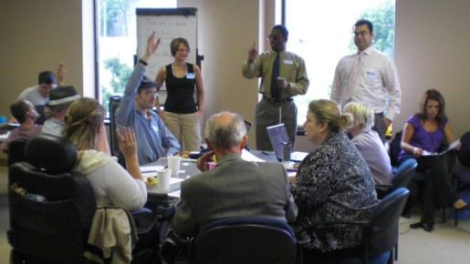
Keeping the Promise
Self-Advocates Defining the Meaning of Community Living, 2011

Slide 35
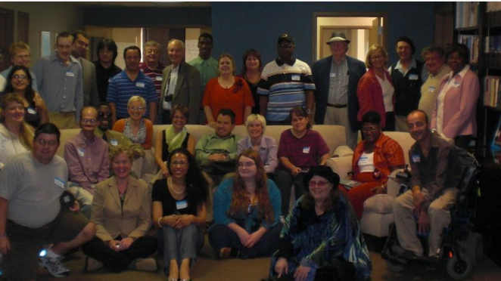
Keeping the Promise Continued
You can trace a straight-line from Keeping the Promise to the Settings Rule:
“Outcomes from self-directed lives must be the measure of success” (pg. 3).

Slide 36
Why is Stakeholder Input Important?
Foundational Value
Nothing about us, without us.
Practical Reality
Self-advocates and families can see what state agencies can not.

Slide 37
How does Vermont DDC work with partners?
Conduit for information.
Convenor of stakeholder meetings & town halls.
Composer of public comment for sign-on.

Slide 38
What has the VTDDC done?
Conflict of interest free case management
Renewed focus on
the Settings Rule
State claimed the rule did not apply.
State asked for “the choice model.”
State was put under a plan of correction.
Timeline for the plan was reduced by CMS.
We built a relationship with CMS.
State filed a plan saying there were no settings that merited heightened scrutiny.
CMS selected VT for review & a visit this summer.
CMS asked the Council to host a stakeholder session.
Our relationship with CMS paid off!

Slide 39
What more will VTDDC do?
Strategic use of $’s: Implementing Act 186.
Multiple formats: What Makes a House a Home?
Use all the tools.

Slide 40
Start with a blank canvas
Stakeholder Engagement is not “public comment.”
Public comment is when you put out a draft of a policy, regulation, or program that has already been thought about and ask the public to react.

Slide 41
Tips for Stakeholder Engagement
Set your terms and insist upon them – recording, time, location, etc.
Ensure a safe space – consider confidentiality & conflicts of interest.

Slide 42
Tips for Stakeholder Engagement Continued
Insist meeting materials are accessible.
Send materials in advance
Need to know vs nice to know
Use plain language
Ask open-ended questions.

Slide 43
Michigan Advocacy in Action
Michigan Advocacy in Action
Brett Williams, Public Policy Analyst for the Michigan Council on Developmental Disabilities and NACDD Public Policy Committee Chairman​

Slide 44
HCBS – Stakeholder input
Brett Williams
Michigan Developmental Disabilities Council

Slide 45
The importance of Stakeholder input - HCBS
Advocacy is never a “won” and done.

Slide 46
The Value of Stakeholder input
Extremely complex:
No two states have the same needs, nor systems of supports and services
Program Design – Systemic operations verse beneficiaries needs
Perspectives – best results are driven from expansive input and thoughtful consideration

Slide 47
Partner engagement and Activities
Proactive outreach
Start with what is in your arena – DD Act partners
Expand your networks
Your DSA

Slide 48
Partner engagement and Activities continued
Activities related to HCBS
State transition plan
Medicaid policy proposals
Medical services Administration
Statewide Self-Advocacy Action Team

Slide 49
Moving forward
Providing comments – state
CMS / state plan amendment feedback
CMS and other

Slide 50
Questions for the panel? Please use the "raise hand" function or type your question in the chat box.

